Slide 1
CLASS PROJECTS – BIG DATA 2016

Slide 2
FIRST LET’S TIE UP SOME LOOSE ENDS
Assignment Deadlines
HBASE/HIVE assignments
To be completed by Thu(29) for 5th sem
To be completed by Sat(1) for 7th sem
Summarize and present the following videos
Del Harvey – Twitter video
Shyam Shankar – human-machine cooperation
Should be done by first class next week

Slide 3
AVAILABLE PROJECTS
Analysis based
IPL Analysis
Coding based
Building a distributed key value store

Slide 4
IPL ANALYSIS – CLASS PROJECT

Slide 5
OVERVIEW
2nd innings
Score = 0/0
0 overs, 0% finished
b1, b2 batting
1st innings
Score = 0/0
0 overs finished
b1, b2 batting
Complete by T2
Given
2 cricket teams
Batting order
Bowling order
Who bats first
Predict the score
How?
Flowchart at right
Select bowler
Select bowler
Predict ball by ball what will happen in over
Predict ball by ball what will happen in over
Yes
No
No
Update score, batsmen, overs finished
Update score, batsmen, overs finished
All out or 20 overs?
All out or 20 overs?

Slide 6
PREDICTING OUTCOME OF OVER
Predict ball by ball
Ignore extras for now
Handle wickets separately
Ignore stage of the game
1st innings – how many overs are complete
2nd innings – overs complete, % target complete
We need to calculate p(0, 2, 3, 4, 6 runs scored), for each ball
This depends upon
Who is batting
Who is bowling

Slide 7
ESTIMATING PROBABILITIES
Maximum Likelihood Estimator
P(event) = (no. of times event occurred)/(total number of events)
Example
Suppose McCleneghan bowls 40 balls to Shikhar Dhawan
4 times Shikhar Dhawan hits a 4
P(hitting 4) = 0.1

Slide 8
SIMPLE APPROACH (MAY NOT WORK)
Go over all the games
If we find a game where
Shikhar Dhawan is batting
McCleneghan bowling
4 runs are scored
Add 1 to the number of times 4 is hit
Calculate probabilities

Slide 9
PROBLEM WITH SIMPLE APPROACH
Many times, in IPL, we may need combinations we haven’t seen before or have seen rarely
If it’s a rare event, probability calculation may not be accurate

Slide 10
SOLUTION
Cluster (group together) similar batsmen into say 10 groups
Also cluster similar bowlers
Calculate probability of n runs when
Batsman of group A is batting
Bowler of group X is bowling

Slide 11
CLUSTERING DETAILS
Download from cricinfo.com
Player vs player statistics for all T20s in 2015
Player profiles
Use these player profiles to cluster batsmen, bowlers
From the player vs player statistics, calculate the probability of runs being scored in over

Slide 12
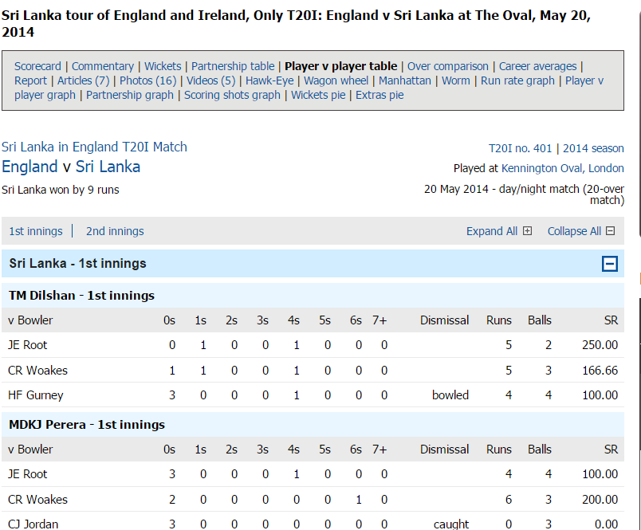
PLAYER VS PLAYER INFO
http://www.espncricinfo.com/england-v-sri-lanka-2014/engine/match/667887.html?view=pvp

Slide 13
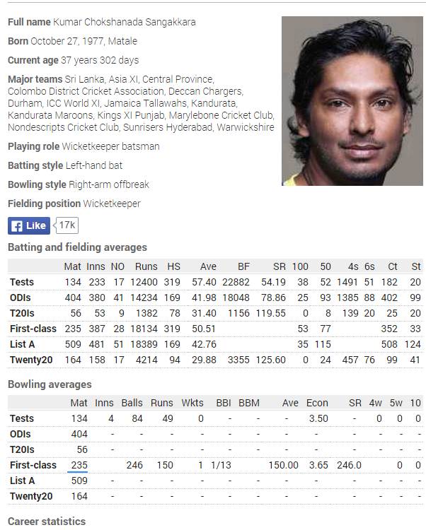
PLAYER PROFILE
http://www.espncricinfo.com/ci/content/player/50710.html

Slide 14
WICKETS
From statistics, calculate probability of batsman being out
Example
Suppose A&B are batting
X,Y,Z are bowling
P(A out when X bowling) = 0.04
P(B out when Y bowling) = 0.06
P(A out when Z bowling) = 0.08
Fall of wickets
Ball 1: X bowls to A; p (A is not out) = 0.96
…
Ball 6: X bowls; p(A is not out) = 0.78
Ball 7: Y bowls to B; p(B is not out) = 0.94
Ball 12: Y bowls; p(B is not out) = 0.69
Ball 13: Z bowls to A; p(A is not out) = 0.78 x 0.92 = 0.72
Ball 17: Z bowls; p(A is not out) = 0.51
Ball 18: Z bowls; p(A is not out) = 0.47 < 0.5
Assume wicket falls on 18th ball

Slide 15
STEP 1
Extract player vs player info from Cricinfo.com for all players in 2015 Download player profiles
Batsmen: Scoring rate, 4s, 6s
Due on
5th sem – 29/9
7th sem – 1/10
- 1 marks per day late
Remaining schedule will be announced next week.

Slide 16
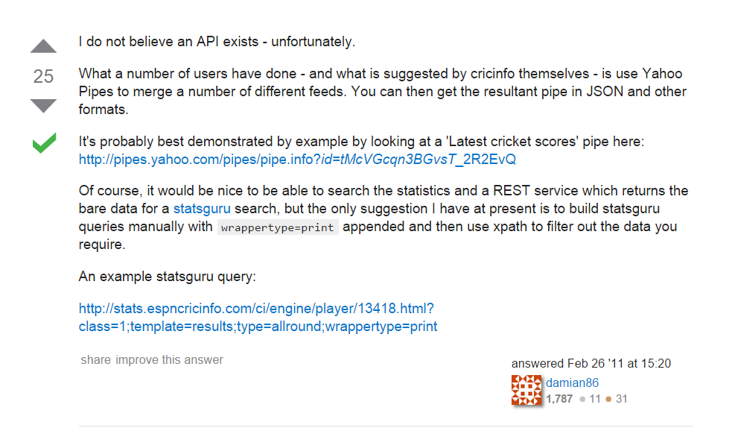
GETTING DATA FROM CRICINFO
http://stackoverflow.com/questions/5127616/does-espn-cricinfo-have-an-api

Slide 17
TIMELINES
TBA

Slide 18
BUILDING A DISTRIBUTED KEY VALUE STORE
BIG DATA 2016 – CLASS PROJECT

Slide 19
OBJECTIVE
Get a practical insight into building a distributed key-value store

Slide 20
WHAT IS A KEY-VALUE STORE?
Simply put a store that is capable of storing data indexed by a key
Key is a string of characters
Value is a string of characters
However, the value is a JSON object

Slide 21
SO WHAT IS DISTRIBUTED
The data is stored across multiple servers
Each server is responsible for part of the keys
It will be the primary server for a part of the keys
It will also be a backup server for one of the primaries

Slide 22
WHAT COMPONENTS WILL BE BUILT/USED
Zookeeper for storing configuration information
Address of the active servers
Key to server mapping
Client
will take requests from the user
Types of requests supported
Put (char *key, char *value);
Get(char *key)
Client will contact zookeeper to determine address of the master server
Contact the master server to get key-server mapping
Determine whether the cluster is up.
Use key-server mapping to connect to the server that is responsible for the keys

Slide 23
SERVER INITIATIALIZATION
Check if there is a master
Use zookeeper for this
If no master
Declare self as master
Set cluster status to INITIALIZING
Wait x minutes for other servers to come up
Set cluster status to READY
Send start signal to all other servers
Send kry-range and replicas to each server
Also send server id back. This is a sequence #
Send total #servers.
If there is a master
Register with master
Wait until start signal
Store configuration data on which key-range server is responsible for.

Slide 24
SERVER – NORMAL OPERATION
Clients will send requests to the server
Server will determine request type – put, get
Server will determine if it can process the request or the request has to be serviced by other servers
For self served requests – it will process the request and send back status of response
Remote server – respond with error message.(ERR_KEY_NOT_RESPONSIBLE)
Server storage
Data will be stored in memory and not in any file. Management of memory is left to you.

Slide 25
SERVER - REPLICATION
On coming up, will register with zookeeper it’s address and the set of keys it is responsible for.
On writing request to the local storage, the data is also queued to be written to a remote server.
Remote server = (current_server id + 1) % total #servers.

Slide 26
HANDLING SERVER FAILURE
Client tries connecting to server with key.
On server failure, connects to master to get new list of keys-server mapping.
Talks to the replica to retrieve data
When server comes back up
The data which was written on the replica should be synced back

Slide 27
WEEKLY SCHEDULE
Week No | Deliverable | Details
1 | Basic client-server communication for the commands | Set up a client and server and establish communication between these. Have the client send get/put/getmultiple messages and get a fixed response
2 | Implement get/put | Single client server with get/put implemented. Provide server side script that can check contents of the storage
3 | Introduce zookeeper. Set up master server. | Server must store information in zookeeper and client must use it for query
4 | Implement replication across servers
5 | Implement get/put across multiple servers
6 | Demonstrate high availability | On a server going down, client must still be able to retrieve information from a replica.

Slide 28
FINAL DEMO
Must be shown on a cluster of at least 3 nodes.
Assume that data is split fixed across 3 nodes.
Each week progress gets 10 points except first and last.
First week 5 points
Last week 15 points
For those doing this as both part of Big Data and CCBD course project
Additional Goal: Handling addition of new servers and distribution of part of the key values to these servers.

