Slide 1



q
Department Of Information Technology
ABES Engineering College, Ghaziabad(U.P.)
WEATHER APPLICATION
conclusion
introduction
requirement
design
contents
analysis
working
references
Domain : Weather Application
Team Members : Sarthak Singh(1803213150),
Vishwas Chaudhary(1803213177)
Section : IT-C

Slide 2


q
02
Requirement
03
Code Snippets
04
Project Design
conclusion
introduction
requirement
contents
analysis
design
working
refernces
05
Working
06
Conclusion
07
References

Slide 3




q
It is a basic weather application that takes data from the weather API and gives the information of any city that is provided by the user.
The weather application takes data of every city’s weather from API and users can search the current weather of every city across the globe and if entered city is not correct, it shows invalid city.
conclusion
requirement
introduction
analysis
contents
design
working
references
It uses HTML, CSS ,JAVASCRIPT for designing the frontend and the application uses NODE JS and MONGO DB database.
IMA is completely online and uses efficient data storage thus reducing the number of hard copies required.

Slide 4
q
HARDWARE REQUIREMENTS
Memory : 2GB RAM or above
Storage : 50GB or above
Processor : Intel i5 or AMD Ryzen 2550 or better
conclusion
introduction
requirement
design
contents
analysis
working
references
SOFTWARE REQUIREMENTS
Operating Systems : Windows, OS , Linux, Android, iOS
Browsers : Mozilla Firefox, Goggle Chrome, Safari etc
Visual Studio Code, Mongodb , Nodejs

Slide 5
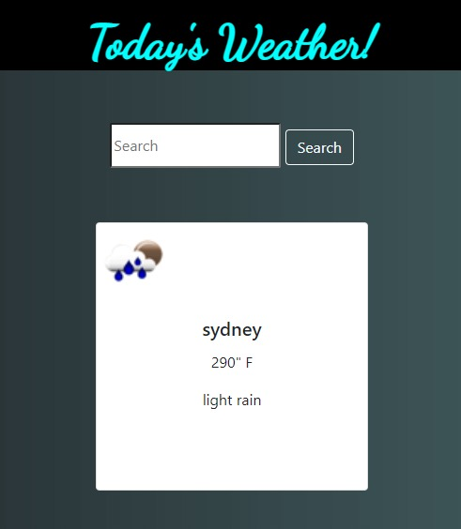
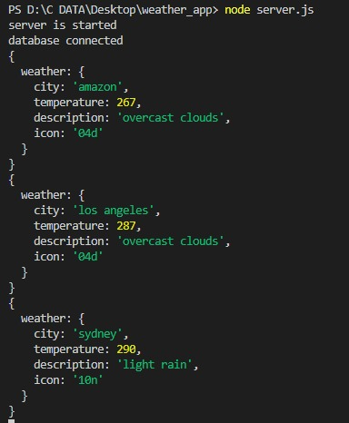
q
Code Snippets
conclusion
Snippets
introduction
requirement
design
contents
working
references

Slide 6





q
Project Design
conclusion
design
introduction
requirement
contents
working
analysis
references
USER
BROWSER
SERVER
API
DATABASE

Slide 7
Let’s get started
Install VS Code.
Install Nodejs, Mongodb compass.
Open project in vs code and create new terminal.
conclusion
Install dependencies: npm install.
design
analysis
introduction
requirement
references
working
contents
Run the application using npm start/ nodemon server.
Go to browser and enter URL .
Now enter the city you want to check weather for.

Slide 8
q
Future Plan :
This project would enable weather predictability with the help of machine learning and data science.
On searching for an invalid city, it will show closest possible valid cities.
We will host this website to convert it into an application.
conclusion
analysis
design
introduction
requirement
references
working
contents
Conclusion :
It aims at displaying weather conditions and current temperature of different cities across the globe.

Slide 9
q
References :
w3schools Online Web Tutorials
analysis
conclusion
design
introduction
requirement
working
contents
Stack Overflow
references
Nodejs docs

