Slide 1
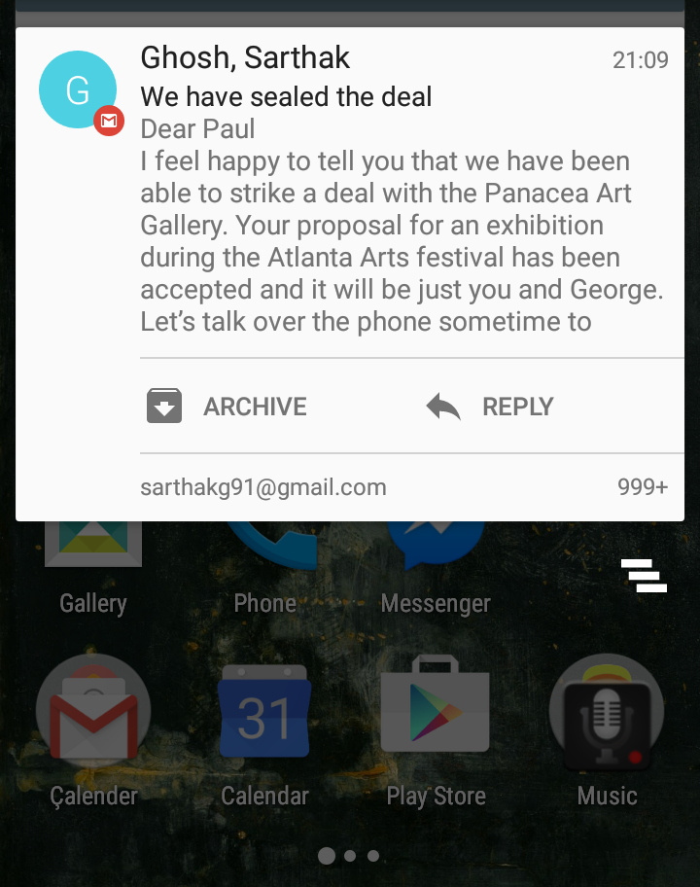
L
Leland, Wilson
11:37

Slide 2
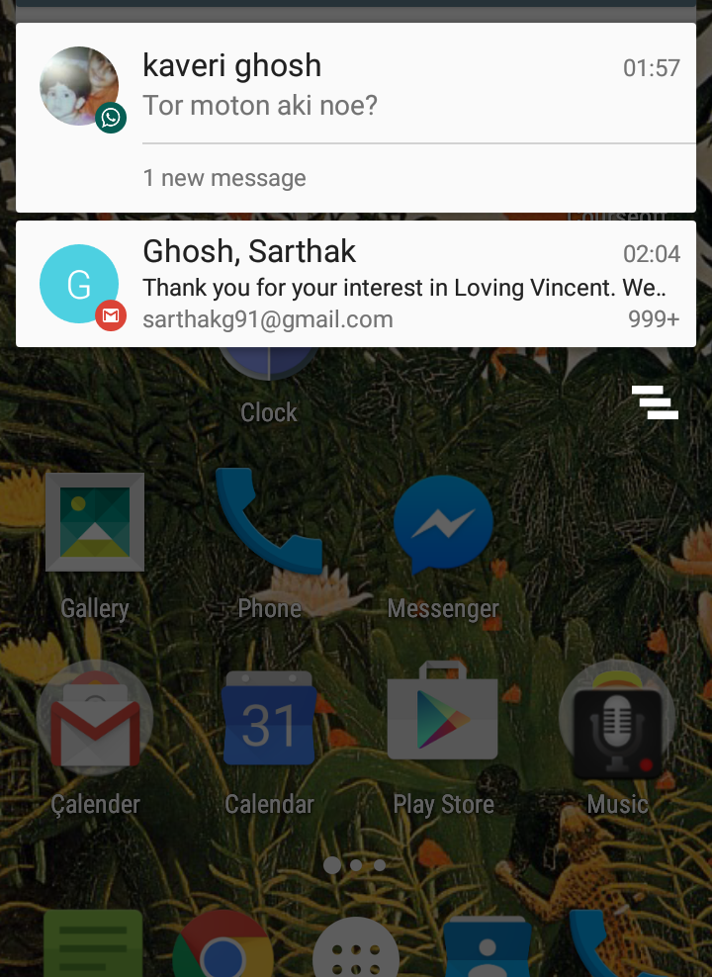
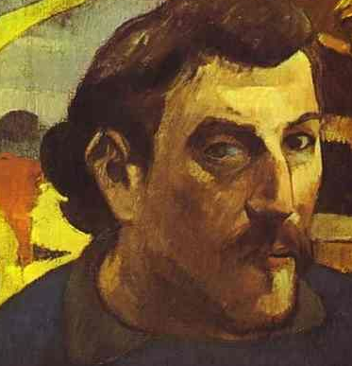
Paulie
11:57
George, I have a surprise for..
Loving Vincent
11:57
L

Slide 3
