Slide 1

MOBILITY SYSTEM FOR PEOPLE WITH DISABILITY
EMPOWERING MOBILITY, ENABLING INDEPENDENCE!
MOBILITY PHANTOMS
CONVERTIBLE WALKER STICK
1) JAYSHREE SUBHASH ZALTE 2) SIDDHIKA AVINASH PATIL 3) SANTOSHI RAVINDRA FALLE 4) SARTHAK BALASAHEB HARDE 5) VAISHNAV ADINATH TANPURE 6) Gargi somesh shelke

Slide 2

Problem Statement: Current mobility system management needs advancements with proper cost for product.
Numerous people around the world face the issue with mobility due to their disabilities.
Doing daily chores and simple activities gets difficult.
And affording proper mobility aids that are also multipurpose and are easy to handle is a huge challenge as well.
Not everyone is capable to own high end mobility devices which are helpful for daily chores and activities.

Slide 3
Mind Mapping
Wheelchair
Scooter
Walker
Crutches.
Ramp
lift.
Handrails.
Purposeful Non-complicated.
Safe
Secure. Comfortable
Convenient.
Accessibility Features and Devices
User needs
Mobility System for PWD
Paralysis
Amputation.
Parkinson's disease . Arthritis
Spinal cord injury
Neuromuscular disorder.
Cost-Management. Suitable products. Nonstandard. Sustainability. Acceptance.
Types of Disabilities
Challenges:

Slide 4
Persona 1: Suman (67yo Woman with Arthritis)
Background: Retired school teacher. Lives alone. Two grown children living nearby. Loves gardening, cooking, reading. Arthritis has made it difficult for her to enjoy these activities as much as she used to.
Doubts/Fears: Lack of independence. Pain and Discomfort
Feeling like a burden Health Declination.
Aspirations: Maintain Independence Manage Arthritis symptoms Staying positive Enjoy the activities she loves.
Summary: Suman is 67 year old lady who lives alone in house. She is dealing with arthritis which makes her life difficult. The pain and limited mobility, makes her feel demotivated at times. She yarns for the independence and positivity which a normal person has.
Challenges Faced: Managing chronic pain.
Discomfort. Limited mobility.
Feeling frustrated and isolated at times.
Motivation: Independence. Connection with loved ones. Self care.

Slide 5
Persona 2: Rohan(18yo boy with Paralysis)
Background: 18yo boy suffering from Paralysis belonging to a rural Village. Has partial paralysis in his left leg since he was 5. He is courageous, determined and positive. Supportive family.
Doubts/Fears: Being a burden Being bullied Feeling left behind Loosing Independence Will he ever be able to walk normally.
Aspirations: Playing with Friends. Walk without assistance. Getting education normally. Proving his worth. Becoming a role model for more people like him.
Challenges faced: Physical pain &Discomfort. Limited mobility, reliance on crutches or wheelchairs Social stigma and bullying from peers Emotional struggles with self acceptance and confidence.
Motivation: Family&Friends Inspiring stories of others with similar problems Desire to live a normal life.
Summary: Rohan is an 18 year old boy facing challenges and problems due to his disability. He has partial paralysis in his left leg. His aspiration are to walk without assistance and to be a role model and an inspiration for others with disabilities

Slide 6
5W1H Questions
Who's affected?
People having physical disabilities, chronic illnesses, or even temporary disabilities, and their families or caregivers.
What is the problem?
There is no good solution; there is a lack of social acceptance and accessible environments that lead to physical and emotional difficulties.
Where does this happen?
Public areas, workplaces, and educational institutions that have accessibility features for persons with disabilities.
When does it happen?
At birth; as a result of accidents or injuries; by age-related conditions.
Why is it important to solve?
Improving independence, social acceptance, quality of life, and safety.
How will your solution help?
The foldable walker-stick provide better mobility, self-esteem, and independence.

Slide 7
5W1H Summary
Thinking about these questions helped us understand the problem by showing how immobility affects people in different situations, like at home, work, or school.
It made us realize that the lack of accessibility and social acceptance causes both physical and emotional struggles. This helped us see that solutions need to focus on improving independence and self-esteem.
The convertible walker-stick can help by making people feel more capable and confident, empowering them.

Slide 8
Theory Of Prioritization
1.Affordability barriers-5100
2.Identifying different needs-5100
4.Safety standards-4200
3.Limited funding-5100
5.User difficulties-4200
6.Lack of accessible infrastructure-3210
7.Identifying right devices.-3210
8.Utilization misunderstanding-3210
9.Knowledge of aids-2400
10.Technology and innovation.-2400
11.Poor maintenance-2400
12. Lack of awareness -2310
13.Size issue-2310
14.User Comfort-510
15. Lack of social acceptance-510

Slide 9
SCAMPER: Combine
Why combine?
Combine helps to make a single item multipurpose.
It can merge ideas together to come up with a better solution
What have we implemented through it?
We have used combine to make one device out of a walking stick and a walker, helping people with mobility issues to walk normally as well as climb stairs, make a journey through bumpy roads. Basically putting together the idea of making a multipurpose device.

Slide 10
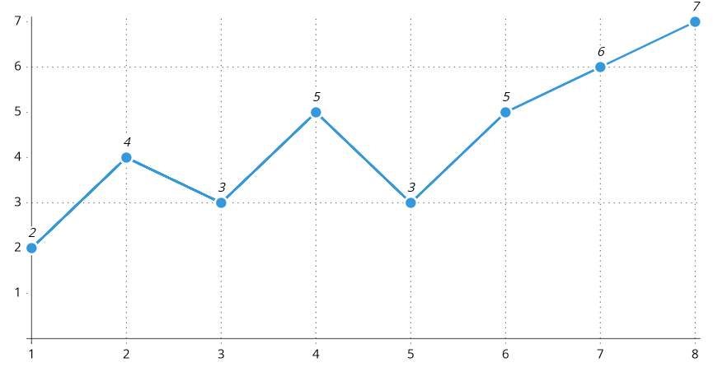
Journey Map 1
Mukti
A 66 year old woman with Arthritis.
1.Her son brings her CWS(convertible
walker stick).
2.She holds it in hand.
3.She feels it is like any other stick.
4.She goes on a walk.
5.She comes across a set of stairs.
6.She presses the button on CWS.
7.CWS opens up into a walker.
8.She climbs the stairs with better support.

Slide 11
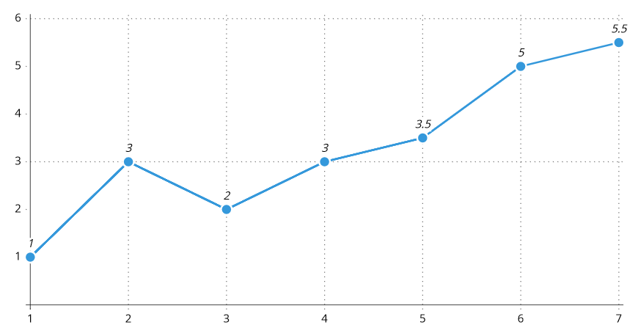
Journey Map 2
Nimesh
A 26 year old man with a right fractured leg.
1.His leg gets fractured in an accident.
2.He buys a CWS online .
3.He wants to go to work in a taxi .
4.He finds CWS easy to carry .
5. He gets out of taxi and presses the button to convert it to a walker
6. He can walk sturdily to his work desk with walker’s help
7.He puts it back into stick mode and hangs it.

Slide 12

Prototype

Slide 13
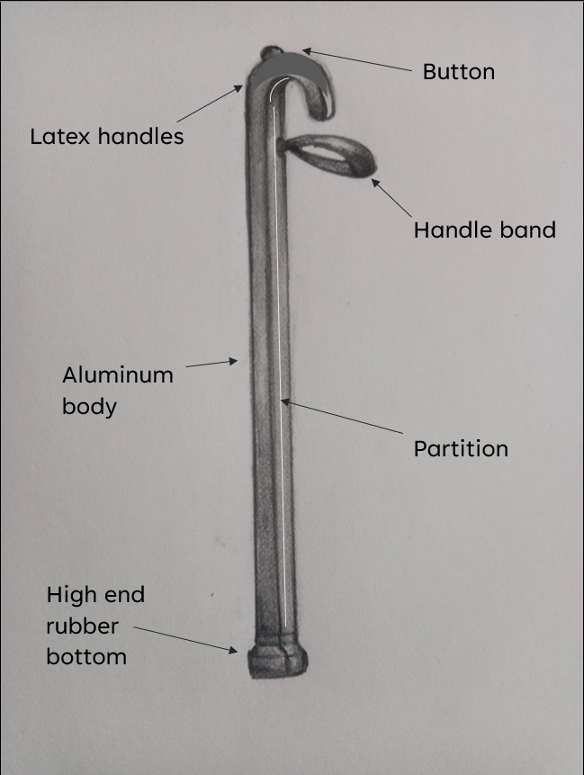
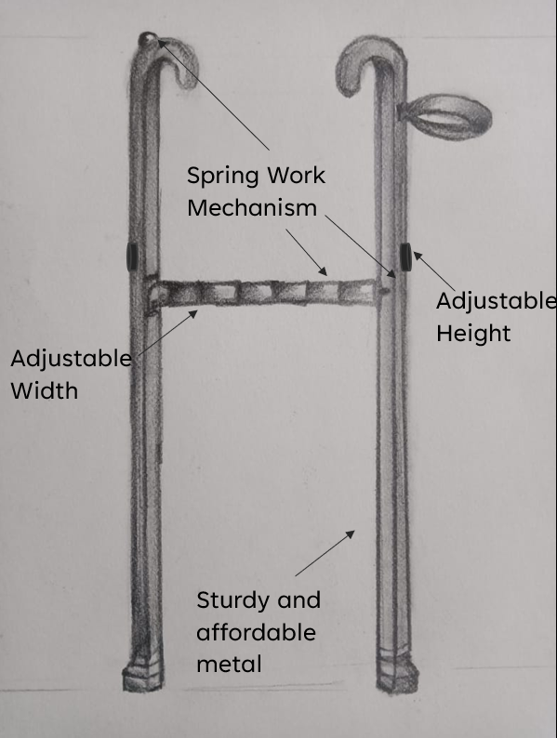
Prototype
A walking stick that can convert into a walker!
The model is made up of Aluminum, keeping in mind to make it durable, affordable and sturdy.
It works with spring mechanism, so no worries about batteries!
The bottom pods are made out of high end rubber making them slip resistant and heavy duty.

Slide 14
Thank You

