Slide 1

SMART INDIA HACKATHON 2026
ZEIT
Two-Lane Adaptive Noise Cancellation for Defence Communications
Problem Statement ID — 26052
Problem Statement Title — AI/ML-enabled adaptive noise cancellation for stationary, non-stationary and impulsive defence noise
Theme — Miscellaneous
PS Category — Hardware
Organisation — DRDO · Department of Defence Production / IDEX
Team ID — HW2026106
Team Name — ZEIT v.1.0
Mentor — Dr. Swati Singal — Assistant Professor, CSE / SSCSE, Sharda University, Greater Noida

Slide 2
ZEIT — Two-Lane Impulse-Adaptive Noise Cancellation
PROPOSED SOLUTION (DESCRIBE YOUR IDEA/SOLUTION/PROTOTYPE)
DETAILED EXPLANATION OF THE PROPOSED SOLUTION
INNOVATION AND UNIQUENESS OF THE SOLUTION
LANE A · hearing protection · closes in under 1 ms · FxLMS on its own module
1
Two lanes, not one
Mic 3 · error
FxLMS filter
Anti-noise driver
The ear
Protection closes in under a millisecond; transmit tolerates 25 ms. Fusing them makes both impossible.
Mic 2 · reference
error signal — what still reaches the ear
2
Detect, do not predict
LANE B · transmit to radio · 25.3 ms end to end · eleven blocks on the Pi 5
Published deep ANC buys latency by predicting noise. A gunshot is unpredictable by definition.
Mic 1 · voice
Engine · 11 blocks
Vocoder · MELPe
Radio link
HOW IT ADDRESSES THE PROBLEM
3
RMS is undefined here
Heavy-tailed noise has infinite variance. We scale on percentile and fractional lower-order moments.
Impulsive noise — gunshots, artillery
Detect-and-react transient path, trained through the clipping with α-stable augmentation
Adaptive
A live kurtosis classifier retunes γ and β every frame — not tuned once, offline
4
Measured, not downloaded
Calibrated gunshot data of our own, holdout split assigned before capture, checksum-frozen reference.
High speech intelligibility
A dedicated voice guard, with DNSMOS SIG reported separately so over-suppression stays visible
Real-time on embedded hardware
23.7 K parameters at 39.6 MMAC/s — it runs on a Raspberry Pi 5, not a Jetson
5
Crack before blast
42.3 ms of warning
PROJECT HANDBOOK AND 3D WORKBENCH — LIVE DEPLOYMENT
https://zeit-handbook.netlify.app/
0 · trigger
45.2 · crack
87.5 · blast
https://zeit-handbook.netlify.app/zeit-bench-3d

Slide 3
TECHNICAL APPROACH
TECHNOLOGIES TO BE USED (E.G. PROGRAMMING LANGUAGES, FRAMEWORKS, HARDWARE)
C++17
real-time path
ONNX Runtime
inference on ARM
PyTorch
training, offline
GTCRN
23.7 K params
Aux-IVA
blind separation
BMRI
impulsive path
PFFFT
BSD FFT, not GPL
Raspberry Pi 5
8 GB, the engine
UMC202HD
2-ch capture
METHODOLOGY AND PROCESS FOR IMPLEMENTATION (FLOW CHARTS/IMAGES/ WORKING PROTOTYPE)
HARDWARE CHAIN — no development computer in the signal path
3 microphones
voice · reference · error
UMC202HD
24-bit, 48 V
Raspberry Pi 5
blocks 1–11
Communication unit
MELPe 2400 bps
Earcups
return audio
05 Classifier
kurtosis → γ, β
LANE B SIGNAL CHAIN — one 20 ms frame, 10 ms hop, 25.3 ms end to end
01
Audio in
02
Aux-IVA
03
Normalise
04
STFT + ERB
the adaptive decision — the system retunes per frame rather than being tuned once, offline
impulsive frame
stationary / non-stationary
LANE A CONTROL LOOP — SEPARATE MODULE, CLOSES IN UNDER 1 ms
06
BMRI — detect and interpolate
07
GTCRN — learned mask
Mic 2
reference
FxLMS W(z)
filtered-x
Driver → ear
anti-noise
Mic 3
in-ear error
recombine
error — the residual
08
Deep filter
09
Voice guard
10
Residual
11
ISTFT
→
Radio
OFFLINE PIPELINE — none of this ships; it shapes the weights that do
Range capture
96 kHz · calibrated
Measure
16 quantities
Validate
against holdout
Mix + augment
α-stable, clipped
Train
SI-SNR + L1
Prune + quantise
structured, INT8
Export ONNX
the only boundary
C++ engine
parity-tested
mismatch → retune the generator
25.3 ms algorithmic · 10 ms compute per hop · under 1 ms Lane A · 39.6 MMAC/s
SOURCE CODE — EVERY FIGURE IN THIS DECK IS REPRODUCIBLE FROM IT
https://github.com/Sarthakk1407/Zeit_at_SIH.git

Slide 4
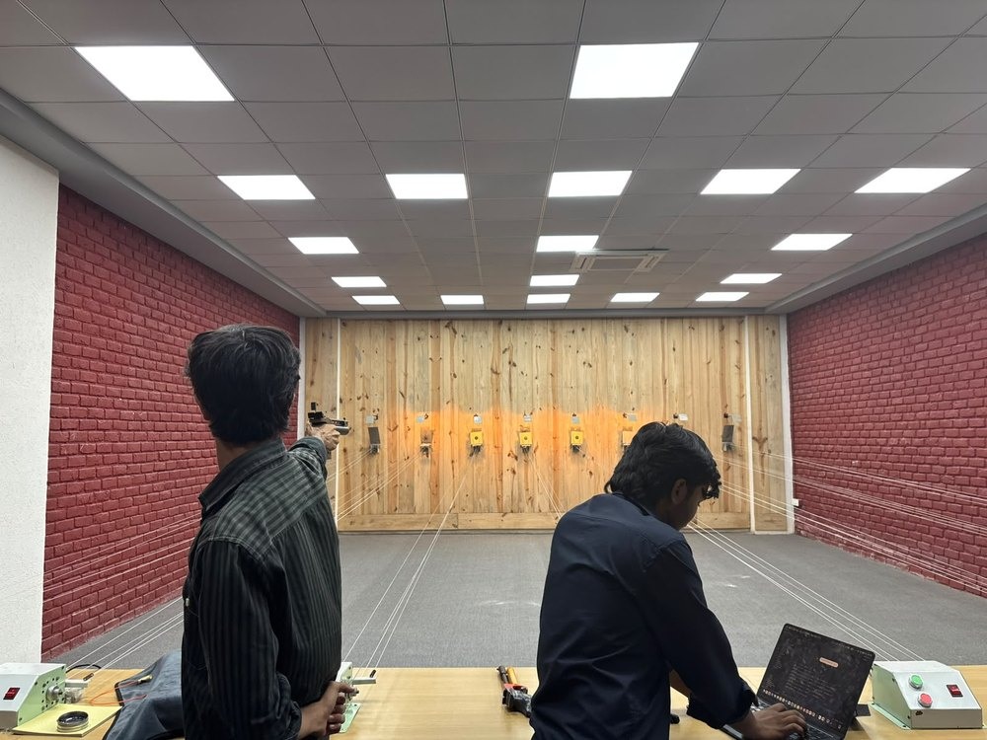
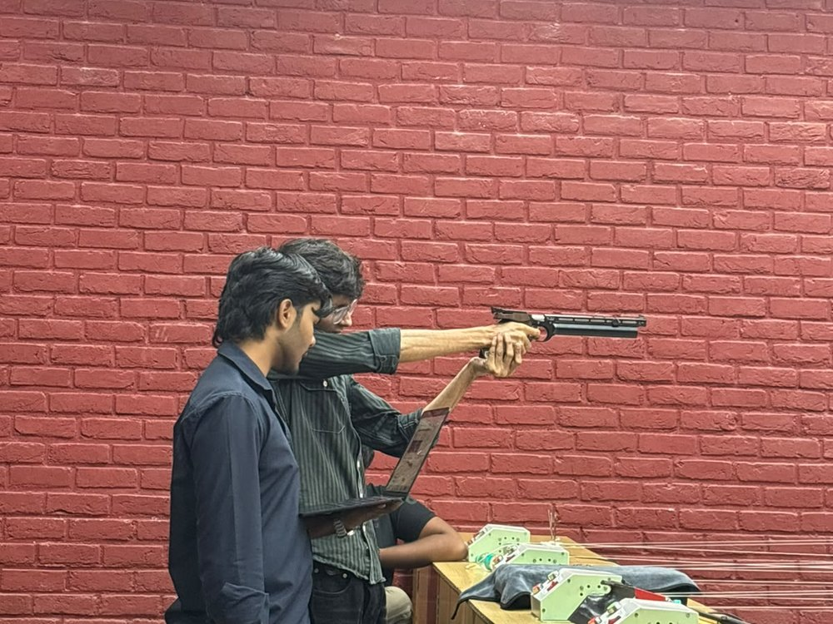
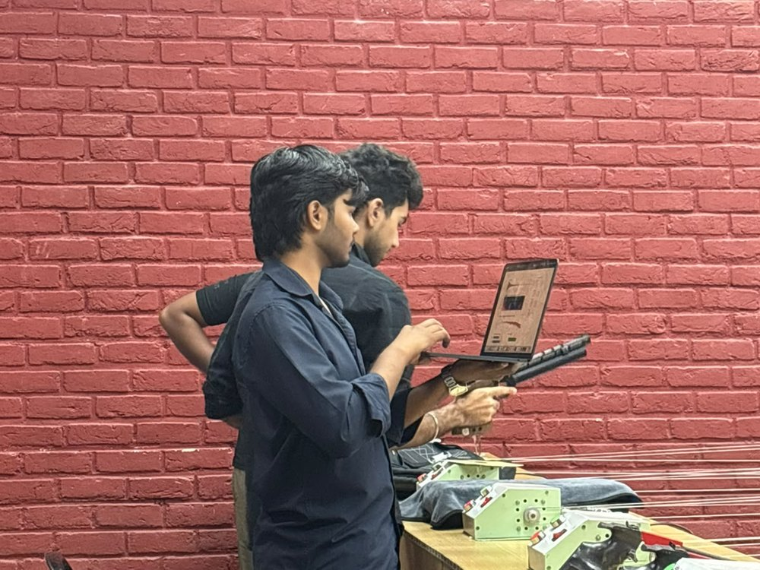
FEASIBILITY AND VIABILITY
ANALYSIS OF THE FEASIBILITY OF THE IDEA
23.7 K
25.3 ms
< 1 ms
~₹12 k
parameters in the neural core
Lane B, end to end
Lane A loop, closed
prototype bill of materials
GTCRN · ICASSP 2024
20 ms frame · 10 ms hop
anti-noise beats the wavefront
Pi 5 · UMC202HD · cooler · PSU
VERIFICATION CHAIN — EVERY NUMBER IN THIS DECK TRACES BACK TO A CHECKSUMMED ARTEFACT
Capture
96 kHz · 24-bit
GO / NO-GO
after every 3 shots
Calibrate
absolute dB SPL
Measure
54 quantities / shot
Freeze
SHA-256 data + engine
Compare
against the holdout
Reproduce
by config hash
reject → re-shoot, on site
PROOF OF EXECUTION — LIVE-RANGE GUNSHOT CAPTURE (OUR OWN DATA)
PRIMARY DATA · NOT A PUBLIC DATASET
WHY THE RECORDING IS USABLE, NOT JUST DRAMATIC
2-channel staggered gain 18–24 dB apart — the cold channel survives the clip
96 kHz · 24-bit uncompressed WAV · limiter and high-pass OFF
Calibrated to absolute dB SPL with a reference tone, not relative dBFS
54 quantities measured per shot · 16 categories · frozen signature
Indoor range · staggered-gain two-channel rig · captured live on the ZEIT toolkit laptop
Holdout split assigned before the first shot · SHA-256 freezes data + engine
GO / NO-GO validation after every three shots — a range is not repeatable
POTENTIAL CHALLENGES AND RISKS
STRATEGIES FOR OVERCOMING THESE CHALLENGES
One-shot range access — nothing is repeatable
GO / NO-GO after every three shots catches a bad take on site
The microphone clips on the blast, irreversibly
Staggered-gain pair 18–24 dB apart; the cold channel always survives
The Pi 5 throttles and latency drifts
Official cooler and 27 W supply are mandatory parts, not accessories
Targets move with input SNR
Reported as curves against input SNR, with the crossing point stated
A denoiser can be judged in the wrong place
The MELPe vocoder sits inside the evaluation chain — measured twice

Slide 5
IMPACT AND BENEFITS
POTENTIAL IMPACT ON THE TARGET AUDIENCE
THE SOLDIER
THE UNIT AND ITS COMMANDER
INDIAN DEFENCE INDUSTRY
140 dB
MIL-STD-1474 ceiling at the ear
~200 ms
of speech a single shot destroys
₹12 k
prototype bill of materials
Hearing protected — Lane A cancels at the eardrum in under 1 ms, before any processing happens.
Fewer repeats — a command lands on the first transmission instead of the third.
Indigenous IP — permissive licences end to end, no GPL, no foreign cloud.
Voice still gets out — commands survive the gunfire that used to bury them.
Measured, not asserted — words lost per shot is a number, reported per weapon and per distance.
Microcontroller-class — 23.7 K parameters runs on a Pi 5, not a Jetson.
Situational awareness kept — listening mode preserves ambient sound; combat mode protects the voice.
Works on the issued radio — MELPe 2400 bps, no new waveform to certify.
Feeds a DRDO SDR — designed to drop into the software-defined radio programme.
WHAT ONE GUNSHOT COSTS, AND WHAT THE SYSTEM CHANGES
WITHOUT
Blast at 150 dB
arrives at the ear
~200 ms of speech lost
the impulse window
Command missed
words lost per shot
Repeat under fire
delay, and risk
WITH ZEIT
Lane A cancels at the ear
closed in under 1 ms
Lane B conceals, recovers
IRT target under 35 ms
Command lands
on the first transmission
Hearing preserved
MIL-STD-1474 respected
BENEFITS OF THE SOLUTION (SOCIAL, ECONOMIC, ENVIRONMENTAL, ETC.)
Health and social
Operational
Economic
Strategic
Impulse noise is the leading cause of service-related hearing loss. Lane A protects the ear before any processing.
Voice survives the noise class the PS names first, and the system re-tunes per frame rather than being tuned once.
A microcontroller-class model instead of a Jetson: lower unit cost, lower power, longer field endurance.
Indigenous IP and permissive licences — deployable under Make in India procurement, with no cloud dependency.
THE ENVELOPE THE SYSTEM WORKS INSIDE
> 15 dB
> 0.85
> 2.5
< 25.3 ms
< 1 ms
< 6 W
SNR
STOI
PESQ
lane B
lane A
board power
MATURITY PATH · bench integrated → range, calibrated data → field trial with a unit → radio integration → production, Make in India

Slide 6
RESEARCH AND REFERENCES
DETAILS / LINKS OF THE REFERENCE AND RESEARCH WORK
HOW THE READING WAS USED
WHERE THE PUBLISHED WORK STOPS
THE SIXTEEN SOURCES
16
papers read end to end
No impulsive noise in deep ANC.
Foundations
Every result table uses engine, factory, babble and speech-shaped noise — not the class DRDO names first.
Widrow — Adaptive Noise Cancelling, Proc. IEEE, 1975
Varga & Steeneken — NOISEX-92, 1993 · Shao & Nikias — FLOM, 1993
Latency is bought by prediction.
Learned enhancement
11
inform the design — method, baseline, evidence
1.5–1.7 dB lost per 10 ms on periodic noise. A gunshot gives prediction nothing to work with.
GTCRN — Rong, ICASSP 2024 · H-GTCRN, dual channel
RMS normalisation is invalid.
DCCRN · FullSubNet · DeepFilterNet2 — real time on a Pi 4, 2022
Heavy-tailed noise has infinite variance. The closest prior system normalises by RMS anyway.
Impulsive noise
5
put code on the device
Ruhland — BMRI, IEEE/ACM TASLP 23(10), 2015 · Ono — Aux-IVA, 2011
Mic-side clipping is modelled by nobody.
Yuan, Li & Kuruoğlu — α-stable noise, 2023 · Berger — IS³, 2025
Loudspeaker saturation is modelled carefully; a 140 dB blast destroys the waveform at the capsule.
Baselines, metrics and standards
Zhang & Wang — Deep ANC, 2021 · Tan — dual-mic DC-CRN, 2021
Widrow · Shao & Nikias · BMRI · GTCRN · H-GTCRN — one block each, named on slide 3.
Le Roux — SDR, 2019 · Reddy — DNSMOS, 2022 · MIL-STD-1474 · JSS 55555
WHAT ACCOMPANIES THIS SUBMISSION
System Handbook
3-D Prototype Workbench
Architecture Audit
Source and data toolkit
Ten figures, every block specified, every unverified figure marked as such.
Both lanes modelled, earcup cut away, a simulated shot traced end to end.
Thirteen ranked findings against our own design, each traced to a source.
21 CLI tools, the measurement engine, and the SHA-256 freeze.
zeit-handbook.netlify.app
zeit-handbook.netlify.app/zeit-bench-3d
in the repository
github.com/Sarthakk1407/Zeit_at_SIH
EVERY FIGURE IN THIS DECK IS REPRODUCIBLE — the deck itself is built by script from the template, and the 3-D renders on slides 2 and 3 come out of the same model the handbook publishes.
Sixteen sources were read end to end and a gap analysis written against each. Five of them ship as code; the rest set the baseline we measure against, or the standard we are held to. Where our own review found a defect in this project's design, it is recorded in the audit rather than omitted — thirteen findings, ranked, with the four most serious answered on this slide.

