Slide 1

SMART INDIA HACKATHON 2026
TITLE PAGE
Problem Statement ID — 26052
Problem Statement Title — AI/ML-enabled adaptive noise cancellation for stationary, non-stationary and impulsive defence noise
Theme — Miscellaneous
PS Category — Hardware
Organisation — DRDO · Department of Defence Production / IDEX
Team ID — (from SIH portal)
Team Name — ZEIT v.1.0
Mentor — Dr. Swati Singal — Assistant Professor, CSE / SSCSE, Sharda University, Greater Noida
Two-lane impulse-adaptive noise cancellation for defence communications

Slide 2
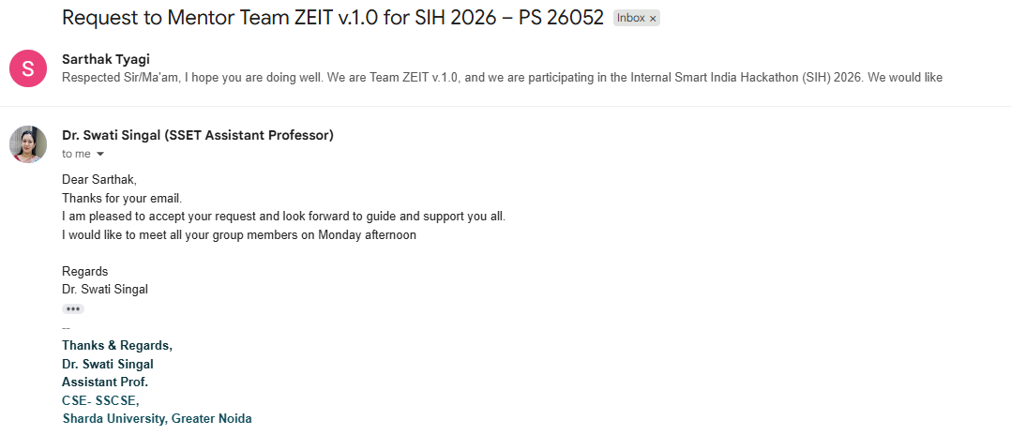
MENTOR APPROVAL
GUIDANCE ACCEPTED FOR PROBLEM STATEMENT 26052 · INTERNAL SMART INDIA HACKATHON 2026
Dr. Swati Singal
Sharda University, Greater Noida
Assistant Professor, Computer Science — SSCSE
Mentor — Team ZEIT v.1.0
Accepted by email in reply to “Request to Mentor Team ZEIT v.1.0 for SIH 2026 — PS 26052”

Slide 3
ZEIT — Two-Lane Impulse-Adaptive Noise Cancellation
PROPOSED SOLUTION (DESCRIBE YOUR IDEA/SOLUTION/PROTOTYPE)
DETAILED EXPLANATION OF THE PROPOSED SOLUTION
INNOVATION AND UNIQUENESS OF THE SOLUTION
LANE A · hearing protection · under 1 ms · FxLMS, no neural network
1
Two lanes, not one
Mic 3 · error
FxLMS filter
Anti-noise driver
The ear
Protection needs under a millisecond; transmit tolerates 25 ms. Fusing them makes both impossible.
Mic 2 · reference
error signal — what still reaches the ear
2
Detect, do not predict
LANE B · transmit to radio · 25.3 ms · eleven blocks
Published deep ANC buys latency by predicting noise. A gunshot is unpredictable by definition.
Mic 1 · voice
Engine · 11 blocks
Vocoder · MELPe
Radio link
HOW IT ADDRESSES THE PROBLEM
3
Crack before blast
The supersonic shockwave arrives 42.3 ms ahead of the muzzle blast. Physical look-ahead, not algorithmic.
Impulsive noise — gunshots, artillery
Detect-and-react transient path; α-stable augmentation trained through the clipping
Adaptive
Live kurtosis classifier retunes γ and β every frame, not tuned once offline
4
RMS is undefined here
Heavy-tailed noise has infinite variance. We scale on percentile and fractional lower-order moments.
High speech intelligibility
Voice guard, plus DNSMOS SIG reported separately so over-suppression is visible
5
Measured, not downloaded
Real-time on embedded hardware
23.7 K parameters at 39.6 MMAC/s — a Raspberry Pi 5, not a Jetson
Calibrated gunshot data, holdout split assigned before capture, checksum-frozen reference.

Slide 4
TECHNICAL APPROACH
TECHNOLOGIES TO BE USED (E.G. PROGRAMMING LANGUAGES, FRAMEWORKS, HARDWARE)
C++17
real-time path
ONNX Runtime
inference on ARM
PyTorch
training, offline
GTCRN
23.7 K params
Aux-IVA
blind separation
BMRI
impulsive path
PFFFT
BSD FFT, not GPL
Raspberry Pi 5
8 GB, the engine
UMC202HD
2-ch capture
METHODOLOGY AND PROCESS FOR IMPLEMENTATION (FLOW CHARTS/IMAGES/ WORKING PROTOTYPE)
HARDWARE CHAIN — no development computer in the signal path
3 microphones
voice · reference · error
UMC202HD
24-bit, 48 V
Raspberry Pi 5
blocks 1–11
Communication unit
MELPe 2400 bps
Earcups
return audio
05 Classifier
kurtosis → γ, β
LANE B SIGNAL CHAIN — one 20 ms frame, 10 ms hop, 25.3 ms end to end
01
Audio in
02
Aux-IVA
03
Normalise
04
STFT + ERB
the adaptive decision — what makes the system adapt per frame rather than being tuned once
impulsive frame
stationary / non-stationary
06
BMRI — detect and interpolate
07
GTCRN — learned mask
recombine
08
Deep filter
09
Voice guard
10
Residual
11
ISTFT
→
Radio
OFFLINE PIPELINE — none of this ships; it shapes the weights that do
Range capture
96 kHz · calibrated
Measure
16 quantities
Validate
against holdout
Mix + augment
α-stable, clipped
Train
SI-SNR + L1
Prune + quantise
structured, INT8
Export ONNX
the only boundary
C++ engine
parity-tested
mismatch → retune the generator
25.3 ms algorithmic · 10 ms compute per hop · under 1 ms Lane A · 39.6 MMAC/s

Slide 5
FEASIBILITY AND VIABILITY
ANALYSIS OF THE FEASIBILITY OF THE IDEA
23.7 K
39.6
2.78 ms
~₹12 k
model parameters
MMAC per second
per 20 ms frame
prototype bill of materials
GTCRN, ICASSP 2024
runs below Jetson class
closest prior work, on CPU
excluding microphones
Embedded feasibility is already demonstrated
DeepFilterNet2 runs full-band speech enhancement in real time on a Raspberry Pi 4. Our model is roughly 75× smaller.
The architecture is assembled from published, reproducible parts
GTCRN, Aux-IVA and BMRI all have public results. We are not inventing a model — the contribution is the data, the validation and the measurement.
The measurement toolkit already exists and passes its own self-test
21 command-line tools, nine automated quality checks, calibration to absolute pressure, and a checksum-frozen reference.
POTENTIAL CHALLENGES AND RISKS
STRATEGIES FOR OVERCOMING THESE CHALLENGES
One-shot range access; nothing is repeatable
GO / NO-GO validation after every three shots. Balloons and firecrackers give an energy-scaling axis with no range at all
The microphone clips on the blast — irreversibly
Staggered-gain pair 18–24 dB apart, so one channel always survives. Clipping is modelled in training rather than wished away
Pi 5 throttles; latency drifts across a long run
Official active cooler and 27 W supply, both mandatory. Report 99th-percentile frame time, never the mean
PS targets may be unreachable at very low SNR
Report PESQ, STOI and SNR as curves against input SNR and state the crossing point, rather than as a single pass/fail number
α-stable augmentation may simply not help
A Gaussian-augmented baseline is trained alongside. An honest negative result with an explanation is still a result

Slide 6
IMPACT AND BENEFITS
POTENTIAL IMPACT ON THE TARGET AUDIENCE
The soldier
The unit and its commander
Indian defence industry
Commands are heard through gunfire, and hearing is protected at the same time. MIL-STD-1474 sets the limit at the ear at 140 dB peak; few weapons produce below 150 dB.
Fewer repeated transmissions, fewer misheard orders. The operational cost of a gunshot is measured directly as words lost per shot.
An indigenous, permissively licensed engine that runs on a ₹12,000 board and feeds a DRDO software-defined radio. No foreign cloud in the loop.
BENEFITS OF THE SOLUTION (SOCIAL, ECONOMIC, ENVIRONMENTAL, ETC.)
Operational
Health and social
Economic
Strategic
Voice survives the noise class the problem statement names first, and the system adapts per frame rather than being tuned once
Impulse noise is the leading cause of service-related hearing loss. Lane A protects the ear before any processing happens
A microcontroller-class model instead of a Jetson. Lower unit cost, lower power, longer field endurance
Indigenous IP, permissive licences, no GPL and no cloud dependency — deployable under Make in India procurement
TARGETS THE SYSTEM IS BUILT AGAINST — reported as curves against input SNR, with the crossing point stated
> 15 dB
> 0.85
> 2.5
< 25.3 ms
140 dB
watts
SNR
STOI
PESQ
latency
MIL-STD-1474 limit at the ear
power draw, on the board
Wider application — the same engine serves aerospace ground crew, armoured vehicle intercom, mining and heavy industry: any environment where speech must survive impulsive noise.

Slide 7
RESEARCH AND REFERENCES
DETAILS / LINKS OF THE REFERENCE AND RESEARCH WORK
Foundations
Learned enhancement
Impulsive noise
Baselines and metrics
Widrow et al. — Adaptive Noise Cancelling, Proc. IEEE 63(12), 1975
DCCRN — complex-domain enhancement, arXiv:2008.00264
Ruhland et al. — Binary Mask Residual Interpolation, TASLP 23(10), 2015
Zhang & Wang — Deep ANC, Neural Networks, 2021
Varga & Steeneken — NOISEX-92, Speech Communication 12(3), 1993
FullSubNet — full-band + sub-band fusion, arXiv:2010.15508
Yuan, Li & Kuruoğlu — α-stable training noise, arXiv, 2023
Tan, Zhang & Wang — dual-microphone DC-CRN, IEEE/ACM TASLP, 2021
Shao & Nikias — Fractional lower-order moments, 1993
DeepFilterNet2 — real time on a Raspberry Pi 4, IWAENC 2022
Berger et al. — IS³ impulsive–stationary separation, WASPAA 2025
Le Roux et al. — SDR: half-baked or well done?, ICASSP 2019
Wang & Chen — Supervised Speech Separation, IEEE/ACM TASLP, 2018
Rong et al. — GTCRN, ICASSP 2024 · 23.7 K params, 39.6 MMAC/s
Ono — Auxiliary-function IVA, WASPAA 2011
Reddy et al. — DNSMOS P.835, ICASSP 2022
H-GTCRN — Aux-IVA + GTCRN hybrid, dual channel
MIL-STD-1474 · ANSI/ASA S3.2 · JSS 55555
WHERE THE PUBLISHED WORK STOPS — the gaps this project is built on
No impulsive noise in deep ANC at all
Latency is bought back by prediction
RMS normalisation is formally invalid
Microphone-side clipping is modelled by nobody
Every result table uses engine, factory, babble and speech-shaped noise. The foundational paper does not address the noise class DRDO names first.
1.5–1.7 dB lost per 10 ms — on periodic noise. On a gunshot, prediction has nothing to work with. Nobody has measured the collapse.
For heavy-tailed noise the variance is infinite. The closest prior system normalises by RMS; the fix is cited inside another paper we hold.
Loudspeaker saturation is modelled carefully. A 140 dB blast destroys the waveform at the capsule, before any algorithm sees it.
Full technical account, interactive 3-D prototype model and the design review are maintained alongside this submission. Sixteen sources read end to end; five of them put code on the device — Widrow, Shao & Nikias, BMRI, GTCRN and H-GTCRN. Everything else is method, baseline or evidence.

