Slide 1
21CSS201T
COMPUTER ORGANIZATION AND ARCHITECTURE
UNIT-3
Design of ALU and De Morgan’s Law

Slide 2
Arithmetic Logic Unit
  ALU is the heart of any Central Processing Unit.
  A simple ALU is constructed with Combinational circuits.
  It is a digital circuit to do arithmetic operations like addition, subtraction, multiplication and division.
  Logical operations such as OR, AND, NOR etc.
  Data movement operations such as LOAD and STORE.
  Complex ALUs are designed for executing Floating point, decimal operations and other complex numerical operations. These are called as Co-processor and work in tandem with the main processor.
  The design specifications of ALU are derived from the Instruction set Architecture.
  The ALU must have the capabilities to execute the instructions of ISA.
  Modern CPUs have multiple ALU to improve the efficiency.

Slide 3
Arithmetic Logic Unit
ALU includes the following Configurations :
- Instruction Set Architecture
- Accumulator
- Stack
- Register – Register architecture
- Register – Stack architecture
- Register – memory architecture
The size of input quantities of ALU is referred as word length of a computer

Slide 4
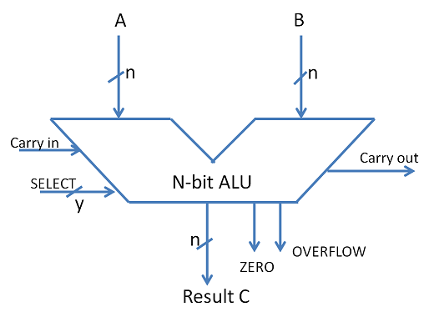
ALU Symbol

Slide 5
ADDERS
The basic building blocks of an ALU in digital computers are Adders.
Types of Basic Adders are
- Half Adder
- Full Adder
Parallel adders are nothing but cascade of full adders. The number of full adders used will depend on the number of bits in the binary digit which require to be added.
Ripple carry adders are used when the input sequence is large. It is used to add two n-bit binary numbers.
Carry look ahead adder is an improved version of Ripple carry adder.
It generates the carry-in of each full adder simultaneously without causing any delay.

Slide 6
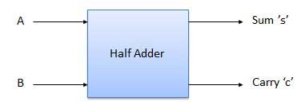
Half Adder
Half adder is a combinational logic circuit with two input and two output. The half adder circuit is designed to add two single bit binary number A and B. It is the basic building block for addition of two single bit numbers. This circuit has two outputs, carry and sum.

Slide 7
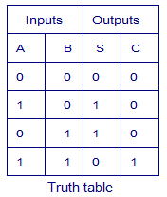

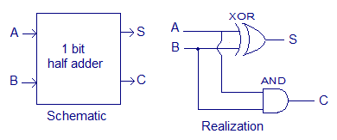
Truth Table and Circuit Diagram
Boolean Expression

Slide 8
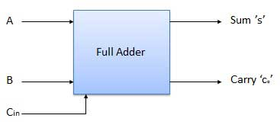
Full Adder
Full adder is developed to overcome the drawback of Half Adder circuit. It can add two one-bit numbers A and B, and carry c. The full adder is a three input and two output combinational circuit.

Slide 9
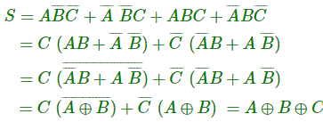

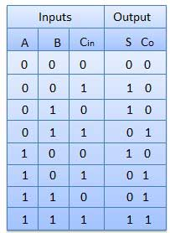
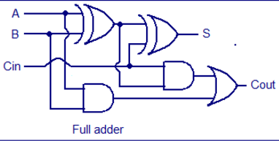
Truth Table and Circuit Diagram

Slide 10
Design of ALU
ALU or Arithmetic Logical Unit is a digital circuit to do arithmetic operations like addition, subtraction, division, multiplication and logical operations like AND, OR, XOR, NAND, NOR etc.
A simple block diagram of a 4 bit ALU for operations AND, OR,XOR and ADD is shown here :

Slide 11
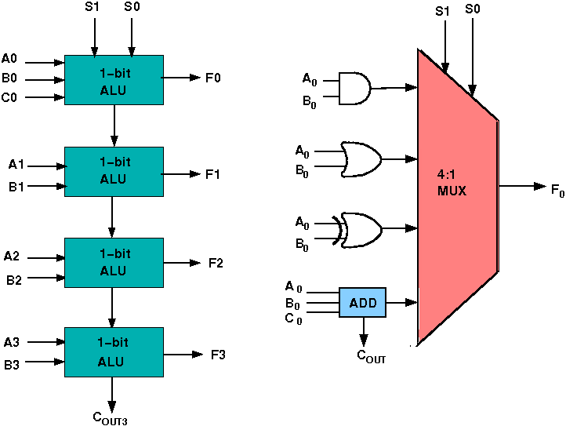
The 4-bit ALU block is combined using 4 1-bit ALU block

Slide 12
Design Issues
The circuit functionality of a 1 bit ALU is shown here, depending upon the control signal S₁ and S₀ the circuit operates as follows:
for Control signal S₁ = 0 , S₀ = 0, the output is A And B,
for Control signal S₁ = 0 , S₀ = 1, the output is A Or B,
for Control signal S₁ = 1 , S₀ = 0, the output is A Xor B,
for Control signal S₁ = 1 , S₀ = 1, the output is A Add B.

Slide 13
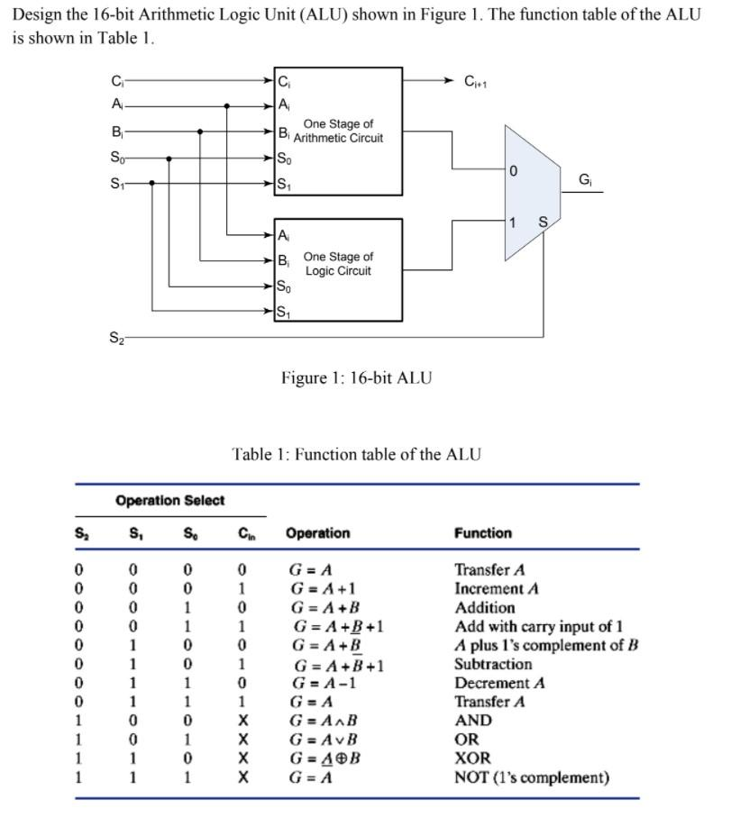
16 bit ALU Design

Slide 14
De Morgan’s Theorem
It is a very powerful tool used in digital design
De Morgan’s theorem are used to solve the expressions of Boolean
Algebra.
The theorem explains that the complement of the product of all the
terms is equal to the sum of the complement of each term. Likewise,
the complement of the sum of all the terms is equal to the product
of the complement of each term.
.

Slide 15

Two Theorems
Theorem1
The left hand side (LHS) of this theorem represents a NAND gate with inputs A and B, whereas the right hand side (RHS) of the theorem represents an OR gate with inverted inputs.
This OR gate is called as Bubbled OR.

Slide 16
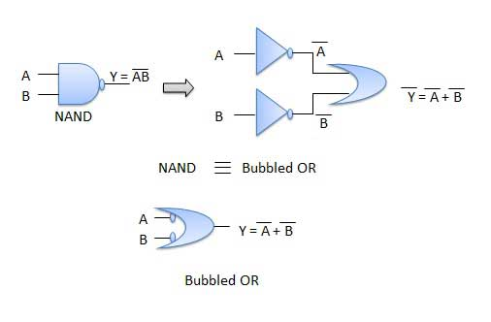
Theorem1 – Logic diagram

Slide 17
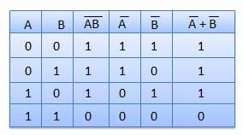
Table showing verification of the De Morgan's first theorem

Slide 18

Theorem 2
The LHS of this theorem represents a NOR gate with inputs A and B, whereas the RHS represents an AND gate with inverted inputs.
This AND gate is called as Bubbled AND.

Slide 19
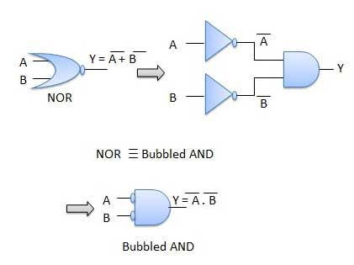
Theorem 2- Logic diagram

Slide 20
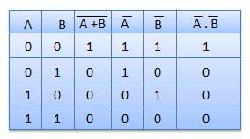
Table showing verification of the De Morgan's second theorem

Slide 21
Applications of De Morgan’s Theorem
In the domain of engineering, using De Morgan’s laws, Boolean expressions can be built easily only through one gate which is usually NAND or NOR gates. This results in hardware design at a cheaper cost.
Used in the verification of SAS code.
Implemented in computer and electrical engineering domain.
De Morgan’s laws are also employed in Java programming.

Slide 22

Ripple Carry Adder
Typical Ripple Carry Addition is a Serial Process:
• Addition starts by adding LSBs of the augend and addend.
Then next position bits of augend and addend are added along with the carry (if any) from the preceding bit.
This process is repeated until the addition of MSBs is completed.
Speed of a ripple adder is limited due to carry propagation or carry ripple.
Sum of MSB depends on the carry generated by LSB.

Slide 23
Ripple Carry Adder
Example: 4-bit Carry Ripple Adder
Assume to add two operands A and B where
A = A3 A2 A1 A0
B = B3 B2 B1 B0
A= 1 0 1 1 +
B = 1 1 0 1
--------------------
A+B=1 1 0 0 0
Cout S3 S2 S1 S0

Slide 24
Ripple Carry Adder
Carry Propagation
From the above example it can be seen that we are adding 3 bits at a time sequentially until all bits are added.
A full adder is a combinational circuit that performs the arithmetic sum of three input bits: augends Ai, addend Bi and carry in Cin from the previous adder.
Its result contain the sum Si and the carry out, Cout to the next stage.

Slide 25
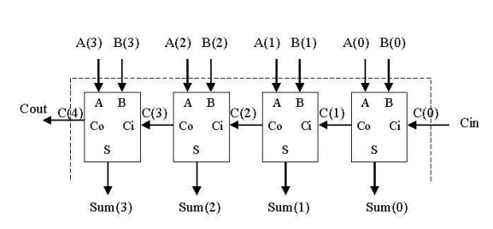

Slide 26
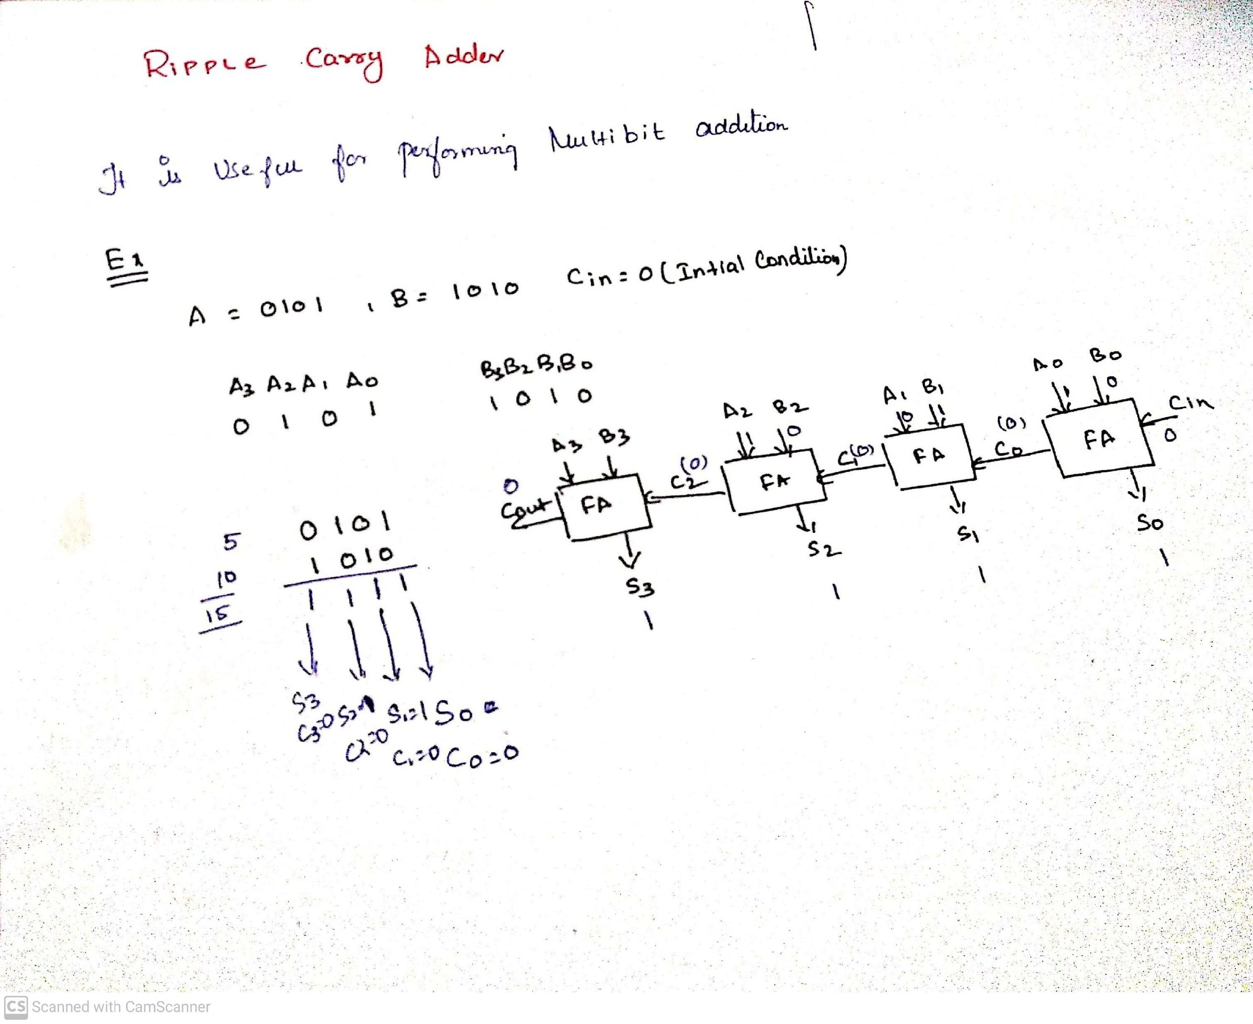
example

Slide 27
Ripple Carry Adder
4-bit Adder
A 4-bit adder circuit can be designed by first designing the 1-bit full adder and then connecting the four 1-bit full adders to get the 4-bit adder as shown in the diagram above.
For the 1-bit full adder, the design begins by drawing the Truth Table for the three input and the corresponding output SUM and CARRY.
The Boolean Expression describing the binary adder circuit is then deduced.
The binary full adder is a three input combinational circuit which satisfies the truth table given below.

Slide 28
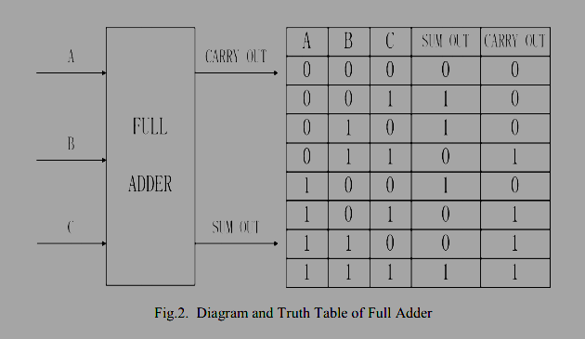
Ripple Carry Adder
Full Adder

Slide 29
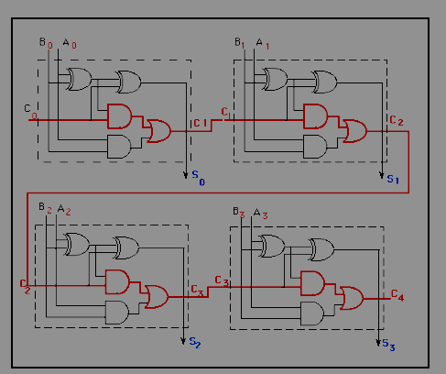
Ripple Carry Adder
4-bit Adder

Slide 30
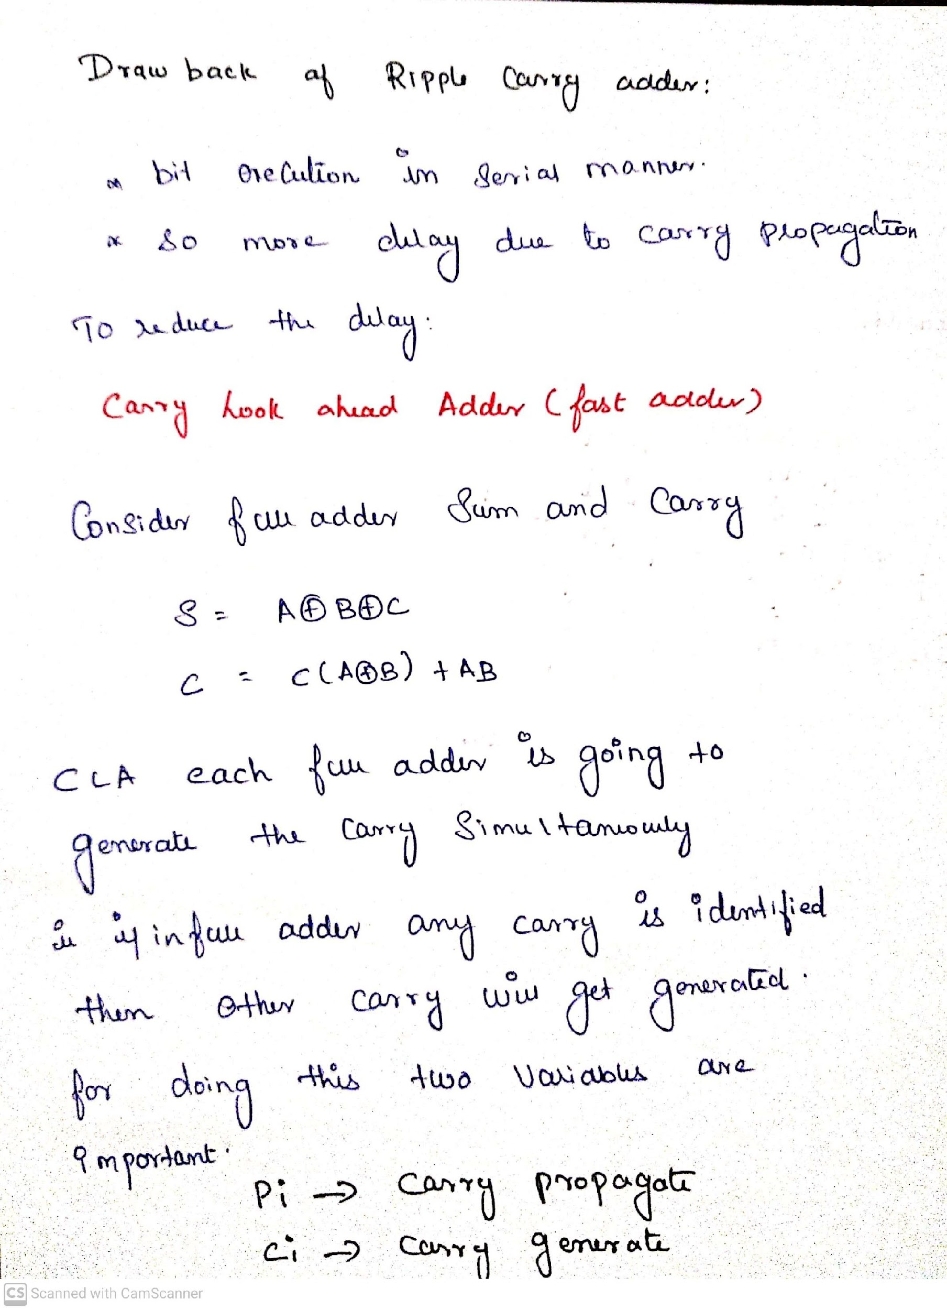

Slide 31
Design of Fast adder:
Carry Look-ahead Adder
A carry-look ahead adders (CLA) is a type of adder used in digital logic. A carry-look ahead adder improves speed by reducing the amount of time required to determine carry bits.
It can be contrasted with the simpler, but usually slower, ripple carry adder for which the carry bit is calculated alongside the sum bit, and each bit must wait until the previous carry has been calculated to begin calculating its own result and carry bits (see adder for detail on ripple carry adders)

Slide 32
The carry-look ahead adder calculates one or more carry bits before the sum, which reduces the wait time to calculate the result of the larger value bits.
In a ripple adder the delay of each adder is 10 ns , then for 4 adders the delay will be 40 ns.
To overcome this delay Carry Look-ahead Adder is used.

Slide 33
Carry Look-ahead Adder
Different logic design approaches have been employed to overcome the carry propagation delay problem of adders.
One widely used approach employs the principle of carry look-ahead solves this problem by calculating the carry signals in advance, based on the input signals.
This type of adder circuit is called as carry look-ahead adder (CLA adder). A carry signal will be generated in two cases:
(1) when both bits Ai and Bi are 1, or
(2) when one of the two bits is 1 and the carry-in (carry of the previous stage) is 1.

Slide 34
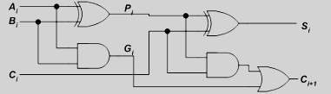
Carry Look-ahead Adder
The Figure shows the full adder circuit used to add the operand bits in the Ith column; namely Ai & Bi and the carry bit coming from the previous column (Ci ).

Slide 35


Carry Look-ahead Adder
In this circuit, the 2 internal signals Pi and Gi are given by:
The output sum and carry can be defined as

Slide 36
Carry Look-ahead Adder
Gi is known as the carry Generate signal since a carry (Ci+1) is generated whenever Gi =1, regardless of the input carry (Ci).
Pi is known as the carry propagate signal since whenever Pi =1, the input carry is propagated to the output carry, i.e., Ci+1. = Ci (note that whenever Pi =1, Gi =0).
Computing the values of Pi and Gi only depend on the input operand bits (Ai & Bi) as clear from the Figure and equations.
Thus, these signals settle to their steady-state value after the propagation through their respective gates.

Slide 37
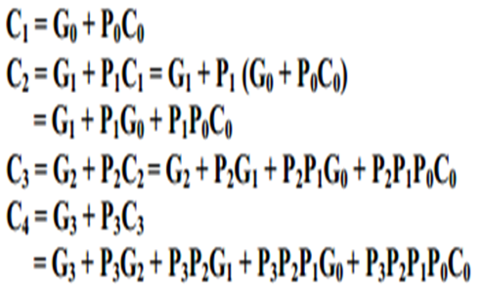
Carry Look-ahead Adder
Computed values of all the Pi’s are valid one XOR-gate delay after the operands A and B are made valid.
Computed values of all the Gi’s are valid one AND-gate delay after the operands A and B are made valid.
The Boolean expression of the carry outputs of various stages can be written as follows:

Slide 38
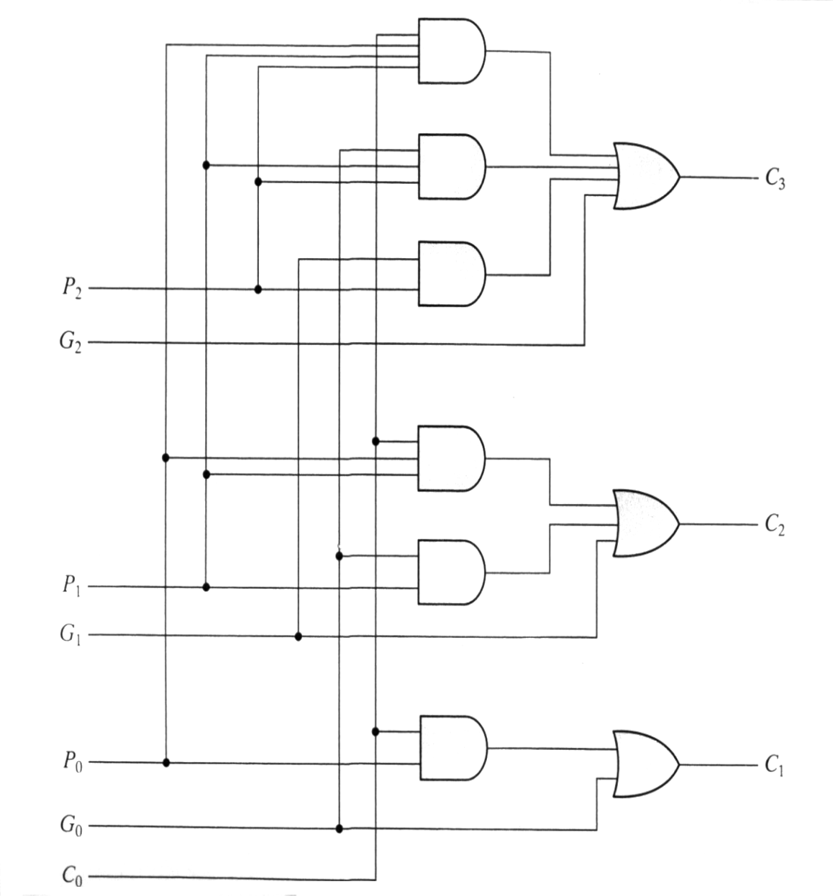
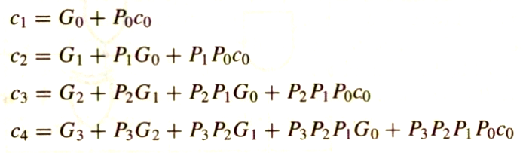
Carry Look-ahead Adder
Implementing these expressions (for a 4-bit adder), results in the logic diagram. (IC- 74182)

Slide 39
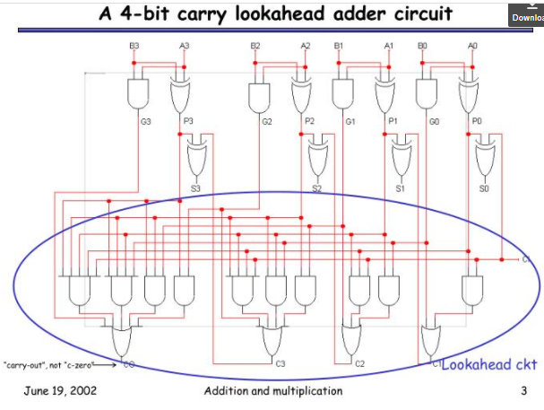

Slide 40
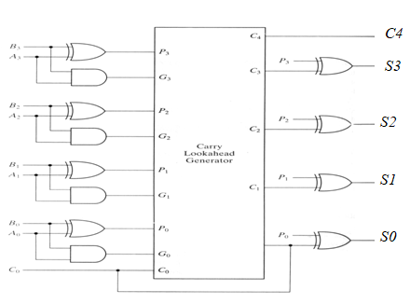
4-bit Carry Look-ahead Adder

Slide 41
4-bit Carry Look-ahead Adder
independent of n,
the n-bit addition process requires only four gate delays (against 2n)
C_{i+1}-- in 3 Gates delay; S_{i} – in 4 Gates delay irrespective of n. C₁ in 3 gates delay,C₂ in 3 gates delay,C₃ in 3 gates delay and so on.
S₀ in 4 gates delay, S₁ in 4 gates delay, S₂ in 4 gates delay and so on.

Slide 42
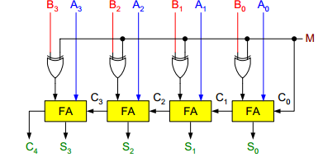
Binary Parallel Adder/Subtractor:
The addition and subtraction operations can be done using an Adder-Subtractor circuit.
The figure shows the logic diagram of a 4-bit Adder-Subtractor circuit.

Slide 43
Binary Parallel Adder/Subtractor:
The circuit has a mode control signal M which determines if the circuit is to operate as an adder or a subtractor.
Each XOR gate receives input M and one of the inputs of B, i.e., Bi. To understand the behavior of XOR gate consider its truth table given below.

Slide 44
If one input of XOR gate is zero then the output of XOR will be same as the second input. While if one input of XOR gate is one then the output of XOR will be complement of the second input.

Slide 45
Binary Parallel Adder/Subtractor:
So when M = 0, the output of XOR gate will be Bi ⊕ 0 = Bi. If the full adders receive the value of B, and the input carry C0 is 0, the circuit performs A plus B.
When M = 1, the output of XOR gate will be Bi ⊕ 1 = Bi. If the full adders receive the value of B’, and the input carry C0 is 1, the circuit performs A plus 1’s complement of B plus 1, which is equal to A minus B.

Slide 46

Multiplier –
Unsigned, Signed
Fast, Carry Save Addition of summands

Slide 47
Binary Multiplier
The usual method of long multiplication for decimal numbers applies also for binary numbers.
Unsigned number multiplication : Two n-bit numbers; 2n-bit result

Slide 48
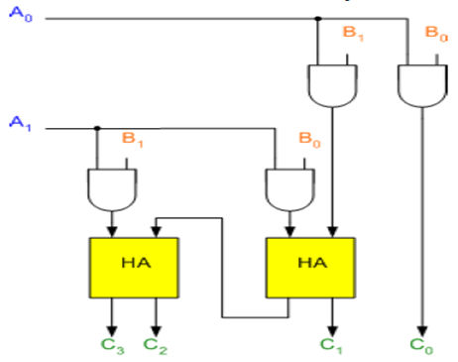
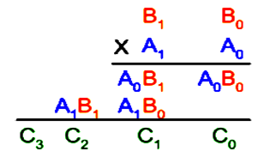
Binary Multiplier

Slide 49
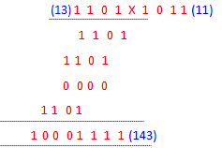
Binary Multiplier
Unsigned number multiplication
Two n-bit numbers; 2n-bit result

Slide 50
Binary Multiplier
The first partial product is formed by multiplying the B1B0 by A0. The multiplication of two bits such as A0 and B0 produces a 1 if both bits are 1; otherwise it produces a 0 like an AND operation. So the partial products can be implemented with AND gates.
The second partial product is formed by multiplying the B1B0 by A1 and is shifted one position to the left.
The two partial products are added with two half adders (HA). Usually there are more bits in the partial products, and then it will be necessary to use FAs.

Slide 51
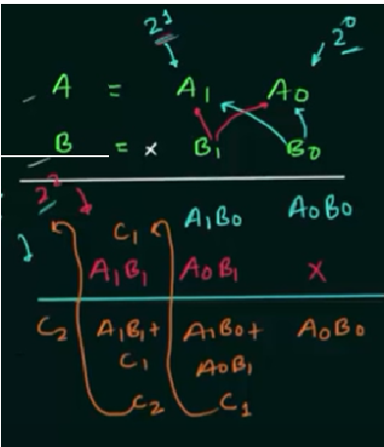
Binary Multiplier

Slide 52
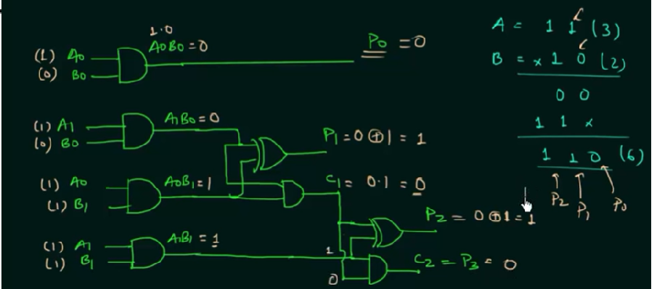
Binary Multiplier

Slide 53
Binary Multiplier
The least significant bit of the product does not have to go through an adder, since it is formed by the output of the first AND gate as shown in the Figure.

Slide 54
Example
  B₃ B₂ B₁ B₀
  1 1 0 1 1 3
  * 1 1 0 * 6
  0 0 0 0 A₀ 1 8
  + 1 1 0 1 A₁ 6
  1 1 0 1 0 7 8
  + 1 1 0 1 A₂
  1 0 0 1 1 1 0

Slide 55
Multiplication of Positive Numbers:
Shift-and-Add Multiplier
Shift-and-add multiplication is similar to the multiplication performed by paper and pencil.
This method adds the multiplicand X to itself Y times, where Y denotes the multiplier.
To multiply two numbers by paper and pencil, the algorithm is to take the digits of the multiplier one at a time from right to left, multiplying the multiplicand by a single digit of the multiplier and placing the intermediate product in the appropriate positions to the left of the earlier results.

Slide 56
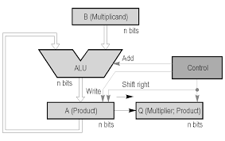
Shift-and-Add Multiplication

Slide 57
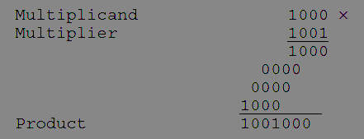
Shift-and-Add Multiplier
As an example, consider the multiplication of two unsigned 4-bit numbers,
8 (1000) and 9 (1001).

Slide 58
Shift-and-Add Multiplier
In the case of binary multiplication, since the digits are 0 and 1, each step of the multiplication is simple.
If the multiplier digit is 1, a copy of the multiplicand (1 ×multiplicand) is placed in the proper positions;
If the multiplier digit is 0, a number of 0 digits (0 × multiplicand) are placed in the proper positions.
Consider the multiplication of positive numbers. The first version of the multiplier circuit, which implements the shift-and-add multiplication method for two n-bit numbers, is shown in Figure.

Slide 59
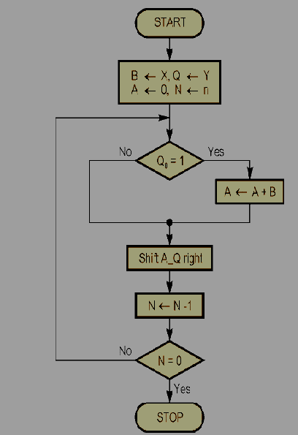
Shift - and - Add multiplier

Slide 60
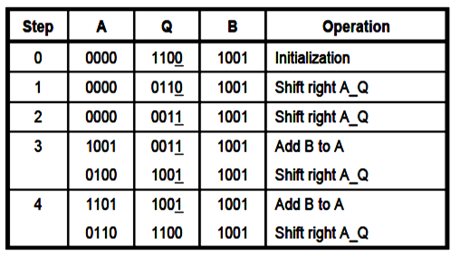
Shift-and-Add Multiplier
For Example, Perform the multiplication 9 x 12
(1001 x 1100). Finally, both A and Q contains the result of product.

Slide 61
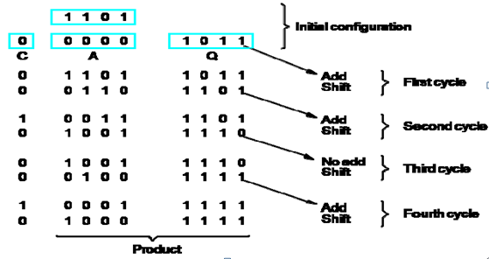
Shift-and-Add Multiplier
Example 2:
A = 0000 M ( Multiplicand) 🡪 13 ( 1 1 0 1) Q(Multiplier) 🡪 11 (1 0 1 1).

Slide 62
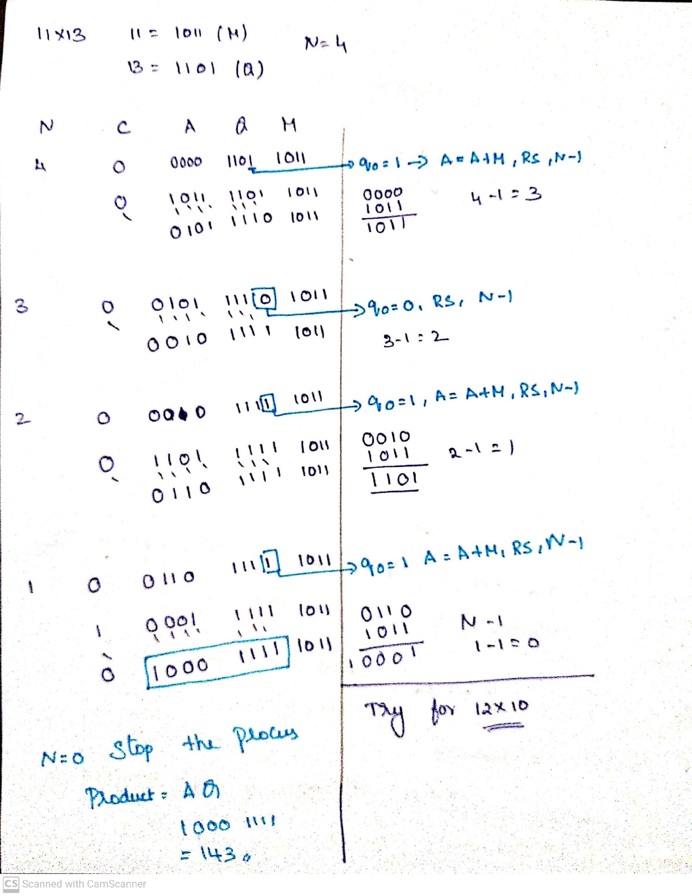
Example to multiply 11 and 13

Slide 63
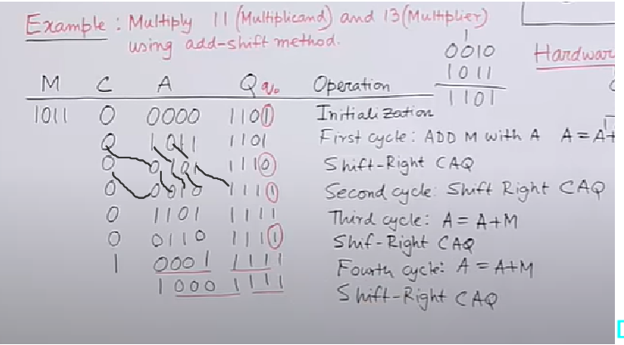
Example to multiply 11 and 13

Slide 64
Signed Multiplication - Booth Algorithm
A powerful algorithm for signed number multiplication is Booth’s algorithm which generates a 2n bit product and treats both positive and negative numbers uniformly.
This algorithm suggest that we can reduce the number of operations required for multiplication by representing multiplier as a difference between two numbers.

Slide 65
Signed Multiplication - Booth Algorithm
A powerful algorithm for signed number multiplication is Booth’s algorithm which generates a 2n bit product and treats both positive and negative numbers uniformly.
This algorithm suggest that we can reduce the number of operations required for multiplication by representing multiplier as a difference between two numbers.

Slide 66
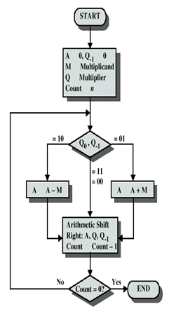
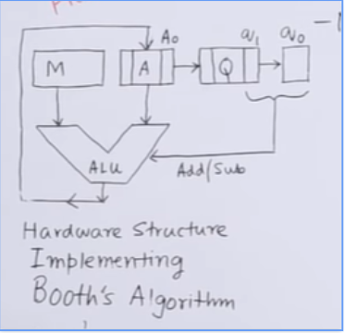
Signed Multiplication - Booth Algorithm

Slide 67
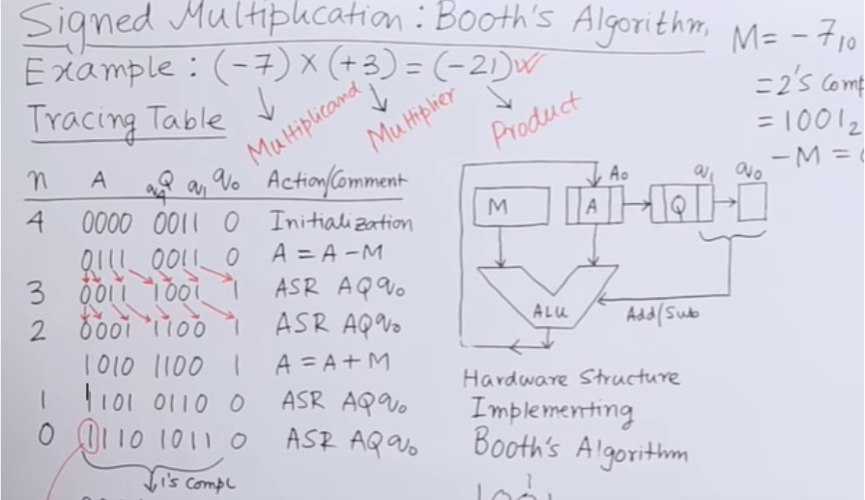
Signed Multiplication - Booth Algorithm

Slide 68
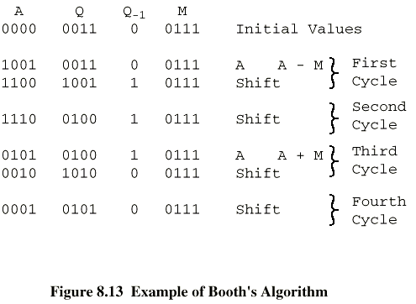
Signed Multiplication - Booth Algorithm

Slide 69
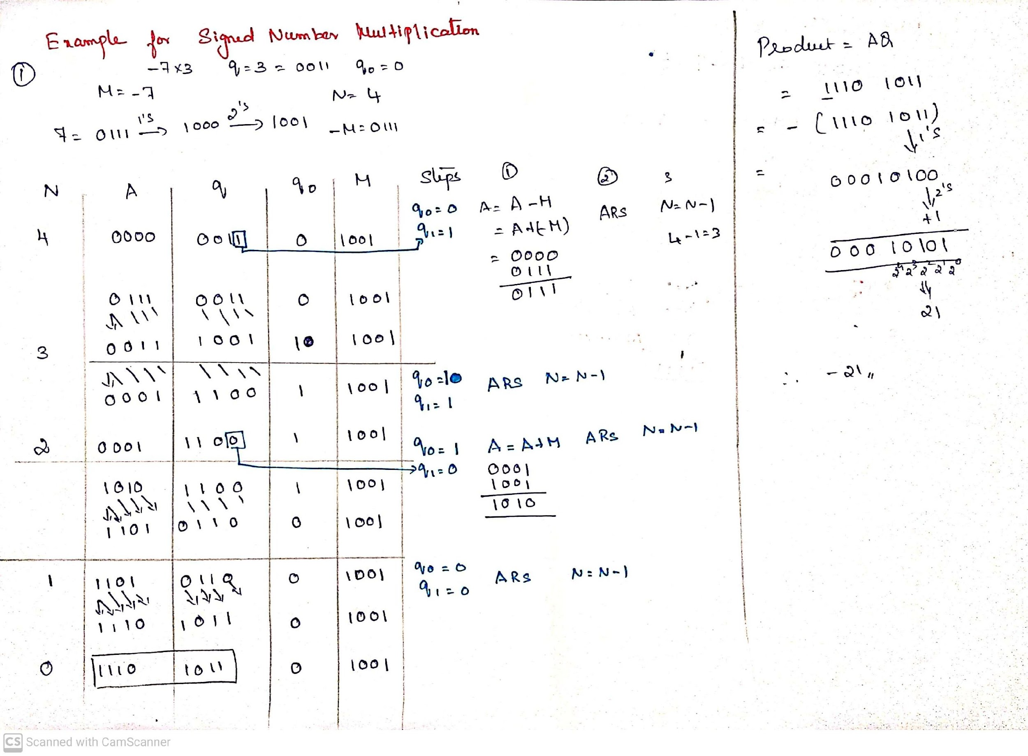

Slide 70
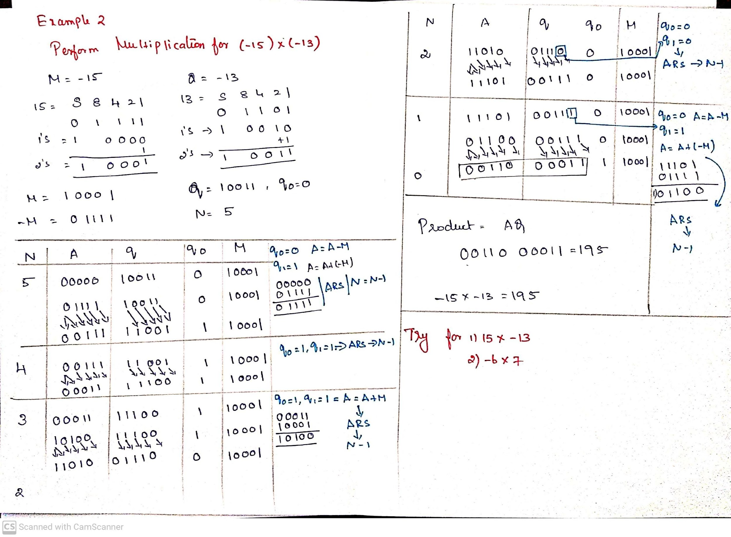

Slide 71
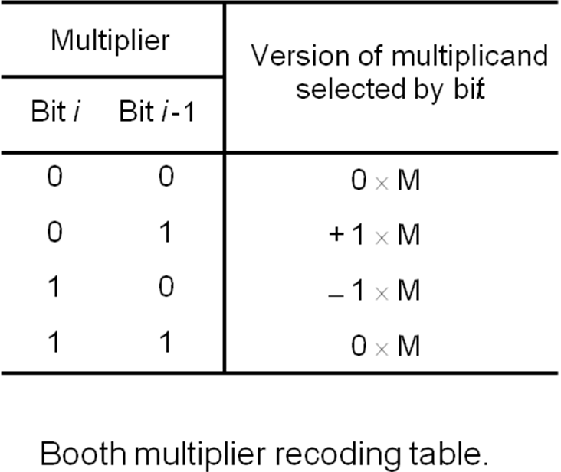
Alternate Method : The BOOTH Algorithm
Booth multiplication reduces the number of additions for intermediate results, but can sometimes make it worse as we will see.
Booth multiplier recoding table

Slide 72
The BOOTH RECODED MULTIPLIER
Booth Recoding:
30₁₀ : 0 1 1 1 1 0 0
+1 0 0 0 -1 0
(ii) 100₁₀: 0 1 1 0 0 1 0 0 0
+1 0 -1 0 +1 -1 0 0
(iii) 985₁₀: 0 0 1 1 1 1 0 1 1 0 0 1 0
0 +1 0 0 0 -1 +1 0 -1 0 +1 -1

Slide 73
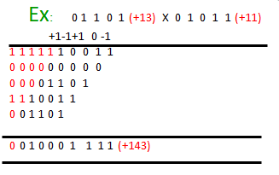
BOOTH Algorithm
Booth algorithm treats both +ve &
-ve operands equally.
(a) + Md X + Mr

Slide 74
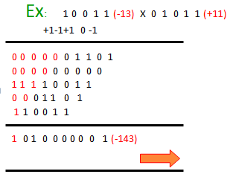
BOOTH Algorithm
Booth algorithm treats both +ve &
-ve operands equally.
(b) - Md X + Mr

Slide 75
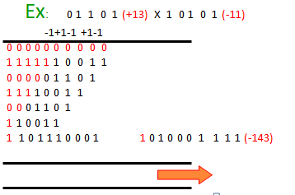
BOOTH Algorithm
Booth algorithm treats both +ve &
-ve operands equally.
(c) + Md X - Mr

Slide 76
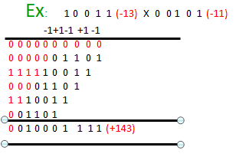
BOOTH Algorithm
Booth algorithm treats both +ve &
-ve operands equally.
(d) - Md X - Mr

Slide 77
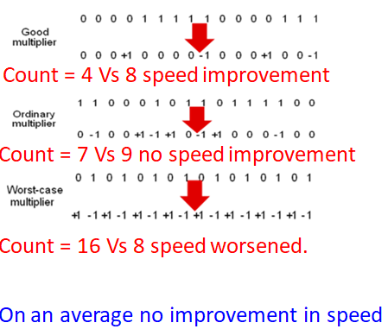
BOOTH Algorithm

Slide 78


Slide 79
FAST MULTIPLICATION
1.BIT PAIR RECODING OF MULTIPLIERS
2.CARRY SAVE ADDITION OF SUMMANDS

Slide 80
Fast Multiplication
There are two techniques for speeding up the multiplication operation.
The first technique guarantees that the maximum number of summands (versions of the multiplicand) that must be added is n/2 for n-bit operands.
The second technique reduces the time needed to add the summands (carry-save addition of summands method).

Slide 81
Bit-Pair Recoding of Multipliers
This bit-pair recoding technique halves the maximum number of summands. It is derived from the Booth algorithm.
Group the Booth-recoded multiplier bits in pairs, and observe the following: The pair (+1 -1) is equivalent to the pair (0 +1).
That is, instead of adding —1 times the multiplicand M at shift position i to + 1 x M at position i + 1, the same result is obtained by adding +1 x M at position I Other examples are: (+1 0) is equivalent to (0 +2),(-l +1) is equivalent to (0 —1). and so on

Slide 82



Bit-Pair Recoding of Multipliers

Slide 83


Bit-Pair Recoding of Multipliers

Slide 84


Slide 85

Bit-Pair Recoding of Multipliers

Slide 86

Carry-Save Addition of Summands
A carry-save adder is a type of digital adder, used to efficiently compute the sum of three or more binary numbers.
A carry-save adder (CSA), or 3-2 adder, is a very fast and cheap adder that does not propagate carry bits.
A Carry Save Adder is generally used in binary multiplier, since a binary multiplier involves addition of more than two binary numbers after multiplication.
It can be used to speed up addition of the several summands required in multiplication
It differs from other digital adders in that it outputs two (or more) numbers, and the answer of the original summation can be achieved by adding these outputs together.
A big adder implemented using this technique will usually be much faster than conventional addition of those numbers.
Fast Multiplication
Bit pair recoding reduces summands by a factor of 2
Summands are reduced by carry save addition
Final product can be generated by using carry look ahead adder

Slide 87
Carry-Save Addition of Summands
Disadvantage of the Ripple Carry Adder - Each full adder has to wait for its carry-in from its previous stage full adder. This increase propagation time. This causes a delay and makes ripple carry adder extremely slow. RCAr is very slow when adding many bits.
Advantage of the Carry Look ahead Adder - This is an improved version of the Ripple Carry Adder. Fast parallel adder. It generates the carry-in of each full adder simultaneously without causing any delay. So, CLAr is faster (because of reduced propagation delay) than RCAr.
Disadvantage the Carry Look-ahead Adder - It is costlier as it reduces the propagation delay by more complex hardware. It gets more complicated as the number of bits increases.
Notes:
Propagation delay is time elapsed between the submission of an input and occurrence of the corresponding output.

Slide 88

Ripple Carry Array

Slide 89

Carry Save Array

Slide 90
Carry-Save Addition of Summands
Consider the addition of many summands, We can:
Group the summands in threes and perform carry-save addition on each of these groups in parallel to generate a set of S and C vectors in one full-adder delay
Group all of the S and C vectors into threes, and perform carry-save addition of them, generating a further set of S and C vectors in one more full-adder delay
Continue with this process until there are only two vectors remaining
They can be added in a Ripple Carry Adder (RPA) or Carry Look-ahead Adder (CLA) to produce the desired product

Slide 91


Slide 92


Slide 93


Slide 94
Division – Restoring and
Non—Restoring

Slide 95

Integer Division
More complex than multiplication
Negative numbers are really bad!
Based on long division

Slide 96

Integer Division
Decimal Division
Binary Division
Figure: Longhand division examples

Slide 97
Long Hand Division
Longhand Division operates as follows:
Position the divisor appropriately with respect to the dividend and performs a subtraction.
If the remainder is zero or positive, a quotient bit of 1 is determined, the remainder is extended by another bit of the dividend, the divisor is repositioned, and another subtraction is performed.
If the remainder is negative, a quotient bit of 0 is determined, the dividend is restored by adding back the divisor, and the divisor is repositioned for another subtraction

Slide 98
Restoring Division
Similar to multiplication circuit
An n-bit positive divisor is loaded into register M and an n-bit positive dividend is loaded into register Q at the start of the operation.
Register A is set to 0
After the division operation is complete, the n-bit quotient is in register Q and the remainder is in register A.
The required subtractions are facilitated by using 2’s complement arithmetic.
The extra bit position at the left end of both A and M accommodates the sign bit during subtractions.

Slide 99


Restoring Division
Figure: Logic Circuit arrangement for binary Division (Restoring)

Slide 100

Flowchart for Restoring Division

Slide 101


Restoring Division – Example

Slide 102
Non-Restoring Division
Initially Dividend is loaded into register Q,
and n-bit Divisor is loaded into register M
Let M’ is 2’s complement of M
Set Register A to 0
Set count to n
SHL AQ denotes shift left AQ by one position leaving Q₀ blank.
Similarly, a square symbol in Q₀ position denote, it is to be calculated later

Slide 103

Flowchart for Non-Restoring Division

Slide 104


Non-Restoring Division

Slide 105


Non-Restoring Division - Example

Slide 106

IEEE 754
Floating point numbers and operations.

Slide 107
Floating-Point Arithmetic (IEEE 754)
The IEEE Standard for Floating-Point Arithmetic (IEEE 754) is a technical standard for floating-point computation which was established in 1985 by the Institute of Electrical and Electronics Engineers (IEEE).
The standard addressed many problems found in the diverse floating point implementations that made them difficult to use reliably and reduced their portability.
IEEE Standard 754 floating point is the most common representation today for real numbers on computers, including Intel-based PC’s, Macs, and most Unix platforms.

Slide 108
IEEE 754 - Basic components
IEEE 754 has 3 basic components:
The Sign of Mantissa
  0 represents a positive number while
  1 represents a negative number.
The Biased exponent
  The exponent field needs to represent both positive and negative exponents.
  A bias is added to the actual exponent in order to get the stored exponent.
The Normalised Mantissa
  The mantissa is part of a number in scientific notation or a floating-point number, consisting of its significant digits.
  Here we have only 2 digits, i.e. O and 1. So a normalised mantissa is one with only one 1 to the left of the decimal.

Slide 109


IEEE 754 - Precision
IEEE 754 numbers are divided into two based on the above three components:
Single precision and
Double precision.
1. Single precision
2. Double precision

Slide 110
Example 1: Single precision
Biased exponent 127+6=133
133 = 10000101
Normalised mantisa = 010101001
we will add 0's to complete the 23 bits
The IEEE 754 Single precision is:
0 10000101 01010100100000000000000
This can be written in hexadecimal form 42AA4000

Slide 111
Example 2: Double precision
Biased exponent 1023+6=1029
1029 = 10000000101
Normalised mantisa = 010101001
we will add 0's to complete the 52 bits
The IEEE 754 Double precision is:
0 10000000101 0101010010000000000000000000000000000000000000000000
This can be written in hexadecimal form 4055480000000000

Slide 112
IEEE 754 - Special Values
EEE has reserved some values that can ambiguity.
Zero
  Zero is a special value denoted with an exponent and mantissa of 0.
  -0 and +0 are distinct values, though they both are equal.
Denormalised
  If the exponent is all zeros, but the mantissa is not then the value is a denormalized number.
  This means this number does not have an assumed leading one before the binary
point.
Infinity
  The values +infinity and -infinity are denoted with an exponent of all ones and a mantissa of all zeros.
  The sign bit distinguishes between negative infinity and positive infinity.

Slide 113
IEEE 754 - Special Values
Not A Number (NAN)
  The value NAN is used to represent a value that is an error.
  This is represented when exponent field is all ones with a zero sign bit or a mantissa that it not 1 followed by zeros.
  This is a special value that might be used to denote a variable that doesn’t yet
hold a value.
Single Precision
Exponent | Mantisa | Value
0 | 0 | exact 0
255 | 0 | Infinity
0 | not 0 | denormalised
255 | not 0 | Not a number (NAN)
Double Precision
Exponent | Mantisa | Value
0 | 0 | exact 0
2049 | 0 | Infinity
0 | not 0 | denormalised
2049 | not 0 | Not a number (NAN)

Slide 114

Ranges of Floating point numbers
The range of positive floating point numbers can be split into normalized numbers,
and denormalized numbers which use only a portion of the fractions’s precision.
Since every floating-point number has a corresponding, negated value, the ranges above are symmetric around zero.
There are five distinct numerical ranges that single-precision floating-point numbers are not able to represent with the scheme presented so far:
  Negative numbers less than – (2 – 2-23) × 2127 (negative overflow)
  Negative numbers greater than – 2-149 (negative underflow)
  Zero
  Positive numbers less than 2-149 (positive underflow)
  Positive numbers greater than (2 – 2-23) × 2127 (positive overflow)

Slide 115
Ranges of Floating point numbers
Overflow generally means that values have grown too large to be represented. Underflow is a less serious problem because is just denotes a loss of precision, which is guaranteed to be closely approximated by zero.
The total effective range of finite IEEE floating-point numbers is
 | Binary | Decimal
Single Precision | ± (2 – 2⁻²³) × 2¹²⁷ | approximately ± 10^{38.53}
Double Precision | _{± (2 – 2}-52) _{× 2}1023 | approximately ± 10^{308.25}

Slide 116
IEEE 754 - Special Operations
Operation | Result
n ÷ ±Infinity | 0
±Infinity × ±Infinity | ±Infinity
±nonZero ÷ ±0 | ±Infinity
±finite × ±Infinity | ±Infinity
Infinity + Infinity Infinity – -Infinity | +Infinity
Operation | Result
-Infinity – Infinity -Infinity + – Infinity | – Infinity
±0 ÷ ±0 | NaN
±Infinity ÷ ±Infinity | NaN
±Infinity × 0 | NaN
NaN == NaN | False

