Slide 1


Streamlined End-to-End Real-Time Data Ingestion and Analysis Pipeline with Azure Tools
-Presented by
Vikas Reddy Gorantla
Sarthak Kulkarni
Seemalamudi Nikhil Sai

Slide 2
Introduction
Overview
Objectives
System Architecture Overview and ER Diagram
Challenges
Resources Used
Results
Conclusion
AGENDA

Slide 3
INTRODUCTION
This project focuses on building an end-to-end data pipeline using Azure Data Factory and Azure Databricks to process and analyze streaming data in real-time.
This project not only demonstrates the capabilities of Azure’s cloud services but also highlights their synergy in solving real-world problems.
By combining advanced data engineering techniques with cloud technologies, this project lays the foundation for robust real-time data processing pipelines

Slide 4
OVERVIEW
The project handles high-velocity streaming data sourced from Kaggle datasets in CSV or Delta formats.
Built an end-to-end Azure pipeline to automate data ingestion, transformation, and storage for an e-commerce platform.
Stored raw data in Azure Blob Storage and moved it to Azure Data Lake Storage using Azure Data Factory.
Used Azure Databricks for data transformations like calculating final prices, standardizing purchase dates, and computing total sales.
Automated the entire process, ensuring seamless data flow from ingestion to transformation, with the final data stored in Azure Data Lake Storage for analysis.

Slide 5




OBJECTIVES
Enable Real-Time Data Processing and Analytics
Build a Scalable and Reliable Data Pipeline
Seamless Integration of Azure Services for End-to-End Automation

Slide 6



Azure Resources Used for This Project
Azure Storage Account
Azure Data Factory
Azure Databricks
For orchestrating the data pipeline and scheduling workflows.
For real-time data processing and analytics using Apache Spark.
For storing raw and processed data.

Slide 7
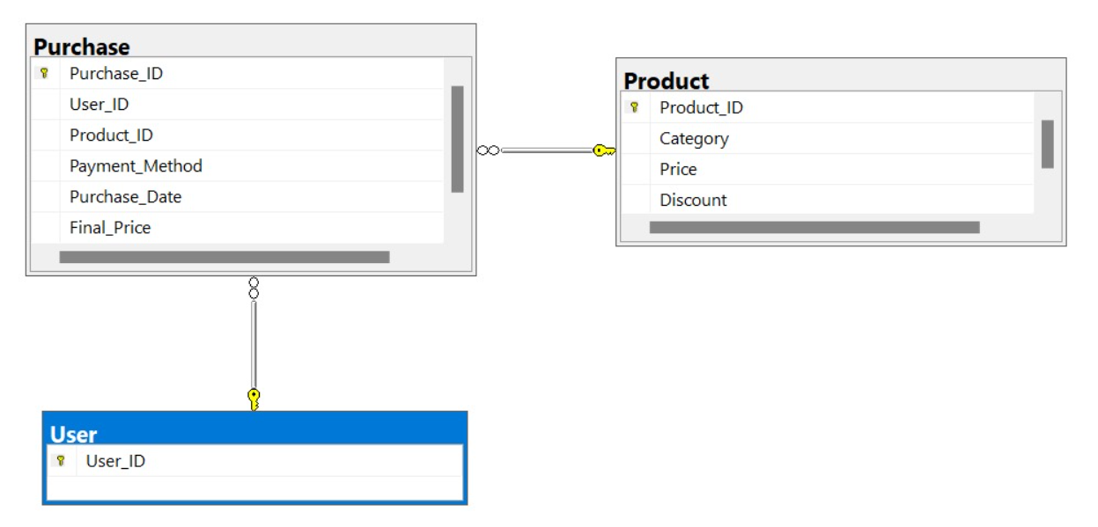
ARCHITECTURE
ER DIAGRAM
The architecture integrates Azure Data Factory and Azure Databricks to orchestrate and process real-time streaming data efficiently.
Azure Data Factory serves as the orchestration layer, enabling scheduling and execution of data workflows. It triggers Azure Databricks notebooks as part of its pipeline activities to process streaming data.
ADF uses Linked Services to connect to Databricks, ensuring seamless communication between the two services.

Slide 8



CHALLENGES
Handling High-Velocity Streaming Data
Managing the ingestion and processing of large volumes of streaming data in real-time poses a significant challenge.
Optimizing Resource Utilization
Efficiently managing Azure resources to minimize costs while ensuring scalability and high performance is a challenging aspect of the project

Slide 9

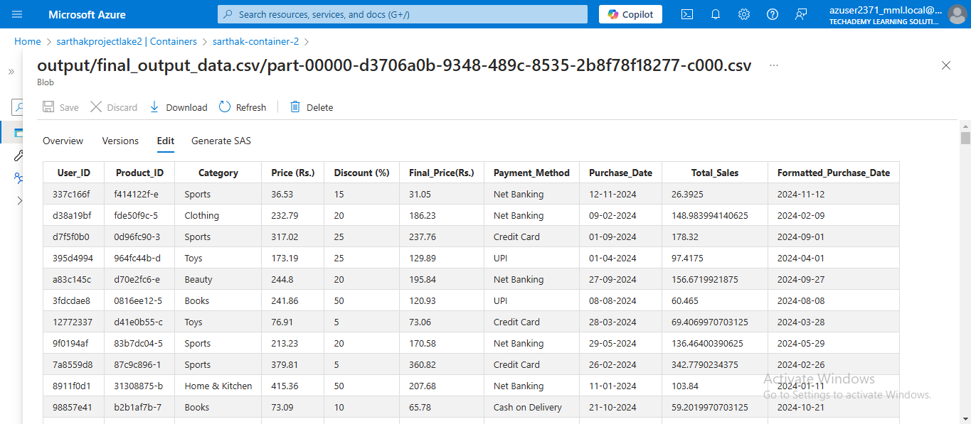
RESULTS
The output CSV file confirms the successful execution of an end-to-end Azure pipeline using Azure Data Factory (ADF) and Azure Databricks (ADB).
Data was ingested from Azure Blob Storage and processed through a streaming pipeline.
Transformations included calculating Final_Price (Rs.), standardizing Formatted_Purchase_Date, and computing Total_Sales.
ADF orchestrated the workflow by triggering Databricks activities for data transformation.
The clean dataset contains product details, payment methods, and sales metrics, highlighting the pipeline’s efficiency in data processing and preparation for analysis.

Slide 10
CONCLUSION
End-to-End Data Pipeline: The project successfully built and implemented an end-to-end data pipeline using Azure Data Factory (ADF) and Azure Databricks (ADB), demonstrating seamless integration and real-time data processing.
Efficient Data Ingestion and Processing: Data was efficiently ingested from Azure Blob Storage, processed through a streaming pipeline, and transformed to compute critical business metrics like Final_Price (Rs.) and Total_Sales.
Orchestration with ADF: Azure Data Factory orchestrated the entire workflow, triggering Databricks activities for data transformation and ensuring smooth execution of the pipeline.
Clean and Ready Data: The pipeline successfully delivered a clean, transformed dataset, including essential product, payment, and sales information, making it ready for further analysis, reporting, and decision-making.
Scalability and Real-Time Processing: The pipeline demonstrates the ability to handle real-time data processing, providing businesses with actionable insights and enabling informed decision-making.

Slide 11


Thank you

