Slide 1




Dayananda Sagar University (DSU) - Main Campus
School of Engineering
Devarakaggalahalli, Harohalli Kanakapura Road, Bengaluru South Dist., Karnataka 562112
DEPARTMENT OF
COMPUTER SCIENCE AND ENGINEERING
(ARTIFICIAL INTELLIGENCE AND MACHINE LEARNING)
Capstone Project Phase-I (23AM4701)
Review-2
Title: “ML Sentry – Intelligent MLOps Governance Platform for Continuous Model Monitoring and Compliance”
Under the Supervision of
Guide: Dr. Abdul Haq Nalband
Associate Professor, Dept. of CSE (AI&ML), SOE, DSU
Co-Guide: Prof. Ashish Raj
Assistant Professor, Dept. of CSE (AI&ML), SOE, DSU
Rishabh R Soranganvi – ENG23AM0179
Sarthak Ramachandra – ENG23AM0185
Saumyaa Priyadarshinee – ENG23AM0187
Sonika D – ENG23AM0197
SDGs aligned: SDG 9 (Industry, Innovation & Infrastructure), SDG 10 (Reduced Inequalities)
Academic Year: 2026-2027

Slide 2
Contents
Introduction
Domain & SDG Mapping
Problem Statement
Objectives
Project Scope
Literature Review
Base Paper & Novelty
Methodology / Approach
Sample of Data Collection
Tools & Technologies
Implementation & Results
Expected Outcomes (Achieved)
Timeline (Gantt Chart)
References
Paper Communicated – Proof
KSCST – Proposal Proof

Slide 3
Introduction
Background: Machine-learning models are deployed into production and then mostly left alone, while the real-world data they see keeps changing.
Motivation: Data drift, performance decay and unfair errors for one group usually go unnoticed until users are affected; teams find out late, often from complaints.
Context: ML Sentry is an open-source governance layer that runs in Docker next to a live model. It reads the model’s evaluation metrics from the team’s own MLflow, checks them against limits, and a LangGraph agent (Groq, with a local Ollama fallback) judges how serious a problem is and alerts on Slack.
Relevance: Model-agnostic: the model is never uploaded or moved, and every metric name and limit is set in one .env file. Demonstrated on a California Housing price-prediction model.

Slide 4
Domain & SDG Mapping
Domain: Agentic AI & MLOps Governance – continuous monitoring of deployed ML models (demo: real-estate price regression).
Primary – SDG 9 (Industry, Innovation & Infrastructure): ML Sentry is reusable, open-source infrastructure that keeps deployed AI systems reliable.
Secondary – SDG 10 (Reduced Inequalities): the bias check alerts when the model becomes much less accurate for one group (coastal vs inland districts in the demo).

Slide 5
Problem Statement
Problem: Deployed models silently degrade through data drift, performance decay (concept drift) and group bias, and there is usually no automatic way to notice it, judge how serious it is, and tell the team.
Current practice: Tools such as Evidently, MLflow and SageMaker Model Monitor compute metrics and dashboards, but a person must still read them, decide the severity and act.
Gap addressed: No lightweight, open-source, model-agnostic layer that reasons over the metrics and their history, explains the issue in plain language, alerts the team, and confirms recovery after retraining. ML Sentry fills this gap.

Slide 6
Objectives
Implement a full monitoring pipeline (data drift, concept drift, performance decay, and fairness violations) on a loan-approval model trained on the German Credit Data (UCI) dataset.
Build a working compliance-mapping module that auto-generates Model Cards and audit artifacts aligned with EU AI Act and NIST AI RMF requirements.
Build and validate an agentic governance layer using the Groq API (primary) with a local Ollama model as fallback, giving the agent genuine multi-step tool-use to reason over monitoring signals and autonomously trigger alerts, incident reports, and retraining recommendations.

Slide 7
Project Scope
In scope (Phase 1 – completed): metric reading from MLflow, threshold checks, LLM severity agent with fallback, Slack alerts, re-check after retraining, Docker packaging, and a demo on California Housing with injected drift, decay and bias.
Out of scope: training or hosting the user’s model, automatic retraining or rollback, legal compliance certification, and multi-tenant production deployment.
Application domain: any team with a deployed model that logs to MLflow (finance, healthcare, real estate, etc.); the demo uses real-estate price prediction.

Slide 8
Literature Review (1/2)
Paper | Algorithm / Method | Dataset | Metrics | Research Gap
[1] Myakala et al., 2025 – AutoDrift | Prophet, ADWIN, K-S test, Airflow / MLflow | NASA CMAPSS FD001 | 91.2% forecast precision; 12-cycle drift-detection delay | Hard-coded retraining logic; no fairness or severity reasoning
[2] Nigenda et al., 2022 – SageMaker Model Monitor | Data sketches + t-test, K-S test | SageMaker production models (1.5–2+ yrs) | Drift scores for data, concept, bias | Alerts on drift, but no reasoning about cause or severity; tied to AWS
[3] Eck et al., 2022 – Monitoring framework | General-purpose drift monitoring | 3 supply-chain production datasets | Feature, prediction, performance drift | Dashboards only; interpretation and action stay manual
[4] Bodor et al., 2023 – MLOps monitoring | MLOps pipeline with CI/CD + monitoring hooks | Illustrative case studies | Deployment frequency, monitoring coverage | Full lifecycle, but no autonomous / agentic response
[5] Kourouklidis et al., 2023 – Monitoring DSL | Model-driven DSL + runtime | Example monitoring workflows | Qualitative expressiveness | Specifies monitoring only; no reasoning or response
[6] Schelter et al., 2020 – Validating black-box predictions | Meta-learning to estimate performance drop | 6 tabular benchmarks with synthetic shifts | Estimation error vs actual drop | Estimates decay only; no alerting or explanation

Slide 9
Literature Review (2/2)
Paper | Algorithm / Method | Dataset | Metrics | Research Gap
[7] Abbasi et al., 2021 – ElStream | Ensemble learning, majority voting | Real + synthetic streams with induced drift | Accuracy; detection delay | Statistical detection only; no explanation or governance
[8] Hardt et al., 2021 – SageMaker Clarify | Bias detection + SHAP across lifecycle | Production data incl. German Credit | Class imbalance, DPL, KS, SHAP | No autonomous reasoning or alerting
[9] Vasudevan & Kenthapadi, 2020 – LiFT | Spark-based fairness measurement | LinkedIn production pipelines | Demographic parity, equalized odds | Point-in-time; no continuous re-evaluation
[10] Sarwal & Islam, 2024 – Lending bias | RF, SVM, LR, ANN + AIF360 reweighting | HMDA data (2017 vs 2023) | Racial SPD cut 59.2% (2017) vs 13.9% (2023) | Bias changes over time, yet only two static snapshots
[11] Lu et al., 2024 – Responsible FM agents | Pattern-based reference architecture for agents | Patterns from agent frameworks | Qualitative, vs responsible-AI attributes | General-purpose; not built for drift / MLOps
[12] Mayekar et al., 2026 – Agentic compliance | Multi-agent RAG + policy-grounded LLM | Enterprise stores (Slack, S3, Salesforce) | PII detection ~94%; DSAR 4–5 h | Privacy-law focus; no drift or bias monitoring

Slide 10
Base Paper & Novelty of the Proposed Work
Paper | Algorithm / Method | Dataset | Metrics | Research Gap
D. Nigenda et al., “Amazon SageMaker Model Monitor: A System for Real-Time Insights into Deployed ML Models,” KDD 2022 [2] | Data sketches + statistical tests (t-test, K-S) | SageMaker production models, 1.5–2+ years of traffic | Drift scores for data, concept, bias and attribution | Raises drift alerts, but a person must interpret them; no severity reasoning; tied to AWS
Novelty of ML Sentry
Agentic judgement: an LLM agent grades each breach minor / moderate / critical, using the metric history, and says why and what to do.
Model-agnostic and private: reads only metrics from the user’s own MLflow; the model and data never leave the team.
Never silent: Groq → local Ollama → built-in rules, so an alert always goes out.
Closed loop: re-checks the model after retraining and reports RECOVERED.
Open and free: one Docker container, configured from one .env file, built on free / open-source tools.

Slide 11
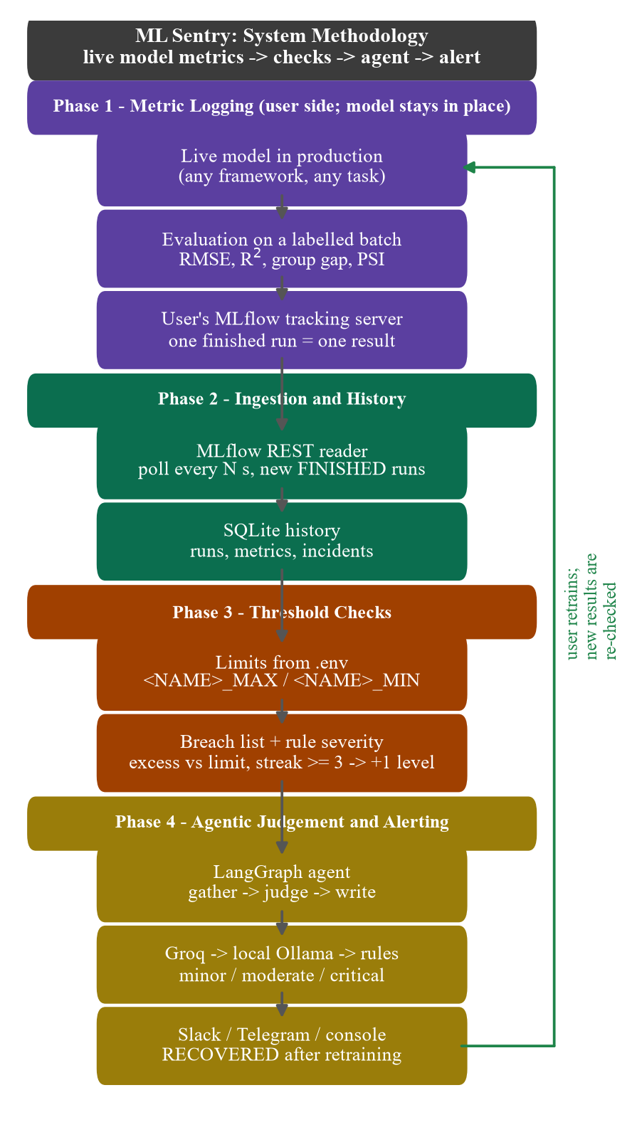
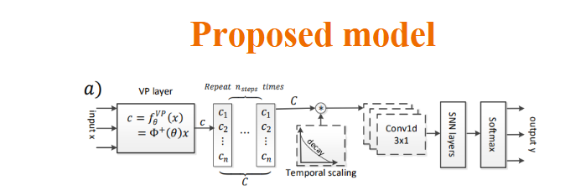
Methodology / Approach – Workflow
1. Log: the user’s model evaluates each new batch and logs its metrics (RMSE, R², RMSE gap, PSI, …) to the team’s own MLflow.
2. Poll: ML Sentry reads new finished runs through the MLflow REST API every few seconds (POLL_INTERVAL_SECONDS).
3. Store: each run’s metrics are saved in SQLite, giving a history and a “bad runs in a row” streak.
4. Check: every watched metric is compared with its _MAX / _MIN limit from .env → breach or OK.
5. Judge: on a breach, the LangGraph agent grades severity (minor / moderate / critical) with a reason and an action.
6. Alert: the message goes to Slack (Telegram optional) and the incident is logged.
7. Re-check: after retraining, if every metric is back within limits, ML Sentry sends RECOVERED.

Slide 12
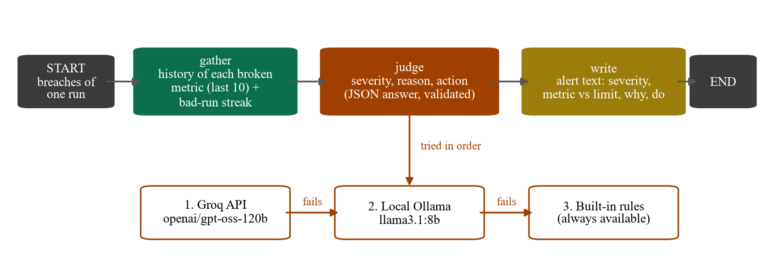
Methodology / Approach – Severity Agent (LangGraph)
gather → judge → write: collect the breaches and recent history, ask the LLM for JSON {severity, reason, action}, then format the alert.
Fallback order: Groq openai/gpt-oss-120b (30 s timeout) → local Ollama llama3.1:8b (180 s) → built-in rules. Temperature 0.
Rule severity: excess ε = |v − L| / |L|; < 25% minor, < 100% moderate, else critical; one level higher after 3 bad runs in a row.

Slide 13
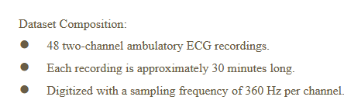
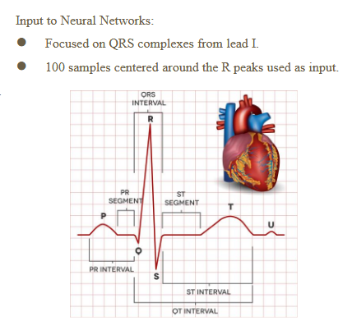
Sample of Data Collection
Source: California Housing (1990 US Census), loaded with scikit-learn’s fetch_california_housing – public and free. Replaces German Credit (1,000 rows) from Review 1.
Size: 20,640 districts, 8 numeric features; target MedHouseVal = median house value in $100k.
Groups: region = coastal if Longitude < −121 (7,143 coastal / 13,497 inland), used for the bias check.
Split (seed 42): train / reference / live, shown right.
Simulation: live data is sent as 8 batches × 500 rows; from batch 4 a fault is injected – drift (MedInc +2.0), decay (target ×1.3) or bias (coastal target ×1.4). Each batch logs 16 metrics to MLflow.
Sample rows (live split)
MedInc | HouseAge | Latitude | Longitude | MedHouseVal | region
2.847 | 27 | 40.16 | −123.22 | 0.413 | coastal
1.342 | 33 | 34.12 | −117.33 | 0.690 | inland
5.232 | 22 | 33.13 | −117.05 | 1.675 | inland
2.620 | 18 | 37.53 | −121.96 | 2.359 | coastal
2.401 | 37 | 37.97 | −121.22 | 0.584 | coastal
Data split
Split | Rows | Coastal | Inland
Train | 12,384 | 4,340 | 8,044
Reference | 4,128 | 1,369 | 2,759
Live | 4,128 | 1,434 | 2,694

Slide 14
Tools & Technologies
Language: Python (3.12 in Docker, 3.14 for development).
ML & data: scikit-learn (HistGradientBoostingRegressor), pandas, Evidently 0.7 (PSI drift).
MLOps: MLflow 3 tracking server (read through its REST API), SQLite for history.
Agent: LangGraph; Groq API (openai/gpt-oss-120b); Ollama (llama3.1:8b, runs locally).
Alerts: Slack incoming webhook (Telegram optional).
Platform: Docker + docker-compose, pytest (9 tests), Git / GitHub.
Hardware: laptop with Intel i5-12450HX, 16 GB RAM, RTX 4050 GPU (for local Ollama); no cloud GPU needed.

Slide 15
Implementation & Results
Scenario | Watched metric: healthy → with fault | Detected | Severity (batches 4–8) | After retraining
Healthy (8 batches) | RMSE 0.42–0.50, R² 0.82–0.87 | 0 false alarms | – | –
Data drift | max PSI 0.03–0.06 → 2.34–3.00 | 5 / 5, delay 0 | C C C C C | 8 / 8 within limits; RECOVERED sent
Performance decay | RMSE → 0.88–0.99; R² → 0.59–0.63 | 5 / 5, delay 0 | M M C C C | 3 / 8 within; RMSE 0.55–0.65 (partly recovered)
Group bias | RMSE gap 0.01–0.14 → 0.58–0.77 | 5 / 5, delay 0 | C C C C C | 7 / 8 within; 1 minor (gap 0.201)
M = moderate, C = critical. Baseline model: RMSE 0.476, R² 0.826, coastal–inland gap 0.043. Limits: RMSE 0.60, R² 0.70, gap 0.20, PSI 0.20.
15 / 15
faulty batches detected
0
false alarms on healthy data
0
batch detection delay
18 / 18
LLM severities matched the rules
Agent: 20 judgements – Groq 5 (7.0–14.7 s), Ollama 13 (20.9–44.3 s), rules 2. Live run: 5 CRITICAL alerts + RECOVERED delivered to Slack.

Slide 16
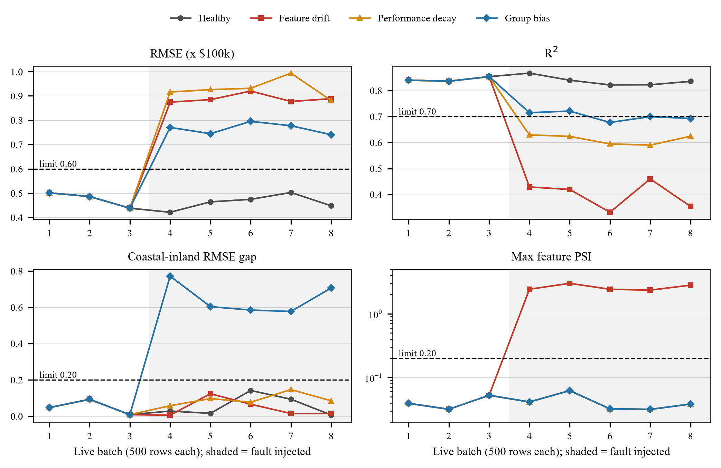
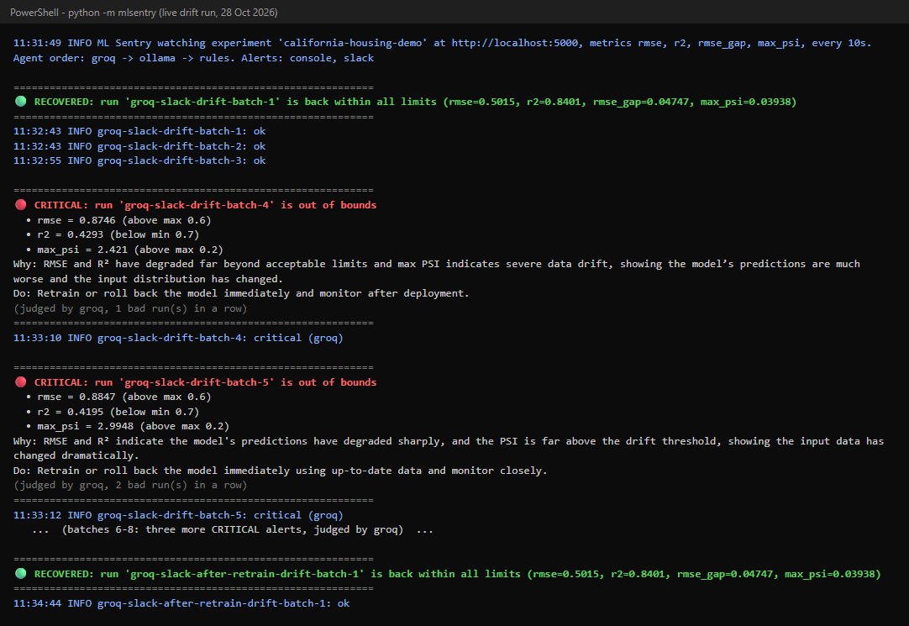
Results – Metrics per Batch and a Live Alert Run
Watched metrics for 8 live batches in each scenario (shaded = fault injected, dashed = limit). Healthy stays within every limit; each fault crosses its limit from batch 4.
ML Sentry console during the live drift run (28 Oct 2026): Groq-judged CRITICAL alerts, also sent to Slack, then RECOVERED after retraining.

Slide 17
Expected Outcomes (Achieved)
Working system: open-source ML Sentry in one Docker container (294 MB) that watches any MLflow-logged model, configured from one .env file.
Evaluation: three injected faults – 15/15 faulty batches detected with no delay and no false alarms; severity escalates while a fault lasts.
Live demo: Groq-judged CRITICAL alerts delivered to Slack, then RECOVERED after retraining; 9 automated tests pass; documentation in the repository.
Research contribution: a system-and-survey paper (methodology, experiments and results written).
Impact: a decision-support and governance tool for teams running ML in production, aligned with SDG 9 and SDG 10.

Slide 18
Timeline (Gantt Chart)
Phase | Key work | W1 | W2 | W3 | W4 | W5 | W6 | W7 | W8 | W9 | Status
1. Data & baseline model | California Housing prep; HistGradientBoosting baseline |  |  |  |  |  |  |  |  |  | Done
2. Fault injection & simulator | Drift / decay / bias injection; batches to MLflow |  |  |  |  |  |  |  |  |  | Done
3. Monitoring core | MLflow reader, SQLite history, threshold checker |  |  |  |  |  |  |  |  |  | Done
4. Agentic severity layer | LangGraph agent: Groq → Ollama → rules |  |  |  |  |  |  |  |  |  | Done
5. Alerts & recovery | Slack alerts; retrain and RECOVERED check |  |  |  |  |  |  |  |  |  | Done
6. Docker & validation | Container; 3 fault scenarios; tests |  |  |  |  |  |  |  |  |  | Done
7. Documentation & paper | Docs, paper, Review-2 preparation |  |  |  |  |  |  |  |  |  | Done

Slide 19
References (1/2)
[1] R. K. Myakala, P. K. Nagata, S. Lavudya, S. K. Pedhapally, V. R. Podduturi, “AutoDrift: A Forecast-Aware Concept Drift Detection and Retraining Pipeline in MLOps with CMAPSS,” in Proc. IEEE 11th Int. Conf. on Big Data Computing Service and Machine Learning Applications (BigDataService), 2025.
[2] D. Nigenda, Z. Karnin, M. B. Zafar, R. Ramesha, A. Tan, M. Donini, K. Kenthapadi, “Amazon SageMaker Model Monitor: A System for Real-Time Insights into Deployed Machine Learning Models,” in Proc. 28th ACM SIGKDD Conf. on Knowledge Discovery and Data Mining (KDD), pp. 3671–3681, 2022.
[3] B. Eck, D. Kabakci-Zorlu, Y. Chen, F. Savard, X. Bao, “A Monitoring Framework for Deployed Machine Learning Models with Supply Chain Examples,” in Proc. IEEE Int. Conf. on Big Data (Big Data), pp. 2231–2238, 2022.
[4] A. Bodor, M. Hnida, D. Najima, “From Development to Deployment: An Approach to MLOps Monitoring for Machine Learning Model Operationalization,” in Proc. 14th Int. Conf. on Intelligent Systems: Theories and Applications (SITA), pp. 1–7, 2023.
[5] P. Kourouklidis, D. Kolovos, J. Noppen, N. Matragkas, “A Domain-Specific Language for Monitoring ML Model Performance,” in Proc. ACM/IEEE Int. Conf. on Model Driven Engineering Languages and Systems Companion (MODELS-C), pp. 266–275, 2023.
[6] S. Schelter, T. Rukat, F. Biessmann, “Learning to Validate the Predictions of Black Box Classifiers on Unseen Data,” in Proc. ACM SIGMOD Int. Conf. on Management of Data, pp. 1289–1299, 2020.

Slide 20
References (2/2)
[7] A. Abbasi, A. R. Javed, C. Chakraborty, J. Nebhen, W. Zehra, Z. Jalil, “ElStream: An Ensemble Learning Approach for Concept Drift Detection in Dynamic Social Big Data Stream Learning,” IEEE Access, vol. 9, pp. 66408–66419, 2021.
[8] M. Hardt, X. Chen, X. Cheng, M. Donini, et al., “Amazon SageMaker Clarify: Machine Learning Bias Detection and Explainability in the Cloud,” in Proc. 27th ACM SIGKDD Conf. on Knowledge Discovery & Data Mining (KDD), pp. 2974–2983, 2021.
[9] S. Vasudevan, K. Kenthapadi, “LiFT: A Scalable Framework for Measuring Fairness in ML Applications,” in Proc. 29th ACM Int. Conf. on Information & Knowledge Management (CIKM), pp. 2773–2780, 2020.
[10] K. Sarwal, S. R. Islam, “Algorithmic Lending Bias: Evaluating the Fairness of Historical Redlining in Loan Approvals,” in Proc. IEEE Int. Conf. on Big Data (BigData), 2024.
[11] Q. Lu, L. Zhu, X. Xu, Z. Xing, S. Harrer, J. Whittle, “Towards Responsible Generative AI: A Reference Architecture for Designing Foundation Model Based Agents,” in Proc. IEEE 21st Int. Conf. on Software Architecture Companion (ICSA-C), pp. 119–126, 2024.
[12] A. P. Mayekar, N. A. Jha, A. E. Pathan, S. M. Yadav, “Agentic AI for Automated Compliance Enforcement Using Retrieval-Augmented Governance Pipelines,” in Proc. IEEE 6th Biennial Int. Conf. on Nascent Technologies in Engineering (ICNTE), 2026.

Slide 21
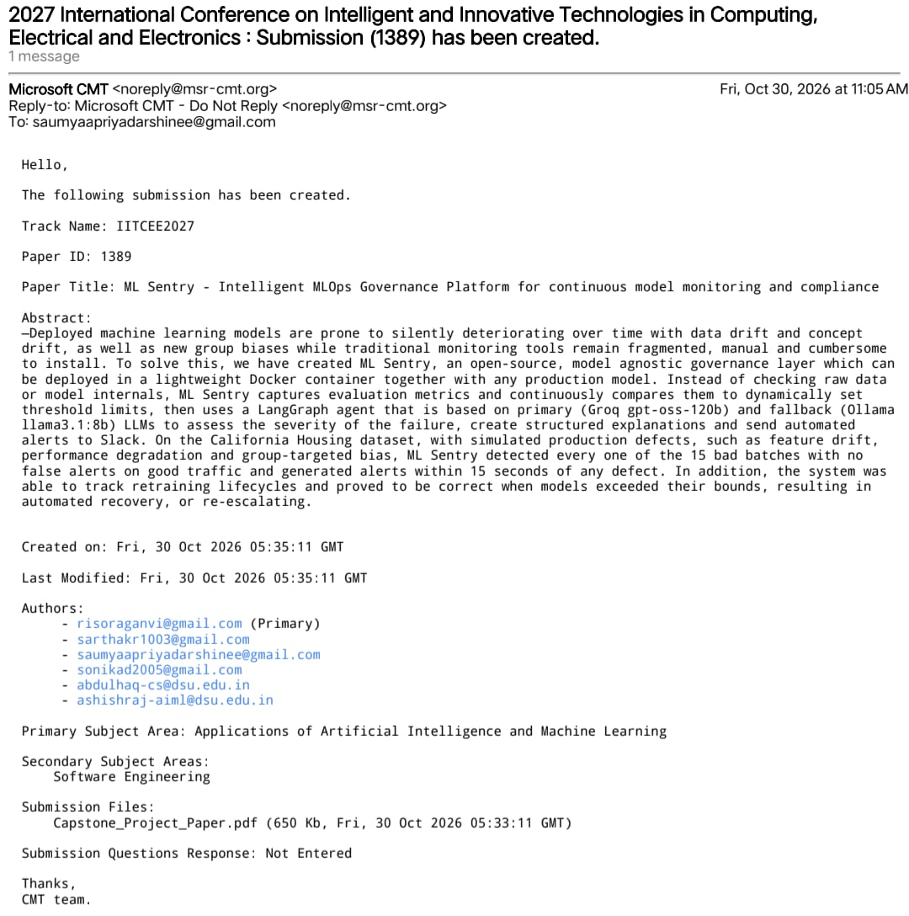
Paper Communicated – Submission Proof
Conference: 2027 International Conference on Intelligent and Innovative Technologies in Computing, Electrical and Electronics (IITCEE 2027)
Paper ID: 1389
Submitted: 30 Oct 2026 via Microsoft CMT
Subject area: Applications of AI & ML (secondary: Software Engineering)

Slide 22
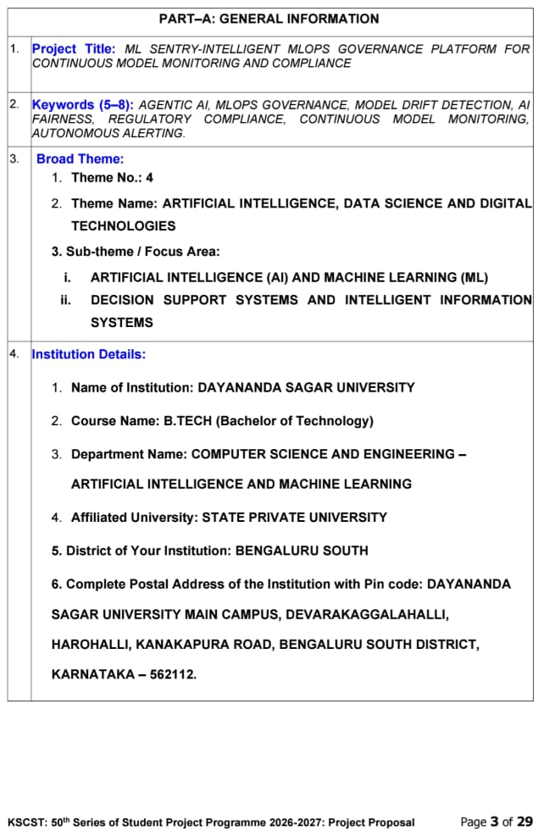
KSCST – Proposal Submitted (Screenshot)
Programme: KSCST 50th Series of Student Project Programme 2026–2027
Theme 4: Artificial Intelligence, Data Science and Digital Technologies
Sub-themes: AI & ML; Decision Support Systems and Intelligent Information Systems
Shown: Part A – General Information (page 3 of 29)

Slide 23


