Slide 1

ASTRA -Automated Security Threat Recognition System
AI-Powered Vulnerability Intelligence & Attack Path Reasoning Platform
This Photo by Unknown Author is licensed under CC BY-NC

Slide 2



The Problem
Security teams face thousands of vulnerabilities daily
Traditional scanners show isolated CVEs
No visibility into how attacks chain together
Prioritization remains manual and reactive
This Photo by Unknown Author is licensed under CC BY-SA
This Photo by Unknown Author is licensed under CC BY-ND

Slide 3
Why Existing Tools Fall Short
Detection without reasoning
Lack of attacker-perspective modeling
Static reports, no contextual intelligence
High cognitive load on security teams

Slide 4
Our Solution: ASTRA
Real-time vulnerability discovery
AI-driven attack path reasoning
Context-aware security intelligence
Human-readable explanations for faster decisions

Slide 5
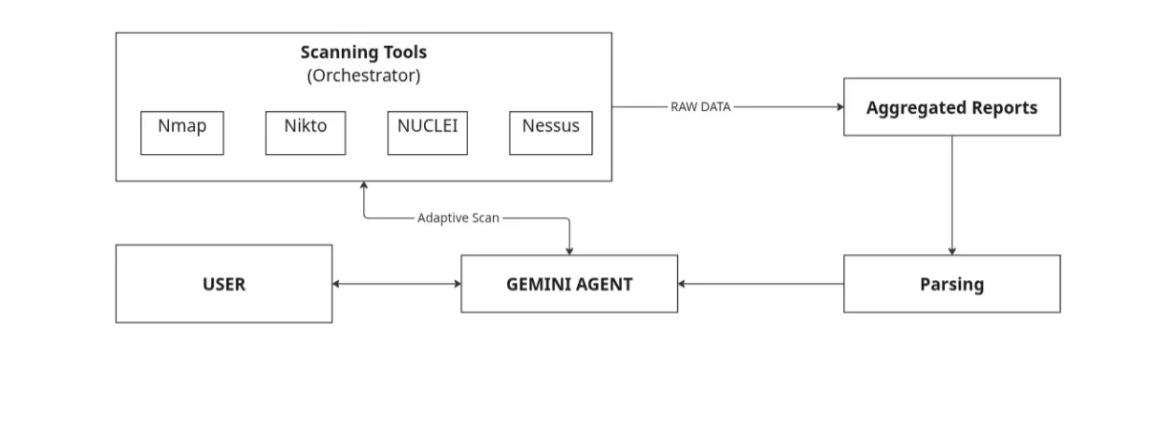
System Architecture
Scanning Layer (Nmap, Nuclei)
Threat Intelligence Enrichment (NVD, ExploitDB)
Attack Path Reasoning Engine
AI RAG-based Analyst Interface

Slide 6
Attack Path Reasoning Engine
Models attacker behavior and privilege escalation
Identifies critical exploit chains
Highlights real-world impact scenarios
Prioritizes vulnerabilities by actual risk

Slide 7
AI Security Analyst (RAG)
Natural language interaction
Explains exploitation steps
Provides actionable remediation guidance
Bridges skill gaps across teams

Slide 8
Key Differentiators
From CVE lists to attack narratives
From alerts to understanding
From reactive defense to proactive security
Designed for scale and collaboration

Slide 9
Impact & Metrics
Improved vulnerability prioritization accuracy
Reduced response time
Clear risk communication
Measurable security posture improvement

Slide 10
Conclusion
ASTRA transforms fragmented vulnerability data into actionable cyber intelligence.
By combining real-time scanning, AI-driven vulnerability reasoning, and graph-based attack path analysis, ASTRA enables security teams to see how attackers actually move, not just where vulnerabilities exist.
Instead of overwhelming analysts with raw scan outputs, ASTRA prioritizes risks based on real attack feasibility, reducing response time and improving decision-making.
With its scalable architecture and AI-first design, ASTRA is built not just for detection, but for anticipation and prevention — making cybersecurity proactive rather than reactive.

