Slide 1
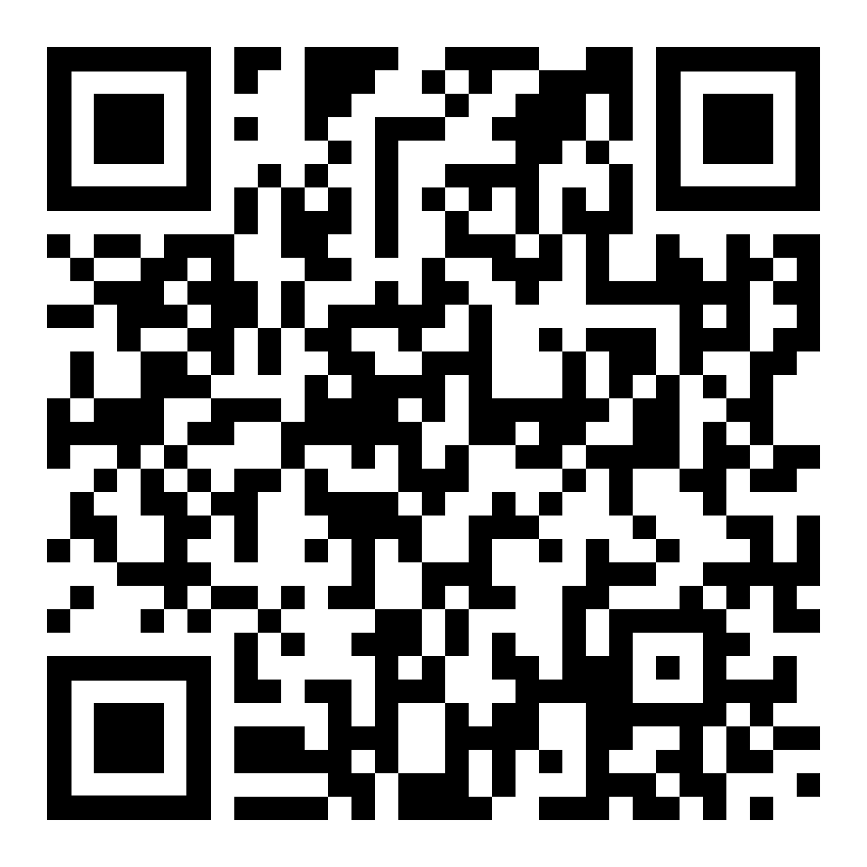
MOVIE APP
Team 13 | JANIKA • MIKHAIL • SARA • ANDREAS
Web Application Project
https://movie-app-frontend-cu6i.onrender.com

Slide 2
Agenda
Team & roles + effort per person
What is the Movie App?
Demos
15 feature checklist
Lessons learned
Summary
Questions and answers

Slide 3

Team & roles + effort per person
Andreas Kotala
UI
Janika Ahonen
Auth (sign up/in/out)
Sara Vehviläinen
UI design
Mikhail Konstantinov
REST documentation
Tailwind / Responsive
Navbar
English / Finnish localization
Search
Groups
Render deploy
Effort: ~69 h
Validation rules
Routing
DB/backend
Reviews page
Effort: ~34 h
Finnkino showtimes
Favorites list
GitHub repo setup
README
Effort: ~31 h
Account deletion + data cleanup
Password change
Reviews/ratings
Effort: ~39 h
DB work
UI design updates
User stories

Slide 4

What is the Movie App?
A community for movie enthusiasts - discover movies, check showtimes, write reviews, and share your favorites with others.
Search movies by title, genre, year, minimum rating and sort results (TMDB)
See local showtimes (Finnkino)
Create groups to plan movie nights
Save favorites and share lists with friends
Write quick reviews and ratings
Works on phone and desktop

Slide 5
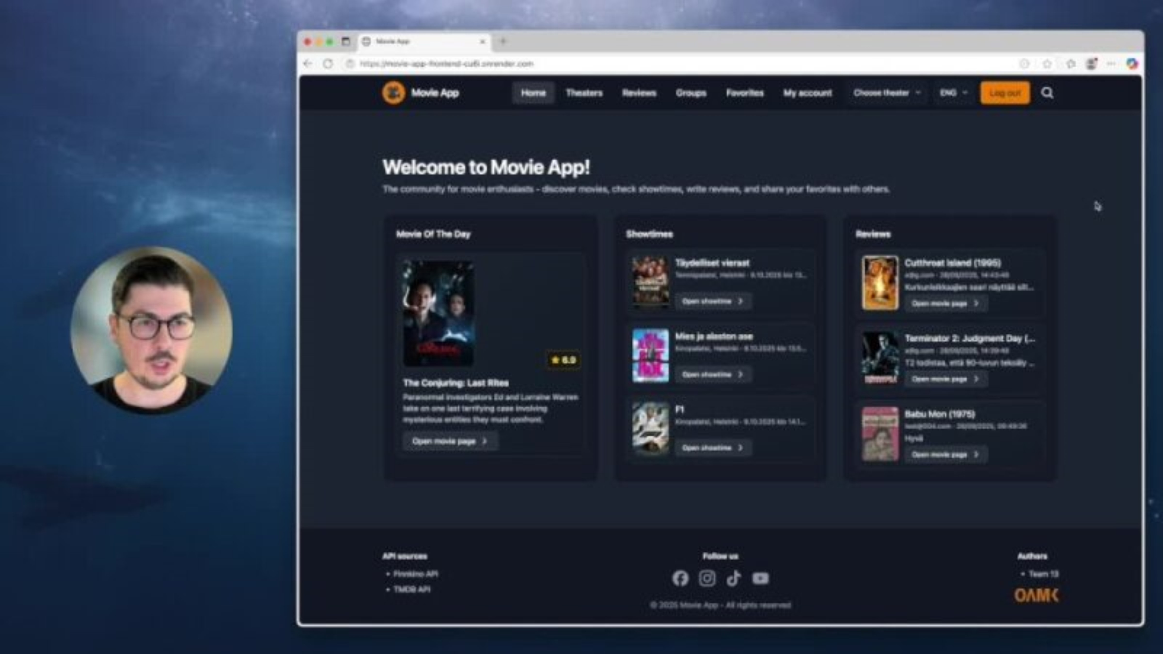
Andreas - UI, Search, Groups, Reviews, Auth (sign up / sign in), REST API tests, Deployment (VIDEO 3:00-3:30)
Duration: 4:32​
Fallback (MP4): https://unioulu-my.....

Slide 6
Fallback link: Sara-MovieApp-Esittely.mp4

Slide 7
15 feature checklist
 | Feature | Status
1 | Responsive UI | ✅
2 | Sign-up | ✅
3 | Sign-in / Sign-out | ✅
4 | Delete Account | ✅
5 | Search | ✅
6 | Showtimes | ✅
7 | Group Page | ✅
8 | Group Page (add member) | ✅
9 | Group Page (remove member) | ✅
10 | Group Page (customization) | ✅
11 | Reviews | ✅
12 | Browse reviews | ✅
13 | Favorites List | ✅
14 | Share Favorites List (public link) | ✅
15 | Optional feature (English / Finnish localization) | ✅
+ | Bonus feature: password change | ✅
+ | REST API testing & deployment | ✅

Slide 8
Lessons learned
Using real APIs (TMDB & Finnkino)
Building secure login with tokens
Writing and testing REST APIs
Following Scrum and weekly sprints
Turning ideas into a real web app

Slide 9
Summary
Movie App is:
Choose faster (search with filters, local showtimes)
Choose together (groups, shared favorites, quick reviews)
Built and shipped right (secure auth, account and data deletion, Render deploy, tested REST)
15/15 requirements delivered

Slide 10
Thank you!
Questions or feedback?
https://movie-app-frontend-cu6i.onrender.com

