Slide 1
Predictive Maintenance of Industrial Machinery
CAPSTONE PROJECT
Presented By:
A.SARA FATHIMA – AALIM MUHAMMED SALEGH COLLEGE OF ENGINEERING – B.TECH ARTIFICIAL INTELLIGENCE AND DATA SCIENCE

Slide 2
OUTLINE
Problem Statement (Should not include solution)
Proposed System/Solution
System Development Approach (Technology Used)
Algorithm & Deployment
Result (Output Image)
Conclusion
Future Scope
References

Slide 3
Problem Statement
Industrial machinery is prone to unexpected failures such as tool wear, overheating, or power issues, leading to unplanned downtime, increased maintenance costs, and reduced operational efficiency. Traditional maintenance methods are often reactive rather than preventive. This project aims to develop a predictive maintenance model that leverages real-time sensor data to anticipate potential machine failures. By analyzing patterns in operational data, the model will classify and predict the type of failure in advance, enabling proactive maintenance and significantly reducing downtime and costs across the fleet.

Slide 4
Proposed Solution
The proposed system aims to address the challenge of predicting potential failure in industrial machines to enable timely maintenance and minimize downtime.
Data Collection:
Gather historical and real-time sensor data from machines, including temperature, vibration, power usage, and operating hours.
Integrate additional contextual data such as machine work load, usage frequency, and environmental conditions to improve prediction accuracy.
Data Preprocessing:
Clean and preprocess the collected data to handle missing values, outliers, and inconsistencies.
Perform feature engineering to extract meaningful features (e.g., abnormal vibration levels, heat trends) that may indicate potential failures.
Machine Learning Algorithm:
Implement a machine learning classification model (e.g., Random Forest, SVM, or Neural Network) to predict the type of failure (e.g., tool wear, overheating, power failure)..
Incorporate influential factors like sensor trends, machine runtime, and load levels to enhance model performance.
Deployment:
Develop a user-friendly interface or dashboard to show real-time predictions and alerts to the maintenance team.
Deploy the solution on a scalable platform using IBM Cloud (Free Tier) to ensure accessibility, uptime, and performance.
Evaluation:
Assess the model's performance using appropriate classification metrics such as Accuracy, Precision, Recall, and F1-Score.
Continuously monitor and fine-tune the model based on performance feedback and real-time results to maintain high prediction reliability.

Slide 5
System Approach
The "System Approach" section outlines the overall strategy and methodology for developing and implementing the predictive maintenance system.
System requirements
Library required to build the model
IBM Cloud account
IBM Watson Studio for model development and deployment
IBM Cloud Object Storage for storing datasets
IBM Watson Machine Learning service for training and deploying models
pandas, numpy – Data handling & computation
matplotlib, seaborn – Data visualization
scikit-learn, xgboost/lightgbm – Model building
ibm_watson_machine_learning – Model deployment
joblib – Model saving/loading

Slide 6
Algorithm & Deployment
Algorithm Selection: A Random Forest classifier is used for predicting the type of machine failure (e.g., tool wear, overheating). It was selected for its high accuracy, ability to handle structured sensor data, and robustness to noise.
Data Input: The model uses real-time and historical sensor data such as temperature, vibration, power consumption, machine runtime, and maintenance logs to detect failure patterns.
Training Process: The model is trained using labeled historical data. Techniques like train-test split, cross-validation, and hyperparameter tuning (using GridSearchCV) are applied to improve performance and generalization.
Prediction Process: After training, the model processes incoming sensor data to predict failure types in real-time, allowing timely alerts and preventive maintenance to avoid costly downtimes.

Slide 7
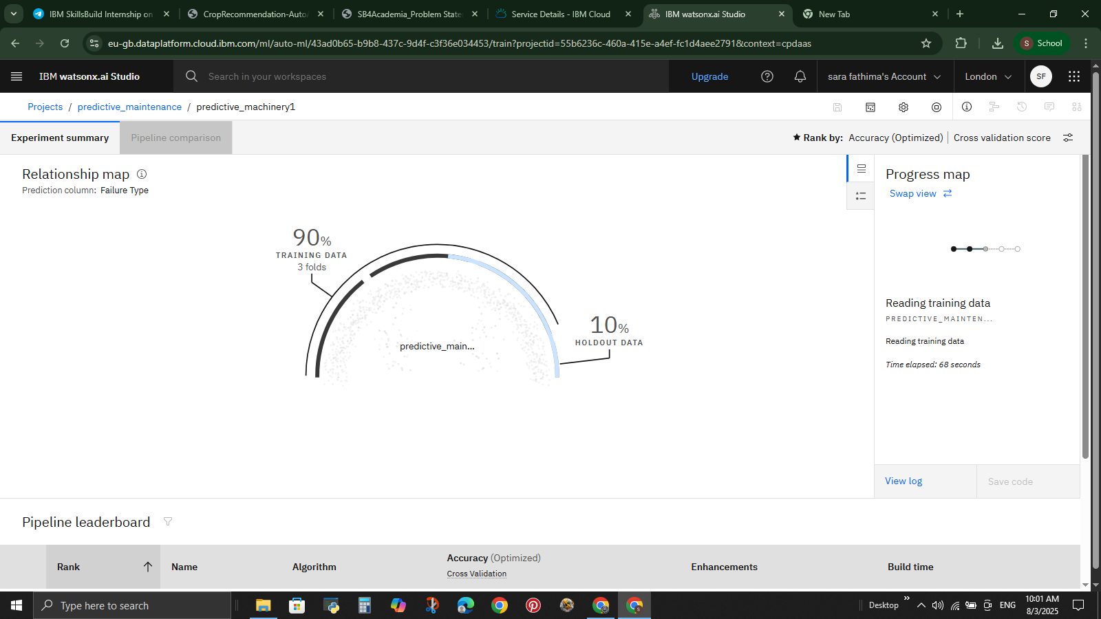
Result

Slide 8
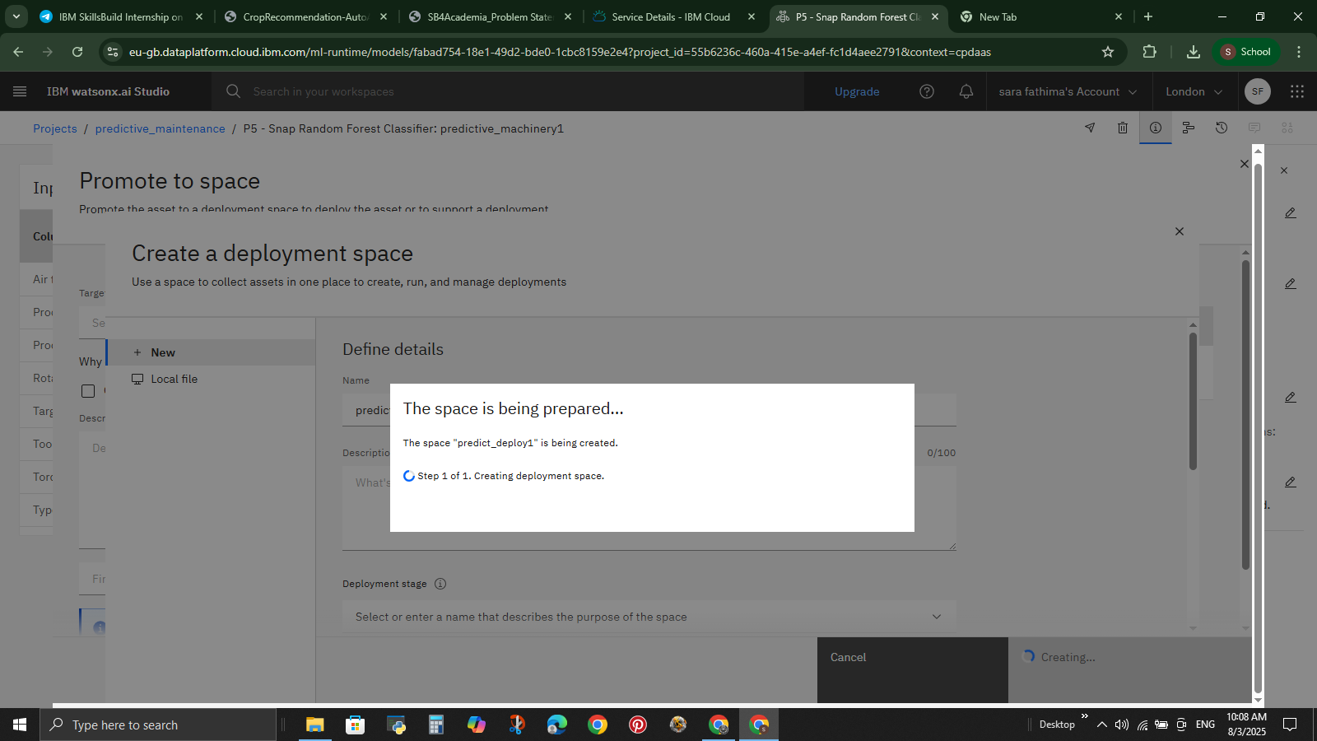

Slide 9
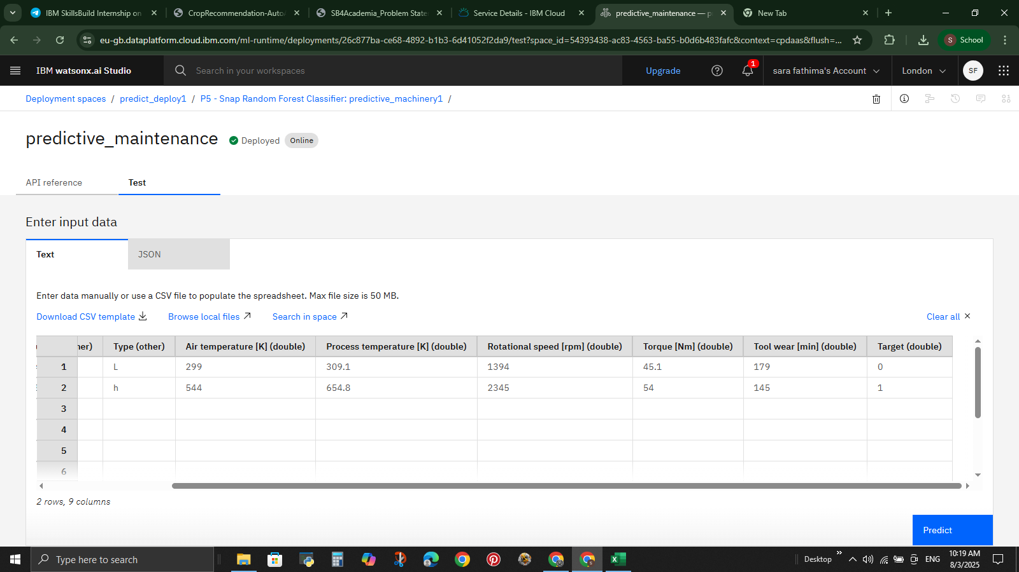

Slide 10
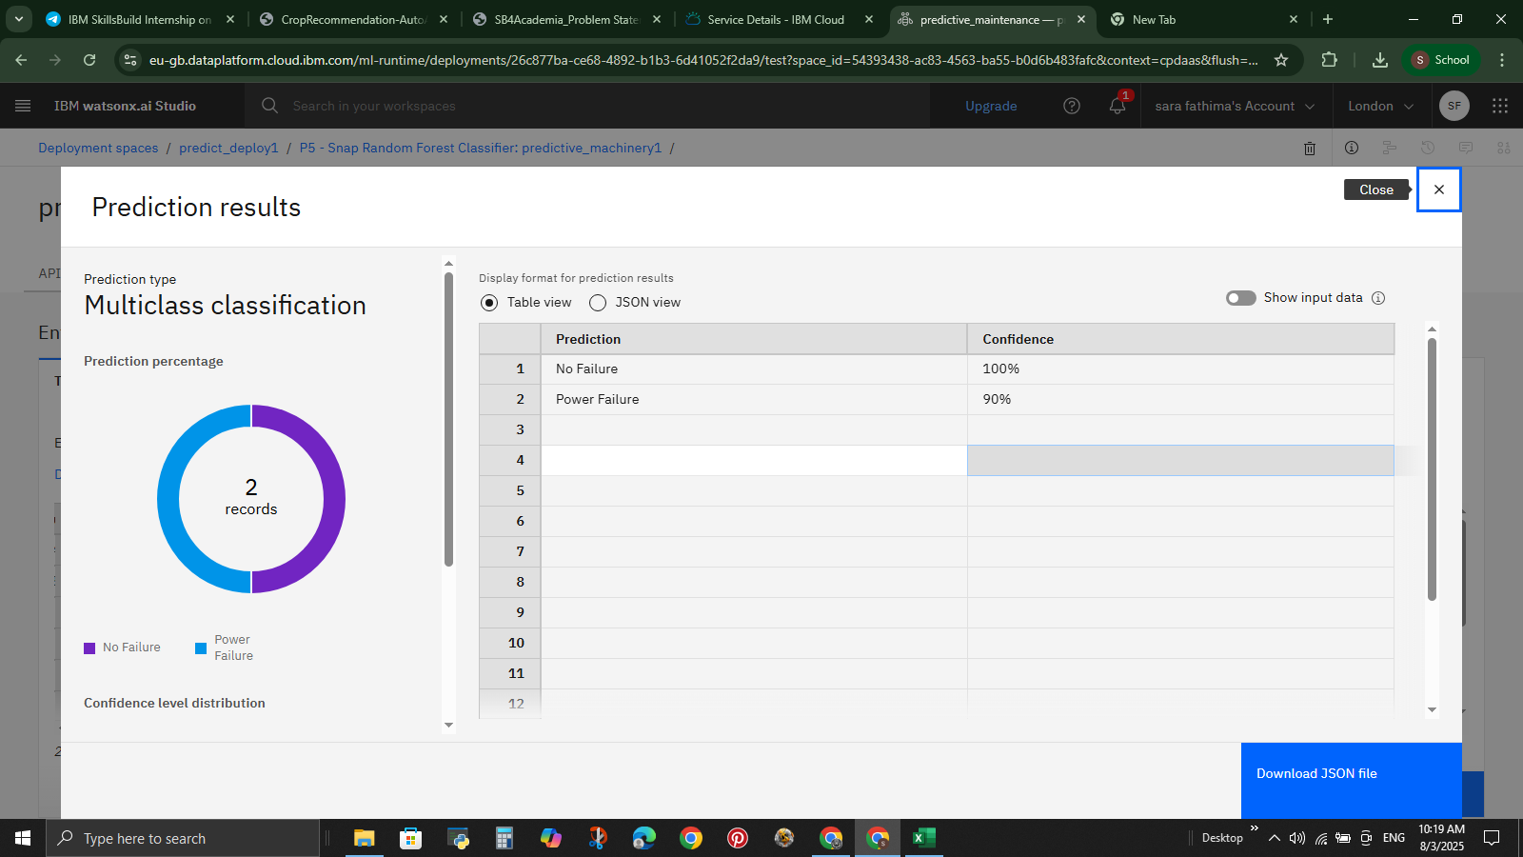

Slide 11
Conclusion
The IBM Watsonx.ai platform enabled accurate failure prediction using a Random Forest Classifier. The model achieved high precision in identifying power failures and no-failure cases. This approach enhances maintenance efficiency and reduces downtime. Future work can include real-time data integration and broader failure coverage.

Slide 12
Future scope
Add more data sources (e.g., environment, operator logs)
Use advanced ML models (e.g., XGBoost, LSTM)
Enable real-time prediction with edge computing
Expand system to multiple locations/factories
Automate model retraining with new data
Improve dashboard with insights and alerts

Slide 13
References
Susto, G. A. et al. (2015). Machine Learning for Predictive Maintenance, IEEE.
Zhang, W. et al. (2019). Data-driven Methods for Predictive Maintenance, IEEE Systems Journal.
Breiman, L. (2001). Random Forests, Machine Learning.
IBM Cloud Docs – Watson Machine Learning.
Scikit-learn Documentation – Modeling & Preprocessing.
Tsai, C. F. et al. (2010). Feature Selection Methods, Decision Support Systems.

Slide 14
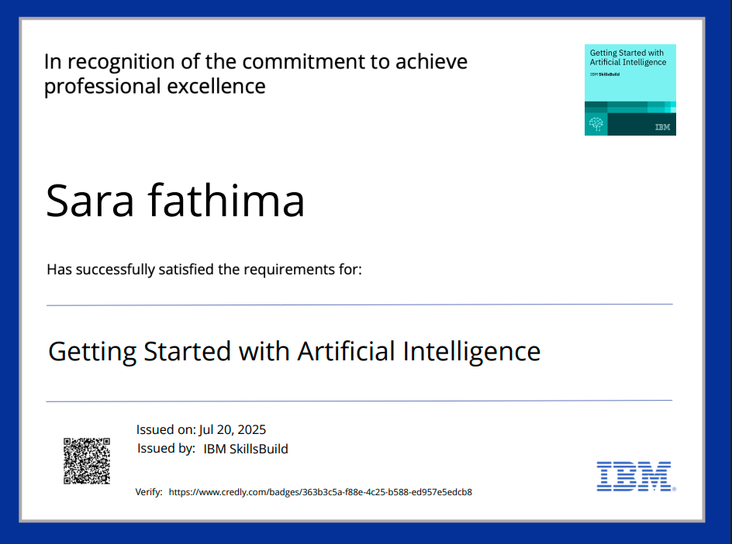
IBM Certifications

Slide 15
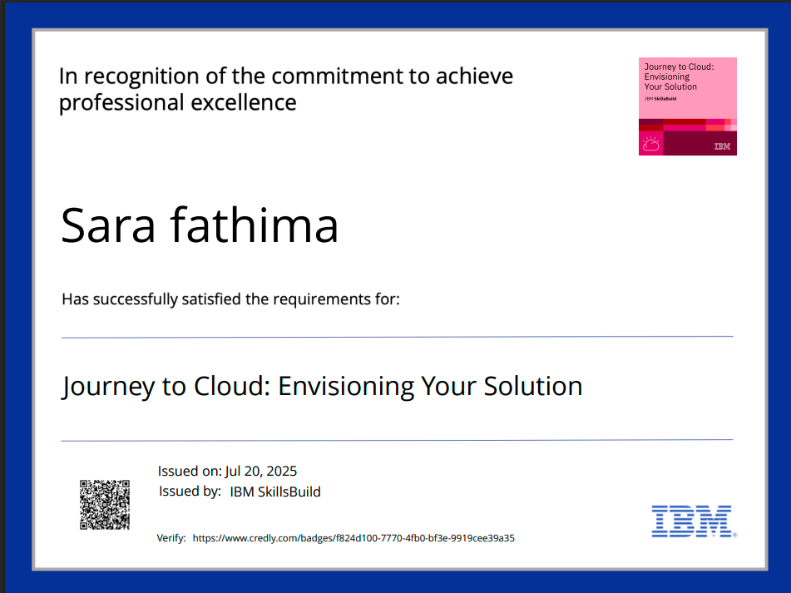
IBM Certifications

Slide 16
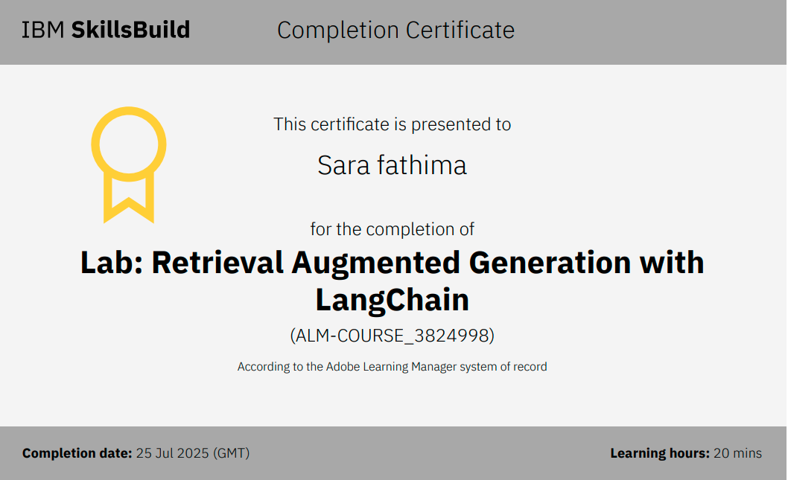
IBM Certifications

Slide 17
THANK YOU

