Slide 1
Employee Data Analysis using Excel
STUDENT NAME: Sarulatha. P
REGISTER NO: 312211264 (3E87AF61CB1C223AF3643C816D7B8)
DEPARTMENT: Bachelor of Commerce
COLLEGE: DR.MGR Janaki College of Arts and Science for Women

Slide 2
PROJECT TITLE
Employee Performance Analysis using Excel

Slide 3


AGENDA
Problem Statement
Project Overview
End Users
Our Solution and Proposition
Dataset Description
Modelling Approach
Results and Discussion
Conclusion
3/21/2024 Annual Review

Slide 4

PROBLEM STATEMENT - Develop a standardized performance evaluation framework - Identify key performance indicators (KPIs) and metrics - Analyze relationships between performance, engagement, and retention. -

Slide 5

PROJECT OVERVIEW - Develop a data-driven approach to analyze and improve employee performance - Enhance talent management decisions through actionable insights - Increase employee engagement, retention, and overall business performance
.

Slide 6

WHO ARE THE END USERS? HR business partners, Line Managers, Employees, Senior Leadership, Talent Management Team, Analytics Team, IT Department, Training and Development Team.

Slide 7

OUR SOLUTION AND ITS VALUE PROPOSITION Develop a consistent evaluation process to ensure fairness and accuracy. Create a centralised platform for data integration, analysis, and visualization.

Slide 8
Dataset Description This dataset contains employee performance data, including demographic information, performance ratings, and talent management metrics.

Slide 9

THE "WOW" IN OUR SOLUTION Assess progress towards goals, objectives, and key performance indicators Determine areas of excellence and areas for improvement. Provide data-driven insights for strategic decisions.
3/21/2024 Annual Review
9

Slide 10
MODELLING
Examine relationships between performance metrics and demographic variables.Identify significant predictors of employee performance.Test hypotheses about differences in performance across groups.
10

Slide 11
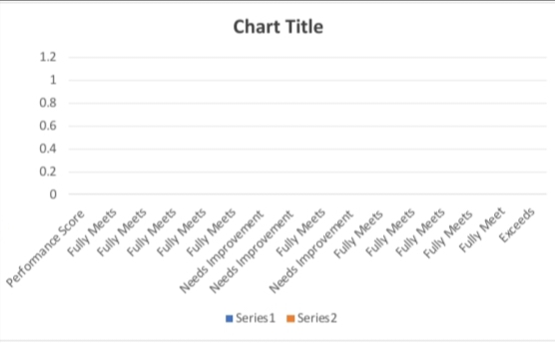
RESULTS
11

Slide 12
Conclusion The employee performance analysis project aimed to develop a data-driven approach to understanding and improving employee performance.

