Slide 1
Ride share application
TEAM NAME : SPRINTERS
TEAM MEMBERS : RASIKA.S
PRIYADHARSHINI.R
SARUMATHI.S
PRATHIBA.S

Slide 2
PROJECT OVERVIEW
Ride Share application is an innovative, AI-powered application exclusively designed for Hexaware employees.
This application aims to streamline the commuting experience by connecting employees who have similar travel routes and schedules
Thereby reducing individual commuting costs, promoting environmental sustainability, and enhancing the overall sense of community within Hexaware.

Slide 3

SCOPE
The scope of this ride-share application is extensive, covering everything from basic ride-booking functionalities to advanced features like real-time tracking, secure payment integration and future enhancements like predictive analytics. The app is designed to be scalable and adaptable to changing market needs with a focus on providing a seamless and secure user experience.

Slide 4
SOLUTION
A user-friendly application connecting riders with drivers seamlessly.
Accessible on multiple devices (desktop, tablet, mobile) with a responsive design.
Frontend: HTML, CSS, JavaScript for a dynamic and responsive user interface.
Backend: Python for server-side logic and database management.
Database: Efficient storage and retrieval of user, ride, and payment data.
Secure data handling, encryption, and compliance with data protection regulations.
Potential for advanced features like predictive analytics, ride-sharing options.

Slide 5
TECHNOLOGIES USED
Frontend: HTML5, CSS3, JavaScript
Backend: Java
Databases: MySQL
Mapping & Location: Google Maps.
Payment Processing: PayPal
Cloud Services: Microsoft Azure
Security:Encryption

Slide 6
GEN AI UTILIZATION
Gen AI Tools in Ride-Sharing
Chatbots
Predictive Analytics (Google
Cloud AI)
NLP (Stanford CoreNLP, SpaCy)
Computer Vision (OpenCV, TensorFlow)
Enhancing:
Demand forecasting
Route optimization
Customer support
Driver behavior analysis
Autonomous vehicles

Slide 7
SYSTEM WORK FLOW
User Side:
Request a Ride
Driver Matching
Track Driver
Ride
Payment
Driver Side:
Login
Receive Request
Accept Request
Pickup
Dropoff
Get Paid
Server Side:
Dispatch
Payment Processing
Support

Slide 8
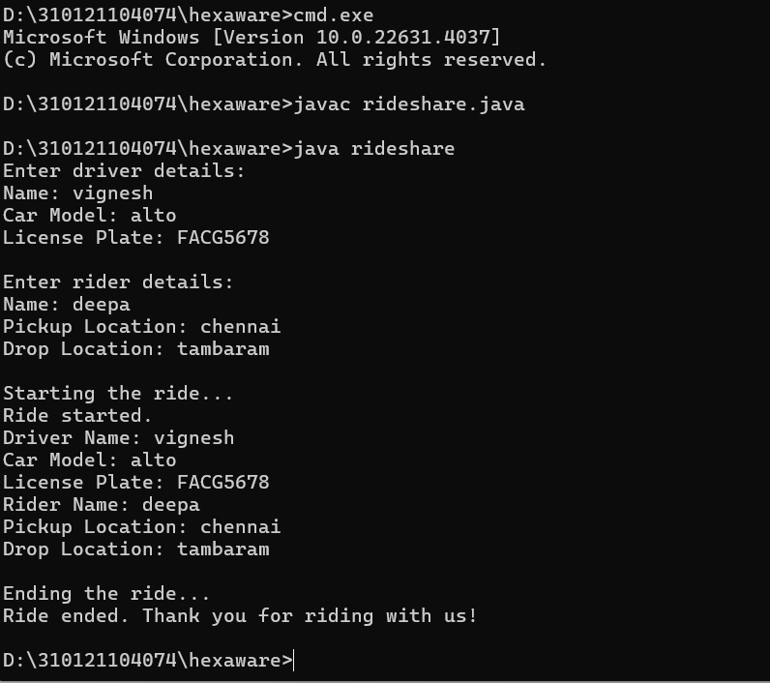
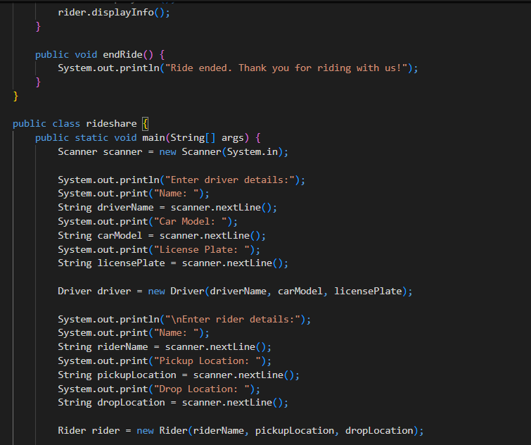
Console output
GITHUB https://github.com/Sarumathi2/Hexaware_SPRINTERS_AIHT.git

Slide 9
KEY FUNCTIONALITIES
User Registration and Authentication: Secure and straightforward processes for users to sign up, log in and manage their profiles.
Ride Booking: Allows users to book rides instantly by selecting their pick-up and drop-off locations.
Payment Integration: Provides accurate fare estimation based on distance and time, with a clear breakdown for users. It supports multiple payment methods, ensuring a secure and flexible transaction process.
Driver and Rider Ratings: Enables a feedback system where both riders and drivers can rate

Slide 10

Best practices and industry standard follows
The rise of ride share applications has created new job opportunities for drivers and stimulated local economies. They also contribute to the gig economy, allowing individuals to earn income flexibly while meeting transportation needs.

Slide 11

CHALLENGES FACED
Despite their advantages, ride share applications face challenges such as regulatory hurdles, competition with traditional transport, and concerns over safety. Addressing these issues is essential for their continued growth and acceptance.

Slide 12

CONCLUSION
Here our team gave just outlook of the application.The UI & working prototype will be discussed in phase 2.While also providing a glimpse into the future roadmap and plans for expansion and growth.

