Slide 1


Slide 2



CODE VERSE HACKATHON 2025
Problem Statement Title- Digital Public Grievance Tracker
Team Name- BlitzCoders
Team Members- Krushna Sidram Jadhav
Sarvadnya Suneet Sonkamble
Gaurav Kailas Walunj

Slide 3
IDEA TITLE
Proposed Solution :
Overview: A platform (web ) for citizens to register complaints, track status, and get updates directly from authorities.
Key Features:
Complaint Registration: With or without personal details (anonymous option).
Complaint Verification Engine: rule-based checks to categorize and prioritize complaints.
Real-Time Tracking: Citizens get notifications for updates and resolution.
Government Dashboard: Authorities can assign, manage, and resolve complaints efficiently.
Analytics & Reports: Helps identify trends, recurring issues, and optimize policy decisions.
Innovation:
BlockChain Technology for complaint verification and prioritization.
Secure anonymous complaint submission.
Data-driven governance insights.
Integrated system for citizens and government officials.

Slide 4
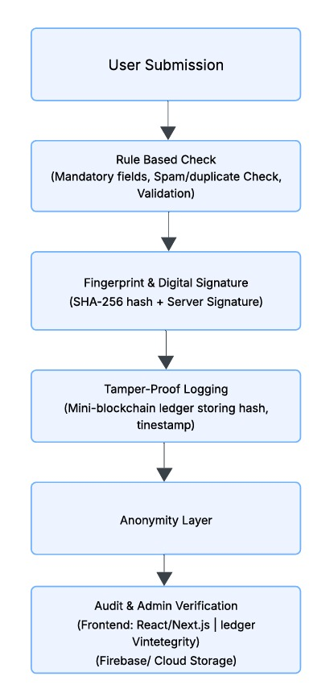
Process Diagram
TECHNICAL APPROACH
Technologies:
Frontend: ReactJS – responsive, interactive UI.
Backend: Node.js – handles APIs, authentication, and complaint management.
Database: PostgreSQL – stores complaints, user info, and analytics data.
Notifications: Firebase – sends SMS, email, and in-app updates.
Cloud Hosting & Security: Google Cloud – scalable, secure, and redundant.
BlockChain Technology : For Verification.
Implementation Steps:
Requirement Analysis – define complaint types, users, workflows.
UI/UX Design – create dashboards for citizens and authorities.
Development – frontend, backend, notifications.
Integration – categorize and prioritize complaints automatically.
Testing – unit, integration, and user acceptance testing.
Deployment – cloud-based secure deployment.
Maintenance – updates, monitoring, feedback integration.

Slide 5
FEASIBILITY AND VIABILITY
Feasibility:
Technical: Uses standard frameworks, scalable cloud hosting.
Operational: Easy to use for citizens and officials; minimal training needed.
Economic: Cost-effective; reduces manual work and operational costs.
Challenges & Risks:
Data privacy issues.
misclassification of complaints.
Low adoption by users unfamiliar with tech.
Server downtime or technical failures.
Mitigation Strategies:
End-to-end encryption, GDPR-compliant.
Hybrid human verification system.
User tutorials, support helpline.
Cloud redundancy, backups, and monitoring.

Slide 6
IMPACT AND BENEFITS
Potential Impact:
Transparent grievance redressal process.
Faster complaint resolution.
Insights for policy-making via complaint trends.
Empowered citizens with a voice.
Key Benefits:
Efficiency – reduces paperwork and delays.
Accountability – authorities monitored through dashboards.
Cost-Effective – automation reduces operational costs.
Scalable – can extend to multiple departments and regions.
Innovative – Using BlockChain technology complaint verification and analytics.
•

