Slide 1
Drug Traceability
Name | Roll No.
Sanket Pardeshi | 324023
Yash Anchule | 324024
Sarvadnya Chiddarwar | 324025
Ayan Sayyad | 324026
SUBJECT: BLOCKCHAIN TECHNOLOGY

Slide 2
Intro
Drug Traceability :
Ability to track the journey of a drug product from its raw materials to the consumer.
Ensuring its authenticity and integrity throughout the supply chain.
Prevent the circulation of counterfeit drugs, which can pose serious risks to patients.
According to the WHO, approximately 10% of the global pharmaceutical market is made up of counterfeit drugs.

Slide 3
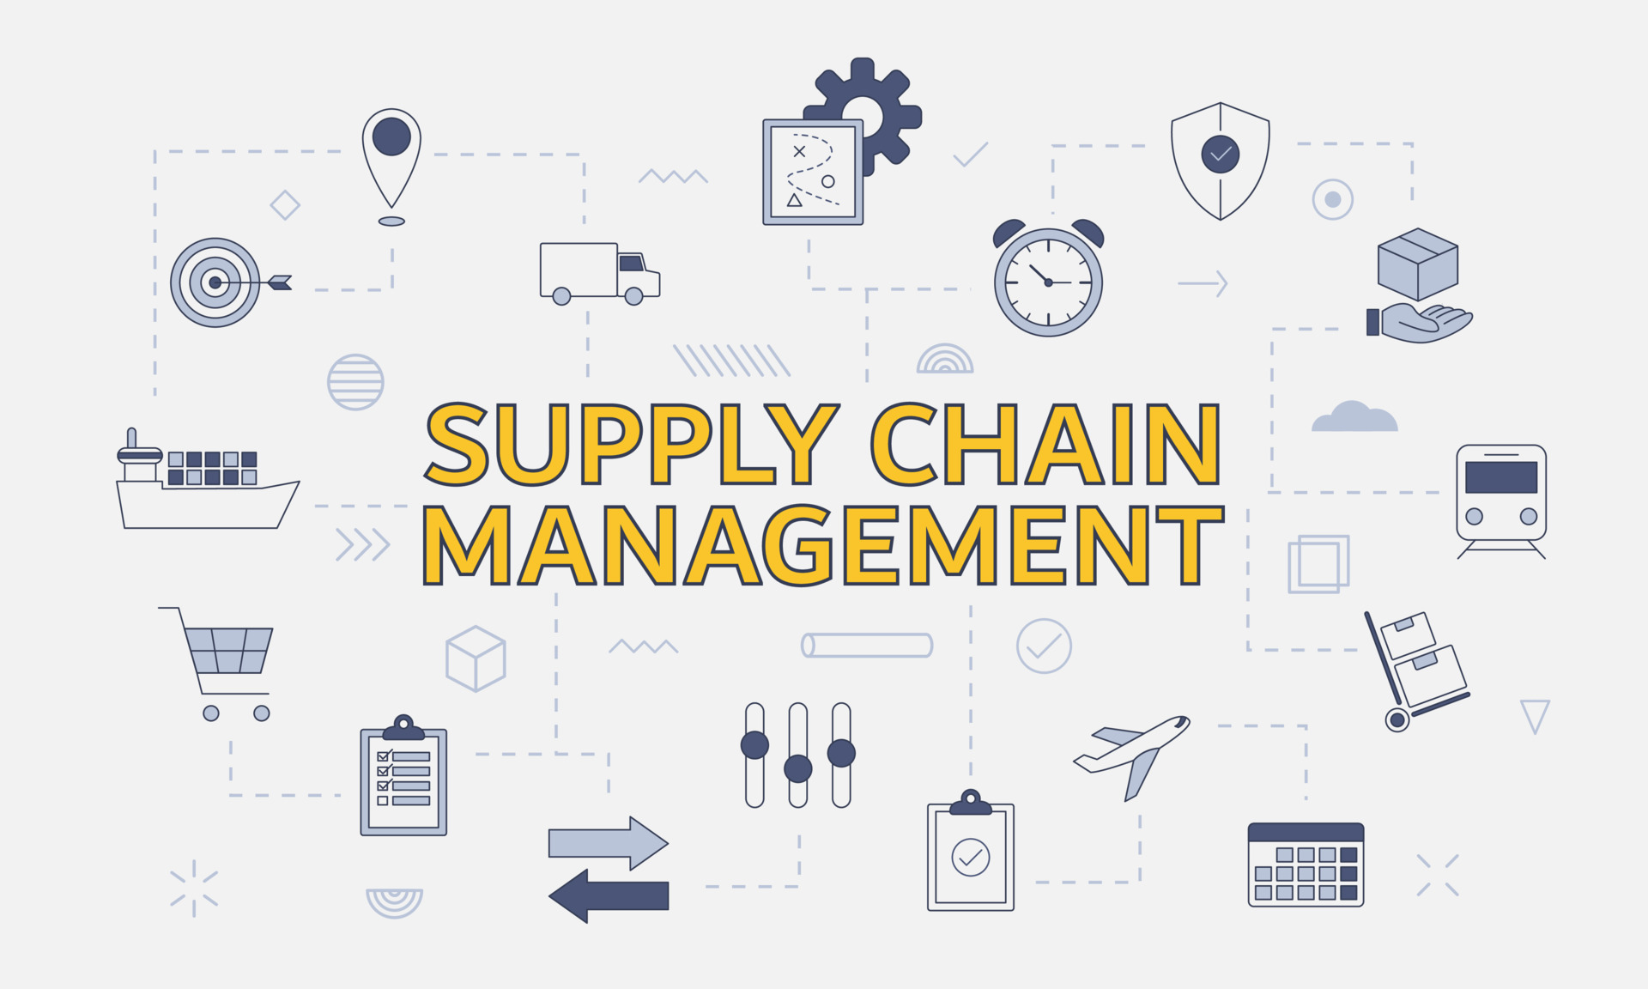
Why Blockchain?
Blockchain provides immutable and transparent record-keeping.
Blockchain technology offers a decentralized network, reducing the risk of fraud and human error.
Blockchain enables secure and efficient data sharing among supply chain partners.
Blockchain-based supply chain solutions increase transparency and accountability, improving the overall efficiency of the supply chain.

Slide 4
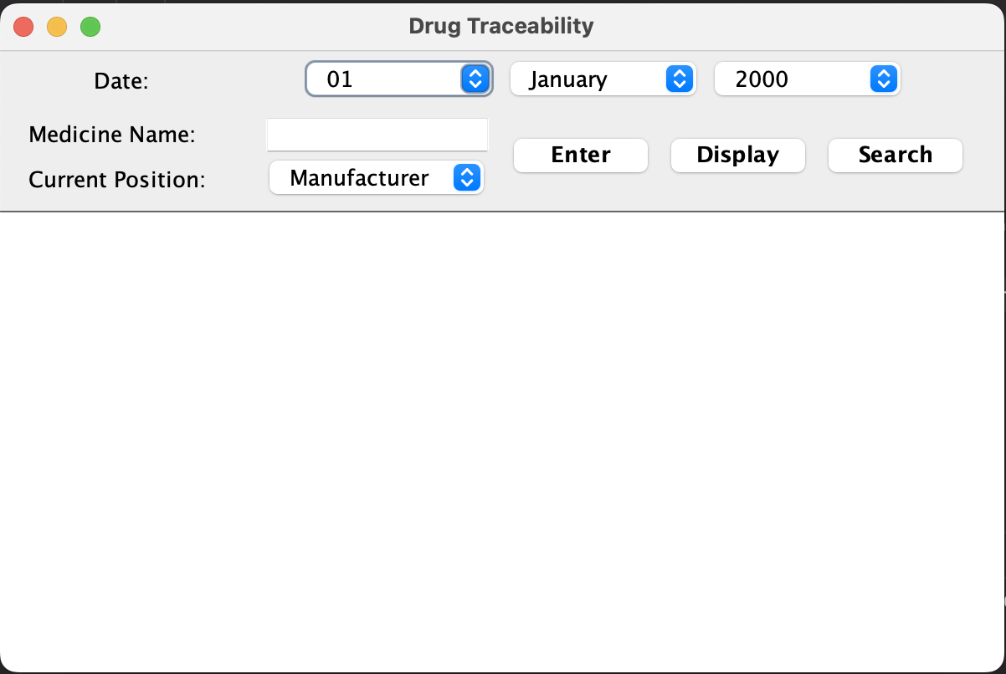
GUI Snapshot

Slide 5
Technology Used
Blockchain
Java
Java Swing

Slide 6
Flow of Program :
Fill in Medicine Name, Select Current Position, Select Date
Click Enter
Data will be stored in variables
Block will be created with Transaction ID as Encrypted form of date
Each block will have Transaction ID, Previous Hash, HashMap of Data Block, timestamp.
Data block will store data about medicine i.e. medicine name, current position, total path.
If more than fixed capacity is added to block, new block will be created.
Click on Display
The complete data stored on blockchain will be displayed
Click on Search
Enter medicine Name
Complete supply chain of the medicine will be displayed

Slide 7
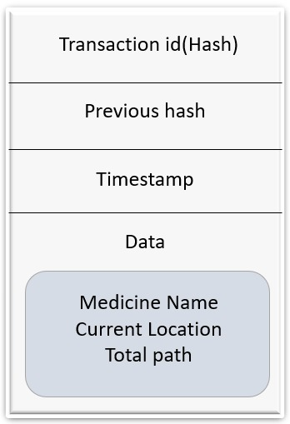
Structure of Block

Slide 8
Steps Snapshots
1.Enter all the details here and Press “Enter”.

Slide 9
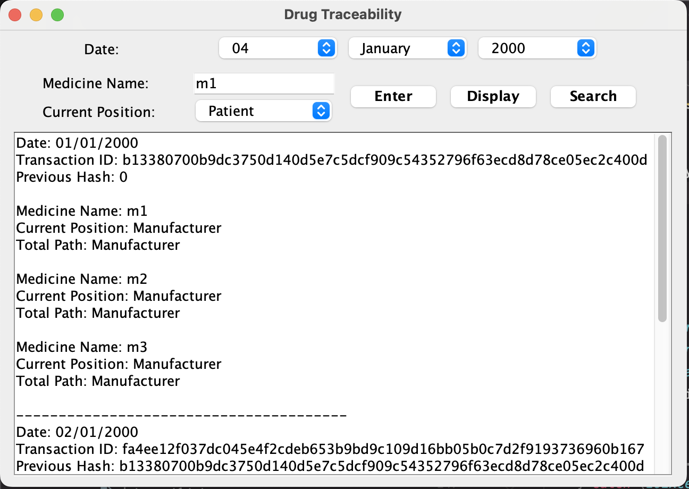
Steps Snapshots
2.Use “Display” to see data.

Slide 10
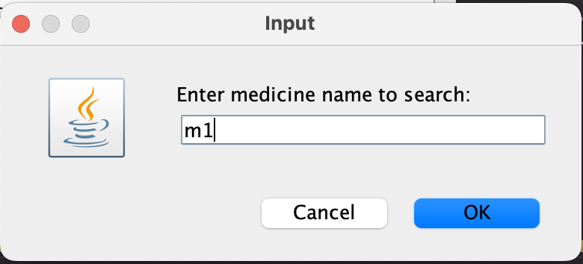
Steps Snapshots
3.Click on “Search” button to open pop up and Enter Medicine Name.

Slide 11
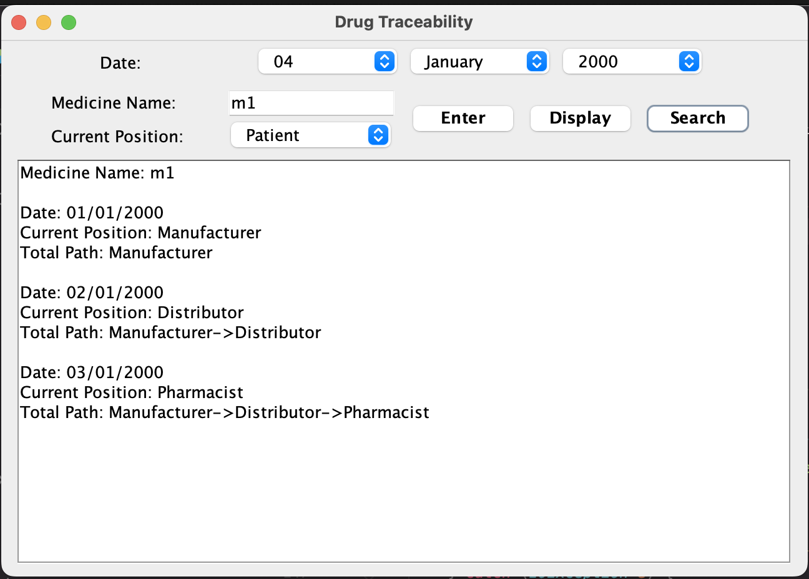
Steps Snapshots
4.Search result will be displayed

Slide 12
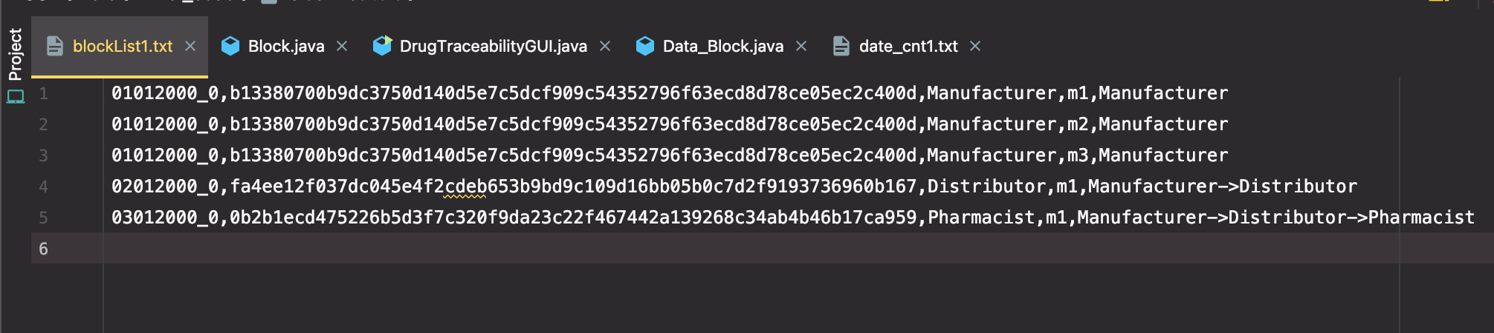
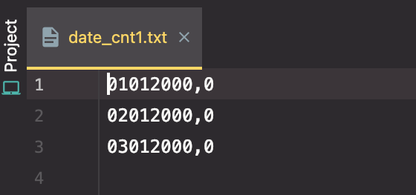
Saved Data
blockList.txt
date_cnt.txt

Slide 13
Applications
Tracking the entire drug supply chain, from manufacturer to patient.
Monitoring the distribution of controlled substances to prevent diversion and abuse.
Ensuring the authenticity of drugs by verifying their origin and production history.
Improving patient safety by reducing the risk of counterfeit drugs entering the supply chain.
Streamlining regulatory compliance by providing a secure and tamper-proof record of drug transactions.

Slide 14
Future Scope
Blockchain can improve clinical trial process by enhancing data sharing, tracking samples, and ensuring data integrity.
Blockchain can manage patient data securely and in a decentralized manner to improve privacy and security of medical records.
Blockchain-based drug traceability can improve transparency and accountability in drug pricing by providing a verifiable record of the drug's journey.
Blockchain can prevent counterfeit drugs by providing a tamper-proof and transparent record of a drug's journey.
Blockchain can ensure regulatory compliance by providing a transparent and verifiable record of a drug's journey from manufacture to distribution.

Slide 15
Conclusion
01
Drug traceability is essential for maintaining the integrity of the pharmaceutical supply chain and ensuring consumer safety.
02
Blockchain technology offers various advantages in drug traceability, such as increased transparency, security, and efficiency.
03
Although there are some limitations to the use of blockchain in drug traceability, ongoing research and development can overcome these limitations in the future.
The future of drug traceability with blockchain technology looks promising and has the potential to revolutionize how we ensure the safety and quality of pharmaceutical products.
04

Slide 16
Thank You

