Slide 1
IOT FUNDAMENTALS
J-COMPONENT REVIEW-2
COURSE CODE: ECE3501

Slide 2
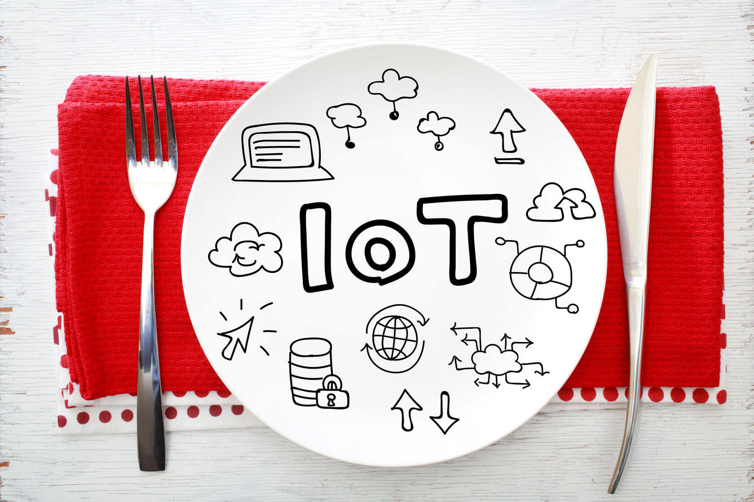
Food quality monitoring system
Sarvagha K - 19MIS0182

Slide 3
CONTENTS
01
04
Objectives of Project
Results and progress
02
05
3 Layer IoT Architecture
Future work plan
03
06
Conclusion and resources
Implementation of techniques/Flowchart
a
a
a
a
a
a

Slide 4
OBJECTIVES:
Utilizing IoT in the food supply chain (FSC) enhances the quality of life by tracing and tracking the food condition and live sharing the obtained data with the consumers or the FSC supervisors.
To ensure food safety it should be monitored at every stage of supply chain. It serves the purpose of preventive consumer health protection by maintaining the required standard ambient conditions needed to preserve the quality of food

Slide 5
3 Layer IoT Architecture
DEVICE LAYER
NETWORK LAYER
APPLICATION LAYER
Devices include DHT11 ,MQ6 and pH Sensor-SEN0161.
Devices are connected to the internet directly or to the gateway, Wi-Fi ESP 8266 which uploads data to cloud server
LCD panel will show the output from the sensor which alerts the consumer Along with the statistics

Slide 6
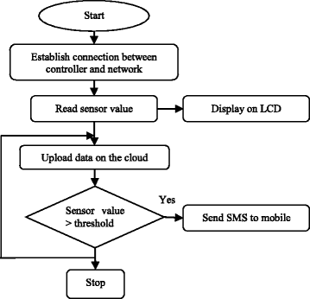
FLOWCHART

Slide 7
Eat clean It’s all about quality, not quantity
“Let your food be your medicine, and your medicine be your food.”
- Hippocrates

Slide 8
IMPLEMENTATION:
TEMPERATURE,HUMIDITY, PH AND TRACES OF CH4
ARDUINO UNO ESPWIFIMODULE,THINKSPEAK IOT ANALYSTICS
APPLICATION WITH DATA OUTPUT

Slide 9
METHODOLOGY:
We have wireless sensor unit to monitor the critical environmental parameters like temperature, humidity, light, moisture etc.
DHT-11 sensor which will senses the humidity and temperature and give it to the Arduino.
Arduino will convert this analog value into digital value compared threshold value.
If the parameter above or below the threshold value then actuators will turn on and
control the temperature. Alarm will be on to turn on.
We have MQ3 sensor detects the emission of ethanol type of gases. If the food/fruits get spoiled, they emit the ethanol type of gases. The MQ3 sensor detects the concentration of such gases and output an analog voltage proportional to the concentration of the gas and also will send message to owner.
We have IR sensor unit, which is used to monitor the stock.

Slide 10
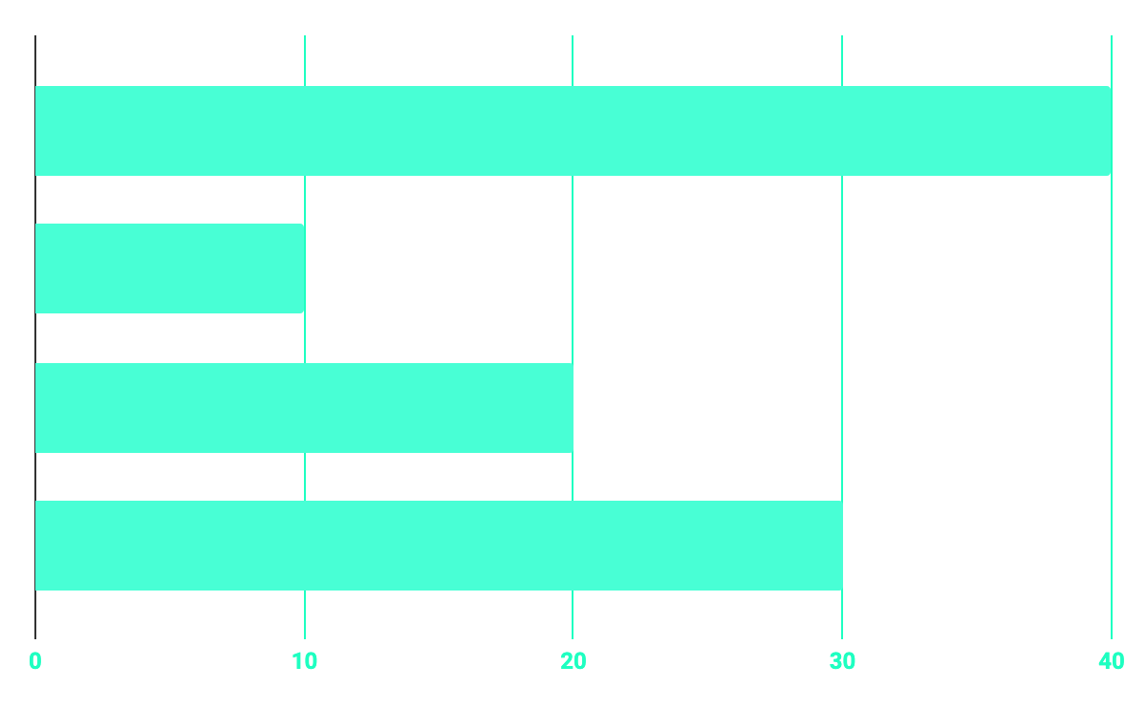
PARAMETERS WITH CONTRIBUTION TO QUALITY
40%
20%
TEMPERATURE
30%
10%
ETHANOL TRACES
HUMIDITY
PH

Slide 11
OUR GOALS
HEALTHY-LIFE
SAFEFTY
QUALITY
Most of the health problems leading to illness or sometimes death is due to eating of unprepared or pink flesh of the animals which when rotted becomes noxious.
Detection gas emission from food items even before the presence of any visible sign of spoilage
Today the health issue is one of the major reasons with effect the human life. The quality of food lies in its cleanliness and sustain for long time.

Slide 12
FUTURE WORK PLAN
CODE THE ARDUINO UNO
CALLIBER THE SENSORS
FINISHED CIRCUIT DESIGN

Slide 13
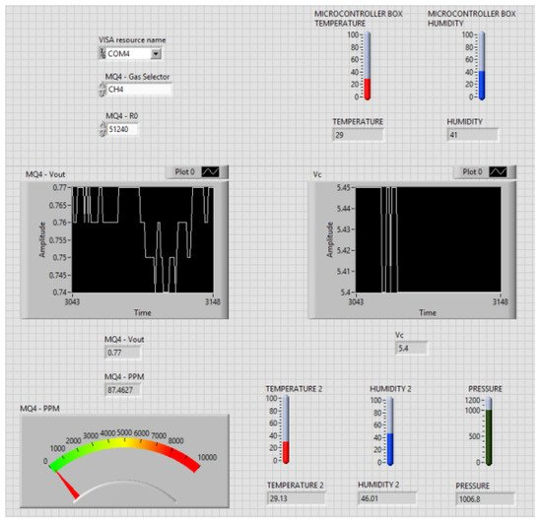
The data acquisition process consists of two stages: The calibration of the sensors and the actual acquisition stage. In the calibration stage, the mathematical model of the MQ gas sensors must be introduced. Each type of sensor has its own behavior, based on the measured gas, identified. For research purposes, a rapid prototype data acquisition interface was developed on a PC. In a future version, because of the widespread use of mobile phones and tablet PCs, the interface will be extended to Android devices. The data acquired from the temperature, humidity and pressure sensors are represented in graphics on the User Interface. The analyzed gas and the specific gas sensor type have to be selected in the interface.

Slide 14
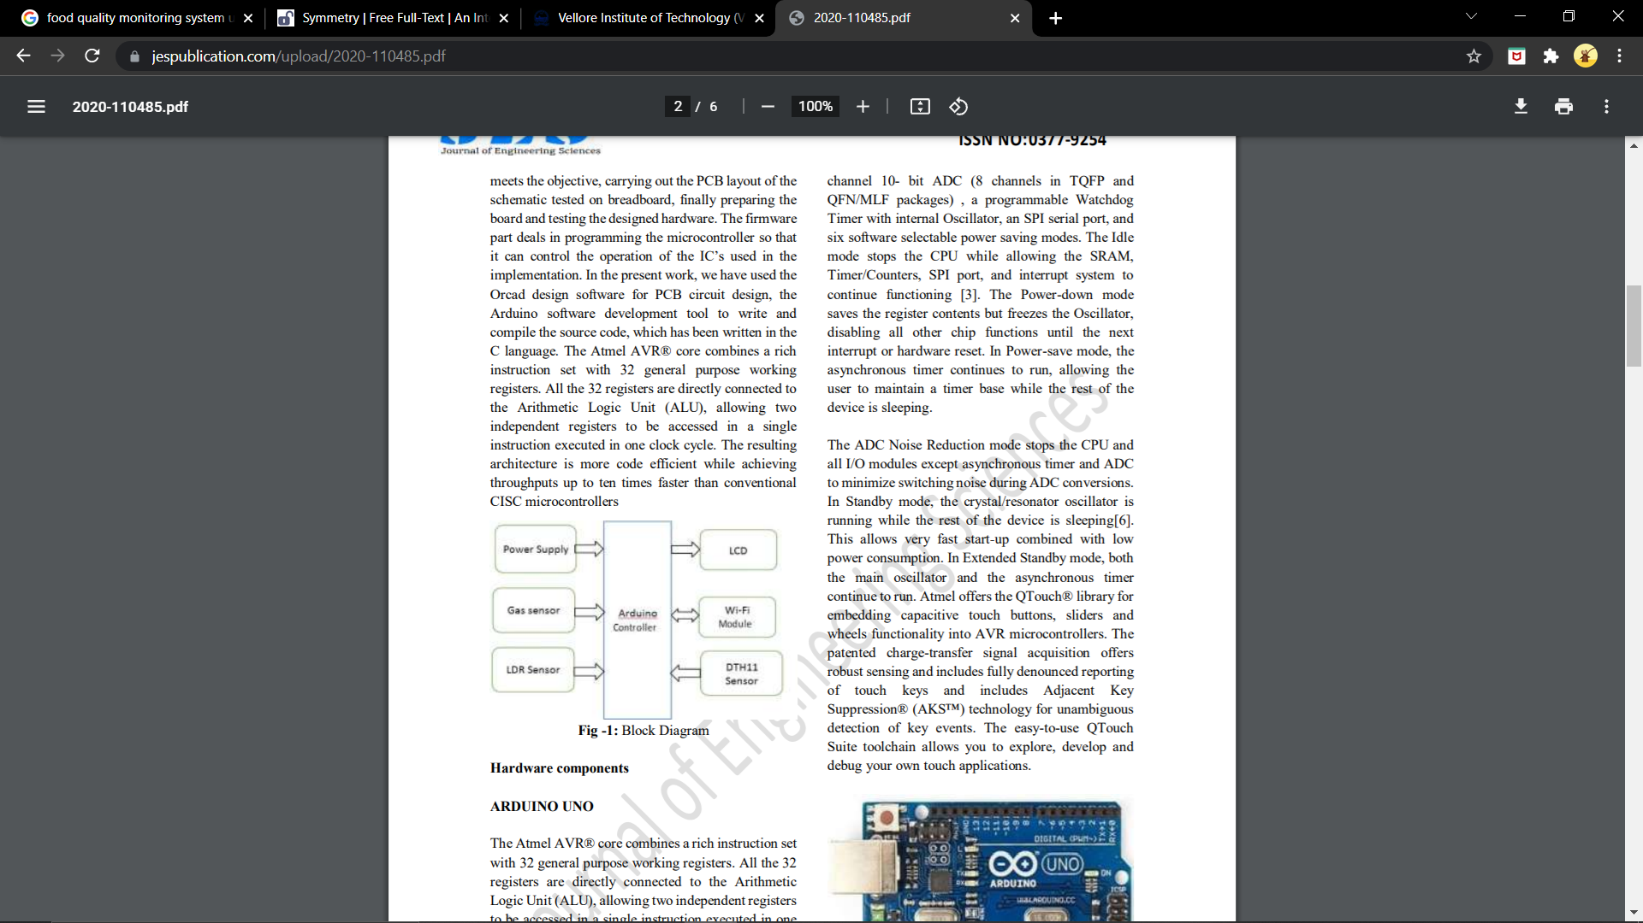
a
We have GSM to communicate with vendor and owner. We have EPS-8266
(wi-fi)module which is used to upload all measured data into the cloud. We use Thing speak cloud, which is freely available. Which will collect the sent data and plot the graph. We can take daily /weekly/monthly report for data analysis. We have LCD display, which displays the status of each sensor LDR Sensor - The LDR is used to sense the intensity of light. The sensor is connected to the A1 pin of the Arduino board. The sensor is connected in a potential divider circuit.

Slide 15
OUR TIMELINE
1
3
TITLE CHOSEN
FINAL
REVIEW
2
4
RESEARCHED PAPERS
REVIEW-2
REVIEW-1 Study on components required
Progress review with completion of circuit

Slide 16
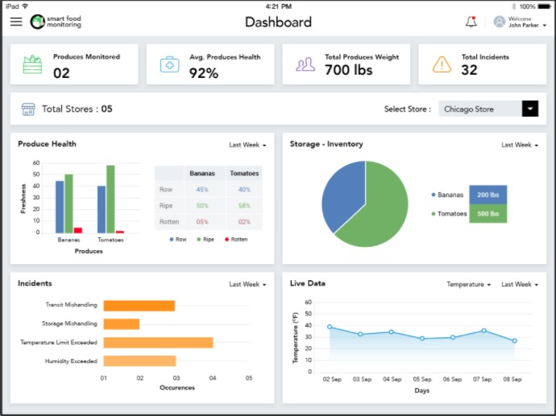
PREDICTED RESULTS
a
a
a
a
a
a
a

Slide 17
PERMISSIBLE LEVEL OF P
H
Item | Approximate pH | Lower range | Upper range
Apple | 3.65 | 3.3 | 4
Avocados | 6.43 | 6.27 | 6.58
Bananas | 4.85 | 4.5 | 5.2
Bananas, red | 4.67 | 4.58 | 4.75
Beans, Kidney | 5.7 | 5.4 | 6
Cabbage | 6 | 5.2 | 6.8
Carrots | 6.14 | 5.88 | 6.4
Carrots, canned | 5.2 | 5.18 | 5.22
Grapes, Lady Finger | 3.55 | 3.51 | 3.58
Onion | 5.8 | 4.8 | 6.8
Potatoes | 5.65 | 5.4 | 5.9
Tomatoes | 4.6 | 4.3 | 4.9
Whole milk | 6.65 | 6.4 | 6.9

Slide 18
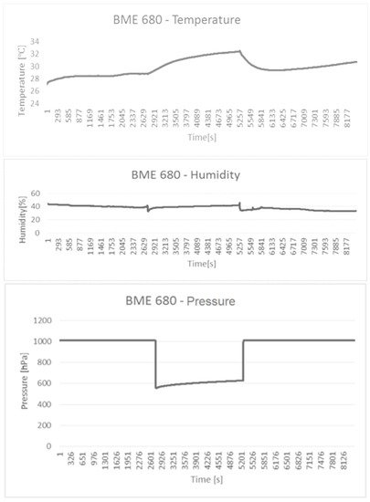
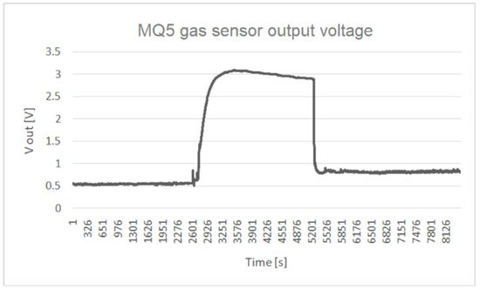
Variation in vacuum container
Variation of the MQ5 gas sensor’s output voltage in vacuum
Humidity and pressure in the empty vacuum container.

Slide 19
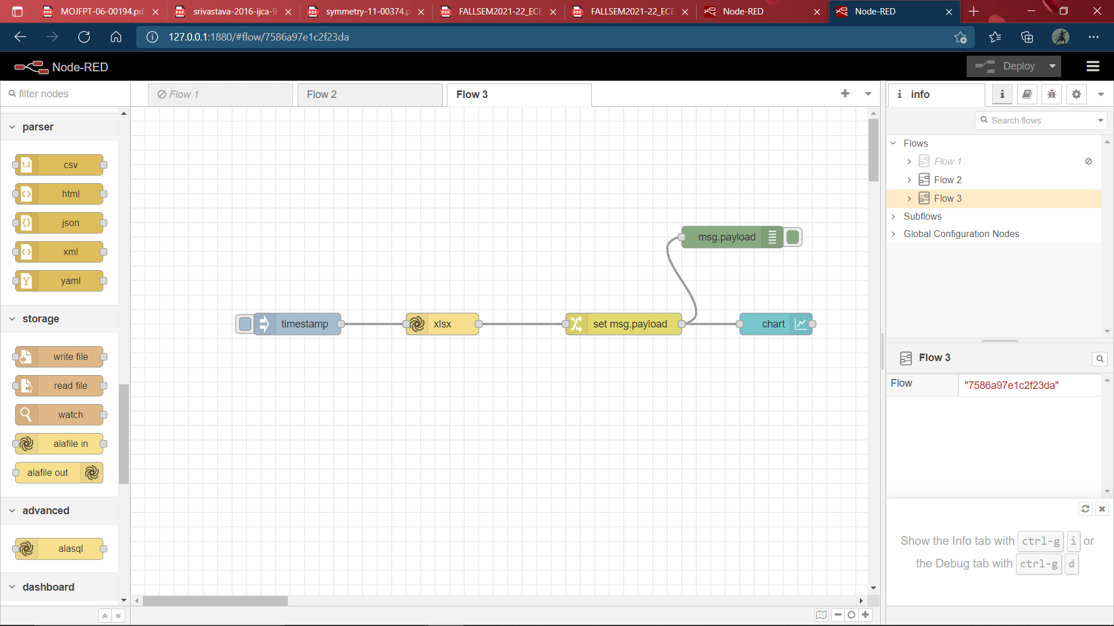
Node red flow

Slide 20
CONCLUSION:
The aging population is a phenomenon occurring not only in India, but also on the other countries. Also, according to the World Health Organization, from a medical point of view, age is associated with many diseases for which there are no effective treatments. However, the same study, showing that the aging population is associated with the increase in the prevalence of the diseases and specific related symptoms, indicates that all these could be delayed by the adoption Symmetry of a healthy lifestyle. In this context, our study contributes to increase the quality of life, through the use of intelligent sensor networks to warn the aged individuals when a food expires, or when certain properties of the food packaging are altered. In this article, we presented a portable system for monitoring vacuum packed foods.
The Internet of Things facilitates a numerous benefits to the society and from our project we can provide and prove the strength of IoT using the Thing speak API that is capable to contribute the services for the purpose of building vast number of IoT applications and help to implement them on the public platform. This Design Provide an Moderate and less expensive way of Sensing and Monitoring system in the field of Domestic and as well industrial standards to implement the IoT .

Slide 21
REFERENCE:
Ee Lim Tan, Wen Ni Ng, Ranyuan Shao, Brandon D. Pereles and Keat Ghee Ong,” A Wireless,Passive Sensor for Quantifying Packaged Food Quality”, Full Research Paper
An Intelligent IoT-Based Food Quality Monitoring Approach Using Low-Cost Sensors Alexandru Popa 1 , Mihaela Hnatiuc 2 , Mirel Paun 2 , Oana Geman 3 , D. Jude Hemanth 4 , Daniel Dorcea 2 , Le Hoang Son 5,6,* and Simona Ghita
Ki-hwan Eom, Chang Won Lee, Nghia Truong Van, Kyung Kwon Jung, Joo Woong Kim And Woo Seung Choi “Food Poisoning Prevention Monitoring System Based On The Smart RFID Tag System”
FOOD SAFETY AND STANDARDS (FOOD PRODUCTS STANDARDS AND FOOD ADDITIVES) REGULATIONS, 2011MINISTRY OF HEALTH AND FAMILY WELFARE (Food Safety and Standards Authority of India)
Dr.M.S.Saravanan, Jeyanta Kumar Singh, N.Thirumoorthy “RFID Sensors for Food Safety Centre by Identifying the Physical Factors that Affecting the Food”.

