Slide 1
AWS Bedrock AgentCore
By: Sarvagya Meel

Slide 2
AWS Amazon Bedrock AgentCore
Agenda
What is AgentCore?
Why AgentCore needed?
Core concepts
Runtime Overview
Integration Flow
POC implementation plans
Pricing units

Slide 3
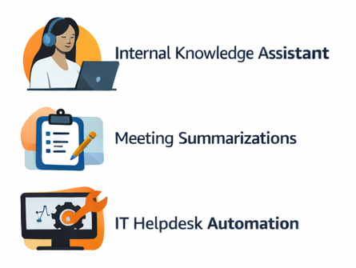
What is AgentCore?
Example use cases:
How you pay (units)
Runtime/Browser/Code Interpreter: vCPU-hour + GB-hour
Gateway: invocations/search/indexing
Memory: events/records/retrievals
Obs & Evals: telemetry + tokens
What it is
Managed platform to build, deploy, and operate AI agents at scale
Composable services can be used together or independently
Core AgentCore services/Capabilities
AgentCore Runtime — Secure, serverless environment to host and run agents/tools without managing infrastructure.
AgentCore Memory — Managed memory system for short-term and long-term context retention (including strategies for how memory is stored/retrieved).
AgentCore Gateway — Converts APIs/Lambda services into MCP-compatible tools and connects to existing MCP servers so agents can discover/invoke tools via a secure endpoint.
AgentCore Identity — Agent identity + access management, designed to help agents securely access AWS and third‑party services.
AgentCore Observability — Monitoring/tracing for agent execution and performance; integrates with CloudWatch and supports OpenTelemetry-style telemetry.
Policy (Preview) — Deterministic control over agent tool actions, enforced via Gateway by intercepting tool calls before execution.
Evaluations (Preview) — Managed evaluation of agent behavior/quality with built-in + custom evaluators (integrated into monitoring).

Slide 4
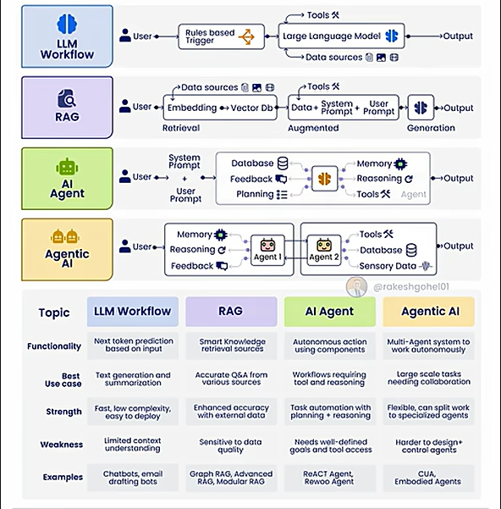
Why AgentCore?
Why the need?
Faster path from prototype to production
Standardized governance and operations
Measurable quality and production visibility

Slide 5
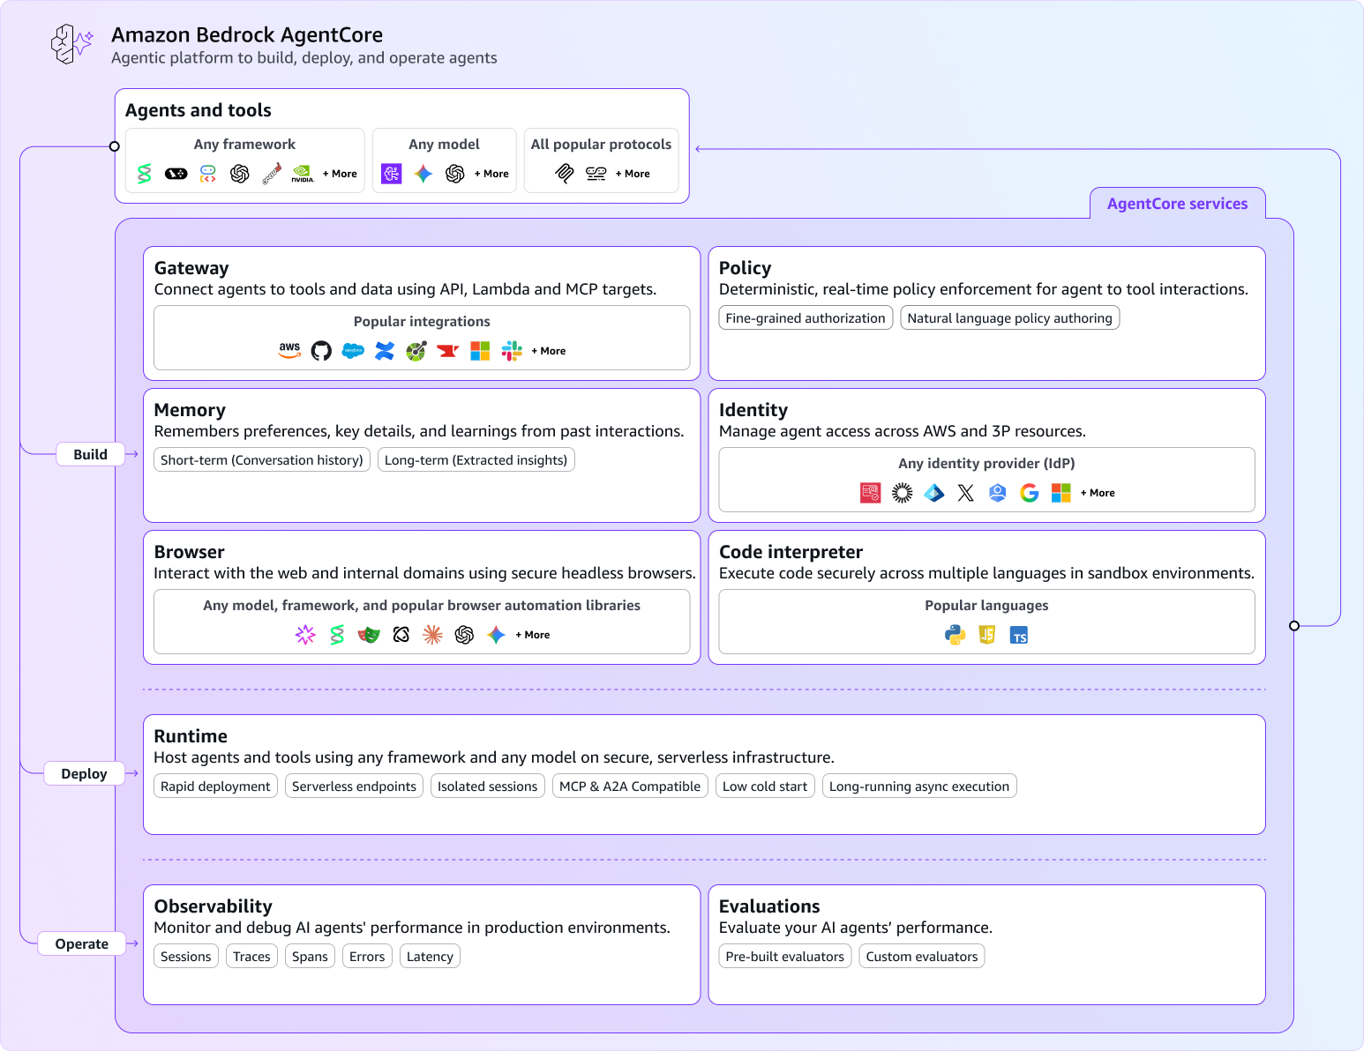
AgentCore — Core concepts
Notes:
“This slide shows why AgentCore is more than a single ‘agent feature’—it’s a modular platform you can adopt incrementally. Each box is a service you can use together or independently, depending on your agent maturity.” [aws.amazon.com]
“At the center is Runtime—a secure, serverless place to run agents and tools with production needs like scaling and session isolation, so teams don’t have to build agent hosting infrastructure from scratch.” [aws.amazon.com]
“Then you add capabilities around it: Gateway is how agents safely call enterprise tools—APIs, Lambda, or MCP tools—through a centralized endpoint. And Policy sits with Gateway to enforce rules deterministically by intercepting tool calls before execution—so control isn’t just ‘in the prompt.’” [aws.amazon.com], [aws.amazon.com]
“For better user experience, Memory gives agents short-term and long-term context and can support experience-based learning patterns, so the agent improves continuity across sessions.” [aws.amazon.com], [aws.amazon.com]
“For enterprise access, Identity integrates with existing identity providers, so agents can securely act on behalf of users without rewriting auth.” [aws.github.io], [aws.amazon.com]
“Finally, to operate this in production: Observability provides end-to-end tracing and monitoring via CloudWatch and OpenTelemetry-compatible telemetry, and Evaluations helps continuously score quality—like correctness and safety—so we can measure performance and detect regressions.” [aws.amazon.com], [aws.amazon.com]
“Net-net: AgentCore provides the building blocks to ship internal enterprise agents that are secure, governed, and measurable—without every team reinventing the platform.” [aws.amazon.com], [aws.amazon.com]

Slide 6
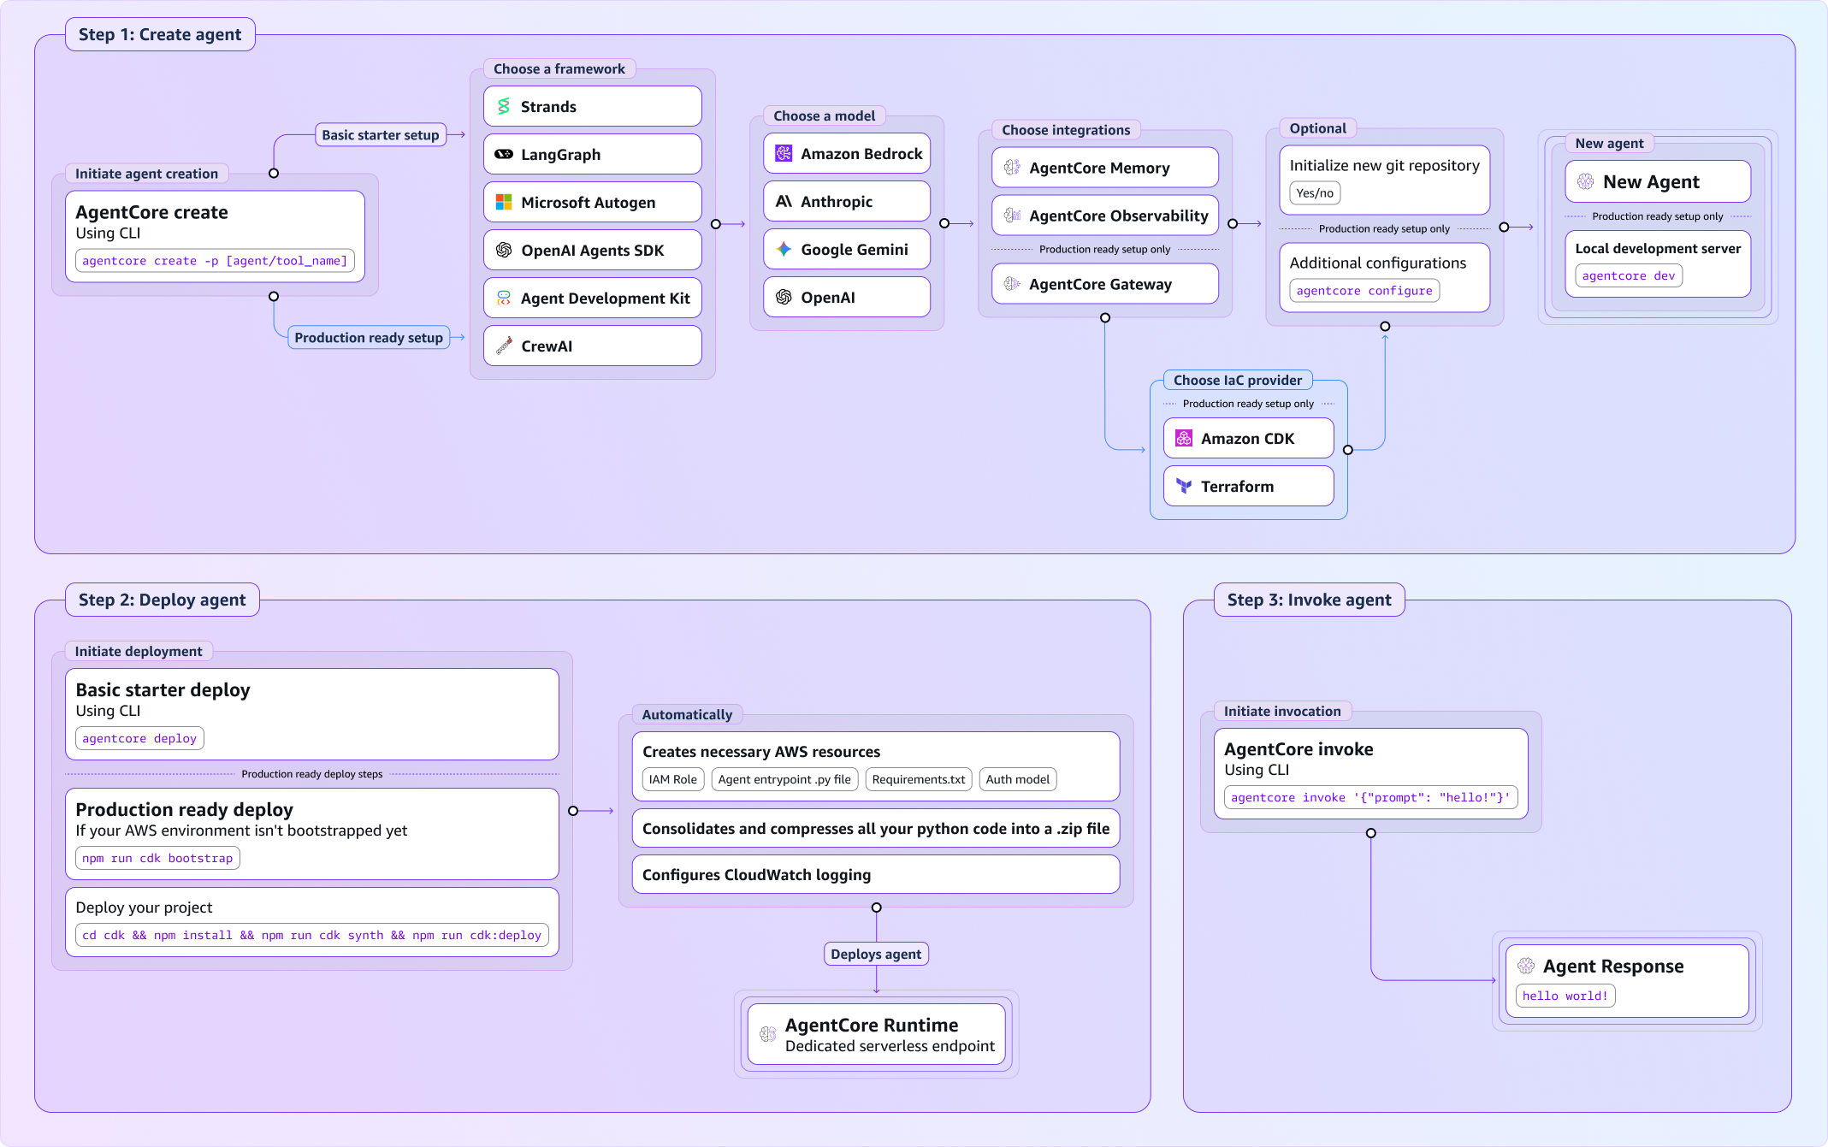
AgentCore — Runtime Overview
Notes:
Framework:
We can use existing langchain , langGraph, CrewAI, deepAgents knowledge from different team members
Model Openai for ask anthropic claude for ms

Slide 7
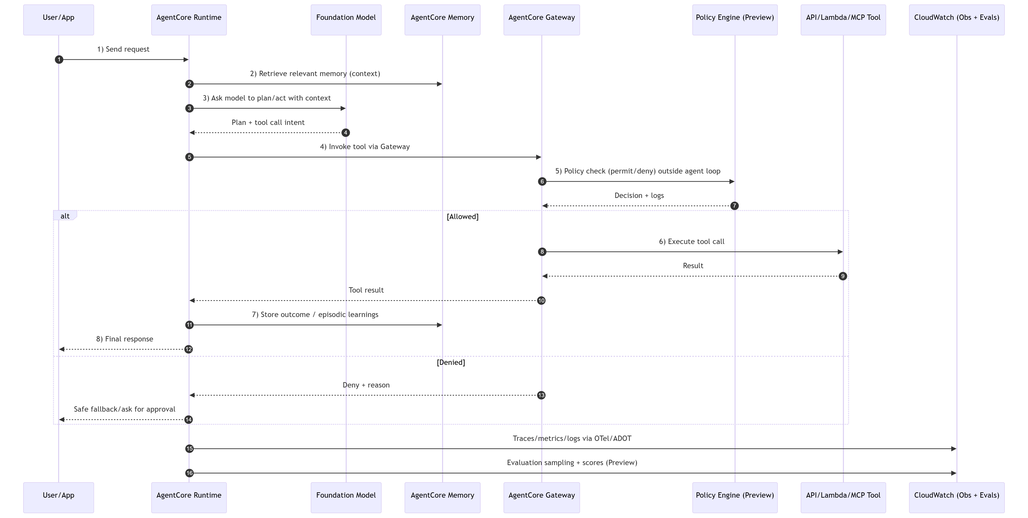
AgentCore - Integration Flow

Slide 8
AgentCore: POC Technical Feasibility Planning
Core POCs
Patterns POCs
POC 1: Knowledge QnA Specialist Agent.
Description: Demonstrates basic agent deployment using Langchain framework on AgentCore Runtime environment.
Dependencies: None
POC 2: Memory as Service.
Description: Implements Model Context Protocol (MCP) server with AgentCore Memory management capabilities on AgentCore Runtime
Dependencies: None
POC 3 : AgentCore Gateway: Tools.
Description: Enables direct tool deployment through AgentCore Gateway using AWS Lambda functions
Dependencies: None
POC 4 : MCP Server, AgentCore Runtime and AgentCore Gateway
Description: Establishes connection between MCP runtime (External or AgentCore hosted) and AgentCore Gateway
Dependencies: None
POC 8 : Agent as a Tool
Description: Wraps the QnA agent from POC 1 as a callable tool accessible through AgentCore Gateway
Dependencies: POC 1
POC 9 : Orchestration
Description: Integrates tool deployment capabilities from Gateway with MCP connectivity to create a fully featured Supervisor agent
Dependencies: POC 3, POC 4
POC 10 : A2A for Multi-Agent
Description: Implements agent-to-agent (A2A) communication patterns and registry enabling multi-agent collaboration on AgentCore
Dependencies: None (conceptually builds on prior POCs)
j
POC 5: AgentCore Identity & Policy
Description: Security, access control, Identity based tool/agent accesses
Dependencies: None (applies to all agents/tools.)
POC 6: AgentCore Observability : observability infrastructure running in parallel to all POC development.
Description: Establishes evaluation framework for assessing agent performance and quality
Dependencies: None (applies to all agents/tools.)
POC 7 : AgentCore Evaluations
Description: Establishes evaluation framework for assessing agent performance and quality
Dependencies: None (applies to all agents/tools.)
Parallel POCs
Notes:
What

Slide 9
AgentCore — Pricing units
Service | Meter (unit) | Price
Runtime | CPU (vCPU-hour), Memory (GB-hour) | $0.0895/vCPU-hr; $0.00945/GB-hr
Browser Tool | CPU (vCPU-hour), Memory (GB-hour) | $0.0895/vCPU-hr; $0.00945/GB-hr
Code Interpreter | CPU (vCPU-hour), Memory (GB-hour) | $0.0895/vCPU-hr; $0.00945/GB-hr
Gateway | Invocations/1,000; Search/1,000; Tool indexing/100 tools/month | $0.005; $0.025; $0.02
Identity | Token/API key requests for non‑AWS resources/1,000 | $0.010 (no addl charge via Runtime/Gateway)
Memory | Events/1,000; Records stored/month; Retrieval/1,000 | $0.25; $0.75 or $0.25; $0.50
Observability | Spans/logs/metrics (CloudWatch) | CloudWatch pricing
Evaluations (Preview) | Built-in: tokens; Custom: eval count | $0.0024/1k in; $0.012/1k out; $1.50/1k
Policy (Preview) | Auth request; NL authoring input tokens | $0.000025/request; $0.13/1k tokens
Note: Observability charges are billed via CloudWatch telemetry ingestion, storage, and queries.

Slide 10
Thank You
Sarvagya Meel

Slide 11
AgentCore — End-to-end reference architecture(IN Development)
Master Agent
User via Teams
APIs / Lambda MCP Tools
AgentCore Identity
ASK Router Agent
AgentCore Gateway
MS Router Agent
Policy (Preview)
New Agents
… future agents
Observability
Evaluations
AgentCore Memory
S5

Slide 12
AgentCore –Phases 1 to 6 implementation plan
Phase 1 — POC
QnA agent on Runtime
Obs + Evals wired
Policy/Identity optional
Phase 2— Summarization Agent
Summarization agent
Identity for Lambda
Policy + Obs + Evals
Phase 3 — Specialist Agents
ASK Router Agent
Meeting Summarization Router Agent
Gateway tool endpoints
Obs + Evals across agents
Phase 4 — Supervisor Agent
Master → ASK/MS router Agents
Gateway tool endpoints
Obs + Evals across agents
Phase 5 — Memory & Identity
Memory strategies on routers
Policy per URL/tool
Identity via Master
Phase 6 — Future Optionals
Summarization Orchestrator Agent
Knowledge Vectorization Agent

Slide 13
POC 1 — Deploy simple QnA LangGraph agent using AgentCore runtime
Scope & deliverables
Description: Demonstrates basic agent deployment using LangGraph framework on AgentCore runtime environmentDevelop and Implement
Deploy on AgentCore Runtime
Enable AgentCore Observability (traces/metrics)
Enable AgentCore Evaluations (quality baselines)
Optional: Enable Gateway
Optional: Integrate Identity
Optional: Integrate Policy where tool actions exist
Users
Runtime (QnA)
Model
Identity (optional)
Obs
Policy
Evals

Slide 14
Phase 2 — MS pipeline (Summarization Agent)
Scope & deliverables
Orchestrator Lambda invokes Summarization agent
Summarization agent developed using current batch LangGraph learnings
Summarization agent hosted on AgentCore Runtime
Integrate Identity for Lambda (as needed)
Enforce Policy for tool/API boundaries
Enable Observability + Evaluations
Orchestrator Lambda
Summarization Agent
NoSql Database
Identity
Evals
Policy
Obs

Slide 15
Phase 3 — Service Agents (ASK Router, MS Router & Other Agents)
Scope & deliverables
Create ASK Router Agent
Deploy AgentCore Runtime
Integrate Gateway endpoints (ASK router URL)
Enable Observability (traces/metrics)
Enable Evaluations (quality baselines)
Enable A2A or MCP
Create MS Router Agent
Deploy on AgentCore Runtime
Integrate Gateway endpoints (MS private APIs)
Enable Observability (traces/metrics)
Enable Evaluations (quality baselines)
Enable A2A or MCP
Create Other Agents
ASK Router Agent
AgentCore Gateway /askRouter URL
MS Router Agent
AgentCore Gateway
/ms-private-gateway URLs
Evaluations
Observability

Slide 16
Phase 4 — Master & Routing pattern (Master → ASK/MS Router Agents)
Scope & deliverables
Create Master Agent
Deploy AgentCore Runtime
Integrate Gateway endpoints (ASK, MS Router Agents)
Enable Observability (traces/metrics)
Enable Evaluations (quality baselines)
Enable A2A or MCP
ASK Router Agent
Master Agent
AgentCore Gateway
MS Router Agent
Evaluations
Observability

Slide 17
Phase 5 — Memory & Policy with Identity
Scope & deliverables
Delegate Identity via Master agent
Identity-based routing and delegated access
Policy across all agent/tool calls
Integrate Memory strategies (semantic / summarized / episodic)
Memory strategy for user preferences (custom)
AgentCore Identity
ASK Router Agent
Master Agent
AgentCore Gateway
MS Router Agent
Policy (Preview)
AgentCore Memory with Strategies

Slide 18
Stage 6 — Future optionals
Scope & deliverables
Create Summarization Orchestrator Agent
SQS triggered Agent for summarizing transcripts/notes for all summarization use cases.(MS, Field MS, etc)
Triggers step function and perform validations based on user identity and policy.
Create Knowledge Vectorization Agent
Knowledge based vectorization agent for data refinement, chunking, vectorization for all uses cases like(ASK,IRG, etc)
Store to NoSql Databases
Optional: Memory for orchestration context
Identity + Policy for non-interactive triggers
MS SQS
Summarization Orchestrator Agent
AgentCore Gateway
Knowledge
Vectorization Agent
AgentCore Gateway
Policy + Obs

Slide 19
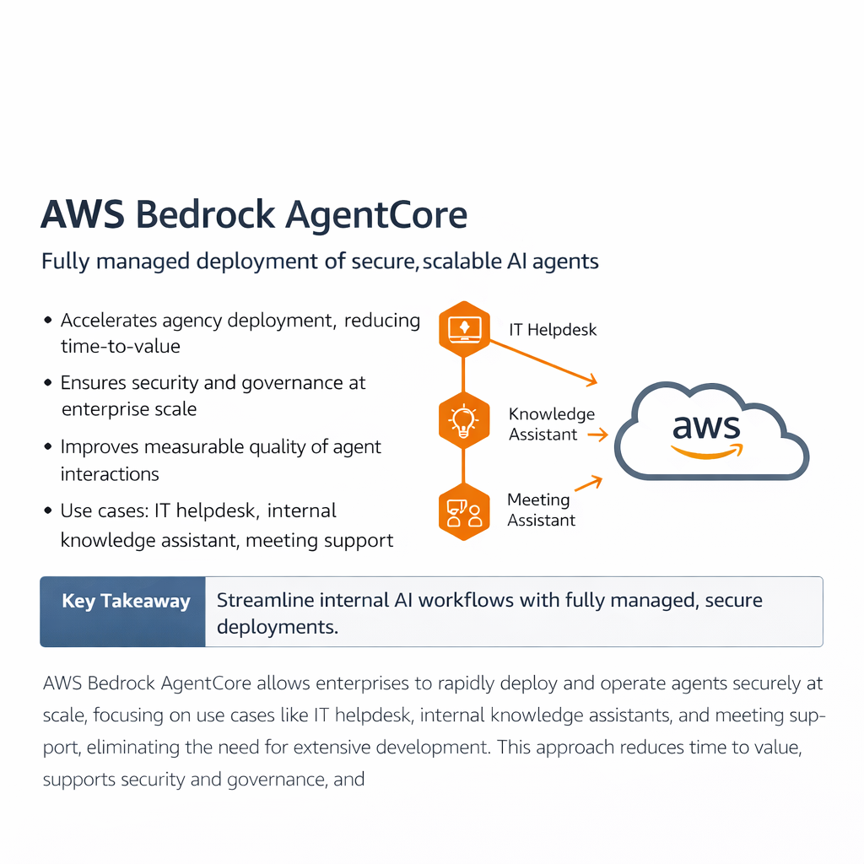
Appendix — Original AgentCore slide 2
Embedded to ensure no content is lost
Source: AgentCore.pptx

Slide 20
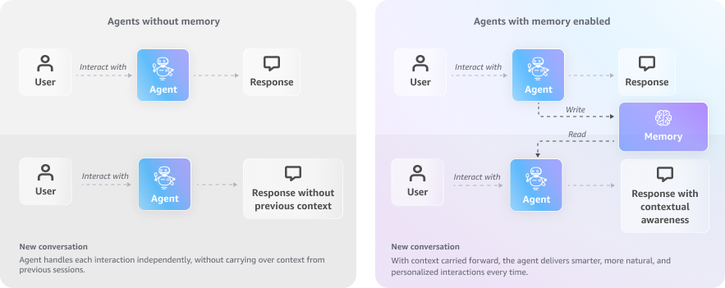
Appendix — Original AgentCore slide 7
Embedded to ensure no content is lost
Source: AgentCore.pptx

