Slide 1
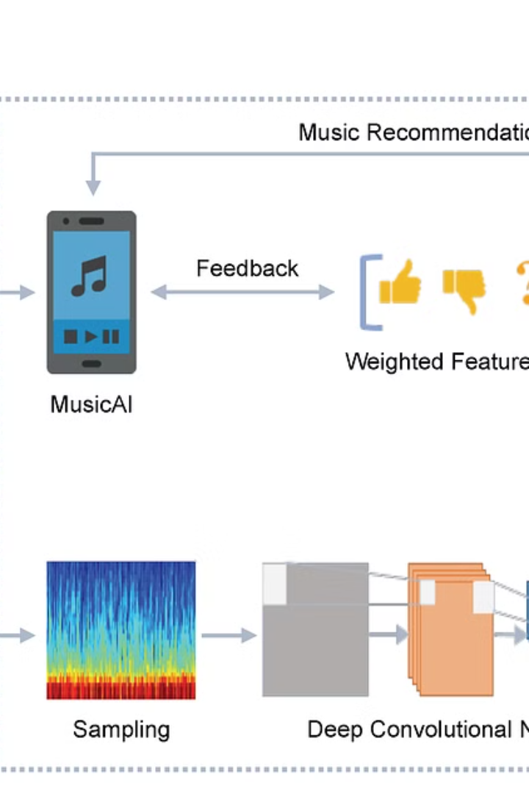
Real-time Emotion-based Music Recommendation System - Face Rhythm
The existing music recommendation systems often lack real-time adaptability and struggle to capture users' immediate emotional context. Traditional approaches heavily rely on historical data or explicit user preferences, leading to suboptimal recommendations that fail to resonate with users on a deeper emotional level. This project aims to revolutionize music recommendations by offering real-time, personalized suggestions tailored to individual preferences and emotional states.

Slide 2
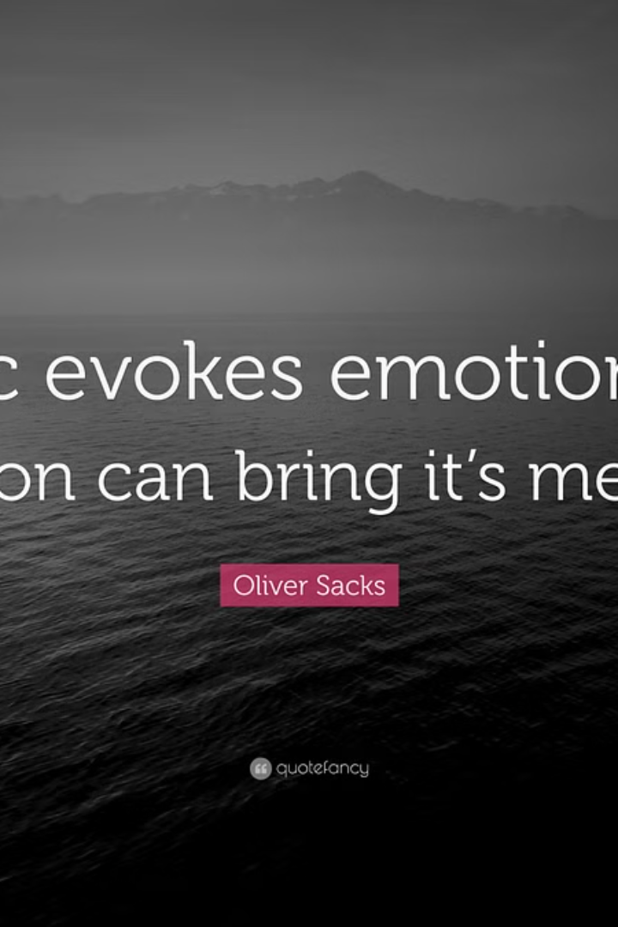
Motivation
In today's digital landscape, personalized and engaging experiences are essential for user satisfaction and retention. Music plays a significant role in people's lives, influencing their emotions and mood. By creating a real-time emotion-based music recommendation system, we aim to enhance user engagement and satisfaction by providing personalized music suggestions that resonate with their emotional state at any given moment.

Slide 3

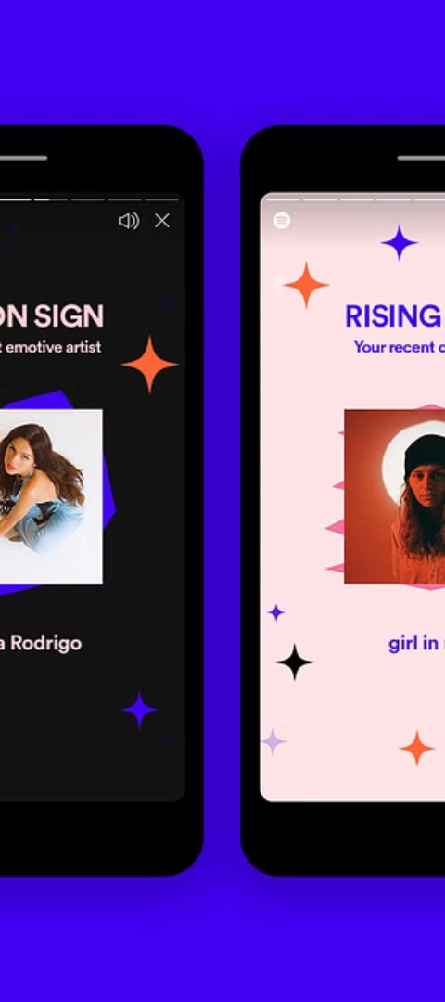
Personalized Emotional Music Journey
Unique Aspect
Significance
Our project aims to create a personalized emotional journey for each user by dynamically adjusting song recommendations based on a nuanced understanding of their emotions. This personalized approach recognizes that emotional states are complex and vary from moment to moment, allowing users to discover music that resonates with their current feelings.
This distinctive feature sets our project apart from traditional music recommendation systems, which often rely on static user preferences or historical data. By continuously adapting to the user's evolving emotional state, our system ensures that the music recommendations remain relevant and engaging, enhancing the overall listening experience.

Slide 4
Novelty
1
Real-Time Emotion-Driven Music Recommendations
2
Seamless Integration of Facial Recognition and Music Recommendation
Unlike traditional music recommendation systems that rely on historical data or explicit user preferences, our project introduces a real-time component that dynamically adjusts song recommendations based on the user's immediate emotional expressions captured through facial recognition.
Our project seamlessly integrates advanced facial recognition technology with a music recommendation system, offering a cohesive and interactive user experience.
3
Privacy-Respecting Emotion Analysis
4
Dynamic User Engagement
The system is designed to not only recommend music based on facial expressions but also to enhance user engagement through a visually appealing and user-friendly interface.
Recognizing the importance of user privacy, our project incorporates robust privacy measures in the facial recognition process, fostering trust and encouraging users to comfortably express their emotions within the system.

Slide 5
Significance
1
Real-Time Emotion-Driven Music Recommendations
2
Seamless Integration of Facial Recognition and Music Recommendation
Unlike traditional music recommendation systems that rely on historical data or explicit user preferences, our project introduces a real-time component. The system dynamically adjusts song recommendations based on the user's immediate emotional expressions captured through facial recognition, providing a more responsive and immersive listening experience.
Our project seamlessly integrates advanced facial recognition technology with a music recommendation system, offering a cohesive and interactive user experience. This integration goes beyond the conventional approach, allowing users to engage with the system effortlessly through their facial expressions, creating a more intuitive and personalized interaction.
3
Privacy-Respecting Emotion Analysis
4
Dynamic User Engagement
The system will be designed to not only recommend music based on facial expressions but also to enhance user engagement through a visually appealing and user-friendly interface. This focus on user engagement ensures that the project goes beyond mere functionality, creating an enjoyable and interactive experience that will encourage users to express and explore their emotions through music.
Recognizing the importance of user privacy, our project incorporates robust privacy measures in the facial recognition process. By prioritizing user privacy, we aim to address concerns associated with facial recognition technology, fostering trust and encouraging users to comfortably express their emotions within the system.

Slide 6
Literature Review
Key Papers
Uniqueness and Shortcomings
Solutions
The literature review identifies several key papers that have explored the use of facial emotion recognition for music recommendations, including "Music Recommendation System Based on Facial Emotion Gestures," "Facial Emotion Based Music Recommendation System," and "Music Recommendation System Based on Facial Emotions."
Our project aims to address these shortcomings by conducting thorough stress testing, comparative analysis against established methods, and exploring practical considerations for real-world deployment.
These papers have pioneered the use of Convolutional Neural Networks (CNNs) and facial emotion recognition for music recommendations, but they often lack discussion on system robustness, performance evaluation, and real-world deployment considerations.

Slide 7
Methodology
Facial Emotion Detection
1
Utilize computer vision algorithms for real-time face detection and emotion recognition. Employ pre-trained deep learning models to classify facial expressions into predefined emotion categories. Extract features from detected facial expressions to accurately represent the user's emotional state.
2
Real-Time Adaptability
Implement a robust real-time processing pipeline to continuously analyze webcam frames and update the user's emotional state. Develop algorithms to dynamically adjust song recommendations based on the user's evolving emotional state, ensuring recommendations remain relevant and personalized.
Mood-Based Song Recommendation
3
Establish a comprehensive database of mood-based song recommendations, associating each mood category with a curated list of songs or music playlists. Utilize machine learning techniques to match the user's current emotional state with the most suitable mood category and recommend songs accordingly.
4
User Engagement Enhancement
Design an intuitive user interface that visually communicates detected emotions and recommended songs to the user. Implement interactive features allowing users to provide feedback on recommended songs, further personalizing recommendations over time.

Slide 8
Methodology - Contd
Facial Emotion Detection
Real-Time Adaptability
Utilize computer vision algorithms for real-time face detection and emotion recognition, employ pre-trained deep learning models to classify facial expressions into predefined emotion categories, and extract features from detected facial expressions to accurately represent the user's emotional state.
Implement a robust real-time processing pipeline to continuously analyze webcam frames and update the user's emotional state, and develop algorithms to dynamically adjust song recommendations based on the user's evolving emotional state.
Mood-Based Song Recommendation
User Engagement Enhancement
Design an intuitive user interface that visually communicates detected emotions and recommended songs to the user, and implement interactive features allowing users to provide feedback on recommended songs, further personalizing recommendations over time.
Establish a comprehensive database of mood-based song recommendations, associating each mood category with a curated list of songs or music playlists, and utilize machine learning techniques to match the user's current emotional state with the most suitable mood category and recommend songs accordingly.

Slide 9



Code
Facial Emotion Detection
Spotify Integration
Main Script
The model.py module handles the facial emotion detection, utilizing computer vision algorithms and deep learning models.
The Spotify.py module integrates the system with the Spotify music platform, enabling the retrieval and playback of recommended songs.
The main.py script orchestrates the functionality of the entire system, coordinating the facial emotion detection, music recommendation, and user interface.

Slide 10
Evaluation
Validation Accuracy
82.06%
Emotion
Precision
Recall
F1-score
Support
Angry
0.81
0.76
0.79
1763
Happy
0.90
0.91
0.90
3241
Sad
0.74
0.80
0.77
2239
Surprise
0.91
0.87
0.89
1496
Neutral
0.81
0.77
0.79
2156
Fear
0.75
0.78
0.76
1858

Slide 11
Authors & Contributions
Sarvajeeth U K
Devesh
Ashwani
Responsible for developing and training the machine learning model for emotion analysis, as well as implementing algorithms for real-time facial emotion recognition.
Focused on data collection and preprocessing, including curating a diverse and well-labeled music dataset and extracting relevant features for input to the machine learning model.
Tasked with integrating the machine learning model with the music recommendation system and developing the user interface to ensure seamless interaction with the integrated system.

Slide 12
Authors & Contributions (continued)
Sparsh
Apoorv Kant
Yash Shedke
Responsible for designing a user-friendly interface where users can input their mood or emotion, ensuring the interface is visually appealing and encourages user engagement.
Tasked with setting up a robust testing framework to evaluate the performance of the emotion analysis model and the recommendation system, as well as collecting and analyzing user feedback to assess the effectiveness of the system.
Responsible for documenting each step of the project, including code documentation, user manuals, and system architecture, and planning for the maintenance of the system after deployment, including updates and addressing potential issues.

Slide 13




Conclusion
Personalized Music Recommendations
The real-time emotion-based music recommendation system offers personalized music suggestions that resonate with users' emotional states in real-time.
Enhanced User Engagement
By integrating facial emotion detection with mood-based song recommendation, the system enhances user engagement and satisfaction in music listening experiences.
Ongoing Research and Development
Further research and development will focus on refining the system's performance, incorporating user feedback, and expanding its capabilities to meet evolving user needs.

