Slide 1

01
Firefly.
Imagine a product that not only elevates your music experience but also lights up your world—literally.
Pitch Deck

Slide 2
02
PROBLEM
78% of users report losing earpods monthly in low-light conditions
Identifying the Problem
Common frustration of losing earpods in dark environments
Safety concerns during night activities
Current Solutions
Most earpods offer excellent sound only, No solution addresses low-light visibility
Consumers left with basic functionality
Market Demand
Users seeking innovation beyond sound quality Growing need for practical features

Slide 3
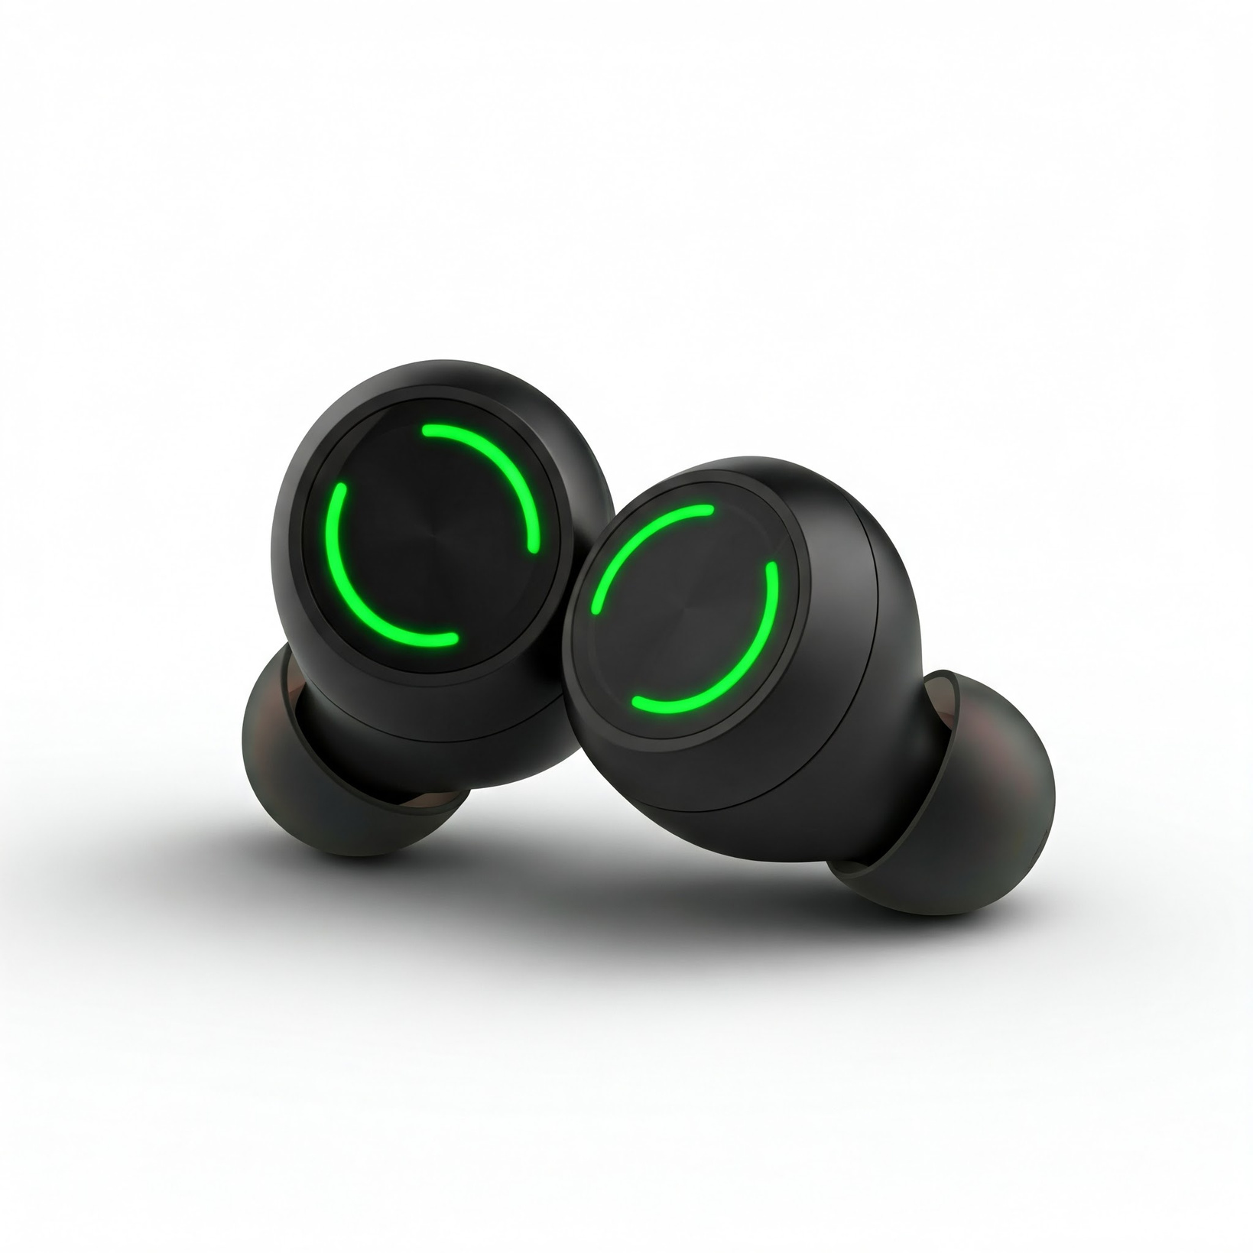
03
MEET FIREFLY: EARPODS THAT GLOW

Slide 4
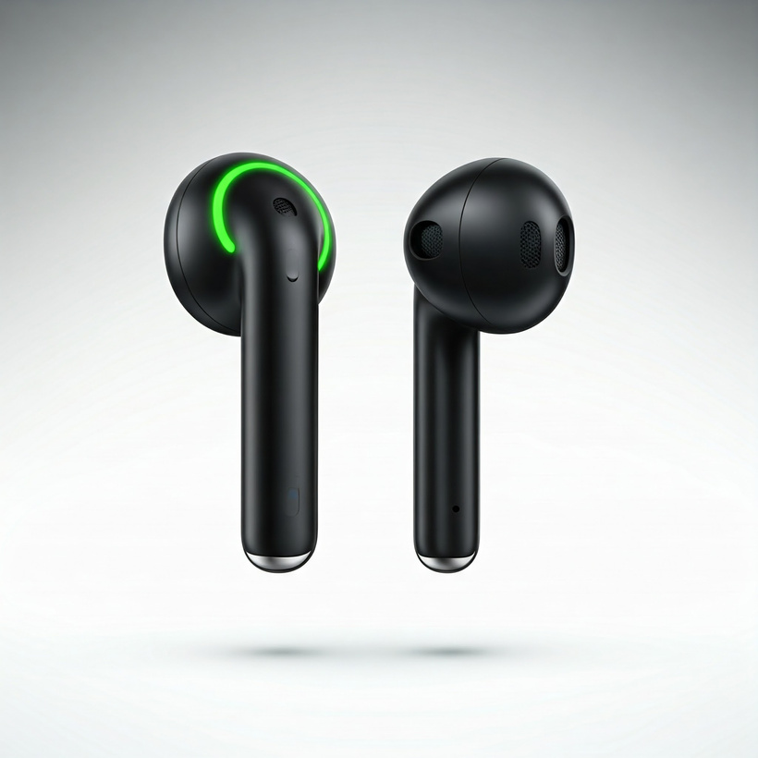
04
Product Features:
Glow-in-the-Dark Technology
Bright, long-lasting illumination
Easy visibility in any condition
Superior Audio Quality
Deep bass and crystal-clear treble
Advanced noise-canceling features
Ergonomic Design
All-day comfort
Secure fit for active use
Battery Life
10 hours continuous playtime
Quick charging capability
The all new Firefly F1

Slide 5

Primary Demographics:
Active lifestyle enthusiasts
Night runners and gym-goers
Travelers and commuters
Tech-savvy young adults
05
TARGET MARKET
Who Will Love Firefly?

Slide 6
COMPETITIVE ANALYSIS
What Sets Firefly Apart?
Only product with integrated glow technology
Premium sound quality matches market leaders
Unique position in the market
KEY DIFFERENTIATORS:
Patented glow technology
Enhanced visibility and safety
Style meets functionality
Innovative user experience
06

Slide 7
07
18 Billion
Global wireless earbuds market: $18 billion by 2026
20% CAGR
33% growth
Size of the Market
Increasing demand for innovative features

Slide 8
08
Pricing Strategy:
Premium positioning: $99-$129
Competitive with high-end earpods
Revenue Streams:
Direct Sales (Website + E-commerce)
Retail Partnerships
Limited Edition Releases
Premium Accessories and Add-ons
Custom charging cases
Extended warranty packages
Premium ear tips for enhanced comfort
Business Model
"How We Make Money"

Slide 9
09
Step 1
Pre Launch teaser campaign
Getting Firefly to Market
Step 2
Pre Orders start
Marketing Channels:
Multi-channel social media approach
Influencer partnerships
Sports and fitness community engagement
Step 3
Q3 2024 Launch

Slide 10
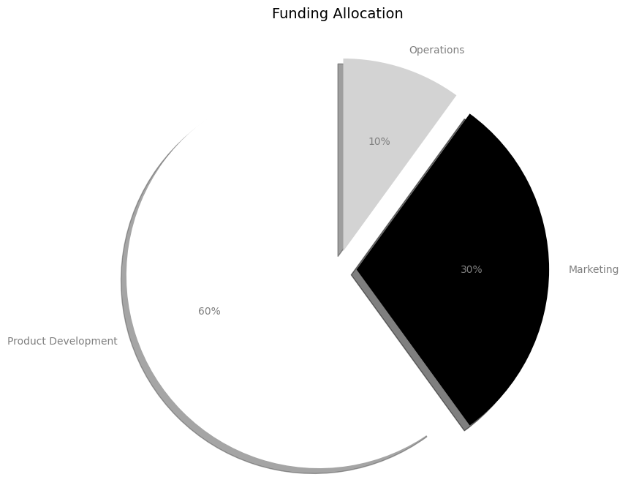
10
YEAR 1
$1 million in sales
18 MONTHS
Break Even
YEAR 2
35% profit margin by year two
FINANCIAL PROJECTIONS
YEAR 5
3x return in 5 years
"Projected Growth and Returns"

Slide 11
Direct
Competitors
11
Apple AirPods: Sound focus only
Bose: Premium audio only
Other brands: Basic functionality
Market position
How Firefly Stands Out
Premium segment positioning
Unique feature advantage
Innovation leader in category

Slide 12
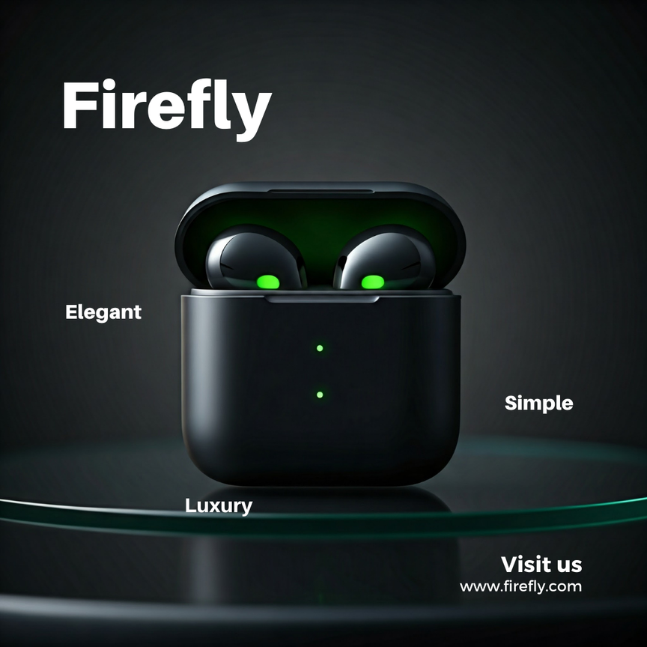
TRACTION AND MILESTONES
12
ACHIEVEMENTS:
Working prototypes developed
Positive beta testing feedback
Retail partnership discussions
Influencer interest secured
NEXT STEPS:
Production scaling
Distribution network expansion
Marketing campaign launch

Slide 13
THE ASK
13
"Join Us in Lighting Up the Market"
Seeking $500,000 for 20% equity
Clear use of funds:
Product development
Marketing campaign
Manufacturing scale-up

