Slide 1
Veelu Leela Sesha Sarvani
Final Project by

Slide 2

PROJECT TITLE
KEYLOGGER AND SECURITY
3/21/2024 Annual Review

Slide 3

AGENDA
1. Introduction
2. Problem Statement
3. Project Overview
4. End Users
5. Solution And Value Proposition
6. The Wow in the Solution
7. Modelling
8. Results
3/21/2024 Annual Review

Slide 4

PROJECT OVERVIEW
Introducing keyloggers and their role in cybersecurity.
Exploring difficulties and risks associated with them.
Understanding the design and functionality of keyloggers.
Examining the outcomes and implications of keylogger deployment.
Identifying end-users of keyloggers.
Analyzing the broader effects on privacy and security, and emphasizing the need for proactive measures to mitigate keylogger risks.
3/21/2024 Annual Review

Slide 5

INTRODUCTION
Keyloggers are a type of surveillance technology used to monitor and record each keystroke typed on a computer.
Types of Keyloggers:
There are two main types of keyloggers: hardware based and software-based.
Hardware keyloggers are physical devices that are attached to the computer, while software keyloggers are installed as malicious software. Both types aim to surreptitiously capture user input.

Slide 6

PROBLEM ST A TEMENT
While Keyloggers can be used for legitimate purposes such as monitoring employees or recovering lost data, they are often used maliciously to steal sensitive information such as passwords, credit card numbers, and personal data.
The unauthorized use can lead to identity theft, financial loss, and breaches of confidential information.
3/21/2024 Annual Review

Slide 7

WHO ARE THE END USERS?
Individuals: Utilize keyloggers for personal security and parental control by monitoring computer activity.
Businesses: Employ keyloggers for employee monitoring and data protection against breaches.
Organizations: Conduct security audits and ensure compliance with regulations through keylogger usage.
Security Professionals: Utilize keyloggers for threat detection and forensic investigations.

Slide 8

PREVENTING KEYLOGGER ATTACKS
Implementing robust cybersecurity measures such as using reputable antivirus software, enabling firewalls, and practicing safe browsing habits can mitigate the risk of keylogger attacks. Additionally, educating users about the dangers of phishing and suspicious downloads is crucial.
3/21/2024 Annual Review

Slide 9

SOLUTION AND ITS V ALUE PROPOSITION
Solution: Adopting a multi-layered security approach, including encryption, two-factor authentication, and regular security training, is vital for safeguarding against keylogger threats.
Value Proposition:
Comprehensive Protection: Offers defense against diverse threats.
Redundancy and Resilience: Provides backup protection, ensuring continuity even if one layer is compromised.
Adaptability: Tailors security measures to specific need. Evolving threats, enhancing effectiveness and efficiency.

Slide 10

THE WOW IN THE SOLUTION
Revolutionary Transformation:
Seamlessly integrating cutting-edge technologies and strategies.
Transforming traditional security methods into innovative solutions.
Empowering Protection:
Robust defense mechanisms and proactive threat mitigation.
Tangible results empowering organizations to thrive in a dynamic cyber landscape.
3/21/2024 Annual Review
10

Slide 11
1. Import necessary libraries
2. Define functions:
- generate_text_log(key)
- generate_json_file(keys_used)
- on_press(key)
- on_release(key)
- start_keylogger()
- stop_keylogger()
3. Initialize global variables:
- keys_used
- flag
- listener
4. Create GUI elements:
- Tkinter window
- Label for status
- Start button
- Stop button
5. Set up Tkinter window properties
6. Define button click event handlers
7. Run Tkinter main loop
MODELLING
The wireframe provided outlines the structure and components of the keylogger application's code.
11

Slide 12

.
The keylogger code models a simple keylogger application with a graphical user interface (GUI).
Functionalities provided :
Keylogging: Captures keyboard events (presses, releases, holds).
Logging Mechanism: Saves key events in text (key_log.txt) and JSON (key_log.json) formats.
Start/Stop Control: Enables users to manage keylogging process via GUI buttons.
GUI Interaction: Displays status label and control buttons using Tkinter.

Slide 13

.
Components of the code :
Global Variables: Initialize keys_used, flag, and keys for managing keylogging and storing events.
Logging Functions: Define generate_text_log and generate_json_file for saving events in text and JSON files, on_press and on_release for handling key events.
Start/Stop Functions: Implement start_keylogger and stop_keylogger to control keylogging and update GUI status.
GUI Creation: Utilize Tkinter to construct basic GUI with label and buttons for user interaction.

Slide 14
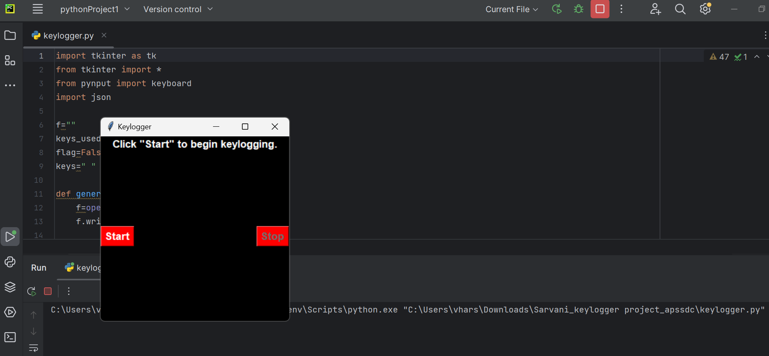
RESULTS
The below image shows the graphical user interface(GUI) by the keylogger program
3/21/2024 Annual Review
14

Slide 15
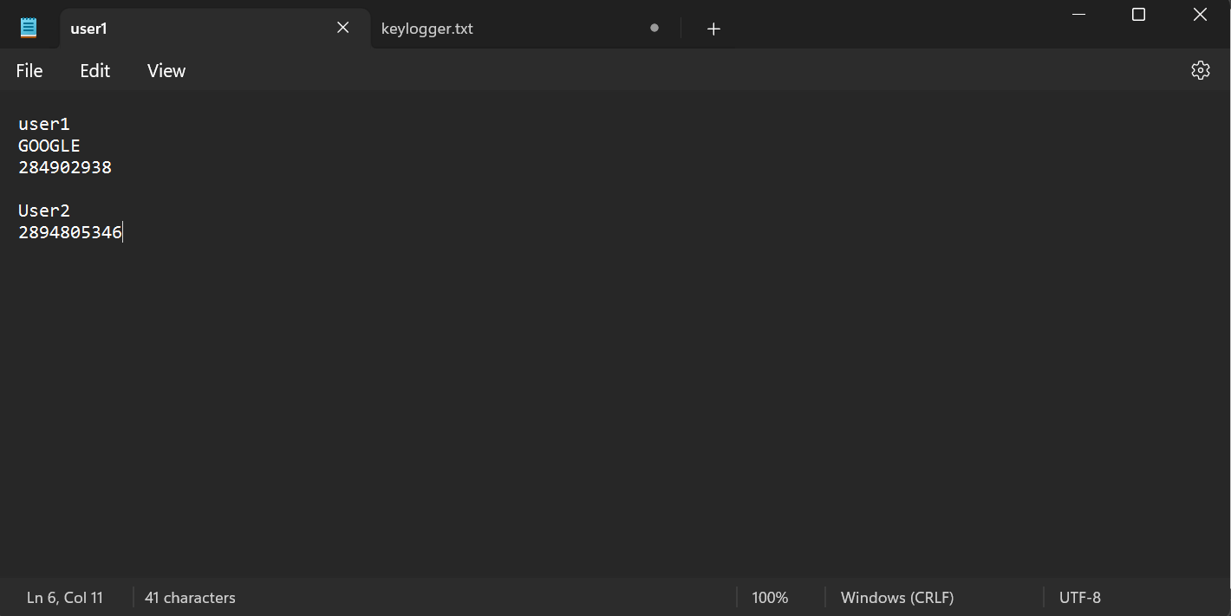
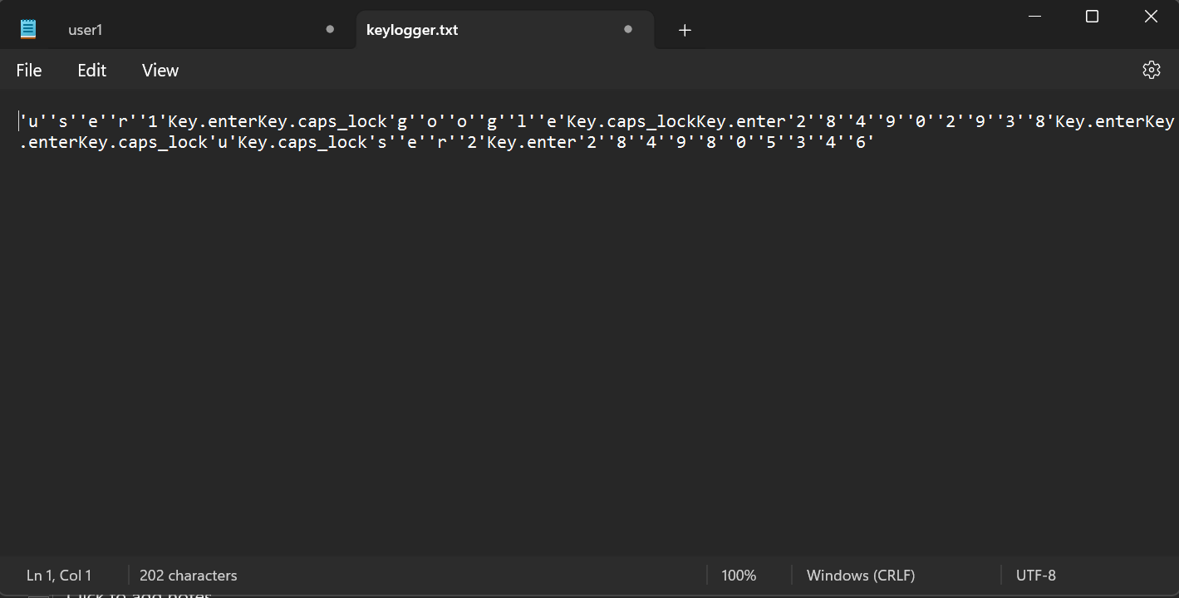
.
By clicking the start button in GUI , we can start recording the each key typed by the user.
The below image shows the ‘keylogger.txt’ file, which saves the key events in text.
Using stop button in GUI, we can stop the keylogger.

Slide 16
PROJECT LINK

