Slide 1
A Seminar on THREEFOLD SECURITY THROUGH HYBRID ENCRYPTION AND STEGANOGRAPHY KEY SAFEGUARDING
Team Details
M V S Sarvani(20EG105327)
P Shivani(20EG105341)
K Rakshitha(20EG105342)
Project Supervisor
Dr T Shyam Prasad M.Tech , PhD.
Assistant Professor

Slide 2
Introduction
In today's digital environment, the rising threat of malicious attacks necessitates robust information security measures. As services move to the Internet, the significance of protecting data has grown. Encryption algorithms have evolved to counter cryptanalysis, making it harder for attackers..Threefold Security employs hybrid encryption, combining symmetric and asymmetric methods for robust data protection. Steganography conceals cryptographic keys within seemingly innocuous data, enhancing security. This approach ensures a triple-layered defense, safeguarding sensitive information through advanced encryption and covert key storage. The combination of these techniques fortifies data integrity and confidentiality.
This approach finds applications in various domains such as secure communication, data protection, and confidentiality in sectors like finance, healthcare, and national security, offering a robust defense against cyber threats and unauthorized access to sensitive information.

Slide 3
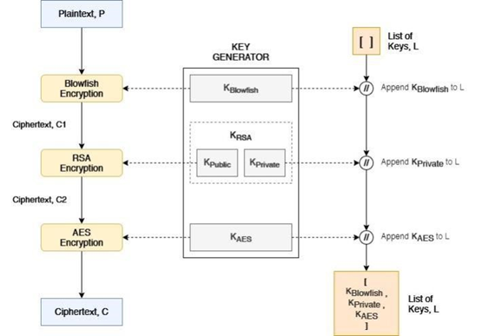
Concept Tree

Slide 4
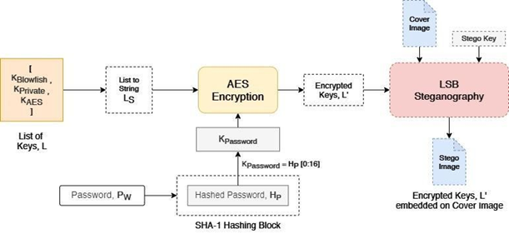
Concept Tree

Slide 5
Literature
Author(s) | Strategies | Advantages | Disadvantages
Shahid Rahman Jamal Uddin Habib Ullah Khan Hameed Hussain Ayaz Ali Khan MuhammadZakarya | A Novel Steganography Technique for Digital Images Using the Least Significant Bit Substitution Method | - Simple implementation. - Low computational overhead. - Fast encoding and decoding processes. - Suitable for scenarios with lower security requirements | - Limited payload capacity. - Susceptible to statistical analysis. - Lower security compared to encryption-based methods.
L. Almazaydeh | Secure RGB image steganography based on modified LSB substitution | -Simple and easy -Low computational overhead -Fast encoding and decoding processes | -low security -limited payload capacity -susceptible to statistical analysis

Slide 6
Literature
Author(s) | Strategies | Advantages | Disadvantages
M. Kalita T. Tuithung S.Majumder | Inverted LSB image steganography using an adaptive pattern to improve imperceptibility | -improved imperceptibility -Potential resistance to visual detection -Balance between security and visual quality | -Complexity in implementation -Potential loss of data -Limited capacity -Dependence on image characteristics
S.Rustad,D.R .I.M.Setiadi,A .Syukur,and P.N.Andono | An adaptive color image steganography method using adjacent pixel value differencing and LSB substitution technique, | -improved security -reduced visual impact -utilizes pixel relationships -robustness | -complexity in implementation -potential loss of data -limited capacity -dependence on image characteristics

Slide 7
Literature(cont..) selected strategy:
Author(s) | Method | Advantages | Disadvantages
Shahid Rahman Jamal Uddin Habib Ullah Khan Hameed Hussain Ayaz Ali Khan MuhammadZakarya | A Novel Steganography Technique for Digital Images Using the Least Significant Bit Substitution Method | - Simple implementation. - Low computational overhead. - Fast encoding and decoding processes. - Suitable for scenarios with lower security requirements | - Limited payload capacity. - Susceptible to statistical analysis. - Lower security compared to encryption-based methods.
L. Almazaydeh | Secure RGB image steganography based on modified LSB substitution | -Simple and easy -Low computational overhead -Fast encoding and decoding processes | -low security -limited payload capacity -susceptible to statistical analysis

Slide 8
Author(s) | Method | Advantages | Disadvantages
M. Kalita T. Tuithung S.Majumder | Inverted LSB image steganography using an adaptive pattern to improve imperceptibility | -Improved imperceptibility -Potential resistance to visual detection -Balance between security and visual quality | -Complexity in implementation -Potential loss of data -Limited capacity -Dependence on image characteristics
S.Rustad,D.R .I.M.Setiadi,A .Syukur,and P.N.Andono | An adaptive color image steganography method using adjacent pixel value differencing and LSB substitution technique, | -Improved security -reduced visual impact -Utilizes pixel relationships -Robustness | -Complexity in implementation -Potential loss of data -Limited capacity -Dependence on image characteristics

Slide 9
Problem Statement
In the contemporary digital landscape, the escalating threat of malicious attacks underscores the need for robust information security. As online services proliferate, safeguarding data becomes increasingly crucial. While encryption has evolved to counter cryptanalysis, encrypted data remains a target. Threefold Security addresses this challenge through hybrid encryption and advanced steganography, providing a triple-layered defense by concealing cryptographic keys.
Existing system : The Novel Steganography Technique using Least Significant Bit (LSB) Substitution involves hiding information in digital images by subtly altering the least significant bits of pixel colour values. This method aims for imperceptibility and may introduce innovative adaptations to enhance security or overall performance compared to traditional LSB methods. Key considerations include the balance between security and payload capacity, along with the method's robustness against potential attacks. Disadvantages
- Limited payload capacity.
- Susceptible to statistical analysis.
- Lower security compared to encryption-based methods.

Slide 10
Problem Statement Illustration
Alice, a data security analyst, is tasked with securely transmitting sensitive information online. Concerned about vulnerabilities in the existing LSB Substitution Steganography Technique, she seeks an advanced solution for enhanced security while maintaining imperceptibility. In the current system, she encrypts her data and hides it within the least significant bits using LSB Substitution. However, this method faces challenges such as limited payload capacity and susceptibility to statistical analysis.
The proposed Threefold Security approach introduces key improvements:
Hybrid Encryption: Sensitive information undergoes hybrid encryption for an added layer of security.
Advanced Steganography: An advanced steganography technique is employed, addressing the limitations of LSB Substitution.
Concealing Keys: Cryptographic keys used in encryption and steganography are hidden within the cover image, creating a triple-layered defense.
.

Slide 11
Proposed Method
The proposed method described in the provided scenario focuses on a threefold encryption system with key storage and LSB steganography for secure data transmission.
Threefold Encryption System:
Blowfish Encryption: The plaintext is initially encrypted using the Blowfish algorithm with a randomly generated key (KBlowfish).
RSA Encryption: The resulting ciphertext is further encrypted using RSA with a public key (KRSA-Public), and the corresponding private key (KRSA-Private) is stored securely.
AES Encryption: Finally, the doubly encrypted ciphertext is further encrypted using AES with another randomly generated key (KAES).
Key Storage:
Throughout the encryption process, the keys used in each layer (KBlowfish, KRSA-Private, KAES) are stored in a list (L). This allows for secure key management and facilitates decryption.

Slide 12
Proposed Method
List String and Encryption:
The list of keys (L) is converted into a string (LS) using separators. This string is then encrypted using AES with a key derived from a user-input password (PW). This enhances the security of key storage.
Steganography:
The encrypted key string (LS-Encrypted) is embedded into a cover image using Least Significant Bit (LSB) steganography. This ensures that even if an attacker gains access to the encrypted image, they won't easily discern the presence of the key.

Slide 13
Proposed Method Illustration
Let's consider a scenario where Alice wants to securely transmit a confidential message (plaintext) to Bob using the described threefold encryption system with key storage and LSB steganography. For simplicity, we'll use sample values for illustration.
Initialization:
Plaintext (P): "Meet me at the secret location."
Blowfish Key (KBlowfish): Randomly generated 32-bit key.
RSA Public Key (KRSA-Public): Randomly generated 1024-bit public key.
RSA Private Key (KRSA-Private): Corresponding private key.
AES Key (KAES): Randomly generated 128-bit key.
List of Keys (L): Empty initially.
Blowfish Encryption:
Ciphertext (C1): Blowfish encryption using P and KBlowfish.
Updated List of Keys (L): [KBlowfish]

Slide 14
Proposed method Illustration
RSA Encryption:
Ciphertext (C2): RSA encryption using C1 and KRSA-Public.
Updated List of Keys (L): [KBlowfish, KRSA-Private]
AES Encryption:
Final Ciphertext (C): AES encryption using C2 and KAES.
Updated List of Keys (L): [KBlowfish, KRSA-Private, KAES]

Slide 15
Proposed method Illustration
Secure Key Storage and Steganography:
List String (LS): Convert L to a string with separators: KBlowfish x KRSA-Private x KAES
User-Input Password (PW): "SecretPassword123"
Hashed Password (HP): SHA-1 hash of PW.
Key from Password (KPassword): First 16 bits of HP.
Encrypted List String (LS-Encrypted): AES encryption of LS using KPassword.
Stego Image: Embed LS-Encrypted into a cover image using LSB steganography.
Now, Alice sends both the Stego Image and the final Ciphertext (C) to Bob. Bob can extract the LS-Encrypted from the Stego Image using the same password and decrypt LS to obtain the original List of Keys (L). Using L, Bob can then decrypt the Ciphertext (C) sequentially through the three encryption layers to retrieve the original plaintext (P). This multi-layered approach enhances the security of the communication and protects the keys using encryption and steganography.

Slide 16
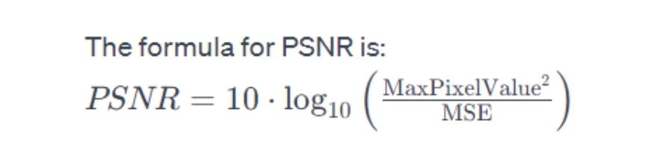
Parameter
Parameter Formulas:
Peak Signal-to-Noise Ratio (PSNR) and Mean Squared Error (MSE) are
commonly used metrics to evaluate the performance of image encryption
algorithms. These metrics are often employed to quantify the quality of the
decrypted image compared to the original, unencrypted image.
Peak Signal-to-Noise Ratio (PSNR):
PSNR is a metric used to quantify the quality of an image by measuring the ratio of
the maximum possible power of a signal to the power of corrupting noise. It is
often expressed in decibels (dB) and is calculated using the Mean Squared Error
(MSE) value.

Slide 17
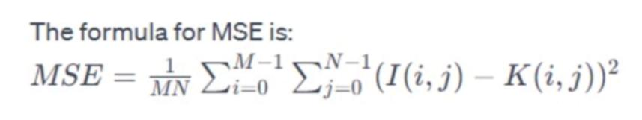
Mean Squared Error (MSE):
MSE measures the average squared difference between corresponding pixels of the original and decrypted images. A lower MSE value indicates better image quality.

Slide 18
Experiment Environment
The experiment environment for the project includes a machine with the following specifications:
Processor:
Intel Core i5
Memory (RAM):
32GB RAM
Storage:
1 TB HDD
Operating System:
Windows OS
Experiment IDE:
Google Colab
Programming Language:
Python

Slide 19
Project status
S.No | Functionality | Status (Completed /in-progress/Not started)
1 | Literature Survey | Completed
2 | Problem Definition | Completed
3 | Module Design | In-progress
4 | Implementation | In-progress

Slide 20
References
[1] Shahid Rahman, Jamal Uddin, Habib Ullah Khan, Hameed Hussain, Ayaz Ali Khan, and Muhammad Zakarya“A Novel Steganography Technique for Digital Images Using the Least Significant Bit Substitution Method”
[2] L. Almazaydeh, ‘‘Secure RGB image steganography based on modified LSB substitution, ’’Int. J. Embedded Syst., vol. 12, no. 4, pp. 453–457, 2020.
[3] M. Kalita, T. Tuithung, and S. Majumder, ‘‘An adaptive color image steganography method using adjacent pixel value differencing and LSB substitution technique, ’’ Cryptologia, vol. 43, no. 5, pp. 414–437, Sep. 2019.
[4] S.Rustad,D.R.I.M.Setiadi,A.Syukur,andP.N.Andono,’’ InvertedLSB image steganography using an adaptive pattern to improve imperceptibility, ’’J. King Saud Univ., Comput. Inf. Sci., vol. 34, no. 6, pp. 3559–3568, Jun. 2022.
[5] Saini, R.; Joshi, K.; Punyani, K.; Yadav, R.; Nandal, R.; Kumari, D. Interpolated Implicit Pixel-based Novel Hybrid Approach Towards Image Steganography. Recent Adv. Electr. Electron. Eng. (Former. Recent Patents Electr. Electron. Eng.) 2023, 16, 851– 871.
[6] Belagali, P.; Udupi, V. Robust Image Steganography Based on Hybrid Edge Detection. Tuijin Jishu/J. Propuls. Technol. 2023, 44, 1509–1521.
[7] Bilgaiyan, S.; Ahmad, R.; Sagnika, S. Adaptive image steganography using rotating colour channels and inverted LSB substitution. SN Comput. Sci. 2023, 4, 565.

Slide 21
Thank you

Slide 22
Project seminar–I Evaluation
S.No | Rubrics | Marks
1 | Concept Introduction | 4
2 | Literature and Parameter | 5
3 | Problem and Problem Illustration | 8
4 | Proposed Method and Illustration | 8
Total |  | 25

