Slide 1

CALCULATOR
Name : Chaganti Sai Sarvani
MICRO IT PROJECT

Slide 2
Introduction
The iOS Calculator Clone is a web-based replica of the default calculator application found on Apple iPhones. Built using HTML, CSS, and JavaScript, this project recreates the clean design and core functionality of the iOS calculator, including basic arithmetic operations, percentage calculation, sign toggling, and a responsive user interface.
The main goal of this project is to demonstrate how a real-world mobile application interface can be replicated using web technologies. It emphasizes layout design using CSS Grid, responsive styling, and user interaction through JavaScript event handling. This project serves as a strong foundation for understanding UI development, event-driven programming, and creating interactive tools on the web.
HTML ( Structure )
The HTML file defines the structure of the calculator interface. It includes:
A display screen (div with id display ) to show the current input or result.A grid of buttons for digits , operations(+ , - , x , ÷ ) , and functions like AC, ± , % , and =.
CSS ( Styling )
The CSS styles the calculator to closely resemble the iOS calculator design. Key styling features include:
A dark theme with color-coded buttons (gray for functions, orange for operators).Rounded buttons using border-radius. A responsive grid layout for buttons
using CSS Grid.
JavaScript (Functionality)
The JavaScript adds interactivity and logic to the calculator:
Input( value ) handles all button clicks and updates the display.
clearDisplay() resets the calculator.
calculate() evaluates the current expression using JavaScript’s eval() function

Slide 3
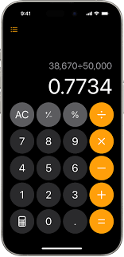
Objective of the project
The main objective of this project is to develop a functional and visually
accurate clone of the iOS calculator using basic web technologies — HTML,
CSS, and JavaScript. The project aims to:
Replicate the user interface (UI) of the native iPhone calculator.
Implement basic arithmetic operations: addition, subtraction, multiplication, and division.
Provide support for calculator functions like percentage (%), clear (AC), decimal (.), equals (=), and sign toggle (±).
Ensure responsive design and smooth button interactions using CSS.
Improve understanding of DOM manipulation, event handling, and expression evaluation in JavaScript.
Serve as a learning project for beginners to practice front-end development and build an interactive web application.

Slide 4

Tools and Technologies Used
1. HTML (HyperText Markup Language)
Used to create the basic structure of the calculator interface.
Defines elements such as the display screen and all calculator buttons.
2. CSS (Cascading Style Sheets)
Used for styling the calculator to match the look of the iOS calculator.
Implements layout using CSS Grid, rounded buttons, and color themes.
Enhances visual appeal and responsiveness.
3. JavaScript
Handles the calculator’s logic and interactivity.
Processes user inputs, performs calculations, updates the display, and handles special functions (%, ±, AC ).
4. Web Browser
Any modern browser (like Google Chrome, Firefox, Safari, or Edge) is used to run and test the calculator.
5. Code Editor (Optional)
Tools like Visual Studio Code, Sublime Text, or Notepad++ are used to write and edit the code.

Slide 5

System Design and Architecture
The iOS Calculator Clone is a client-side web application built entirely with front-end technologies. It follows a simple three
layer architecture, where each layer has a specific role:
1. Presentation Layer (HTML + CSS)
HTML provides the structure of the calculator (buttons, display area).CSS handles the visual design (layout, colors, button
styles, responsiveness).Uses a CSS Grid layout to neatly arrange buttons in rows and columns.
2. Logic Layer (JavaScript)
Handles user interactions (button clicks).Performs all calculations and
operations. Updates the display dynamically using DOM manipulation.
3.Platform Layer (Web Browser)
The entire application runs inside a web browser, which:
Parses and renders HTML/CSS. Executes JavaScript logic. Provides the
runtime environment for the calculator.
4.Component Interaction Flow
User clicks a button
JavaScript captures the click event via onclickCalculator logic processes
input and updates the internal expression. The display is updated dynamically to show the result or ongoing input.

Slide 6
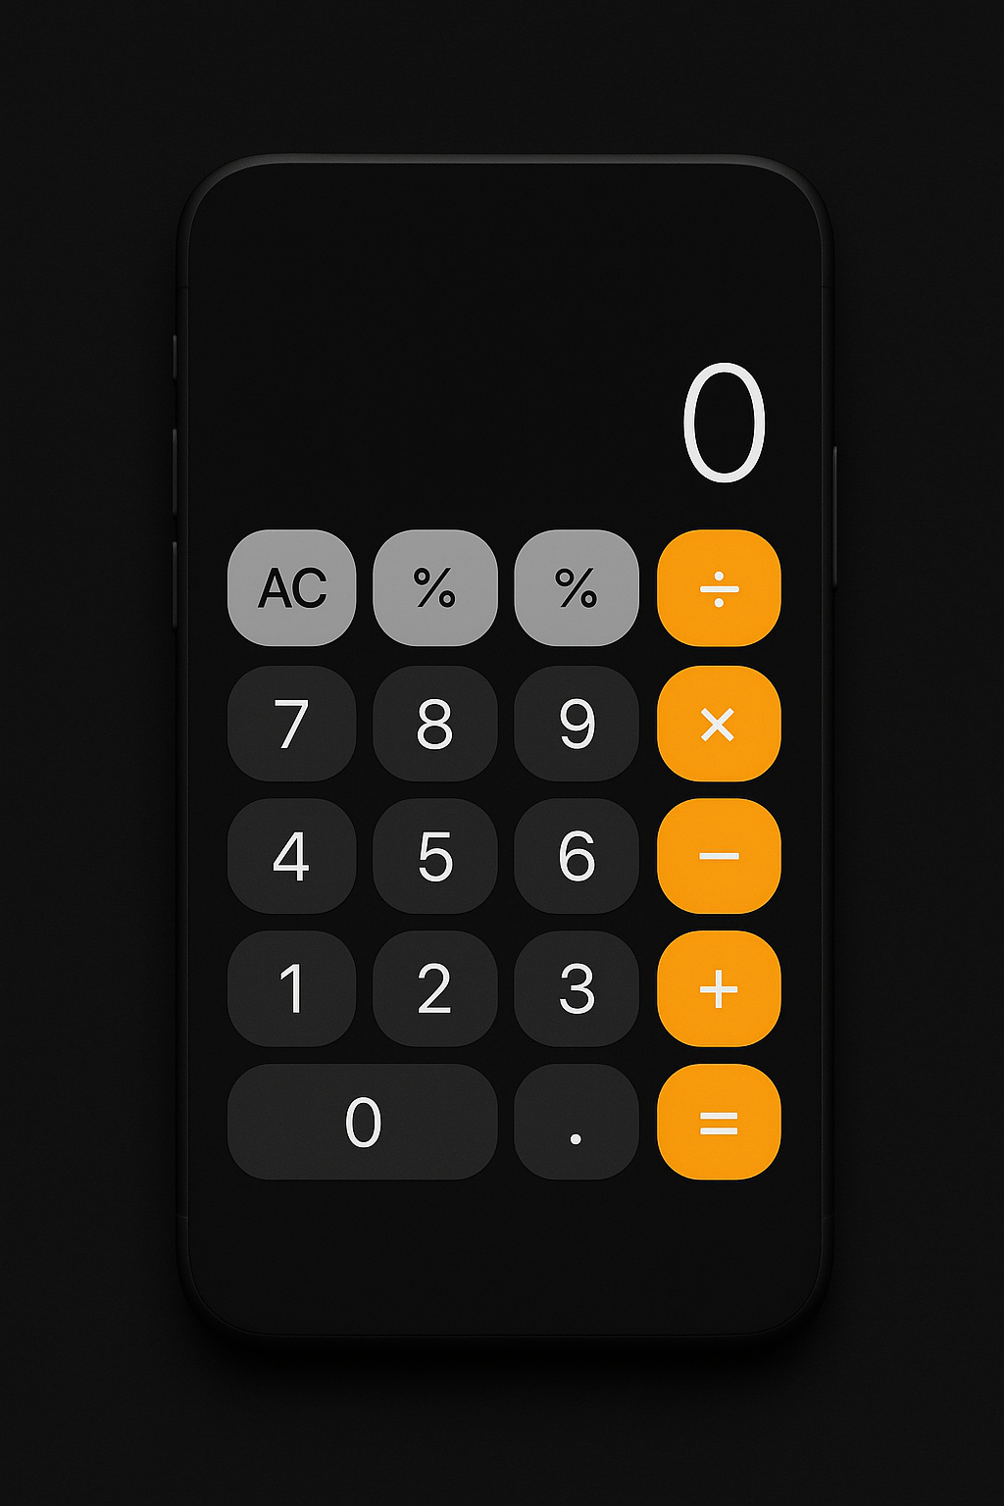
User Interface
The User Interface of the iOS Calculator Clone is designed to closely replicate the look and feel of the native iPhone calculator, providing a
clean, intuitive, and responsive experience for users.
1. Display Screen
Located at the top of the calculator. Shows the current input or the result of calculations. Right-aligned with a large font size for clear visibility.
Background is black with white text, matching the iOS aesthetic.
2. Button Grid
All buttons (digits, operators, and functions) are placed inside a CSS Grid layout.
4 columns and multiple rows to represent:
1) Number buttons (0–9)
2) Operators : + , - , x , , ÷
3) Special functions : % , ± , AC
3.Button Styling
Gray Buttons: Functional controls like : % , ± , AC
Dark Buttons: Number keys (0–9) and . for decimal input
Orange Buttons: Operator keys for arithmetic operations and the equals ( = ) button
Wide Button: The 0 button spans two columns, just like on the iOS calculator.
4.User Experience (UX)
Mimics a real calculator for ease of use. Buttons are large enough for touch interaction. The layout is simple and uncluttered, helping users perform calculations
quickly.

Slide 7
Implementation Details
1. HTML Structure:
A <div class="calculator"> container wraps all elements. Inside it, a <div class="display" id="display">0</div> displays
the current input/result. A <div class="buttons"> section contains 20 calculator buttons, using <button> elements for digits,
operators, and functions.
CSS Styling:
Layout: Uses Flexbox to center the calculator vertically and horizontally on the screen.Grid layout is used for organizing buttons in a 4-column layout.
Design: Dark theme with rounded buttons.
Responsiveness: Adjusts well to screen sizes with viewport meta tag and height : 100vh.
JavaScript :
Input( value ) handles all button clicks and updates the display.
clearDisplay() resets the calculator.
calculate() evaluates the current expression using JavaScript’s eval() function . Handles
edge cases like invalid syntax with try catch
Special Features:
Supports negative numbers
Displays result up to 4 decimal places using toFixed(4)
Input validation handled through simple logic and JavaScript’s eval()

Slide 8
Challenges Faced
1. Handling User Input Dynamically
Problem: Managing user input as a string, especially with combinations like 7 +- 3 ,required careful logic.
Solution: Used JavaScript string operations and conditional checks (like for ± , .) to manage valid expressions.
2. Toggle Sign (± ) Functionality
Problem: Switching between positive and negative values needed to preserve math expression integrity without breaking the
syntax.
Solution: Used startswith( ‘-’) and string slicing logic to toggle the sign properly.
3. Percentage Button (%)
Problem: % doesn't directly compute percentage in JavaScript’s eval(). . Including it as-is caused syntax errors.
Solution: Left it as input for now or required additional logic to process it as division by 100 (optional enhancement).
4. Button Styling and Layout (CSS Grid)
Problem: Making the 0 button span two columns and aligning all buttons responsively was tricky with grid.
Solution: Used grid-column: span 2 for the wide class and applied consistent spacing using gap
5.Error Handling
Problem: Invalid expressions or pressing = without a complete operation could crash the app.
Solution: Wrapped evaluation in try … catch to catch errors and show “Error” on the display.

Slide 9
Learning Outcome
1. Front-End Development Skills
Gained hands-on experience in creating responsive layouts using HTML and CSS.
Understood the use of CSS Grid and Flexbox for UI alignment and spacing.
Learned how to build intuitive and visually appealing UIs resembling real-world applications (iOS calculator).
2. JavaScript Programming
Improved JavaScript skills by handling dynamic user inputs and expressions.
Gained experience using event handling (onclick) for interactive elements
Learned to implement basic input validation, string operations, and conditional logic.
3.Arithmetic Logic Implementation
Learned how to perform arithmetic operations using JavaScript’s eval() function.
Discovered techniques for handling precision in floating-point calculations using toFixed().
4. Error Handling Techniques
Gained knowledge of using try-catch blocks in JavaScript to handle invalid expressions and prevent runtime crashes.
5. UI/UX Design Principles
Understood the importance of button sizing, color coding, and user feedback (e.g., :active states ) in improving usability.
Replicated a professional and polished interface similar to a real iOS calculator.
6. Debugging and Problem Solving
Enhanced debugging skills by resolving layout issues, logic errors, and unexpected input behavior.

Slide 10
Conclusion
The iOS Calculator Clone project successfully demonstrates the design and development of a fully functional web-based calculator using HTML, CSS, and JavaScript. This project not only replicates the look and feel of the native iOS calculator but also implements essential arithmetic operations with user-friendly interaction.
Through this project, practical skills in front-end development, UI design, and client-side scripting were strengthened. The calculator offers a clean interface, accurate calculations, and responsive behavior, showcasing how simple web technologies can be combined to build a real-world utility tool.
Overall, this project helped reinforce programming logic, enhanced problem-solving abilities, and deepened understanding of how modern web applications are built and styled.
This project successfully replicates the core functionality and visual aesthetics of the iOS calculator using only web technologies. From layout and button design to calculation logic, the application performs reliably across various inputs. It provides a seamless user experience and serves as a practical example of how HTML, CSS, and JavaScript can work together to build a responsive, interactive tool.
By working on this calculator project, I enhanced my understanding of user interface design, JavaScript logic, and event-driven programming. Each feature—from handling decimal inputs to toggling signs—helped reinforce real-world application development skills. This calculator stands as proof of not just technical ability, but also an understanding of user-centric design.

Slide 11
Future Scope
The current version of the calculator provides a solid foundation for basic arithmetic operations. However, there are several
opportunities to enhance its functionality, usability, and scalability in future versions:
1. Scientific Mode
Add support for advanced mathematical operations like: Trigonometric functions (sin , cos , tan ) , Logarithmic and
exponential operations ,Square root, power functions, and factorials
2. Expression History
Maintain a history log of past calculations. Allow users to scroll through and reuse previous inputs and results.
3. Keyboard Input Support
Enable users to operate the calculator using the keyboard for faster interaction.
4. Responsive Mobile Layout
Optimize the design for various screen sizes, especially mobile phones and tablets.Use media queries for adaptive UI
adjustments.
5. Memory Functions
Implement features like: M+ , M- ( add to memory/subtract from memory) , MR (memory recall ) , MC (memory clear )
6. Accessibility Improvements
Add ARIA roles and improve focus behavior for screen reader compatibility. Ensure color contrast meets accessibility
standards.

