Slide 1
Software Engineering
Software Engineering is the science and art of
building significant software systems that are:
  1) on time
  2) on budget
  3) with acceptable performance
  4) with correct operation.

Slide 2
Software Engineering
The economies of all developed nations are
dependent on software.
More and more systems are software controlled.
Software engineering is concerned with theories, methods and tools for professional software development.
Software engineering expenditure represents a
significant fraction of the GNP of developed countries.

Slide 3
Software Costs
Software costs often dominate system costs. The costs of software on a PC are often greater than the hardware cost.
Software costs more to maintain than it does to develop.
Software engineering is concerned with cost-effective software development.

Slide 4
Software Products
Generic products:
  Stand-alone systems which are produced by a development organization and sold on the open market to any customer.
Customized products:
  Systems which are commissioned by a specific customer and developed specially by some contractor.

Slide 5
Software Product Attributes
Maintainability
Dependability
Efficiency
Usability

Slide 6
Importance of Product Characteristics
The relative importance of these characteristics depends on the product and the environment in which it is to be used.
In some cases, some attributes may dominate
  In safety-critical real-time systems, key attributes may be dependability and efficiency.
Costs tend to rise exponentially if very high levels of any one attribute are required.

Slide 7
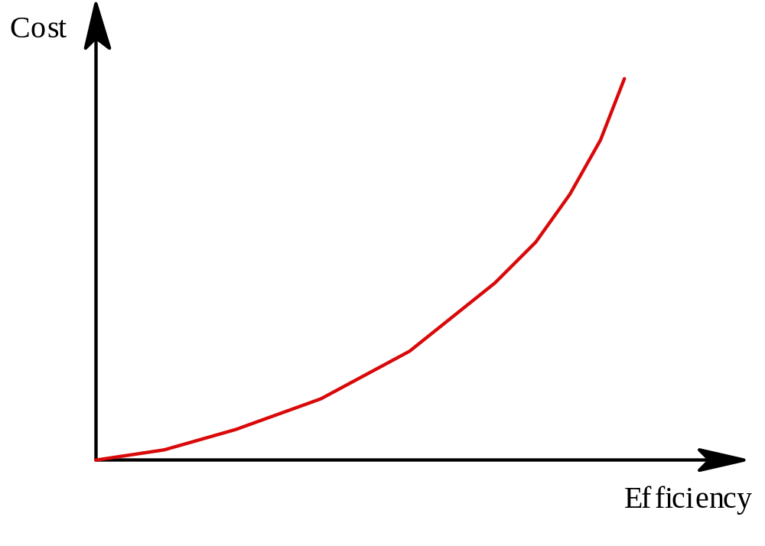
Efficiency Costs

Slide 8
The Software Process
Structured set of activities required to develop a
software system
  Specification
  Design
  Validation
  Evolution
Activities vary depending on the organization
and the type of system being developed.
Must be explicitly modeled if it is to be
managed.

Slide 9
Engineering Process Model
Specification: Set out the requirements and
constraints on the system.
Design: Produce a model of the system.
Manufacture: Build the system.
Test: Check the system meets the required
specifications.
Install: Deliver the system to the customer and
ensure it is operational.
Maintain: Repair faults in the system as they
are discovered.

Slide 10
Software Engineering is Different
Normally, specifications are incomplete.
Very blurred distinction between specification,
design and manufacture.
No physical realization of the system for testing.
Software does not wear out - maintenance
does not mean component replacement.

Slide 11
Generic Software Process Models
Waterfall
  Separate and distinct phases of specification and development
Evolutionary
  Specification and development are interleaved
Formal Transformation
  A mathematical system model is formally transformed to an implementation
Reuse-based
  The system is assembled from existing components

Slide 12
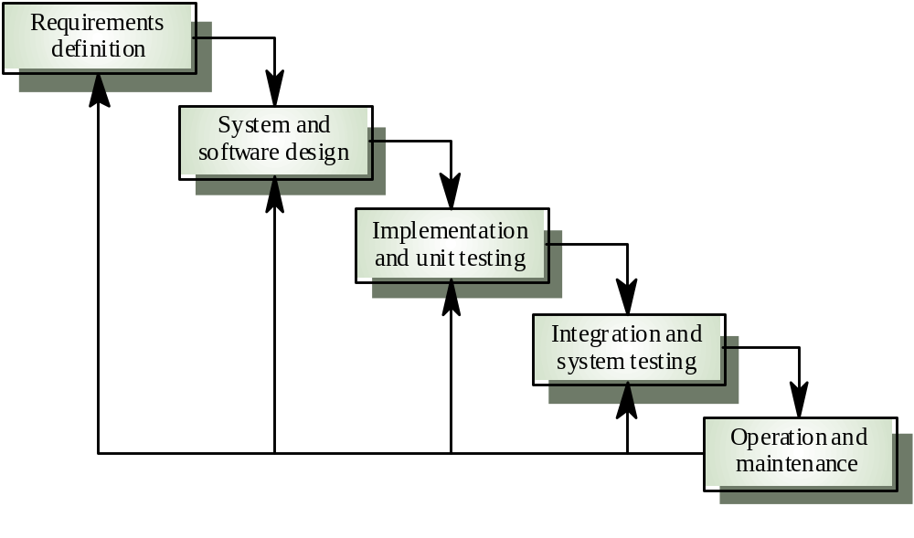
Waterfall Process Model

Slide 13
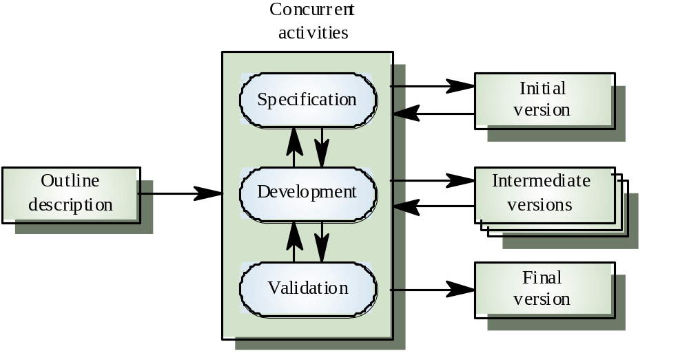
Evolutionary Process Model

Slide 14
Process Model Problems
Waterfall
  High risk for new systems because of specification and
  design problems.
  Low risk for well-understood developments using familiar
  technology.
Prototyping
  Low risk for new applications because specification and
  program stay in step.
  High risk because of lack of process visibility.
Transformational
  High risk because of need for advanced technology and
  staff skills.

Slide 15
Hybrid Process Models
Large systems are usually made up of several
sub-systems.
The same process model need not be used for
all subsystems.
Prototyping for high-risk specifications.
Waterfall model for well-understood
developments.

Slide 16
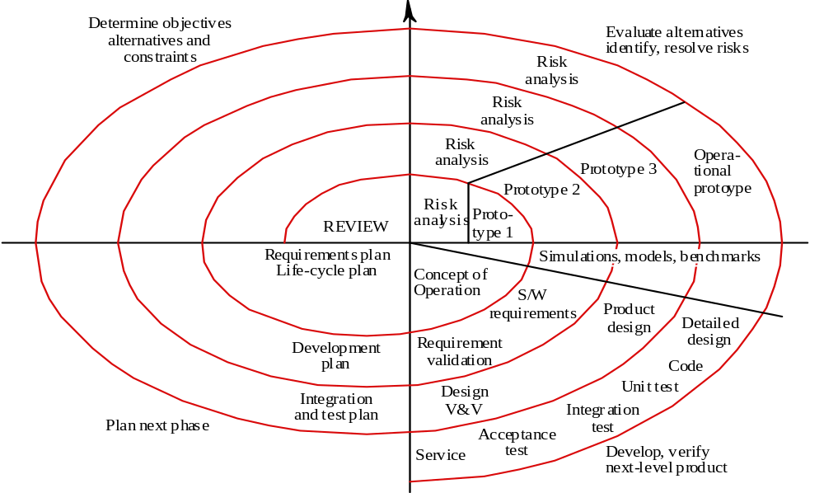
Spiral Process Model

Slide 17
Spiral Model Advantages
Focuses attention on reuse options.
Focuses attention on early error elimination.
Puts quality objectives up front.
Integrates development and maintenance.
Provides a framework for hardware/software
development.

Slide 18
Spiral Model Problems
Contractual development often specifies
process model and deliverables in advance.
Requires risk assessment expertise.

Slide 19
Process Visibility
Software systems are intangible so managers need documents to assess progress.
Waterfall model is still the most widely used model.

Slide 20
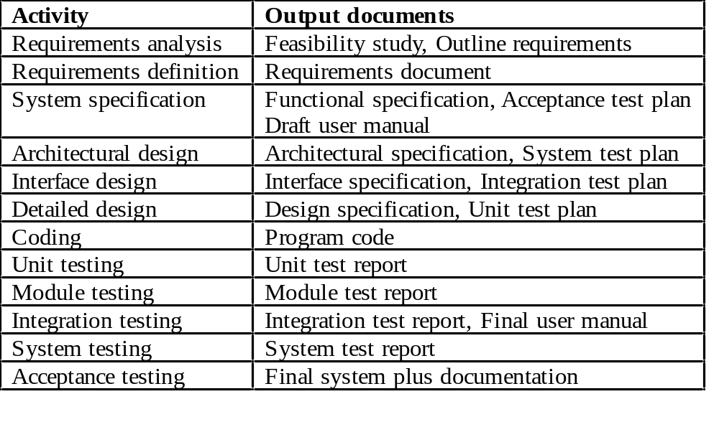
Waterfall Model Documents

Slide 21
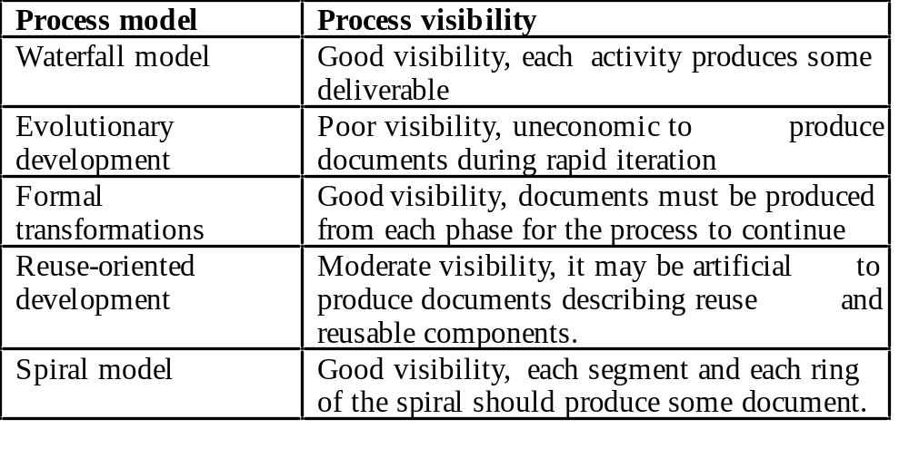
Process Model Visibility

Slide 22
Professional Responsibility
Software engineers should not just be concerned with technical considerations. They have wider ethical, social and professional responsibilities.
No clear rights and wrongs about many of these issues:
  Development of military systems
  Whistle blowing

Slide 23
Ethical Issues
Confidentiality
Competence
Intellectual property rights
Computer misuse

