Slide 1
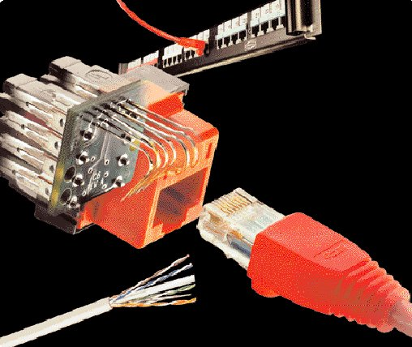
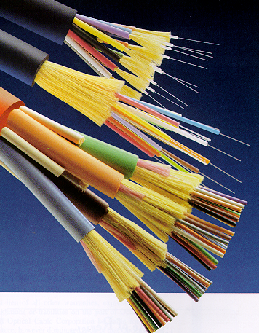
Physical Media
PHYSICAL MEDIA

Slide 2
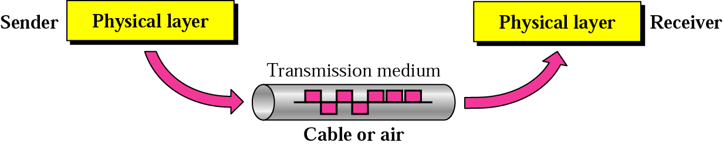
Physical Media
Physical Media

Slide 3
Physical Media
Physical Media
Copper
  Coaxial Cable - Thick or Thin
  Unshielded Twisted Pair - CAT 3,4,5,5e&6
Optical Fiber
  Multimode
  Singlemode
Wireless
  Short Range
  Medium Range (Line of Sight)
  Satellite

Slide 4
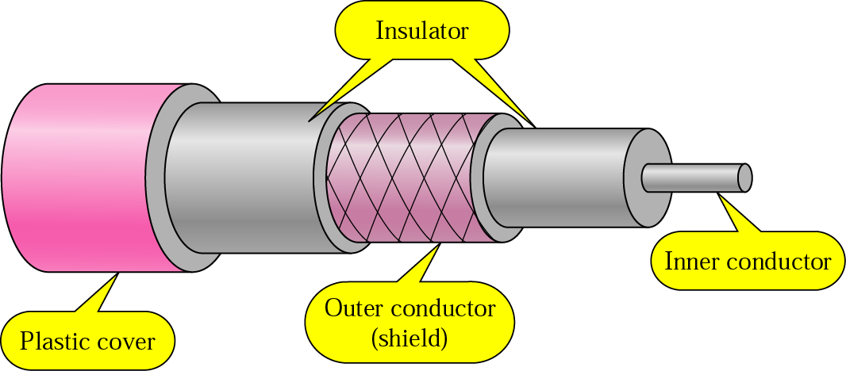
Copper Media: Coaxial Cable
Physical Media
Coaxial cable is a copper-cored cable surrounded by a heavy shielding and is used to connect computers in a network.
Outer conductor shields the inner conductor from picking up stray signal from the air.
High bandwidth but lossy channel.
Repeater is used to regenerate the weakened signals.
Category | Impedance | Use
RG-59 | 75 Ω | Cable TV
RG-58 | 50 Ω | Thin Ethernet
RG-11 | 50 Ω | Thick Ethernet

Slide 5
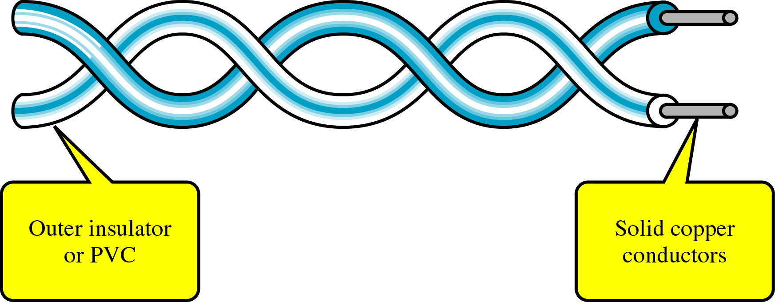
Copper Media: Twisted Pair
Physical Media
Twisted-pair is a type of cabling that is used for telephone communications and most modern Ethernet networks.
A pair of wires forms a circuit that can transmit data. The pairs are twisted to provide protection against crosstalk, the noise generated by adjacent pairs.
There are two basic types, shielded twisted-pair (STP) and unshielded twisted-pair (UTP).

Slide 6
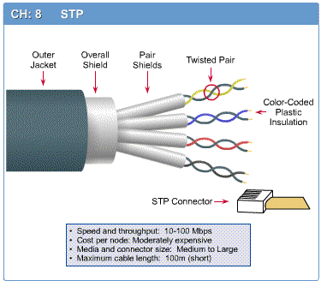
Shielded Twisted Pair (STP)
Physical Media

Slide 7
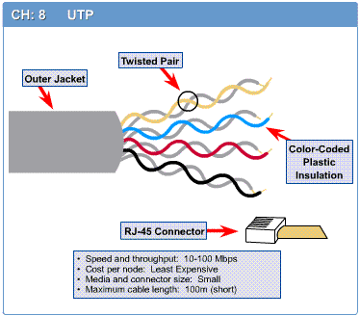
Unshielded Twisted Pair (UTP)
Physical Media

Slide 8
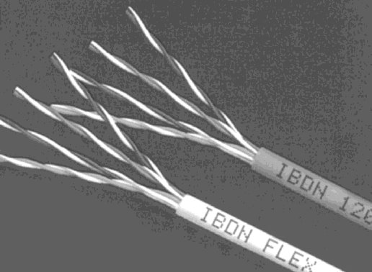

Unshielded Twisted Pair (UTP)
Physical Media
Consists of 4 pairs (8 wires) of insulated copper wires typically about 1 mm thick.
The wires are twisted together in a helical form.
Twisting reduces the interference between pairs of wires.
High bandwidth and High attenuation channel.
Flexible and cheap cable.
Category rating based on number of twists per inch and the material used
CAT 3, CAT 4, CAT 5, Enhanced CAT 5 and now CAT 6.

Slide 9
Categories of UTP
Physical Media
UTP comes in several categories that are based on the number of twists in the wires, the diameter of the wires and the material used in the wires.
Category 3 is the wiring used primarily for telephone connections.
Category 5e and Category 6 are currently the most common Ethernet cables used.

Slide 10
Categories of UTP: CAT 3
Physical Media
Bandwidth 16 Mhz
11.5 dB Attenuation
100 ohms Impedance
Used in voice applications and 10baseT (10Mbps) Ethernet

Slide 11
Categories of UTP: CAT 4
Physical Media
20 MHz Bandwidth
7.5 dB Attenuation
100 ohms Impedance
Used in 10baseT (10Mbps) Ethernet

Slide 12
Categories of UTP: CAT 5
Physical Media
100 MHz Bandwidth
24.0 dB Attenuation
100 ohms Impedance
Used for high-speed data transmission
Used in 10BaseT (10 Mbps) Ethernet & Fast Ethernet (100 Mbps)

Slide 13
Categories of UTP: CAT 5e
Physical Media
150 MHz Bandwidth
24.0 dB Attenuation
100 ohms Impedance
Transmits high-speed data
Used in Fast Ethernet (100 Mbps), Gigabit Ethernet (1000 Mbps) & 155 Mbps ATM

Slide 14
Categories of UTP: CAT 6
Physical Media
250 MHz Bandwidth
19.8 dB Attenuation
100 ohms Impedance
Transmits high-speed data
Used in Gigabit Ethernet (1000 Mbps) & 10 Gig Ethernet (10000 Mbps)

Slide 15

Fiber Media
Physical Media
Optical fibers use light to send information through the optical medium.
It uses the principal of total internal reflection.
Modulated light transmissions are used to transmit the signal.

Slide 16
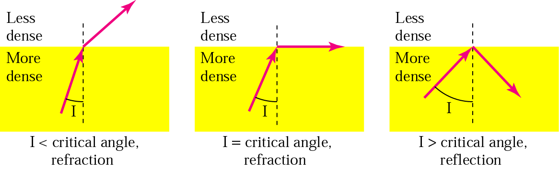
Total Internal Reflection
Physical Media

Slide 17
Fiber Media
Physical Media
Light travels through the optical media by the way of total internal reflection.
Modulation scheme used is intensity modulation.
Two types of Fiber media :
  Multimode
  Singlemode
Multimode Fiber can support less bandwidth than Singlemode Fiber.
Singlemode Fiber has a very small core and carry only one beam of light. It can support Gbps data rates over > 100 Km without using repeaters.

Slide 18
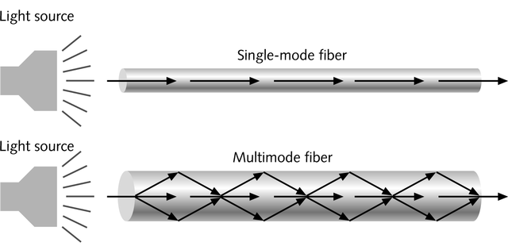
Single and Multimode Fiber
Physical Media
Single-mode fiber
  Carries light pulses along single path
  Uses Laser Light Source
Multimode fiber
  Many pulses of light generated by LED travel at different angles

Slide 19
Fiber Media
Physical Media
The bandwidth of the fiber is limited due to the dispersion effect.
Distance Bandwidth product of a fiber is almost a constant.
Fiber optic cables consist of multiple fibers packed inside protective covering.
62.5/125 µm (850/1310 nm) multimode fiber
50/125 µm (850/1310 nm) multimode fiber
10 µm (1310 nm) single-mode fiber

Slide 20
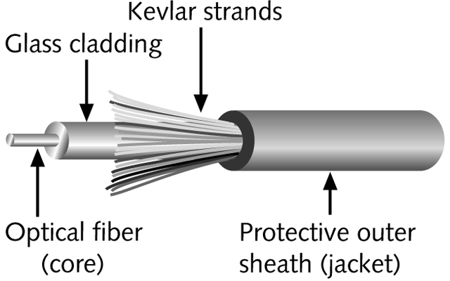
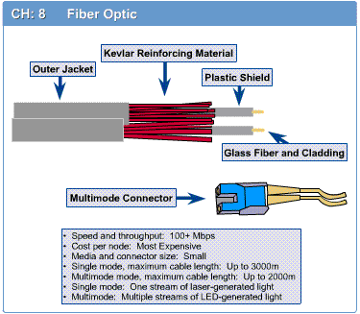
Fiber-Optic Cable
Physical Media
Contains one or several glass fibers at its core
Surrounding the fibers is a layer called cladding

Slide 21
Fiber Optic Cable
Physical Media
FO Cable may have 1 to over 1000 fibers

Slide 22
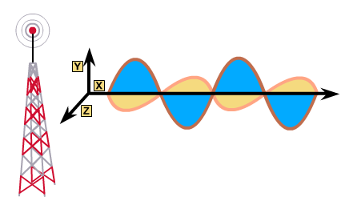
Wireless Media
Physical Media
Very useful in difficult terrain where cable laying is not possible.
Provides mobility to communication nodes.
Right of way and cable laying costs can be reduced.
Susceptible to rain, atmospheric variations and Objects in transmission path.

Slide 23
Wireless Media
Physical Media
Indoor : 10 – 50m : BlueTooth, WLAN
Short range Outdoor : 50 – 200m: WLAN
Mid Range Outdoor : 200m – 5 Km : GSM, CDMA, WLAN Point-to-Point, Wi-Max
Long Range Outdoor : 5 Km – 100 Km : Microwave Point-to-Point
Long Distance Communication : Across Continents : Satellite Communication

Slide 24
Frequency Bands
Physical Media
Band | Range | Propagation | Application
VLF | 3–30 KHz | Ground | Long-range radio navigation
LF | 30–300 KHz | Ground | Radio beacons and navigational locators
MF | 300 KHz–3 MHz | Sky | AM radio
HF | 3–30 MHz | Sky | Citizens band (CB), ship/aircraft communication
VHF | 30–300 MHz | Sky and line-of-sight | VHF TV, FM radio
UHF | 300 MHz–3 GHz | Line-of-sight | UHF TV, cellular phones, paging, satellite
SHF | 3–30 GHz | Line-of-sight | Satellite communication
EHF | 30–300 GHz | Line-of-sight | Long-range radio navigation

Slide 25
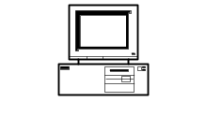
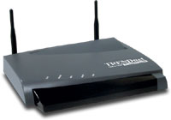


Wireless LAN
Physical Media
PC
Access Point
Internet
Router
Switch
PC
Access Point

Slide 26
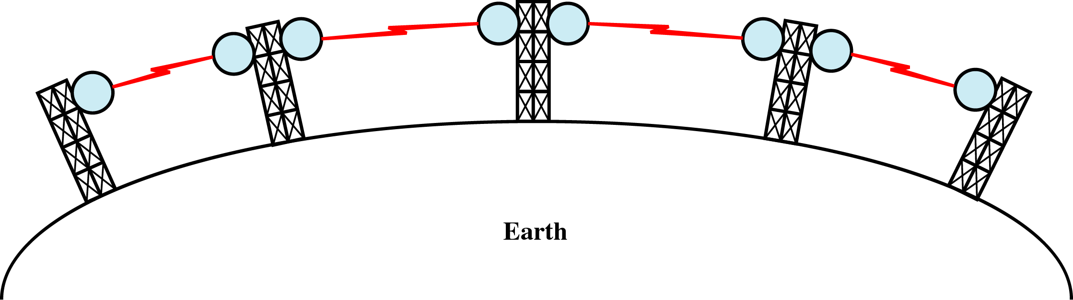
Terrestrial Microwave
Physical Media
Microwaves do not follow the curvature of earth
Line-of-Sight transmission
Height allows the signal to travel farther
Two frequencies for two way communication
Repeater is used to increase the distance Hop-by-Hop

Slide 27
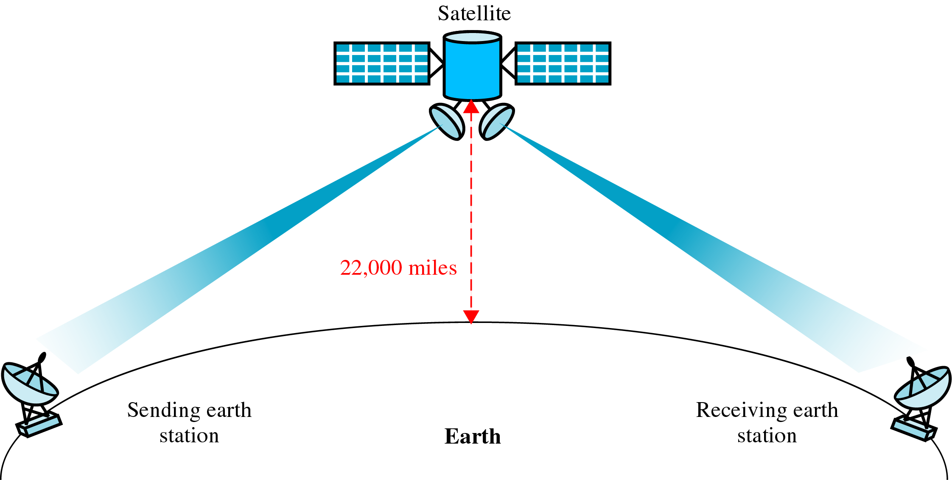
Satellite Communication
Physical Media

