Slide 1
Here, we study computer organization
  Structure: how computer components are connected together, how they communicate
  Function: what these components do
We start with the most important component, the CPU (central processing unit or processor)
  This is the brain of the computer, it does all the processing
  The CPU is in charge of executing the current program
    each program is stored in memory along with data
    the CPU is in charge of retrieving the next instruction from memory (fetch), decoding and executing it (execution)
    execution usually requires the use of one or more circuits in the ALU and temporary storage in registers
    some instructions cause data movement (memory accesses, input, output) and some instructions change what the next instruction is (branches)
  We divide the CPU into two areas
    datapath – registers and ALU (the execution unit)
    control unit – circuits in charge of performing the fetch-execute cycle
Notes:
As we covered in chapter 1, the basic process of the computer is the fetch-execute cycle. The Control Unit is programmed to perform this cycle. It issues commands to perform an instruction fetch (from memory to CPU), place the instruction in the instruction register, decode the instruction which comprises both determining what command will be issued (whether an arithmetic/logic operation, data movement, or condition and branch), fetch any operands (from memory or registers), execute the command, store the result (either to memory or registers) and determine if an interrupt has arisen during this cycle. We explore this in more detail later in this chapter.

Slide 2
Two Kinds of Registers
User registers
  These store data and addresses (pointers to data)
    These are manipulated by your program instructions
      Example: Add R1, R2, R3
        R1 ← R2 + R3
  Computers will have between
    1 and hundreds of registers
    Possibly divided into data and address registers
  Registers are usually the size of the computer’s word size
    32 or 64 bits today, previously it had been 8 or 16 bits
  Some machines use special-purpose registers
    each register has an implied usage
  Others have general-purpose registers
    use them any way you want to
Control registers
  Registers that store information used by the control unit to perform the fetch-execute cycle
    PC – program counter – the memory location of the next instruction
    IR – instruction register – the current instruction being executed
    Status flags – information about the results of the last instruction executed (was there an overflow, was the result positive, zero or negative? Etc)
    Stack Pointer – location in memory of the top of the run-time stack (used for procedure calls and returns)
Notes:
The typical notation for assembly instructions, like Add R1, R2, R3, is that the first operand listed is the destination and the next operands are the source. Some instructions use 2 operands instead, in which case the first operand is taken to be both destination and source. For instance, Add R1, R2 → R1 ← R1 + R2. Notice that these are destructive operations in that one operand is over-written. Some instructions use only 1 operand, in which case the other operand is implied to be a special purpose register like the accumulator (AC). Add X is taken to mean AC ← AC + X.

Slide 3
ALU and Control Unit
The ALU consists of circuits to perform arithmetic and logic operations
  Adder
  Multiplier
  Shifter
  Comparitor
    Etc…
  Operations in the ALU set status flags (carry, overflow, positive, zero, negative, etc)
  Also, possibly, temporary registers before moving results back to register or memory
The control unit is in charge of managing the fetch-execute cycle
  It sends out control signals to all other devices
  A control signal indicates that the device should activate or perform it’s function
  For instance:
    Instruction fetching requires
      sending the PC value to main memory
      signaling memory to read
      when the datum comes back from memory, move it to the IR
      increment the PC to point to the next instruction
    These operations are controlled by the control unit
    Now the control unit decodes the instruction signals the proper ALU circuit(s) to execute it
Notes:
We visited the ALU circuits in chapter 3 (or most of them). Recall that all circuits in the ALU operate when passed in data. We use a MUX to select the proper device’s output to pass back along the bus and into a destination register. Also, the various circuits will send result info to the status flag (positve, negative or zero, carry, overflow).

Slide 4
The System Clock
In order to regulate when the control unit issues its control signals, computers use a system clock
  At each clock pulse, the control unit goes on to the next task
    Register values are loaded or stored at the beginning of a clock pulse
    ALU circuits activate at the beginning of a clock pulse
    Typical clock speeds are based on the amount of time it takes to perform one of these actions (register or ALU)
Clock performance is based on the number of pulses per second, or its Megahertz (or Gigahertz) rating
  This is a misleading spec
  The number of clock pulses (cycles) that it takes to execute one instruction differs from one computer to the next
    Assume computer A takes 10 clock cycles per instruction but has a 1 Gigahertz clock speed
    Assume computer B can execute 10 instructions in 11 cycles using a pipeline, but has a 250 Megahertz clock speed
    Which one is faster? B even though its clock is slower!
Notes:
It may be surprising, but system clock speed does not equate to processor speed. There are many complicated factors that determine how fast a processor is. It was discovered in the late 80s that a pipeline will greatly increase processor speed, moreso than clock speed. So computer architects have been more focused on determining how to best provide parallelism both in terms of the ability to overlap instructions and in terms of offering extra hardware than on increasing clock speed. In fact, clock speed is not so much limited to any technological factor as it is limited by “what is the shortest operation available” because the system clock is often tuned to an operation. In RISC instruction sets, which we explore in chapter 5, we see that the system clock is often tuned to the time it takes to perform a cache access.

Slide 5
Comparing Clocks
It is difficult to compute CPU performance just by comparing clock speed
  You must also consider how many clock cycles it takes to execute 1 instruction
  How fast memory is
  How fast the bus is
  Etc
    The book offers an example comparing 286 multiply to a pentium multiply
In addition, there are different clocks in the computer, the Control Unit and the whole CPU are governed by the system clock
  There is usually a bus clock as well to regulate the usage of the slower buses
Notes:
We study measuring CPU performance in CSC 462/562 (Computer Architecture).

Slide 6
The Bus
System Bus connects the CPU to memory and I/O devices
  A bus is a collection of wires that carries electrical current
  The current is the information being passed between components
    typically the information is a datum or program instruction, but can also include control signals and memory or I/O addresses
  There are 3 parts to a bus
    the data bus (for both data and program instructions)
    the control bus (control signals from the Control Unit to devices, and feedback lines for acknowledging that the devices are ready or for interrupting the CPU)
    address bus (the address of the memory location or I/O device that is to perform the given data movement operation)
  Additionally, computers may have multiple buses
    local bus – connects registers, ALU and control unit together (also an on-chip cache if there is one)
    system bus – connects CPU to main memory
    expansion or I/O bus – connects system bus to I/O devices
Notes:
The address bus is uni-directional, the CPU always sends out the address, no other devices will send an address. The control bus is bi-directional, the CPU sends out commands to memory (read/write) and I/O devices (input, output, possible fast forward, rewind, format) and requests (are you available?) and the devices can send responses (busy/available) and interrupts (calls for attention). Data bus is bi-directional – data is sent from the CPU to memory for a store command, from CPU to I/O for an output command, from memory to CPU for a load command, from I/O to CPU for an input.

Slide 7
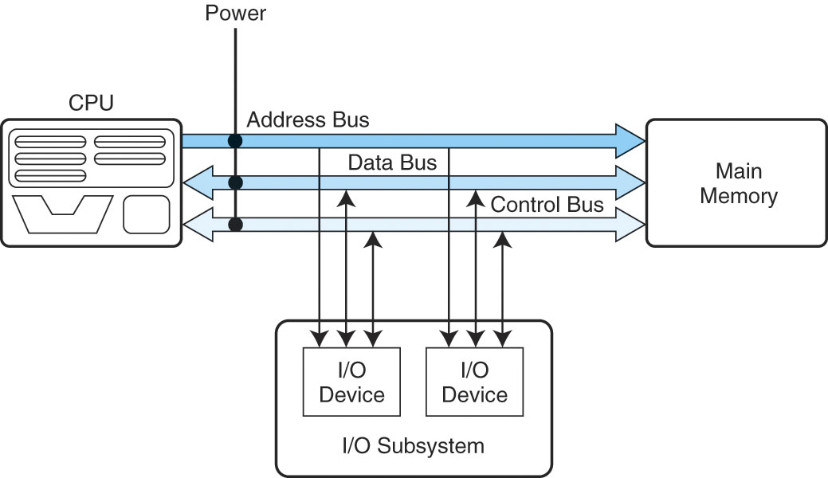
The System Bus
Here we see the system bus in more detail
The CPU connects to the bus through pins
The bus is on the motherboard inside the system unit
Main memory (a collection of chips) connects to this bus through pins
The I/O subsystem connects to this bus through the expansion bus
The bus carries three types of information
  the address from the CPU of the intended item to be accessed
  the control information (read versus write, or status information like “are you available?”)
  the data, either being sent to the device, or from the device to CPU

Slide 8
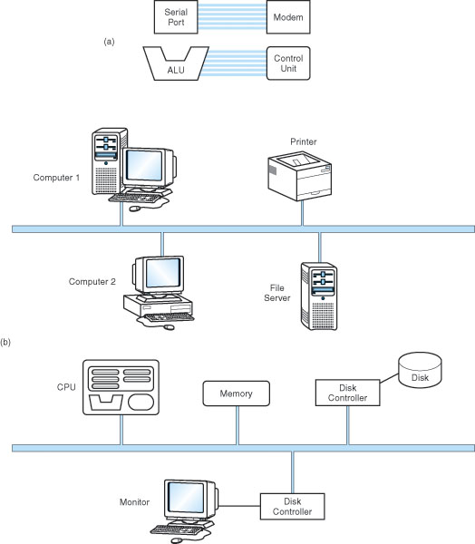
More on Buses
Buses connect two types of devices
  Masters – those devices that can initiate requests (CPU, some I/O devices)
  Slaves – those devices that only respond to requests from masters (memory, some I/O devices)
Some buses are dedicated
  The bus directly connects two devices (point-to-point bus)
Most buses connect multiple components
  Common pathway or multipoint
Point-to-point
Buses
Multipoint
network
Multipoint
Expansion bus
Notes:
This slide is not very important. The most important thing to get from it is that masters can initiate requests and that slaves only respond. Memory is a slave device, the CPU is a master device, and I/O devices are both. Few buses are point-to-point except within the CPU. The system bus connects to the expansion bus, and the expansion bus connects to the network, so you can think of a computer network as an extension to the expansion (I/O) bus.

Slide 9
Bus Interactions
Except for point-to-point buses, we have to worry about who gets to use the bus
  Especially the expansion bus where multiple I/O devices may want to communicate between themselves and the CPU or memory at the same time – we need a form of bus arbitration
    Daisy chain arbitration
      each device has a bus request line on the control bus, when a device wants to use the bus, it places its request and the highest priority device is selected (this is an unfair approach)
    Centralized parallel arbitration
      the bus itself contains an arbiter (a processor) that decides – the arbiter might become a bottleneck, and this is also slightly more expensive
    Distributed arbitration
      the devices “vote” to determine who gets to use the bus, usually based on a priority scheme, again possibly unfair
    Distributed arbitration using collision detection
      it’s a free-for-all, but if a device detects that another device is using the bus, this device waits a short amount of time before trying again

Slide 10
I/O Subsystem
There are many different types of I/O devices, collectively known as the I/O Subsystem
  Since I/O devices can vary greatly in their speed and usage, the CPU does not directly control these devices
  Instead, I/O modules, or interfaces, take the CPU commands and pass them on to their I/O devices
    One interface is in charge of one or more similar types of devices
  To communicate to the right I/O device, the CPU addresses the device through one of two forms
    Memory-mapped I/O
      the interface has its own memory which are addressed as if they were part of main memory, so that some memory locations are not used, they are instead registers in the I/O interfaces
    Isolated I/O
      the CPU differentiates memory addresses from I/O addresses by having additional control lines indicating whether an address is meant for memory or I/O
        we will explore I/O in more detail in chapter 7
Notes:
I/O interfaces contain registers and in some cases, memory buffers. So each of these is given its own address. In memory-mapped I/O, these addresses overlap those of memory so that a request issued to one of these memory addresses is actually a request of I/O, not memory and memory ignores the request. In such a system, the addresses are the earliest (say the first 5000 addresses). As an example, a disk interface might have these storage locations:
0: control register (bits for: the command, is the device available? did an interrupt arise? has the interrupt been acknowledged?)
1: address (what memory address will we be sending the datum to once it is loaded from disk?)
2: count (how many bytes/words will we transfer?)
3-1026: (1K worth of storage)
In isolated I/O, the 5000 or so addresses are separate from memory, so that we need an extra control line to indicate if the address is a memory address or an I/O address. In memory-mapped I/O, the early addresses are shared so that, if one of these addresses is sent out, memory ignores it.

Slide 11
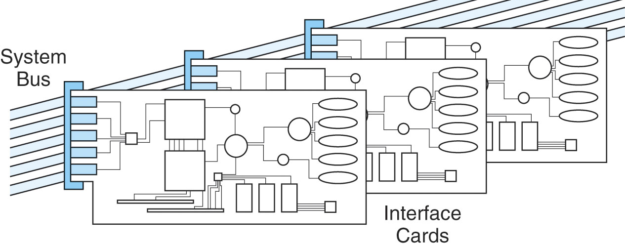
I/O Devices and Bus
The expansion bus typically is the collection of expansion slots and what gets plugged into them
  Here we see interface cards (or expansion cards), each with the logic to interface between the CPU and the I/O device (e.g., printer, MODEM, disk drive)
  Some devices are placed on the card (MODEM), others are plugged into the card through ports
Notes:
Just a figure that illustrates how devices connect to the computer. In some cases, the devices are present on the expansion cards (like a modern MODEM). In other cases, the card contains the interface but the device itself is plugged in through a port of some kind. In either case, the card plugs into an expansion slot on the mother board and the slot itself is connected to the expansion bus (not the system bus as shown in this figure).

Slide 12
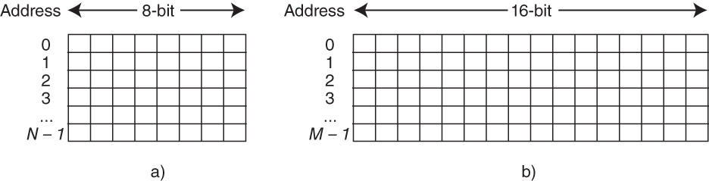
Memory Organization
Memory is organized into byte or word-sized blocks
  Each block has a unique address
    This can be envisioned as an array of cells, see the figure below
  The CPU accesses memory by sending an address of the intended access and a control command to read or write
  The memory module then responds to the request appropriately
    A decoder is used to decode the binary address into a specific memory location
Notes:
We must differentiate between the size of memory and the number of addresses in memory. Computers may be
byte addressable, in which case every byte is its own address and therefore the two sizes are the same (size of memory in bytes, number of addresses)
word addressable, in which case a single memory address denotes a collection of bytes so that the two sizes differ
For instance, above on the right, we have a computer of M addresses where each address stored 16 bitrs (2 bytes), so that in fact the computer has a size of 2*M Bytes or M Words. When a computer is word addressable, we will have to translate memory sizes from bytes to words.
We will want to know the number of bits needed to specify an address. We need this to know the size of the address bus and also to know how big an address register needs to be. In most computers, we use 32 bit or 64 bit registers and buses. A 32 bit address is a decent size but today’s computers are beginning to require larger addresses.
To determine the number of bits per address, we use log ₂ number of addresses. If we are dealing with a byte addressable computer, then this is log ₂ memory size in bytes. If we are dealing with a word addressable computer, then this is log ₂ number of addresses. The number of addresses for a word addressable computer = memory size in bytes / number of bytes per word. The number of bytes per word is the word size / 8 bits (word size is usually given in bits, such as 32 bits).
Examples: We have a 4 GByte computer where the word size = 32 bits. If the computer is byte addressable, then there are 4 G memory locations and we need log ₂ 4G = 32 bits for an address. If the computer is word addressable, then there are 4 GByte / 4 bytes/word = 1 GWord and we need log ₂ 1G = 30 bits for an address.
What about a 32 GByte computer with word size = 64 bits?

Slide 13
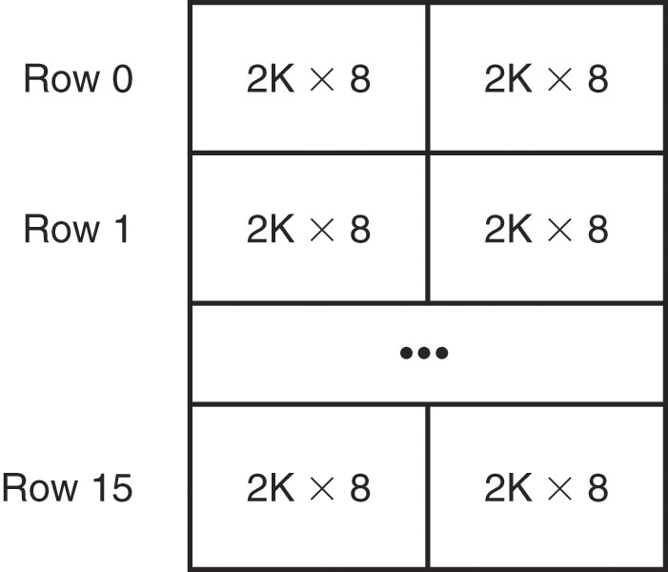
Dividing Memory Across Chips
Each memory chip can store a certain amount of information
  However, architects decide how memory is spread across these chips
  For instance, do we want to have an entire byte on a single chip, or spread a byte across 2 or more chips?
  The figure to the right shows that each chip stores 2 Kbytes and with 16 rows and 2 columns of chips, we can store 64 Kbytes
    Here, a word (16 bits) is stored in two chips in the same row
Notes:
We create our computer memories by spreading them across multiple RAM chips. In the above example, we use 32 2Kx8 chips to build a 64 KByte computer. One advantage to spreading memory over several chips is that it creates distinct memory banks (in the figure above, these are unfortunately called rows). We discuss the use of memory banks on the next slide.
We would assume that for the above example, the word size is 16 bits, that is, going across one complete row or address is 16 bits, spread across two chips. So for instance, in memory location 0, the first 8 bits are placed on one chip and the last 8 bits are placed on a second chip. We would also assume that the machine is word addressable (most computers are today). So for the above example of a 16-bit word addressable computer, there are a total of 32K addresses making up 64KByte. With 32K of addresses, we need log ₂ 32K = 15 address bits. Now further notice that each chip stores 2K addresses of the 32K. There are 16 banks. Out of the 15 address bits, 11 of them are used on the chip to denote the specific address for that chip (actually, for that pair of chips, so its more accurate to say that the 11 bits denote the specific address for that bank). What about the other 4 bits? They are used to denote the bank number (4 bits lets us address 16 banks).
Assume instead that we have 16GBytes where each chip stores 128Mx8, and the machine is word addressable with a word size of 32 bits. How many chips are there? How many banks are there? How many bits does it take to make an address? Of those bits, how many are used for the address on the bank and how many to select the bank?
Before we compute the number of chips, we have to convert memory size to size in words. 16GB of 32-bit words = 16GB / 4 bytes/word = 4GWords (32 bits = 4 words, so we divided 16GB by 4). This makes memory 4Gx32.
To compute the number of chips, divide the size of memory by the size of a chip. The chip size, 128Mx8 means 128M addresses of 8 bits each. We get 4Gx32 / 128Mx8 = 32*4 = 128 chips. The number of banks is 128 chips / (32 / 8) = 32 banks. The size of an address is log ₂ 4G = 32. Of the 32 bits, we need log ₂ 32 = 5 bits for the bank select, leaving 32 – 5 = 27 bits for the address sent to the bank. Note that 2^27 = 128M, which means that we did this correctly in that each bank stores 128M addresses.

Slide 14
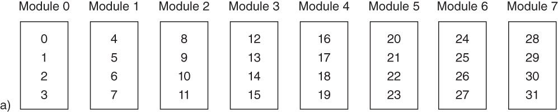
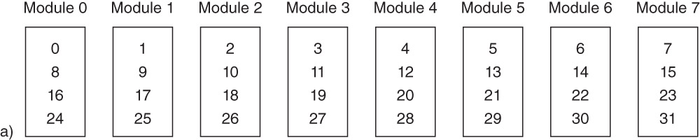
Interleaving Memory
Using high-order interleave, the address is broken into the chip followed by the location on the chip, giving a layout as shown above
  The advantage of high-order interleave is that two different devices, working on two different areas of memory, can perform their memory accesses simultaneously
  e.g., one device accesses address 5 and another accesses 31
In low-order interleave, the address is broken up by location on the chip first, and the chip number last
  Consecutive memory locations are on consecutive chips
  The advantage of lower-order interleave is that several consecutive memory accesses can be performed simultaneously
  For instance, fetching 4 consecutive instructions at one time
Notes:
You can see the pattern of interleaving addresses across banks (here referred to as modules for some reason). Notice that in this above example, they erroneously start the modules at 1 instead of numbering them 0-7. Lets assume that in fact Module 1 refers to Bank 0 and Module 8 refers to Bank 7.
In the above computer, we have 32 total memory locations (we will assume to match the figure that each memory location is placed on a single chip). Thus, we need log ₂ 32 = 5 bits for any address. With 8 banks, we need log ₂ 8 = 3 bits for a bank and that leaves 2 bits for the address on a bank (and this is confirmed by seeing that every bank stores 4 different addresses). Lets further assume that we want to track down memory location 13 = 01101 in binary. In high-order interleave, the bank number is the first set of bits (in this case, the left-most 3 bits) and the address on the bank is the last set of bits (in this case, the right-most 2 bits). So address 13 should be on bank 011 and location 01. Recall that Bank 3 will really be Module 4. So look at Module 4 above in position 1 (the top position is location 0) and you will see 13. In low-order interleave, the bank number is the last set of numbers. For this example then, we will find location 13 at location 01 of bank 101 (bank 5 is Module 6). Look at module 6 position 1 and you will find 13!
Now notice that for high-order interleave, successive memory locations are located on the same bank. Assume that our memory is connected to multiple buses (for instance, memory connects to the CPU over the system bus and to I/O devices over the expansion bus). Since the CPU and an I/O device will most likely be referencing different processes (or perhaps the same process, but different parts of it), then high order interleave makes it likely that the devices will want to communicate with different parts of memory. A single memory bank can only respond to a single access at a time, but if two devices were contacting different banks, then both banks could potentially respond simultaneously. This is the advantage of high-order interleave.
Low-order interleave supports a different idea. Notice in low-order interleave that successive memory locations are stored on separate banks. Many high performance processors will request not just a single item from memory, but its successors too (a look-ahead fetch for instance). Instead of making the processor wait for 4 consecutive memory accesses, which is slow, all 4 accesses can occur simultaneously and then be shipped back to the CPU over the bus in 4 transfers. Since the bus transfer is faster than the memory access, a CPU can request one item and while processing it, 3 more of its neighbors could be on the way for the next few cycles.
Some computers will use low-order interleave and some use high-order depending on which form of parallelism is felt to be more warranted.

Slide 15
Interrupts
The last part of our computer organization is an interrupting mechanism
  Left to itself, the CPU performs the fetch-execute cycle on your program repeatedly without pause, until the program terminates
    What happens if an I/O device needs attention?
    What happens if your program tries to do an illegal operation?
      see the list on page 157 of types of illegal operations
    What happens if you want to run 2 or more programs in a multitasking mode?
  You cannot do this without interrupts
An interrupt is literally the interruption of the CPU so that it can switch its attention from your program to something else
  an I/O device, the operating system, or another user program

Slide 16
The Interrupt Process
At the end of each fetch-execute cycle, the CPU checks to see if an interrupt has arisen
  Devices send interrupts to the CPU over the control bus
    If the instruction causes an interrupt, the Interrupt Flag (in the status flags) is set
  If an interrupt has arisen, the interrupt is handled as follows
    The CPU saves what it was doing (PC and other important registers are saved to the run-time stack in memory)
    The CPU figures out who raised the interrupt and executes an interrupt handler to handle that type of interrupt
    The interrupt handler is a set of code (part of the OS) stored in memory
    While the interrupt is being handled, the CPU may choose to ignore or disable interrupts from interrupting the interrupt handler (known as a maskable interrupt) or may choose to handle a future interrupt (non-maskable interrupt)
    Once the interrupt has been handled, the CPU restores the interrupted program by retrieving the values from the run-time stack
Notes:
Note that while a device may raise an interrupt at any time, an interrupt of the CPU will only be processed at the end of a fetch-execute cycle. Thus, an instruction cannot be interrupted although a program can be.
What information does the CPU save? Since the CPU must resume the process at the next instruction, it saves the PC (which has already been incremented to point at the next instruction). The status flags need to also be saved, as is the stack pointer register, which points to the program’s run-time stack (not to be confused with the operating system’s run-time stack mentioned in the slide above). The accumulator or other data registers may also be saved.
Some high-performance computers use two sets of registers so that an interrupt does not require saving the process information (registers) to a run-time stack in memory. Instead, these values are moved into a second set of registers and then these values are moved back into the original registers when the interrupt is over. Since the extra set of registers is more expensive, this is limited to high-performance computers only. Also, we still may need to use the run-time stack if an interrupt arises while we are handling the interrupt. We discuss how interrupts are handled in more detail in chapter 7.

Slide 17
MARIE: A Simple Computer
We now put all of these elements together into a reduced computer
  MARIE: Machine Architecture that is Really Intuitive and Easy
    Unfortunately we will find that MARIE is too easy, it is not very realistic, so we will go beyond MARIE as well
    We will explore MARIE’s
      CPU (registers, ALU, structure)
      Instruction set (the instructions, their format – how you specify the instruction, addressing modes used, data types available
      Interrupts, I/O
      Some simple programs in MARIE
Notes:
MARIE is based on early computers. What MARIE represents is the most primitive type of computer we can have, that is, the absolute minimum. Modern computers are far more complex. However, we study MARIE just to understand what is going on in the hardware and what an instruction set must contain. We expand on instruction sets in chapter 5 when we look at a variety of different ones, and then we look at IBM PC assembly.

Slide 18
MARIE’s Architecture
Data stored in binary, two’s complement
Stored programs
16-bit word size with word addressing (you can only get words from memory, not bytes)
4K of main memory using 12 bit addresses, 16-bit data
16-bit instructions (4 bits for the op code, 12 bits for the address of the datum in memory)
Registers:
  AC (accumulator) – this is the only data register (16 bits)
  PC (12 bits)
  IR (16 bits)
  Status flags
  MAR (memory address register) – stores the address to be sent to memory, 12 bits
  MBR (memory buffer register) – stores the datum to be sent to memory or retrieved from memory, 16 bits
  8-bit input and 8-bit output registers
Notes:
Since we have 4KWords of word addressable memory, we need log ₂ 4K = 12 bits for an address. Each address is to 1 word (16 bits). So in reality, we have 8KBytes of memory. Each instruction is 16 bits, of which 4 bits are the operation (the op code). The remaining 12 bits are usually an address in memory of an operand, but not in every case. We will explore the operations in a couple of slides.
There is only 1 data register, so operations will implicitly refer to this register, possibly along with an operand from memory. For instance, Add X means AC ← AC + X where X is the memory location of a datum that we want to add to the AC. The MAR and MBR are interfaces between the CPU and the system bus. The CPU will place an address in the MAR and signal a read, memory will look up that address and send the datum back along the data bus, where the value will be temporarily stored in the MBR. Or, the CPU will place an address in the MAR and the AC value in the MBR and signal a write. The value in the MAR is sent to memory over the address bus and the value in the MBR is sent to memory over the data bus. Memory will then save the value on the data bus to the address on the address bus.
I/O works a bit differently. Upon any input, the value is automatically moved to the IN register. The CPU then moves the datum appropriately. On an output, the AC value is moved to the OUT register and the CPU signals an output. The output device takes the datum from OUT and outputs it. The only two devices are keyboard (IN) and monitor (OUT).

Slide 19
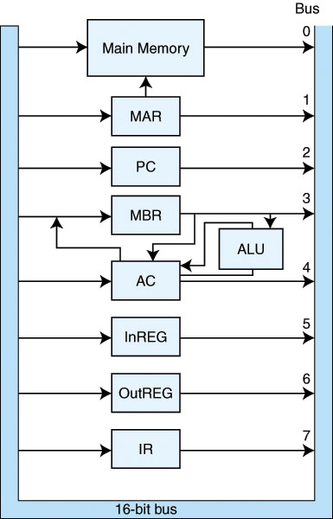
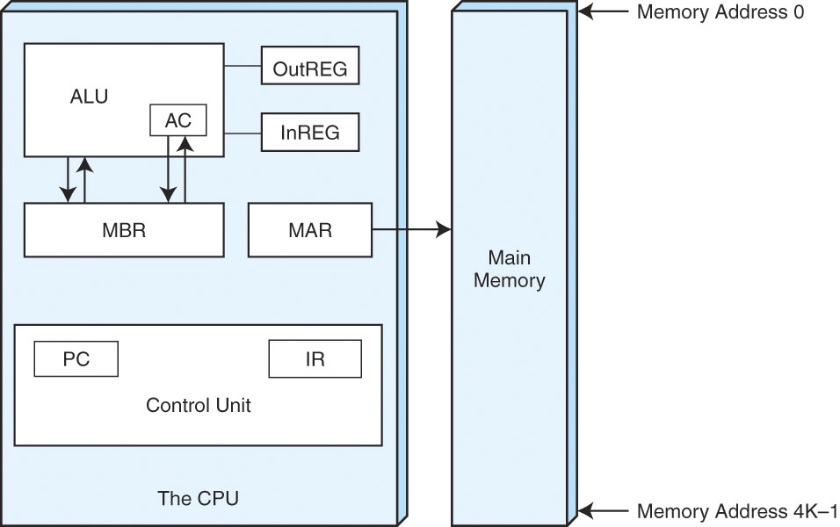
MARIE CPU
The structure of our CPU with the registers shown
Notice that the MAR sends to memory, the MBR
stores the datum being sent to memory or retrieved
from memory, the InREG and OutREG receive data
from and send data to I/O respectively
The data pathways in the
CPU from register to register
or to the ALU or memory
Notes:
The figure on the right is more important to understand as it shows how the various devices communicate. The figure on the left is merely the direction that information flows. There are a couple of pathways missing from the figure on the right:
PC → MAR
Main memory → MBR
Main memory → IR (although this will probably not exist, I explain more later)
PC → incrementer → PC (in fact, the PC is an increment register, so when signaled, it will add 1 to itself)
MAR → PC (used for branches)

Slide 20
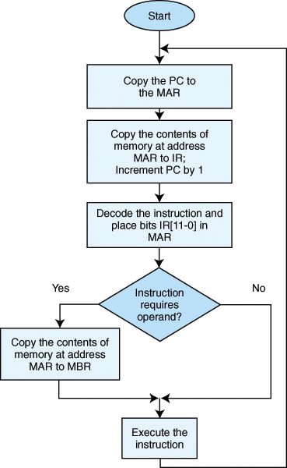
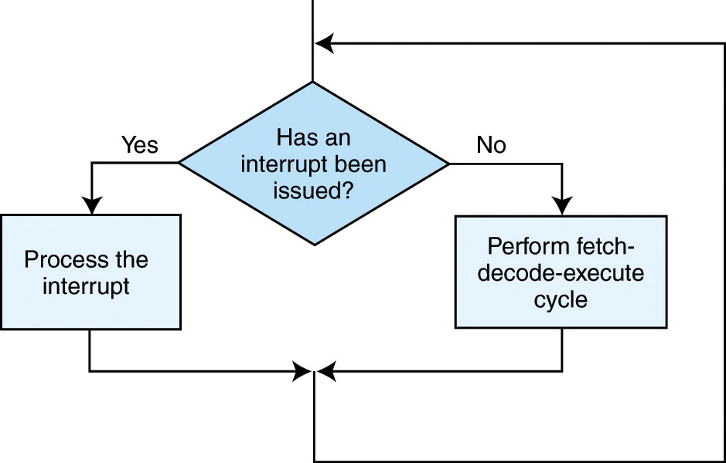
MARIE’s Fetch-Execute Cycle
PC stores the location in memory of the next
Instruction
1) fetch instruction by sending the address to
memory (PC to MAR to memory)
2) memory sends back instruction over data bus,
to MBR, move it to IR, increment PC
3) Decode the instruction (look at op code, place
8-bit data address in MAR if needed
4) If operand required, fetch it from memory
5) Execute instruction
6) If necessary, process interrupt
Notes:
More specifically:
Fetch: MAR ← PC
IR ← M[MAR] // send the address in the MAR to memory, signal a read,
// memory looks up the “datum” (its really an instruction) and sends
// it back to the CPU where it is placed in the IR
PC ← PC + 1
Decode: Analyze IR for op code
Fetch operand: MAR ← IR[11..0] // these bits are an address*
MBR ← M[MAR] // fetch operand *
Execute: instruction specific
Store result: AC ← M[MAR] // *
* -- optional depending on the specific operation
NOTE: The above, and the authors description, is slightly erroneous. The way that the instruction fetch really works is as follows:
MBR ← M[MAR] // first, we fetch the instruction and move it into the MBR
IR ← MBR // now we move it into the IR
If you want to shorten this to IR ← M[MAR], that is acceptable since that is how the authors describe it, but in fact the instruction is first temporarily stored in the MBR before being moved into the IR

Slide 21
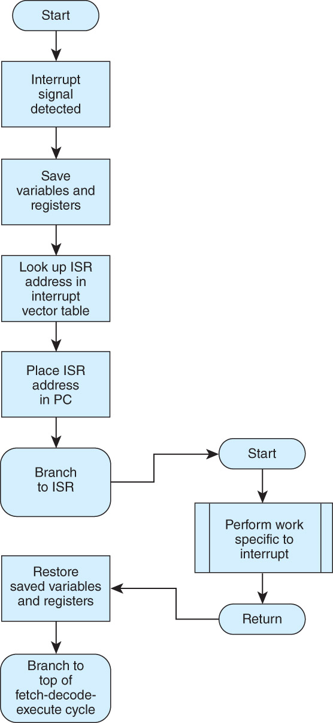
Processing an Interrupt
Which registers should we save?
In MARIE, AC, PC (and SP if we
have one)
ISR is the interrupt service routine’s
starting location, stored in a
special place in memory called
the vector table
We explore this in detail in chapter 7

Slide 22
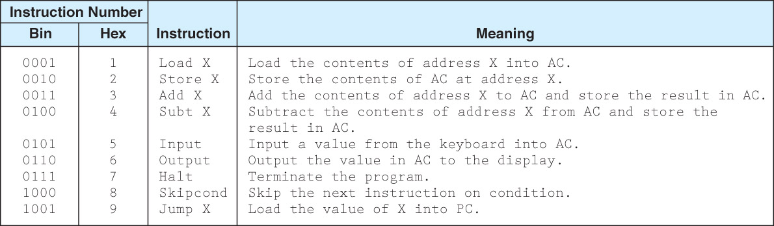
MARIE’s Instructions
move a datum from memory to AC or back (Load/Store)
perform + or – between AC and datum in memory
do I/O
skip over an instruction, jump to a different location in memory (used in if-else, loop instructions)
halt the program
Notes:
Here are the first 9 of the 13 available MARIE instructions. We explore these in more detail in the next few slides. These are all the operations we need except for dealing with pointers. However, other instructions would make programming a lot easier, such as a multiply, or better conditional branch.

Slide 23
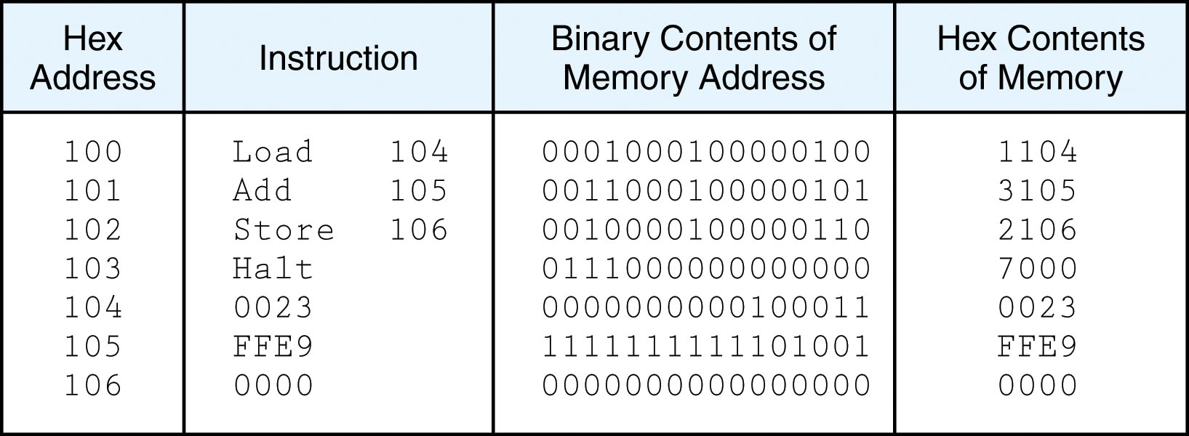
Example: Add 2 Numbers
This code will add the two numbers stored at memory location 104 and 105
Load 104 loads the AC with the value at 104 (0023)
Add 105 adds to the AC the value at 105 (FFE9)
Store 106 takes the value in the AC (000C) and moves it to location 106
Halt then stops the program
Notes:
What we have above is a program to compute A = B + C where A is stored in 106, B is stored in 104 and C is stored in 105. The second column is the program (4 instructions) written in MARIE. The first column shows us how the program is stored in memory (where each instruction and datum is located). The assembler will translate the MARIE program into machine language, shown in the 3rd column. The 4th column merely shows us the contents of memory in hex instead of binary for convenience.
The PC is originally loaded with 100 and the fetch execute process begins until a Halt instruction is reached. Notice that while the first 3 instructions all have operands, Halt does not need one.

Slide 24
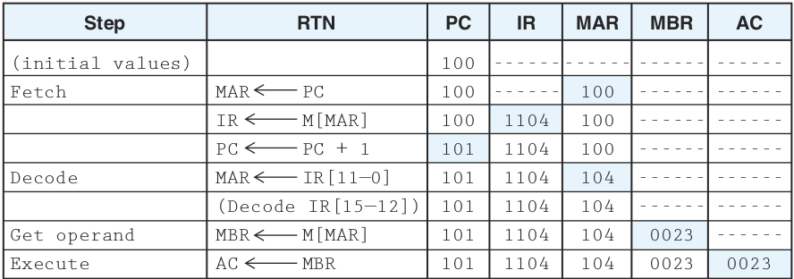
Example: Load 104
Notes:
We step through the program now (excluding the Halt instruction) to see what is going on in the machine. The RTN (register transfer notation) column indicates the register transfers, that is, what the instruction actually does. Each row takes 1 clock cycle to execute.
First, we fetch the instruction (as discussed before, MAR ← PC, IR ← M[MAR], PC←PC+1 although in fact the second row should really be two rows, MBR ← M[MAR], IR ← MBR), next we decode, and since this instruction includes an operand, we must fetch the operand by moving the address of the operand from the IR to the MAR and signal a memory read. This moves the datum in 104 into the MBR. The actual “execution” is merely to take the loaded operand and move it to the AC. Since we already incremented the PC, we are ready for instruction 2. All this instruction did was load the datum at address 104 (0023) into the AC.

Slide 25
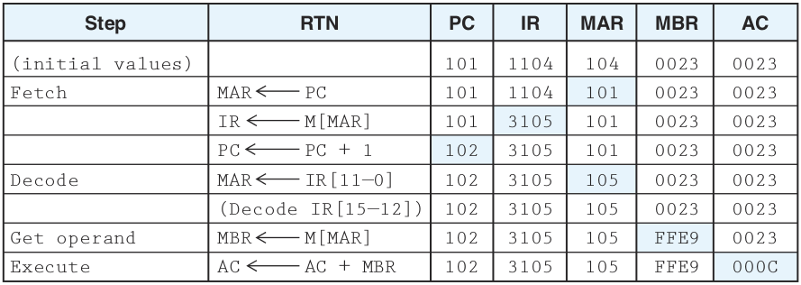
Example: Add 105
Notes:
The fetch is identical for every instruction. This instruction also contains an operand, so we need, during the decode, to move the address from the IR (bits 11..0) into the MAR and fetch the operand. The execution of this instruction is AC ← AC + MBR. MBR has FFE9 (a negative number in 2’s complement – 1111111111101001). Once done, the AC is now 0023 + FFE9 = 000C.

Slide 26
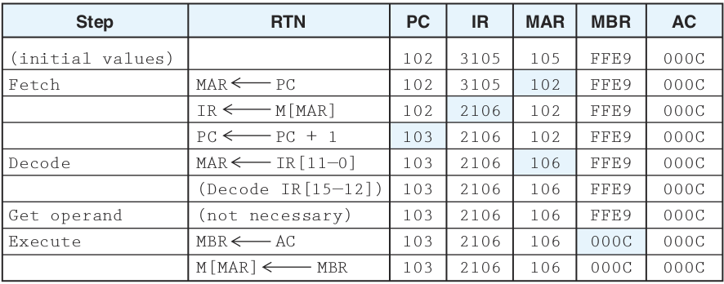
Example: Store 106
Notes:
Same instruction fetch. This instruction does not need an operand fetch, but an operand store. This, like the previous two instructions, requires that we move the address from the IR (bits 11..0) into the MAR. But now we need to move a datum into the MBR. So the execute is MBR ← AC, followed by writing the datum to memory by doing M[MAR]←MBR.
NOTE: the notation MBR←M[MAR] does three things. 1. signal memory read. 2. memory looks up the address on the address bus. 3. memory returns the datum over the data bus (where it gets stored in the MBR). The notation M[MAR]←MBR does three things. 1. signal memory write. 2. datum sent over data bus to memory. 3. memory looks up the address sent over the address bus and stores the datum in the data bus at that location. In the latter case, the datum and address are sent at the same time.

Slide 27
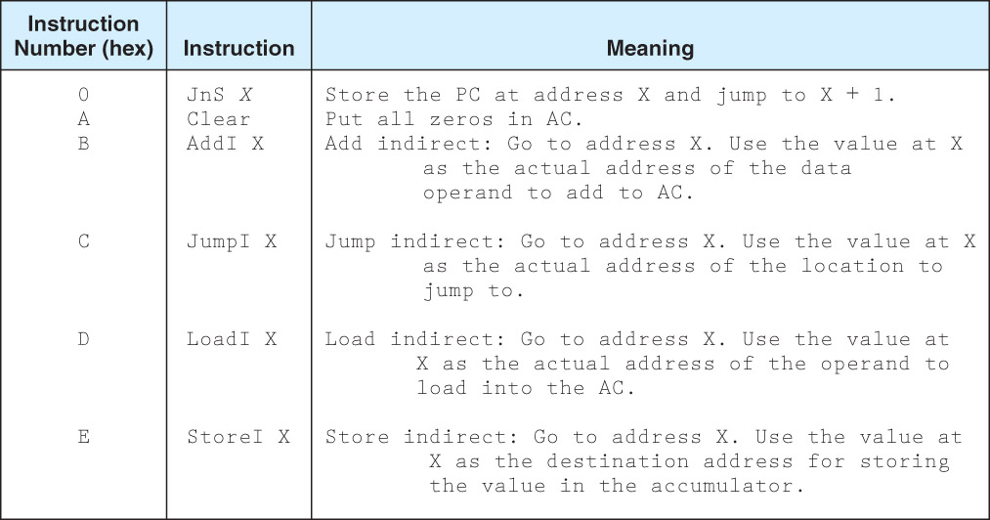
6 More Instructions
Notes:
The Clear instruction is important. The AddI and JumpI are necessary but ones we won’t be covering in any of our problems because they are more complex, but both involve pointers. AddI X does this: AC ← AC + *X (where *X is taken to be a pointer dereference as you use in C). JumpI X does this: PC ← *X instead of PC ← X. We use indirect jumps when the address is stored in memory. This will be the case when we want to permit program code to be moved (as is needed with virtual memory when the operating system moves program code around memory). We may also want to use an indirect jump when we want to compute a branch location. And we will need this as part of our JnS routine.
The JnS X is used for procedure calls – that is, branches where we want to return after the procedure ends. We explore this in the next slide’s notes. Note that while JnS X allows us a “branch and return”, it does not provide for any form of parameter passing. We would need to add that mechanism to make the language more useful.
Of the 4 instructions on this slide, we will only be dealing with Clear.

Slide 28
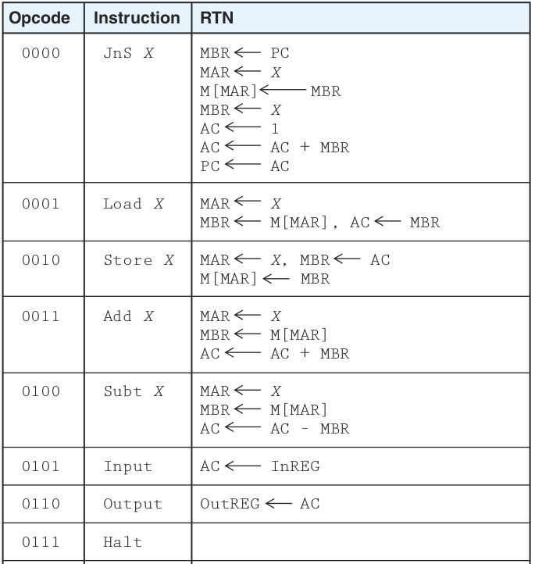
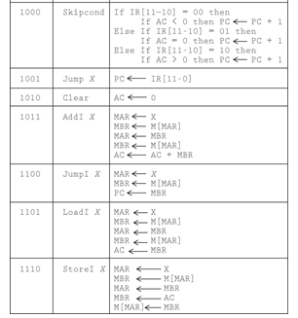
The Complete MARIE Instruction Set
This figure shows the register movements
(RTN – register transfer notation) required
for each of the 15 instructions in MARIE’s
instruction set
Notes:
We have already explored Load, Store, Add and Halt. Subt is essentially the same as Add. Input merely moves the input value from the InReg to AC and output merely moves AC to the OutReg. Jump X merely replaces the PC value (the next instruction) with the location of the branch. Clear resets the AC to 0 (the arrow is missing in the figure above). See if you can figure out AddI on your own.
Skipcond: we need a conditional branch – that is, based on a condition that we have tested, do we branch or not? There are 3 conditions that we can test, AC < 0, AC = 0, AC > 0. The skipcond works as follows: test the condition provided and if true, skip 1 instruction by doing PC ← PC + 1. The condition provided is a 2-bit value in bits 11 and 10 and will be 00 to test AC < 0, 01 to test AC = 0, and 10 to test AC > 0.
Example: if (x<y) x++; // notice we don’t have an x < y condition, so we do x – y and compare it to 0
Load x
Subt y // AC is now x - y
Skipcond 00 // is AC < 0, if so then x < y and we skip 1 instruction (go to the Load X)
Jump Next // we reach this location if the condition was false, that is, x >=y
Load X // start to do the if clause (x++)
Add One // this is explained in the next slide
Store X // finishes x++
Next: … // we branch here if the Skipcond 00 was false
So notice how we had to place a Jump instruction after the skipcond – if the condition is true, skip over 1 instruction otherwise go to that instruction which skips us around the if clause
JnS X: assume X is the location of preceding the first instruction in our subroutine. We take the PC value (which is the location of the next instruction since we already did PC ← PC + 1, that is, PC is the location we want to return to when the subroutine terminates) and store it at location X. Add 1 to PC (using the AC as a temporary storage location) and now start executing code. We are now executing the subroutine. The last instruction in the subroutine will be JumpI X. This will retrieve the PC value from location X and then put that value into the PC so that we continue executing from the point after our JnS X instruction in our previous set of code.

Slide 29
Loop Example
We want to implement the following loop in MARIE code:
for(i=0;i<n;i++)
sum += i;
assume that i is stored at 200, n at 201, sum at 202, that the variable one is stored at 203
storing the value 1, and that the code starts at address 100 (all addresses are hex addresses)
100: Clear 1010 000000000000 A000
101: Store i 0010 001000000000 2200
102: Clear 1010 000000000000 A000
103: Store sum 0010 001000000010 2202
104: Loop: Load i 0001 001000000000 1200
105: Subt n 0100 001000000001 4201
106: Skipcond 00 1000 000000000000 8000
107: Jump xout 1001 000100001110 910F
108: Load i 0001 001000000000 1200
109: Add sum 0011 001000000010 3202
10A: Store sum 0010 001000000010 2202
10B: Load i 0001 001000000000 1200
10C: Add one 0011 001000000011 3203
10D: Store i 0010 001000000000 2200
10E: Jump Loop 1001 000100000100 9104
10F: Xout: Halt
Notes:
Notice in this example that we stored the datum 1 at a location called one. Why couldn’t we write our MARIE instruction as Add 1 instead of Add one?
Recall that the operand specifies a memory location. If we had written it as Add 1, this is really the same as 0011 000000000001, or add to the AC the datum stored at location 000000000001 (1). Thus, we would do AC←AC+M[1], not AC←AC+1. This is because MARIE does not contain an immediate addressing mode. In an immediate addressing mode, the operand is the datum itself, a literal value, like 1. We often denote this in assembly code using #, as in Add #1. MARIE’s Load, Add, Subt and Store instructions all use the direct addressing mode, the operand is the address storing the datum. Thus, we have to use this rather clunky approach of previously storing our literal value (1 for i++) in memory and give that location a name. For the MARIE code we will examine, and the ones that you will solve, assume that you can use either direct or immediate address. If you specify Add ten or Load five, then I will assume that you have a variable named five or ten storing the value it represents, and if you use Add #10 or Load #5, then I will assume you are using an immediate address mode, which isn’t available in MARIE, but should be.
You will be required to hand-compile code for one problem. This means to convert from MARIE into binary or hex (I prefer that you use hex, its easier to read). Otherwise, you won’t have to worry about things like the memory location storing the start of the program or the memory location of any of the variables.
NOTE: when hand-compiling a skipcond, you have 3 choices: skipcond 00, skipcond 01, skipcond 10. Recall that the 2 bits are placed in locations 11 and 10 with the opcodes being in 15-12. So what you will always have is one of these 1000 00 0000000000 → 8000, 1000 01 0000000000 → 8400 or 1000 10 0000000000 → 8800.

Slide 30
Two More Examples
if (x = = y)
x = x * 2;
else
y = y – x;
Load x
Subt y
Skipcond 01
Jump Else
Load x
Add x
Store x
Jump End
Else: Load y
Subt x
Store y
End: Halt
Code to perform z = x * y. This code wipes
out the original value of y.
Clear
Store z
Loop: Load y
Skipcond 10
Jump Done
Subt 1
Store y
Load x
Add z
Store z
Jump Loop
Done: Halt
Other examples located on the website
Notes:
There is no multiplication operation in MARIE, so we have to make do. In the first example, x*2 is merely x + x, so that’s easy. In the second example, we change x * y to be for(i=0;i<y;i++) z = z + x; that is, we add x to z y times. For the second set of code, I am assuming that y is positive. If y is negative, we have an infinite loop, can you figure out why?
How would we do z = x / y and x % y? We subtract y from x until x < 0, then we add y to x. For divide, we count the number of successful subtractions, adding 1 to z each time through the loop. For %, after we add y back to x, we are done and the remainder is stored in y. See if you can write the code for each.
With code written for x * y, x / y, x % y, we can store these chunks of code into subroutines and call them whenever needed using JnS so that we don’t really need these operations implement as MARIE instructions.
Notice how the if-else works: test the condition, if true, the skipcond skips 1 instruction. This instruction branches to the else clause. Otherwise we skip to the if clause. At the end of the if-clause, we branch around the else clause. The while loop works like this: test the opposite of the terminating condition, if true we skip an instruction and go into the body of the loop, otherwise we branch out of the loop, and at the bottom of the loop body, we branch back to the top where we test the condition again.
We have to modify these strategies if our condition is one of these: <=, >=, != because we do not have skipcond codes for these, so instead, we will have to either test the opposite condition and use two branches, or change the code that computes the comparison. Example: (x >= y) we could do y – x and use 00 because if y – x < 0 then x < y and so x >= y is false. Testing these conditions or performing an AND, OR, or NOT, will require some additional logic on your part!

Slide 31
Assemblers and Assembly Language
Compare the machine code to the assembly code
  You will find the assembly code much easier to decipher
    Mnemonics instead of op codes
    Variable names instead of memory locations
    Labels (for branches) instead of memory locations
  Assembly is an intermediate language between the instruction set (machine language) and the high-level language
  The assembler is a program that takes an assembly language program and assembles it into machine language, much like the compiler compiles a high-level language program
  Today we have very sophisticated compilers and provide highly optimized code, so there is no need to ever program in assembly language
    We cover it here so that you can have a better understanding of how the CPU works

Slide 32
Fetch-Execute Cycle Revisited
Recall that the control unit causes the fetch-execute cycle to be performed
  How is the fetch process carried out?
  Once an instruction is fetched, it is decoded and executed, how?
    To answer these questions, we must implement the control unit
  Control units are implemented either in a hardwired form or by microprogramming
    Hardwired – each operation including the execution of every machine instruction uses a decoder to translate the op code into control sequences (such as move PC to MAR, signal memory read, move MBR to IR, increment PC)
      This decoder can be extremely complicated, as you might expect, as every instruction must be converted directly into control signals
    Microprogrammed – a ROM is used to store microprograms, one for each machine instruction

Slide 33
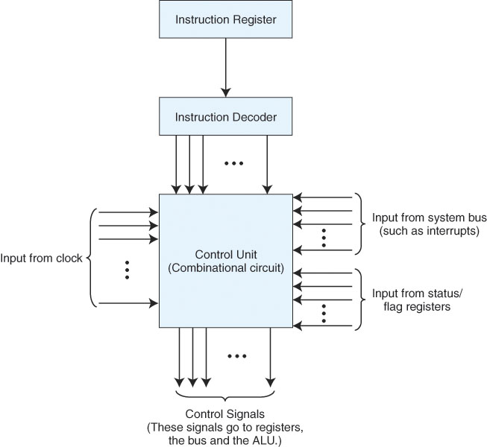
Hardwired Control Unit
The hardwired control unit is one
big circuit
Input is the instruction from the IR,
status flags and the system clock
and output are the control signals to
the registers and other devices
Notes:
The idea behind a hardwired control unit is that it is a big decoder. It receives the particular step of the fetch execute cycle that we are on (for instance, in clock cycle 0, we are doing PC ← MAR, in clock cycle 3 we are signaling a read from memory, in clock cycle 5 we are doing MAR ← IR[11..0], etc) If we are doing part of the fetch, then it will always be the same, so the signal to move PC ←MAR is always given if we are on clock cycle 0, and PC ← PC + 1 is always given if we are on clock cycle 2.
For MAR ← IR[11..0], we must first inspect the IR. If the op code is one that requires an operand (op code = 1, 2, 3, 4, 9, 11, 12) and we are in clock cycle 5, then we signal this operation.
For the execute phase, each instruction has between 1 and 5 (JnS) actual operations during the execute phase. For instance, AC ← AC + MBR is signaled if and only if we are in clock cycle 6 and the op code = 3 OR we are in clock cycle 8 and the op code = 11 (ADDI), and AC ← AC – MBR is signaled if and only if we are in clock cycle 6 and the op code = 4. The control unit’s combinational circuit is very complex even for the 13 instruction MARIE. The advantage is that the CPU is able to execute all phases of the fetch-execute cycle very quickly.

Slide 34
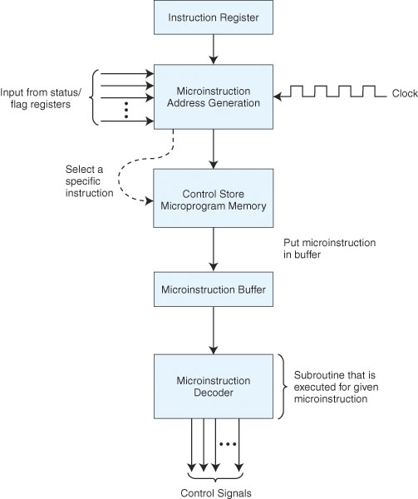
Microprogrammed Control Unit
The control store is a ROM that
stores all of the microprograms
One microprogram per fetch-execute
stage, and one per instruction in the
instruction set
Receive an instruction in IR
Start the microprogram, generating
the address, fetching the instruction
from the ROM and moving it to the
microinstruction buffer to be
decoded an executed
This process is much more time
consuming than the hardwired
unit, but is easier to implement
and more flexible
Notes:
Here, the steps for each instruction are broken into miniprograms called mircoprograms. For instance, the ADD operation has these microinstructions:
MAR ← X
MBR ← M[MAR]
AC ← AC + MBR
All 13 instructions share the same fetch/decode microprograms. So, MARIE would have a total of 16 microprograms, one for fetch, one for decode, one for each of the 13 instructions, and one for interrupts. A real computer would probably have hundreds of separate microprograms. All of these microprograms are stored, microinstruction by microinstruction, in the control store (ROM memory). We use a micro-fetch-execute cycle by generating the address of the next microinstruction using the microinstruction address generator, fetching the microinstruction and moving it into the microinstruction buffer where it is then executed. To save space, we encode our instructions and use a microinstruction buffer to decode it. This is all very complex stuff so we are going to skip over any more details. We cover this in a little more detail in 462/562.
An example of MARIE’s control store is given on the next slide.

Slide 35
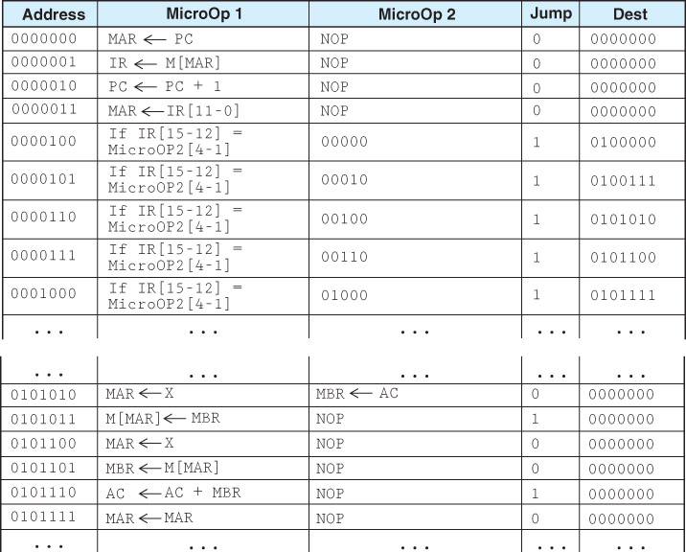
Portion of MARIE’s Control Store
See table 4.8
(p. 221) which
shows the RTN
for each entry
under MicroOp2

Slide 36
CISC vs. RISC
Complex (CISC)
  Microprogrammed control unit
  Large number of instructions (200-500)
  Instructions can do more than 1 thing (that is, an instruction could carry out 2 or more actions)
  Many addressing modes
  Instructions vary in length and format
  This was the typical form of architecture until the mid 1980s, RISC has become more popular since then although most architectures remain CISC
Reduced (RISC)
  Hardwired control unit
  Instruction set limited (perhaps 80-100 instructions)
  Instructions rely mostly on registers, memory accessed only on loads and stores
  Few addressing modes
  Instruction lengths fixed (usually 32 bits long)
  Easy to pipeline for great speedup in performance

Slide 37
Real Architectures
MARIE is much too primitive to be used but it shares many features with other architectures
  Intel – started with the 8086 in 1979 as a CISC, has progressed over time in complexity and capability, 4 general purpose registers, originally 16 bit, expanded to 32 bit with 80386 and floating point operations in pentium, pentium II and later include many RISC features such as pipelining, superscalar and speculative execution
  MIPS – RISC architecture, 32 bit early on, now 64 bit, 32 registers, advanced pipelining with superscalar and speculative execution

