Slide 1



Climate Risk and Disaster Management
Name:
Sarvesh Jhawar
Student ID:
STU684c3cd03aaeb1749826768
Internship ID:
INTERNSHIP_17513641056863b20937d78

Slide 2

Learning Objectives
Data Understanding: Load and explore the dataset to understand its structure, statistics, and missing values.
Data Transformation: Visualize data distribution, handle missing values, and engineer new features like Month and DayofWeek.
Machine Learning Model Development: Define features and a target variable for classification. Train multiple machine learning models and evaluate their performance using accuracy and a classification report.
Deployment: Prepare the trained model for deployment as a Streamlit web application.
GOAL
Source :
www.freepik.com/

Slide 3
Tools and Technology used
Core Libraries:
pandas for data manipulation and analysis.
numpy for numerical operations.
scikit-learn for machine learning models (Random Forest, Decision Tree, Logistic Regression, etc.) and evaluation metrics.
matplotlib & seaborn for data visualization.
Streamlit for building the web application interface.
Development Tools:
Jupyter Notebook for data exploration and model development.
Git/GitHub for version control and repository management.

Slide 4
Methodology
Data Understanding: The Data.csv dataset, derived from NASA’s EONET API, was loaded and explored to understand its structure and content. It contains 5,393 records with details on wildfires, severe storms, volcanoes, and sea ice.
Exploratory Data Analysis (EDA): The number of disaster events over time was visualized, showing a high concentration of wildfires.
Data Transformation: The raw data was cleaned by handling missing values and splitting the coordinate column into Longitude and Latitude. New features like Month and DayOfWeek were created from the date and time data.
Feature Selection: Unnecessary columns such as ID, Title, and raw coordinate strings were dropped, resulting in a processed dataset ready for modeling. The final features used were: Longitude, Latitude, Month, and DayOfWeek.
Model Training: Several classification models were trained and tested on the processed data to predict the Category_title.
Model Evaluation: The models were evaluated using accuracy, a classification report, and a confusion matrix. The best-performing models (Random Forest, Decision Tree) achieved 100% accuracy on the test set.

Slide 5
Problem Statement:
To accurately classify natural disaster events based on geographical and temporal data, providing a tool that can help in disaster management and risk assessment. The project addresses the need to analyze and predict disaster categories (e.g., Wildfires, Severe Storms) from a real-world dataset.

Slide 6
Solution:
This project provides a comprehensive solution for classifying natural disaster events by leveraging a machine learning pipeline, culminating in a user-friendly Streamlit web application.
The core of the solution is a classification model that takes in key features of a disaster event—specifically, its Longitude, Latitude, Month, and Day of Week—to predict its corresponding disaster category.
The Random Forest model was chosen as the primary classifier. The model demonstrated exceptional performance on the test dataset, achieving an accuracy of 100%. A classification report and a confusion matrix further validated this result, showing perfect precision, recall, and f1-scores for both Sea and Lake Ice and Severe Storms categories in the test set.
Git hub link : https://github.com/Sarvesh-Jhawar/Climate-Risk-and-Disaster-Management.-AICTE-.git

Slide 7
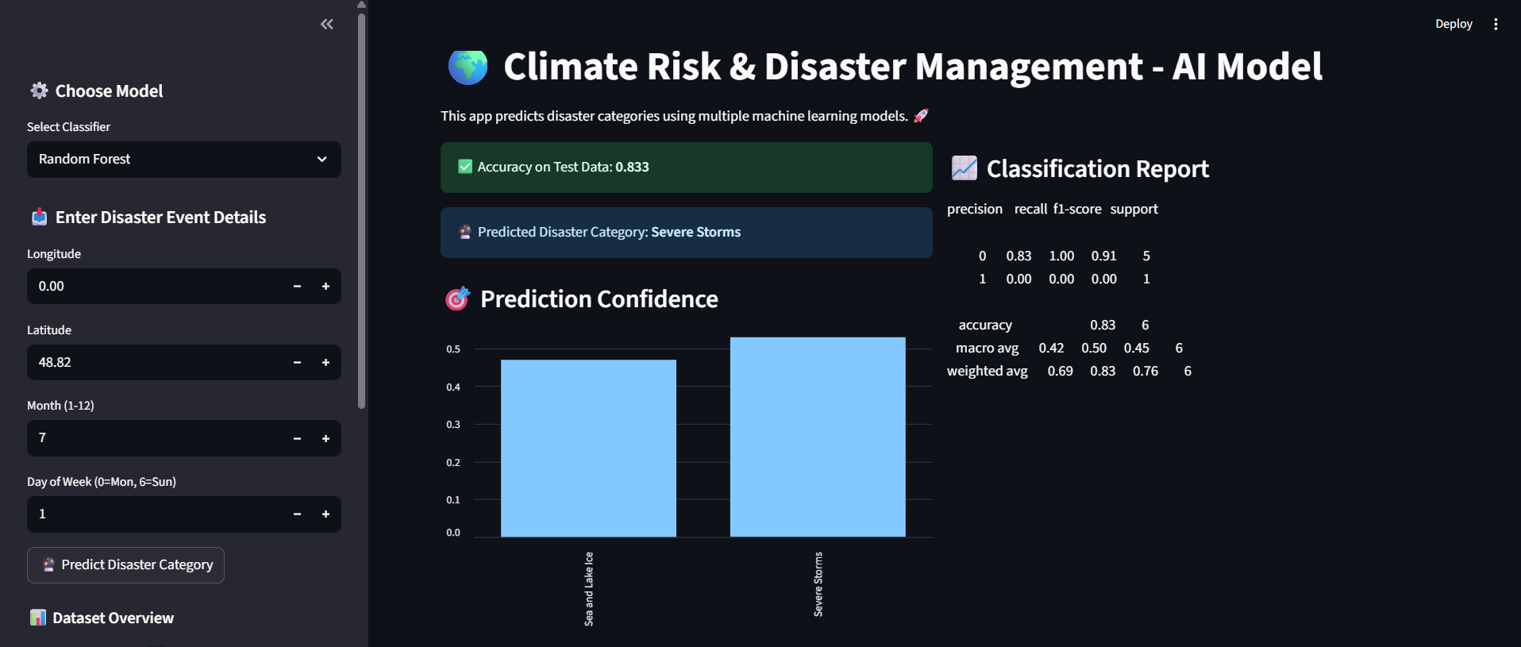
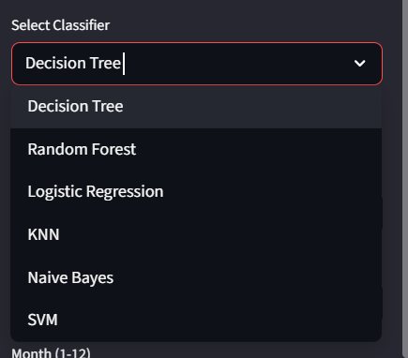
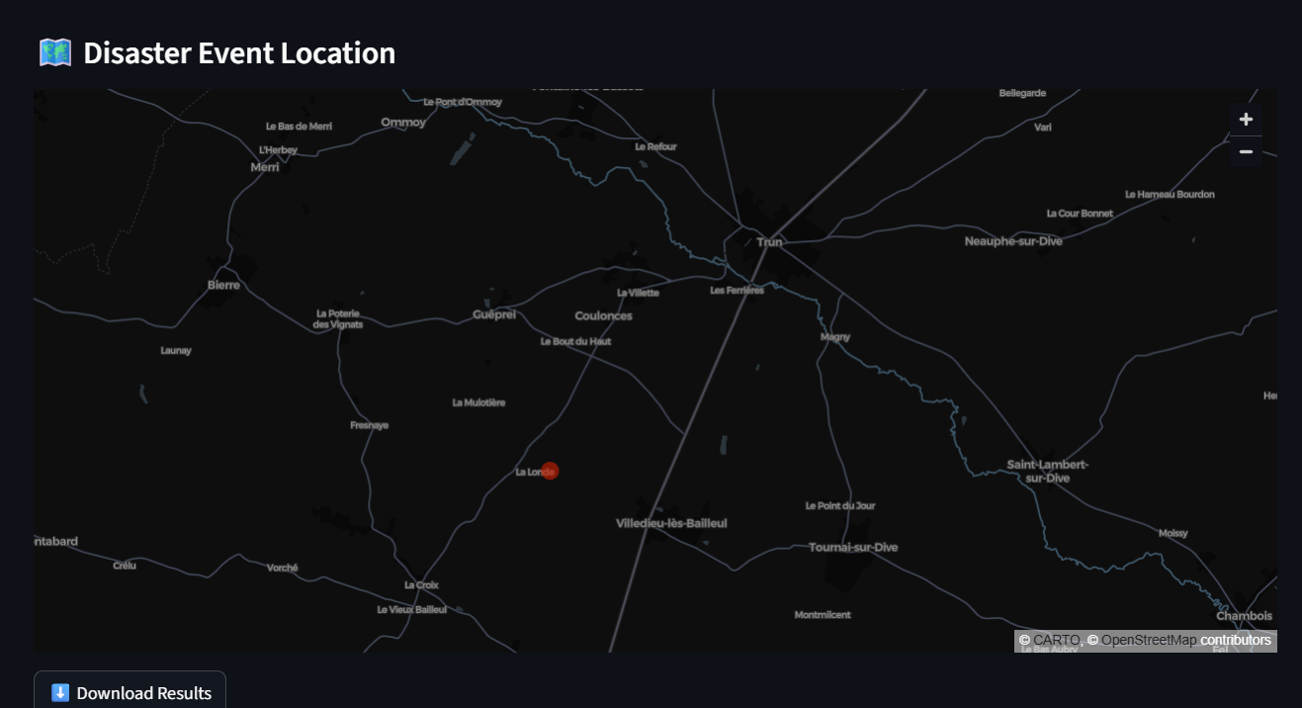
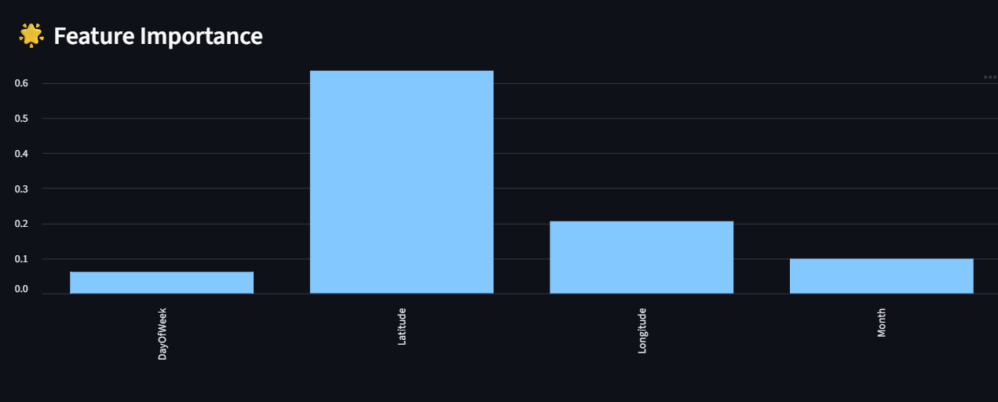
Screenshot of Output:

Slide 8
Conclusion:
The project successfully completed the data understanding, EDA, and data transformation stages.
The machine learning models, particularly Random Forest and Decision Tree, were highly effective, achieving 100% accuracy on the test dataset.
The work lays the groundwork for a practical, deployable tool using a Streamlit web application to classify and visualize climate risks and disaster events.
This project demonstrates a complete machine learning workflow, from raw data to a user-friendly application.

