Slide 1

SCHOOL OF ENGINEERING & TECHNOLOGY
Department of MCA
ACADEMIC YEAR: - 2024-25(ODD SEM.)
EventEase
Python Sem 1 Project
Team Members:
Sarvesh Kolapkar (27)
Sagar Kirpekar (18)
Class: MCA-FY-B
Guided By: Dr. Kamlesh Meshram

Slide 2
Introduction
EventEase is an online event booking & management website
Purpose: Simplifies event planning for various occasions.
Services: Offers photography, venue selection, decoration, sound, anchoring, and catering.
Target Audience: Ideal for individuals and organizations hosting events.
Goal: Deliver quality services for a stress-free event experience.

Slide 3
Problem solving
Client Acquisition:
Feedback System
Budget Tracking
Objectives
Address common challenges in event planning and help vendors find clients
Assist service providers in gaining exposure to potential clients
Allow users to leave reviews and share experiences with vendors for future reference
Connecting
Enable users to set budgets and track expenses throughout the event process
Connect event organizers with vendors easily

Slide 4
Methodology
Research & Analysis
Design
Development
Vendor Partnerships
Testing & Launch

Slide 5
Why I Chose This Topic?
Real-World Application
Market Demand
Personal Interest
User Impact
Addressing Challenges

Slide 6
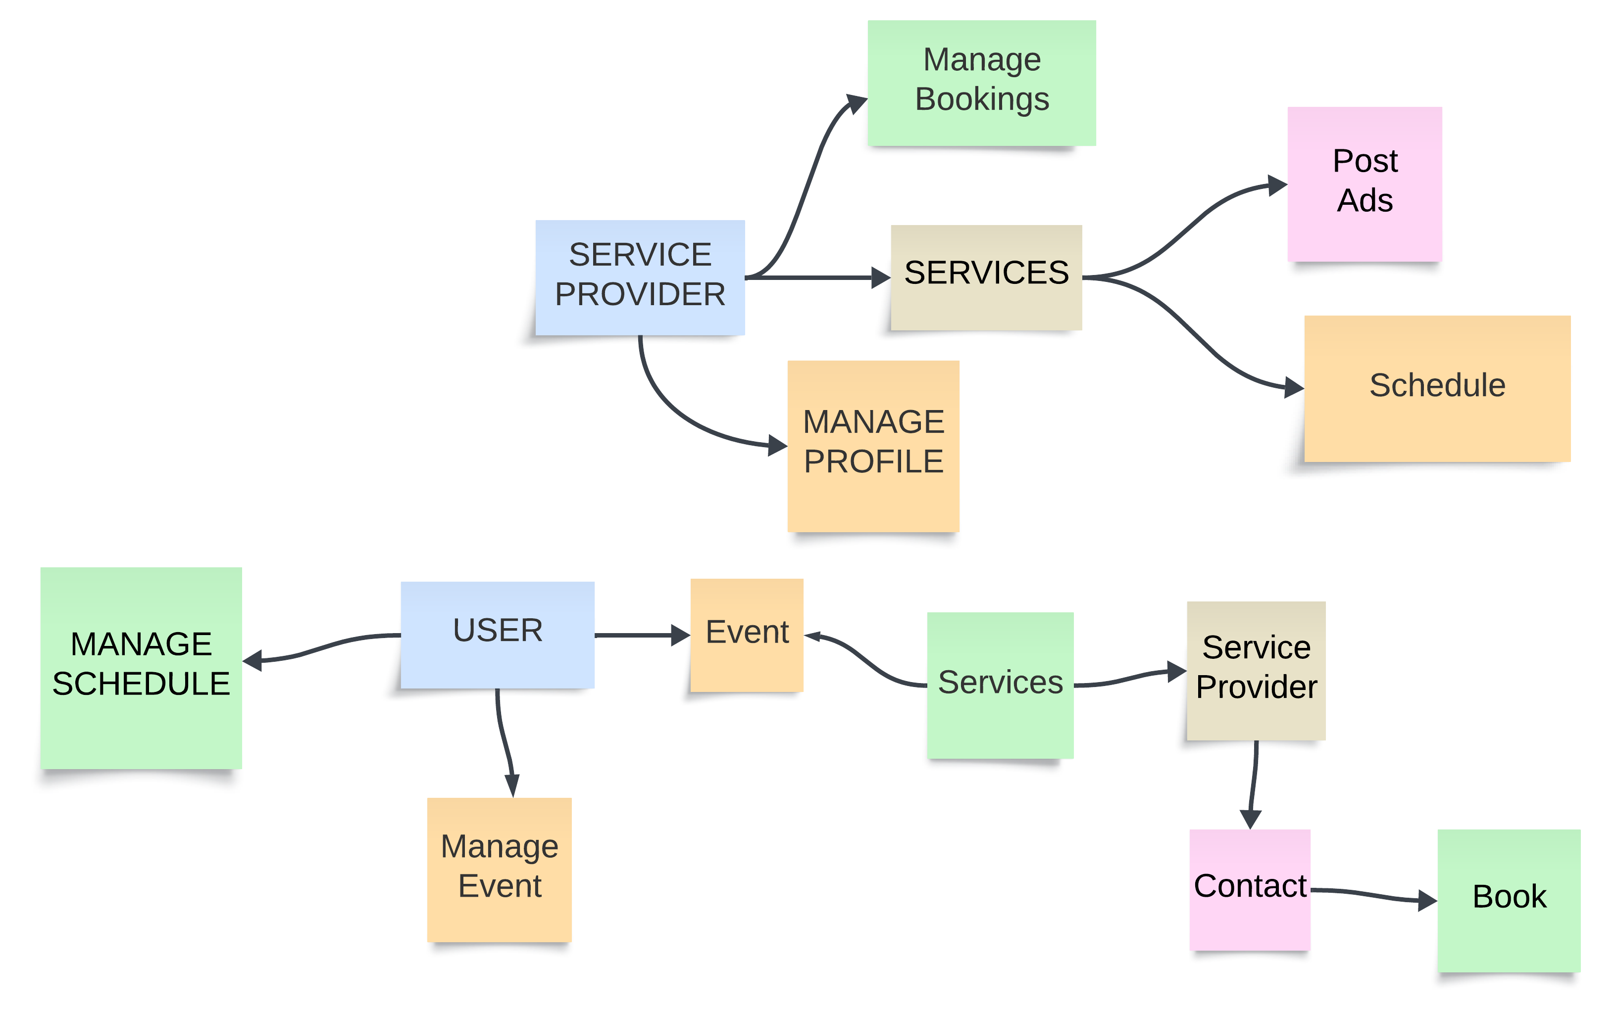
UML diagram

Slide 7
Future Development
Mobile App Development: Create a mobile app for easier access.
    Advanced Search Filters: Implement search filters for users to find vendors based on specific needs.
Personalized Recommendations: Use algorithms to provide personalized vendor.
Payment Integration: Implement secure payment options to facilitate transactions between users & vendors.

Slide 8
Conclusion
The event planning website streamlines organization with a vendor directory, customizable timelines, and expense tracking, all in a mobile-friendly format. It empowers users to plan successful events efficiently and within budget.

Slide 9
Thank you!

