Slide 1

IT594: - DEEP NEURAL NLP
Term Paper Presentation
MEGA: Moving Average Equipped Gated Attention
Sarvesh Bagwe (202211006)
Vedant Dave (202211042)
Kashyap Halavadia(202003040)
Hiren Thakkar (202211074)
Course Instructor:
Prof. Sourish Dasgupta

Slide 2
Problems/ limitations with Transformers
Weak inductive bias:
Almost no prior knowledge of dependency patterns. Trying learn directly from the data at every timestep.
Position information only from absolute/relative positional embeddings.
2) Quadratic complexity:
Time complexity for computing attention matrix as well as space complexity for storing it is quadratic in terms of the length of the input sequence.
b) O(h.n.n) where h is the no of attention heads and n is the length of the input sequence.

Slide 3
Inductive Bias
RNN :
Strong and clear inductive bias.
Uses hidden states to capture local dependencies.
Recurrently model dependencies for effective learning.
Transformers' Attention Mechanism:
Assumes no prior knowledge of dependencies.
Learns pairwise attention weights for input tokens.
Challenging for recognizing patterns, especially in long sequences.
Transformers' Limitations:
It is inefficient for long sequence modeling.
Notes:
Other models like RNN and CNN have a clear and strong inductive bias. RNN using the hidden states to capture local dependencies. RNN recurrently models the dependencies of input tokens step by step. This feature in practice helps these models to learn certain types of data dependencies.
On the other hand, the attention mechanism in transformers assumes no prior knowledge of the patterns of dependencies between tokens, instead it learns to predict the pairwise attention weights for each pair of input tokens. But in practice it is a challenging task to recognize all the dependency patterns directly from the data, particularly when processing long sequences.
Studies have shown that transformers are neither accurate nor efficient for long sequence modelling.

Slide 4
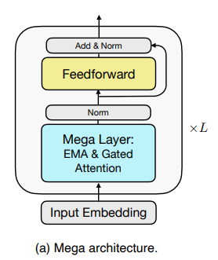
MEGA: Executive Summary
Effective and efficient drop-in replacement of attention for long sequence modelling.
Exponential Moving Average (EMA)
Mega-chunk: linear complexity of time and space.

Slide 5
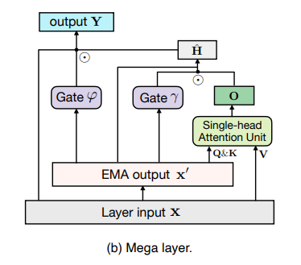
MEGA: Architecture Outline
Exponential Moving Average ( EMA )
Local dependencies that decay exponentially over time .
Incorporates stronger inductive bias into the attention.
Single-headed Gated Attention
Adding a reset gate to the attention output.
Theoretically proving that single-head gated attention is as expressive as multi-head one.
Mega-Chunk
Applying attention to local chunks of fixed length.
Reducing quadratic complexity to linear.

Slide 6



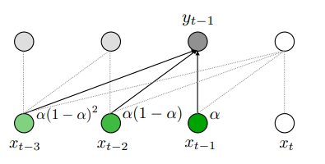
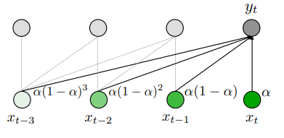
Exponential Moving Average (EMA)
Notations: Assuming 1-dim input sequence
EMA:
Damped EMA:

Slide 7

Efficient Algorithm for EMA
Efficiently compute EMA outputs of all tokens in parallel.
We can compute the weights for each input tokens in advance and compute EMAs with FFTs.

Slide 8
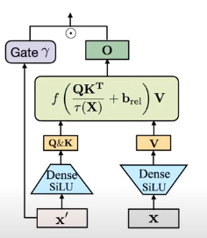



Single-headed Gated Attention in Mega
Adding a reset gate to the attention output
Step1: Getting output from the EMA layer:
Step2: Attention:
Step3: Gated Attention:
Single-headed gated attention is as expressive as multi-head one.

Slide 9
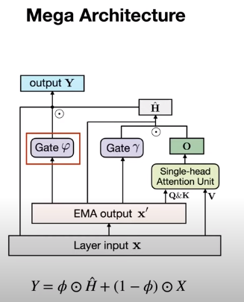
Mega Architecture: Reset and Update gate

Slide 10
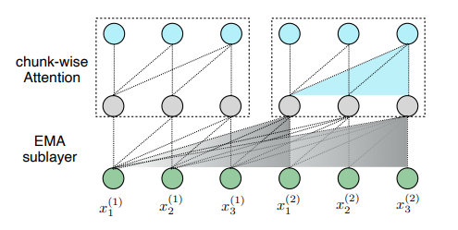
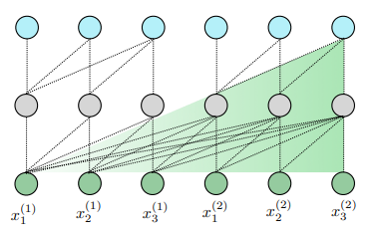
Mega-Chunk: Efficient Mega
Split input sequences into multiple chunks with fixed length.
Applying attention to each chunk
Linear complexity and easy implementation
But will we lose contextual information between chunks?
Fortunately, EMA preserves the information from previous chunks.

Slide 11
Model Evaluation: Experiments
Long Range Arena ( LRA ):
3 tasks on byte-level text classification
3 tasks on pixel-level image classification
Language Modeling:
Enwiki8 (character-level)
WikiText-103 (word-level)
Machine translation:
VMT’14 English-German
Image Classification:
ImageNet-1K
Raw Speech Classification:
Speech commands

Slide 12
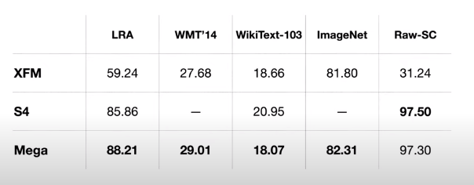
Experimental Results

Slide 13
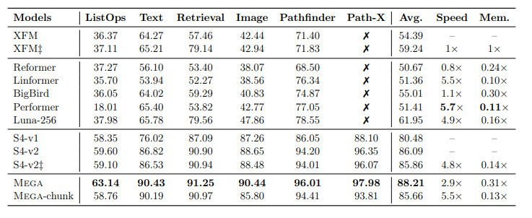
Analysis on LRA: Accuracy and Efficiency
A benchmark of 6 sequence tasks for long range sequence modelling. Intentionally designed to be challenging.

Slide 14
Thank you for your time!

