Slide 1
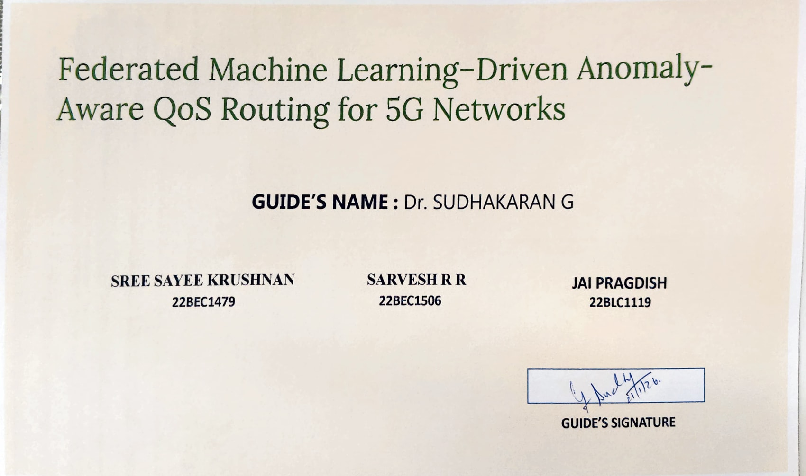

Federated Machine Learning–Driven Anomaly-Aware QoS Routing for 5G Networks
GUIDE’S NAME : Dr. SUDHAKARAN G
SARVESH R R
22BEC1506
SREE SAYEE KRUSHNAN 22BEC1479
JAI PRAGDISH
22BLC1119
GUIDE’S SIGNATURE

Slide 2
PROBLEM STATEMENT
Addressing Critical QoS Degradation in 5G Networks
Modern 5G networks are designed to support a diverse array of applications, from high-definition video streaming and critical emergency services to interactive gaming and massive IoT deployments. Each of these applications comes with distinct and stringent Quality of Service (QoS) requirements.
However, current QoS routing mechanisms often fall short. They primarily rely on standard performance metrics like latency, throughput, and network load, neglecting the crucial aspect of abnormal traffic behaviour. Such anomalies, including sudden traffic bursts, faulty IoT floods, or deceptive priority traffic, can severely compromise the QoS of vital services.
Hence, there is a pressing need for an intelligent QoS routing mechanism capable of dynamically adapting routing decisions based on real-time traffic behaviour analysis.

Slide 3
PROBLEM BACKGROUND
The Dynamic and Vulnerable Landscape of 5G Networks
Dynamic & Distributed Nature
Impact of Abnormal Traffic
Limitations of Current Systems
While not always malicious, abnormal traffic behaviour can significantly increase latency and cause packet loss, critically affecting emergency and low-latency services.
5G networks are inherently dynamic and distributed, presenting unique challenges in managing diverse traffic patterns across numerous base stations.
Existing routing systems assume all traffic is legitimate and only react after congestion has occurred, leading to reactive rather than proactive management.
The significance of addressing this issue cannot be overstated. Failure to proactively manage abnormal traffic behaviour can lead to widespread QoS violations, severe service disruptions, and a markedly poor user experience across the network.

Slide 4
LITERATURE SURVEY
Foundation & Recent Advancements in Network Anomaly Detection
Federated Learning-Based Anomaly Detection for Zero-Day Attack Prevention in 6G Network Slices – Elsevier, 2025
Deep Learning Driven QoS Anomaly Detection for Network Performance Optimization – JES, 2023
Edge-FLGuard: Federated Learning Framework for Anomaly Detection in 5G IoT – MDPI, 2025
Network Slicing Security in 5G and Beyond – IEEE Survey,2023
Federated Learning for 5G and Beyond Networks – IEEE,2023
Federated Learning for Anomaly Detection in Open RAN – IEEE EUCNC, 2024
AI-Based Traffic Management in 5G Networks – IEEE Access , 2023
MDQ: QoS-Congestion Aware Deep RL for Multi-Path Routing – IEEE,2024
QoS-Aware Routing for 5G Networks: A Survey – Elsevier , 2022
Our research builds upon recent advancements in federated learning and anomaly detection within 5G and emerging 6G network architectures. This literature review highlights key works that inform our understanding of network security, QoS management, and the potential of distributed machine learning paradigms.

Slide 5
EXISTING SOLUTIONS
Limitations of Current QoS Routing and Anomaly Detection
QoS-Based Routing
Primarily focuses on metrics like latency, throughput, and bandwidth.
Overlooks the impact of traffic behaviour.
Reacts to congestion rather than preventing it.
ML-Based Anomaly Detection
Mainly applied for security and intrusion detection.
Doesn't directly influence routing decisions.
Often centralised, requiring large datasets and poor scalability.
Current systems treat security and QoS as isolated problems. This disjointed approach creates significant vulnerabilities in 5G networks, where dynamic traffic patterns and diverse application requirements necessitate a unified strategy.

Slide 6
PROPOSED SOLUTION
Introducing Federated Learning for Anomaly-Aware QoS Routing
This project proposes a novel Anomaly-Aware QoS Routing Framework that leverages the power of Federated Learning to create more resilient and efficient 5G networks.
Key Idea:
The core innovation lies in using real-time traffic behaviour intelligence to dynamically influence and adapt QoS routing decisions, moving beyond static performance metrics.
Justification:
Mitigating Abnormal Traffic
Leveraging Federated Learning
Abnormal traffic, even if not explicitly malicious, can severely degrade QoS. Our approach prevents this degradation by proactively identifying and managing such traffic.
Federated Learning enables distributed model training, ensuring privacy preservation by keeping data local to base stations. This also allows for better generalization of anomaly detection models across diverse network segments.

Slide 7
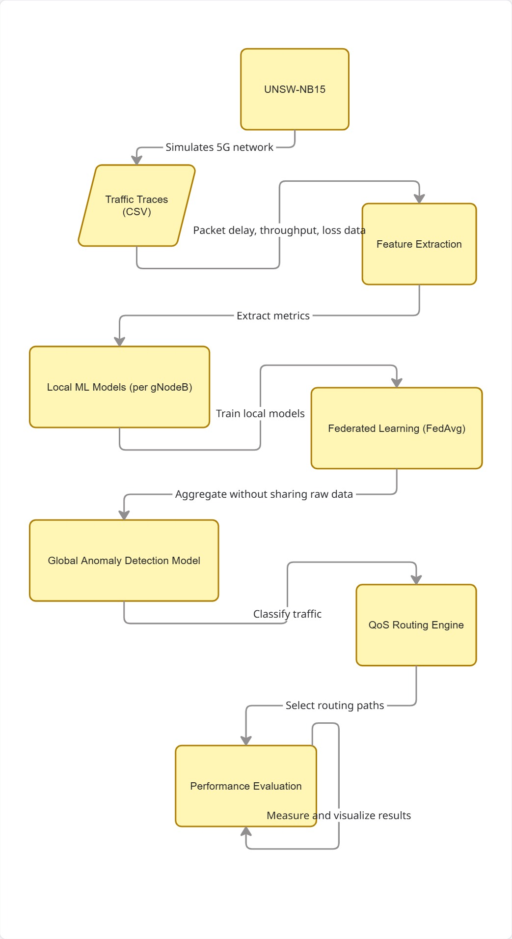
SYSTEM ARCHITECTURE

Slide 8
PROJECT SCOPE
Defining the Boundaries of Our Research
Included in Scope:
Development of a Python-based 5G QoS routing simulator.
Comprehensive traffic behaviour analysis mechanisms.
Design of anomaly-aware routing logic.
Development of a federated learning-based model for anomaly detection.
Performance evaluation using key QoS metrics (latency, throughput, reliability).
This defined scope ensures that our efforts are concentrated on the core problem of anomaly-aware QoS routing through federated learning within a simulated environment, allowing for focused and effective development.

Slide 9







METHODOLOGY
Our Step-by-Step Approach to Anomaly-Aware QoS Routing
Network Simulation
Simulate various 5G network and diverse traffic scenarios to establish a realistic testing environment.
Data Collection
Collect detailed traffic statistics from each base station to form the dataset for model training.
Local Model Training
Train local anomaly detection models at each base station, preserving data privacy.
Federated Aggregation
Aggregate local models using Federated Learning to create a robust global anomaly detection model.
Traffic Classification
Classify traffic behaviour into 'normal,' 'suspicious,' or 'malicious-like' categories.
Routing Adaptation
Dynamically adapt QoS routing decisions based on the classified traffic behaviour.
Performance Evaluation
Evaluate the framework's effectiveness using critical QoS metrics such as latency, throughput, and reliability.
This structured methodology ensures a comprehensive and systematic approach to developing and validating our anomaly-aware QoS routing framework.

Slide 10
TIMELINE
Project Milestones and Schedule
Phase 1
QoS Routing Simulator Development
1-2 Week
Phase 2
Traffic Data Collection & Preprocessing
1-2 Week
Phase 3
ML Model Development (Local Anomaly Detection)
2-4 Week
Phase 4
Federated Learning Integration & Global Model Training
4-6 Week
Phase 5
Anomaly-Aware Routing Logic Implementation
6-8 Week
Phase 6
System Evaluation & Report Preparation
8-10 Weeks
Our project timeline is meticulously planned to ensure efficient progress and timely completion of each phase, leading to a robust and well-documented solution.

Slide 11
TOOLS & TECHNOLOGIES
Essential Software and System Requirements
Software Tools:
System Requirements:
Python 3: The primary programming language for development and simulation.
Standard Laptop/PC: Our framework is designed to run efficiently on conventional computing hardware.
Scikit-learn: For implementing various machine learning algorithms.
No Hardware Dependency: The project does not require specialized or high-end hardware, making it accessible for development and testing.
NumPy, Pandas: Essential libraries for numerical operations and data manipulation.
Matplotlib: For data visualization and graphical representation of results.
Optional: NS-3: For advanced traffic trace validation and detailed network simulation.
These selected tools and technologies provide a robust and flexible environment for developing, simulating, and evaluating our federated machine learning-driven anomaly-aware QoS routing framework.

