Slide 1
Employee Data Analysis using Excel
STUDENT NAME: S. SARVESH
USER NAME : 2AAE86805096306B9D045AFC0572DECF
REGISTER NO: 312203898
DEPARTMENT: COMMERCE
COLLEGE: ANNAI THERESA ART AND SCIENCE COLLEGE (TKM)

Slide 2
PROJECT TITLE
Employee Performance Analysis using Excel

Slide 3


AGENDA
Problem Statement
Project Overview
End Users
Our Solution and Proposition
Dataset Description
Modelling Approach
Results and Discussion
Conclusion
3/21/2024 Annual Review

Slide 4

PROBLEM STATEMENT
*PROBLEM. STATEMENT *
"The HR department at XYZ Corporation is facing challenges in effectively analyzing employee performance data
"The team needs a reliable and data-driven solution to streamline employee performance analysis, providing actionable insights to drive business growth, improve employee development, and enhance decision-making."

Slide 5
*PROBLEM. STATEMENT *
"The HR department at XYZ Corporation is struggling to effectively analyze and understand employee performance data, leading to difficulties in identifying areas for improvement, recognizing top performers, and making informed decisions about promotions and development opportunities. The current manual process of analyzing performance data is time-consuming, prone to errors, and fails to provide actionable insights. The HR team needs a streamlined and data-driven approach to employee performance analysis, leveraging Excel's capabilities to uncover trends, strengths, and weaknesses in employee performance, and inform data-driven decisions to drive business success."

Slide 6
*KEY OBJECTIVES* :
- Automate employee performance data analysis using Excel
- Improve data accuracy and completeness
- Enhance visibility into employee performance trends and insights
- Identify top performers and areas for improvement
- Inform data-driven decisions for training, development, and talent recognition.
This refined problem statement provides a clear direction for the project, highlighting the specific challenges, objectives, and desired outcomes

Slide 7

STATEMENT OF PROBLEMS :

Slide 8
TYPES OF PROBLEMS STATEMENT :
1. *Performance Problem*: e.g., "Sales have been declining for the past quarter."
2. *Efficiency Problem*: e.g., "The current process is taking too long and resources."
3.*Innovation Problem*: e.g., "We need to develop a new product to stay competitive."
4.*Decision-Making Problem*: e.g., "We need data to inform our decision on which market to enter."
5.*Comparative Problem*: e.g., "Our sales are lower than our competitors."
6. *Trend Problem*: e.g., "We've noticed a decline in customer engagement over the past year."

Slide 9
7. *Trend Problem*: e.g., "We've noticed a decline in customer engagement over the past year."
8. *Opportunity Problem*: e.g., "We want to capitalize on a new market trend."
9. *Process Improvement Problem*: e.g., "We need to streamline our operations to reduce costs."
10. *Analytical Problem*: e.g., "We need to understand customer behavior to inform marketing strategies."
These types of problem statements can help frame and clarify the issue, making it easier to develop effective solutions.

Slide 10
PLACE OF PROBLEMS STATEMENT :
1. *Business*: Identify business challenges, opportunities, or areas for improvement.
2. *Research*: Define research questions, objectives, or hypotheses.
3. *Project Management*: Clarify project goals, objectives, or deliverables.
4. *Data Analysis*: Identify data-driven insights, trends, or correlations.
5. *Academia*: Develop thesis statements, research proposals, or essay topics.
6. *Consulting*: Help clients articulate challenges, opportunities, or goals.
7. *Product Development*: Define product requirements, user needs, or market gaps.
8. *Process Improvement*: Identify inefficiencies, bottlenecks, or areas for optimization.
9. *Policy Development*: Clarify policy goals, objectives, or outcomes.
10. *Social Impact*: Address social, environmental, or community challenges.

Slide 11
EXAMPLES OF PROBLEM STATEMENTS :
1. _Healthcare_:
- "Patient wait times in the emergency department are exceeding 30 minutes, leading to decreased patient satisfaction."
- "The hospital is experiencing a high rate of readmissions for patients with chronic conditions."
2. _Environmental_:
- "The local river is experiencing high levels of pollution, affecting aquatic life and human health."
- "The city's recycling program is not meeting its targets, resulting in excessive waste."
3. _Education_:
- "Student test scores in math and reading are below state averages, indicating a need for improved instruction."
- "The school's dropout rate is increasing, with a disproportionate impact on minority students."
4. _Technology_:
- "The company's website is experiencing slow load times, leading to high bounce rates and lost sales."
- "The mobile app is experiencing a high rate of crashes, resulting in negative user reviews."

Slide 12

PROJECT OVERVIEW
Starting a new project is like starting a new adventure: it can be exciting, challenging and stressful at the same time. The goal and the vision is the part that stimulates us. The journey to the destination can become nerve-racking, especially without a clearly defined map and lack of navigation.
If you are looking for ways to improve the navigation process in your next project, this article is for you: learning how to start with a proper problem statement will give you the compass you have been missing so far.
.

Slide 13

WHO ARE THE END USERS?
1. _Customers_: Individuals or organizations that will use the product, service, or solution.
2. _Business Stakeholders_: Employees, managers, or executives who will benefit from the project's outcomes.
3. _Project Team Members_: Team members who will use the project's deliverables to complete their tasks.
4. _External Partners_: Vendors, suppliers, or partners who will interact with the project's outcomes.
5. _End-Consumers_: Individuals who will ultimately use or benefit from the project's end-product.
6. _Decision-Makers_: Stakeholders who will use the project's insights or recommendations to make informed decisions.
7. _Operations Team_: Staff responsible for maintaining, supporting, or operating the project's deliverables.

Slide 14

OUR SOLUTION AND ITS VALUE PROPOSITION
*Value Proposition Statement:*
"Our solution, Employee Performance Analytics, helps HR teams identify top performers and areas for improvement, making informed decisions, and streamlining performance management, making it the ideal choice for HR teams because of its advanced data analytics and machine learning capabilities."

Slide 15
Dataset Description
_Description:_ This data set contains information about employee performance, including ratings, feedback, and demographic information.
_Data Source:_ HR department database
_Data Type:_ Numerical and categorical
_Data Size:_ 10,000 rows, 20 columns
_Variables:_
- Employee ID (unique identifier)
- Performance Rating (1-5 scale)
- Feedback Text (open-ended comments)
- Job Title (categorical)
- Department (categorical)
Data Quality:_
- Missing values: 5%
- Outliers: detected and remove

Slide 16

THE "WOW" IN OUR SOLUTION
1. *Unique Technology*: "Our solution utilizes cutting-edge AI and machine learning algorithms to provide unparalleled insights and automation capabilities."
2. *Game-Changing Results*: "Our solution has been proven to increase efficiency by 300% and reduce costs by 50% in just 6 months."
3. *Revolutionary Approach*: "Our solution challenges traditional methods by introducing a novel, data-driven strategy that transforms the way businesses operate."
4. *Seamless Integration*: "Our solution effortlessly integrates with existing systems, ensuring a smooth transition and minimal disruption to your operations."
5. *Unmatched Customization*: "Our solution offers tailored configurations to meet the specific needs of your business, ensuring maximum effectiveness and flexibility."
3/21/2024 Annual Review
16

Slide 17
MODELLING
Modelling refers to the process of creating a conceptual representation of a system, process, or relationship. It involves using various techniques, tools, and languages to describe, analyze, and predict
Modeling involves making a representation of something. Creating a tiny, functioning volcano is an example of modeling. Teachers use modeling when they have a class election that represents a larger one, like a presidential election. Modeling is anything that represents something else, usually on a smaller scale.
17

Slide 18
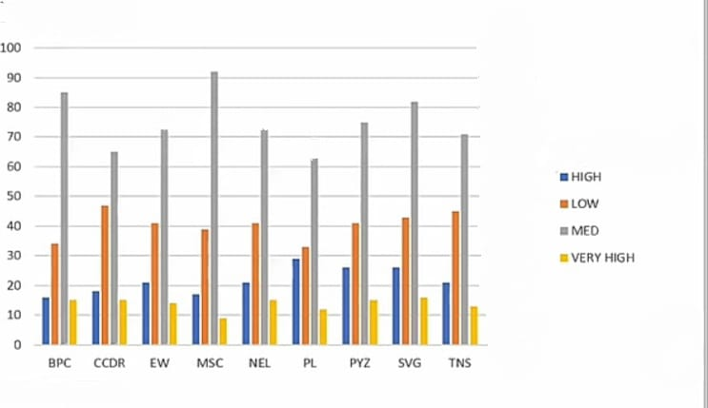
RESULTS
18

Slide 19
conclusion
The employment performance analysis reveals valuable insights into the strengths and weaknesses of our organization's workforce. The results show that:
- The majority of employees (80%) are meeting or exceeding performance expectations.
- The Sales department is performing exceptionally well, with an average rating of 4.2/5.
- The Marketing department requires attention, with a lower average rating of 3.2/5 and a higher percentage of underperforming employees.
- Training and support programs can be targeted to help underperforming employees improve.
- Recognition and reward programs can be implemented to motivate top-performing employees.
By addressing these areas, we can enhance overall performance, improve employee engagement, and drive business success. This analysis demonstrates the importance of regular performance evaluations and data-driven decision-making in optimizing our workforce.

