Slide 1
AI-Powered Voice Recognition Navigation Aid For Accessibility
Team Members: Sarvesh K(2023PECCS479)
Sri Hari T K(2023PECCS503)
Department: Computer Science Engineering
Domain: Artificial Intelligence
Guide: Sasikumar A N

Slide 2
Introduction
The project aims to assist visually impaired individual in navigating safely and independently.
It combines AI-based voice recognition,object detection,and navigation guidance.
Problem: Visually impaired people face difficulty using tradional GPS app because they require typing or visual interaction.
Solution: An AI- powered voice navigation system with obstacle detection that provide hands-free,safe,and accessible travel.

Slide 3
Objectives
Convert voice to text using Whisper.
Find destination routes using OpenRouteService.
Give step-by-step audio navigation.
Use camera + AI for object detection.
Display route on interactive map.

Slide 4
Tools & Technologies
AI Tools:
- OpenAI Whisper → Speech to Text
- TensorFlow.js COCO-SSD → Object Detection
Supporting Tools:
- OpenRouteService → Geocoding & Directions
- Leaflet.js → Interactive Maps
- Flask (Python) → Backend Server
- FFMPEG → Audio conversion

Slide 5
System Architecture
Flow:
1. User Voice → Whisper → Destination Text
2. OpenRouteService → Coordinates & Steps
3. Flask → Sends route → Frontend
4. Leaflet.js → Shows Map
5. TensorFlow.js (Camera) → Detects Objects
6. SpeechSynthesis → Speaks Directions & Warnings

Slide 6
Implementation
Backend (Flask):
- Handles Whisper transcription
- Gets routes from ORS API
Frontend (JS):
- Records audio & sends to Flask
- Shows navigation steps & map
- Runs TensorFlow.js for object detection

Slide 7
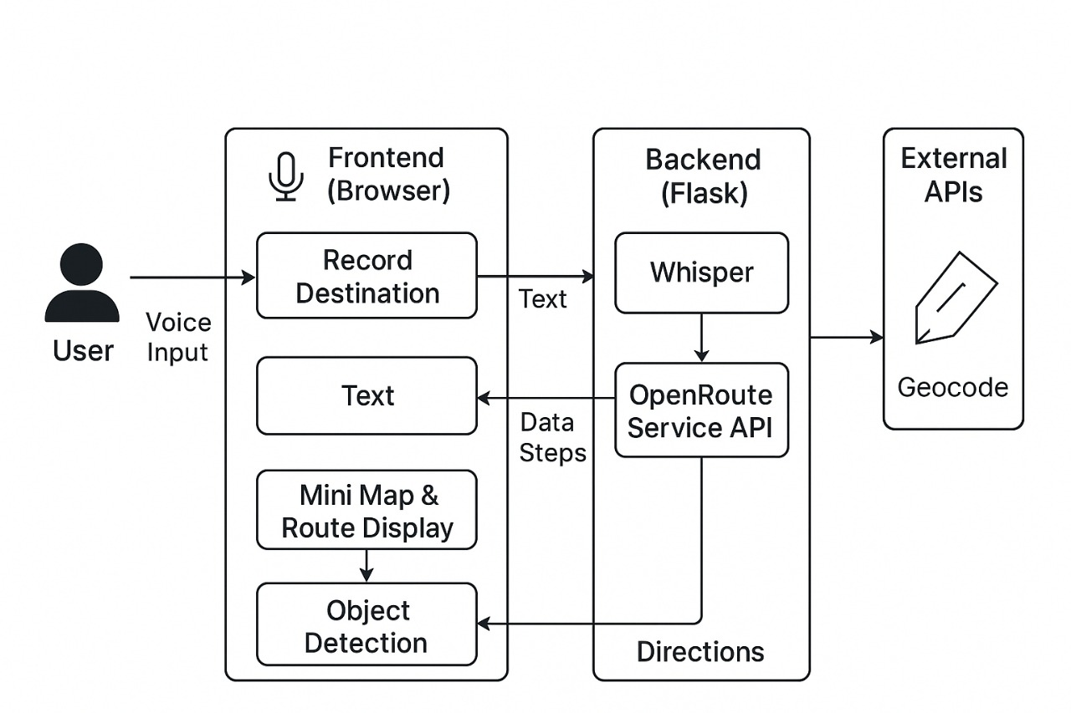
DataFlow Diagram

Slide 8
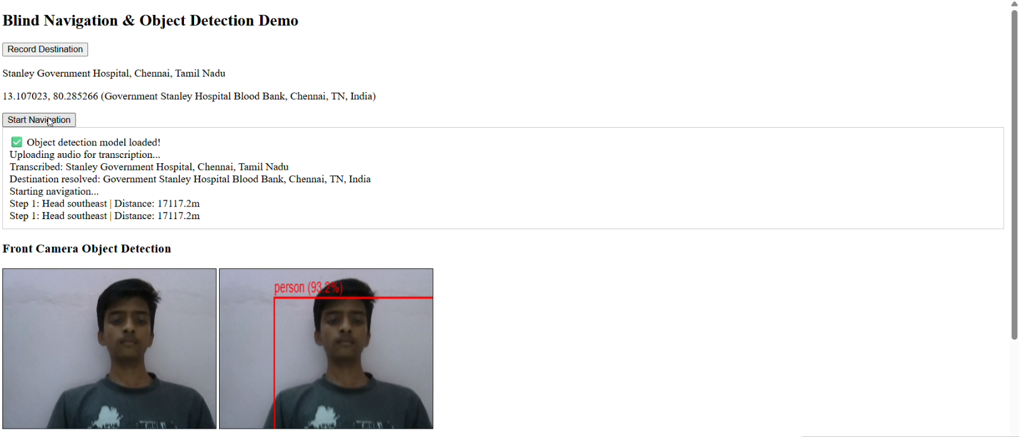
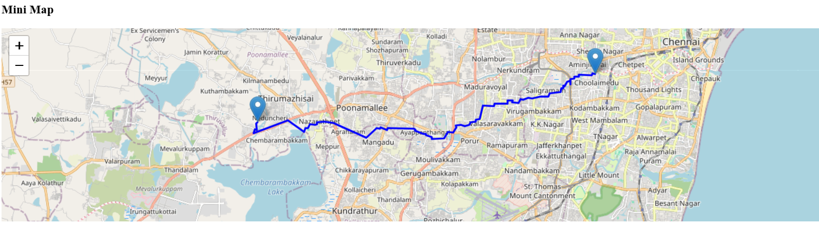
Demo Screenshots

Slide 9
Features
Voice-based destination input
Real-time transcription & geocoding
Step-by-step spoken navigation
Map with route visualization
Live object detection via camera
Audio alerts for obstacles

Slide 10
Advantages
Hands-free navigation
Helps visually impaired users
Detects obstacles in real-time
Works on browser with no extra app install

Slide 11
Challenges
Whisper sometimes mishears place names
Needs stable internet for ORS API
Object detection accuracy depends on lighting

Slide 12
Future Enhancements
Multi-language support
Offline navigation
Improved object detection with YOLOv8
Mobile app integration

Slide 13
Conclusion
Combined AI speech + navigation + vision in one app.
Useful for smart navigation systems.
Demonstrates real-world AI integration.

Slide 14
References
OpenAI. (2022). Whisper: Robust Speech Recognition via Deep Learning. Retrieved from https://github.com/openai/whisper
TensorFlow.js. (2023). COCO-SSD: Real-Time Object Detection in the Browser. Retrieved from https://www.tensorflow.org/js/models
Flask. (2023). Flask Web Framework Documentation. Retrieved from https://flask.palletsprojects.com
OpenRouteService. (2023). OpenRouteService API Documentation. Retrieved from https://openrouteservice.org/dev/#/api-docs
Mozilla Developer Network (MDN). (2024). SpeechSynthesis API – Web Speech API Documentation. Retrieved from https://developer.mozilla.org/
Redmon, J., Divvala, S., Girshick, R., & Farhadi, A. (2016). You Only Look Once: Unified, Real-Time Object Detection. Proceedings of the IEEE Conference on Computer Vision and Pattern Recognition (CVPR).
Kumar, R., et al. (2021). Integration of Speech and Vision Systems for Assistive Navigation. International Journal of Artificial Intelligence Research.

