Slide 1
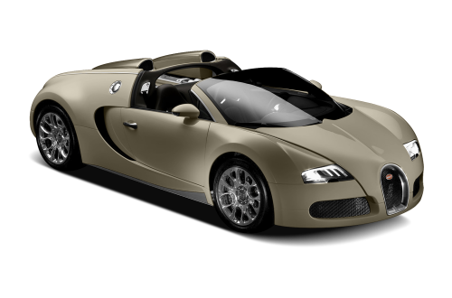
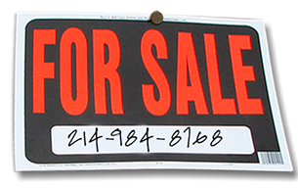
Modeling the Automotive Market
OPIM 5604: Predictive Modeling – Fall 2017
GROUP 6: Martin Winczura, Sarvesh Bangad, Lauren Flecha-Rosado
& Graig Defeo

Slide 2
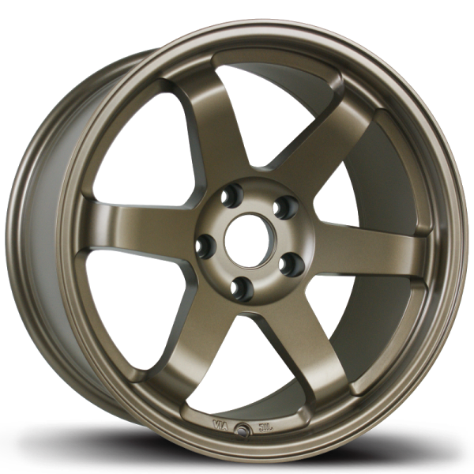
Agenda
Business Overview
Data Pre-processing
Model Process
Model Assessment

Slide 3
Data & Business Goal Overview
We are considering the data as an automotive manufacturer new to the market
Data Set:
Existing manufacturers and how they price their cars
Data Size:
11,914 records / 16 columns
Business Goal:
Predicting price of vehicles based on its features and characteristics

Slide 4
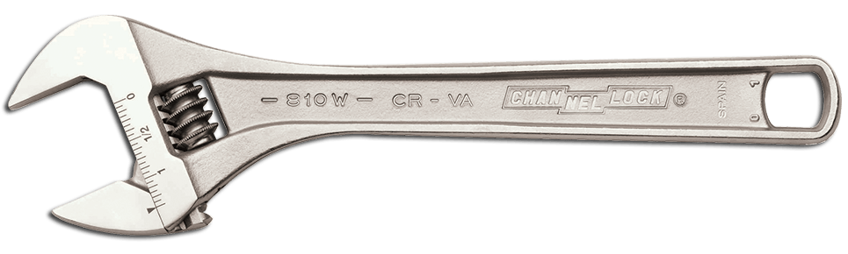
Data Dictionary

Slide 5
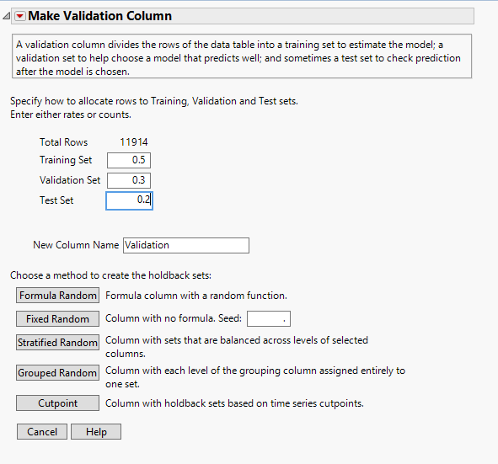
Sample
3 Data Sets:
Training = 50%
Validation = 30%
Test = 20%

Slide 6
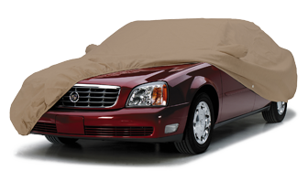
Explore – Data Preprocessing
Starting out, our goal was to explore the data set
We attempted to identifying correlations between variables
We explored missing values via analysis and inconsistencies
We created a plan of how to deal with missing values
We investigated outliers in the data

Slide 7
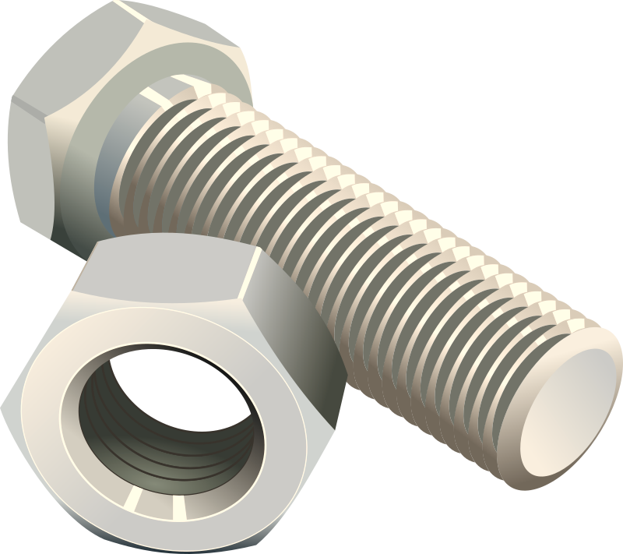
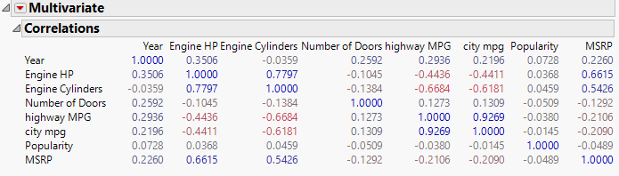
Correlation
‘Engine HP’ and ‘Engine Cylinders’ are correlated to MSRP since correlation coefficient > 0.5
‘Engine HP’ and ‘Engine Cylinders’ are also correlated to each other (0.7797)
‘city mpg’ and ‘highway mpg’ are also highly correlated to each other (0.9269)

Slide 8
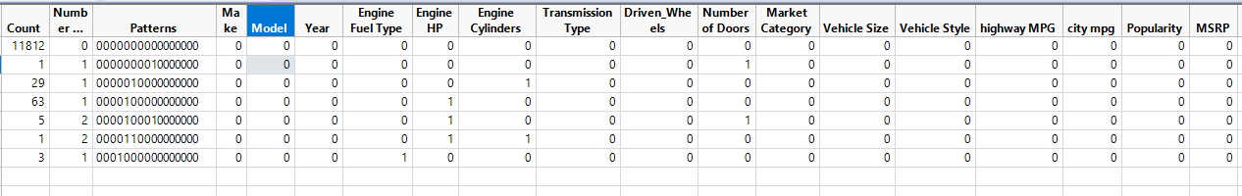
Missing Values and Inconsistencies
Total Records missing = 102
Engine Cylinders = 29 Records Missing
10 records of missing values for Engine Cylinders of electric car have been updated = 0
Total Missing Records Excluded = 93 (0.78% of data set)

Slide 9
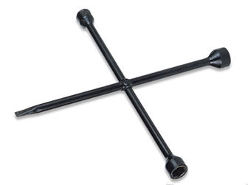
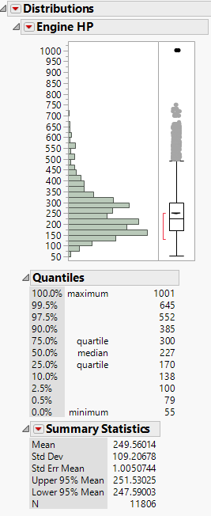
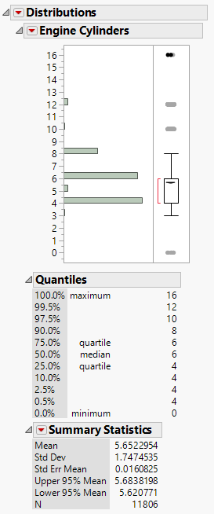
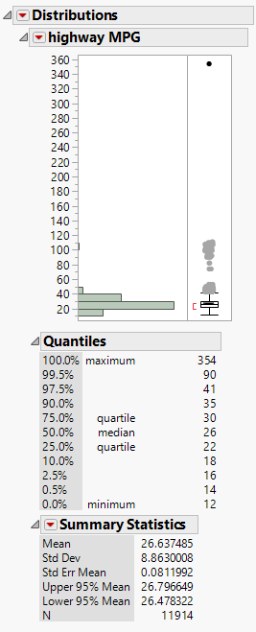
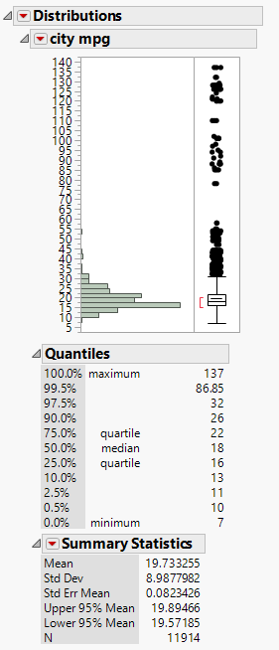
Outliers
Notes:
Engine HP = There are cars in the market (Bugatti Veyron) which have HP around 1000
Engine Cylinders = Few models of Ferrari, Mercedes, BMW are available which have more than 8 Cylinders
And Records with zero engine cylinders belong to electric cars.
Highway MPG = Data Set contains electric car. Hence data records above 100 MPG are not outliers
However, record with 354 MPG is not possible even for electric car. Hence, manually imputed the record with value = 34 MPG of another record having same car make and other car features.

Slide 10
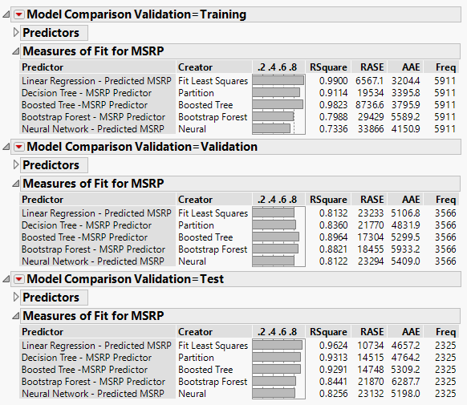
Model Process Models Assessment
First Approach:
Linear Regression
Decision Tree
Boosted Tree
Bootstrap Forest
Neural Networks

Slide 11

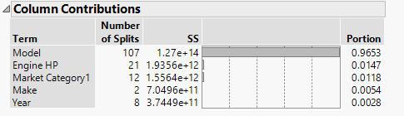
Best Model – Boosted Tree
Our results show that the “Model” of the vehicle is the single most important factor in predicting the price of a car. This however, is a flawed results as the model of the car is only a name. There are various other features which define a “model”.
However this would suggest it is possible to sell a car just based on the model designation (i.e. sell a Rolls Royce Phantom simply because it is a “Phantom”)

Slide 12
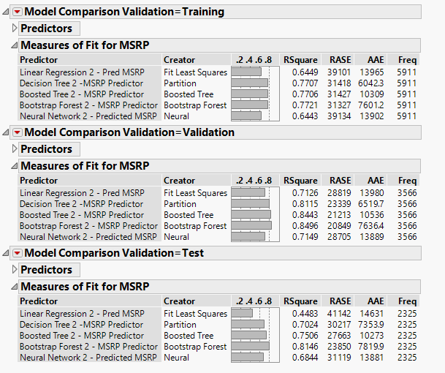
Model Process Models Assessment
Second Approach:
Linear Regression
Decision Tree
Boosted Tree
Bootstrap Forest
Neural Networks

Slide 13
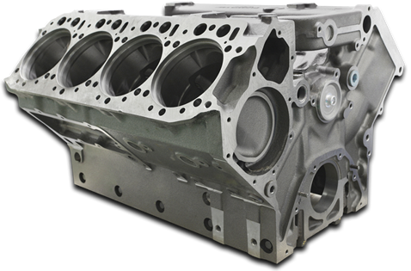
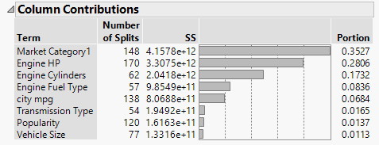
Best Model – Bootstrap Forest
We can say that the following features/characteristics of the car are the most important in predicting the price of the car:
Market Category, Engine HP and Engine Cylinders
Engine Fuel Type and City MPG
This result would explain a broader category of vehicles and be more useful for an automotive manufacturer to use in pricing their own vehicles.

Slide 14
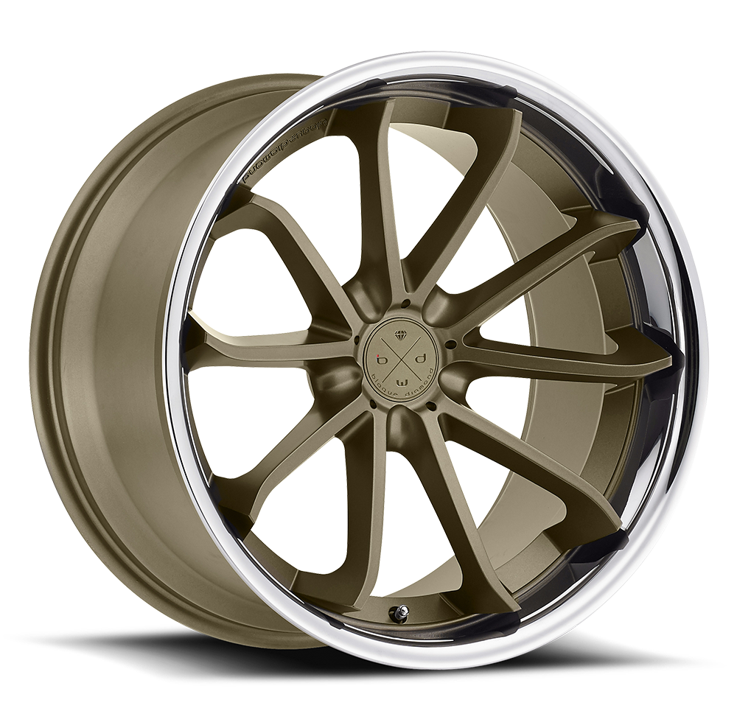
Questions?

