Slide 1
Smart Dustbin: Revolutionizing Waste Management
Welcome! We're excited to introduce our Smart Dustbin, a revolutionary waste management system designed to simplify and optimize the process of separating and disposing of trash.

Slide 2
Problem Statement and Motivation
1
Waste Mismanagement
2
Lack of Automation
Improper waste disposal leads to environmental pollution and health hazards. Traditional waste bins lack efficient sorting mechanisms.
Manual waste sorting is time-consuming and labor-intensive, leading to inefficiencies and increased costs.
3
Environmental Concerns
4
Sustainable Solutions
Landfills are overflowing, and improper waste disposal contributes to greenhouse gas emissions and resource depletion.
Our Smart Dustbin addresses these challenges by providing a convenient and effective solution for waste separation and management.

Slide 3

Key Features of Smart Dustbin
Waste Separation
Automated Lid Control
The Smart Dustbin features two compartments, one for dry waste and one for wet waste, ensuring proper separation and recycling.
The lid opens automatically using an ultrasonic sensor, detecting the presence of waste and eliminating the need for manual operation.

Slide 4
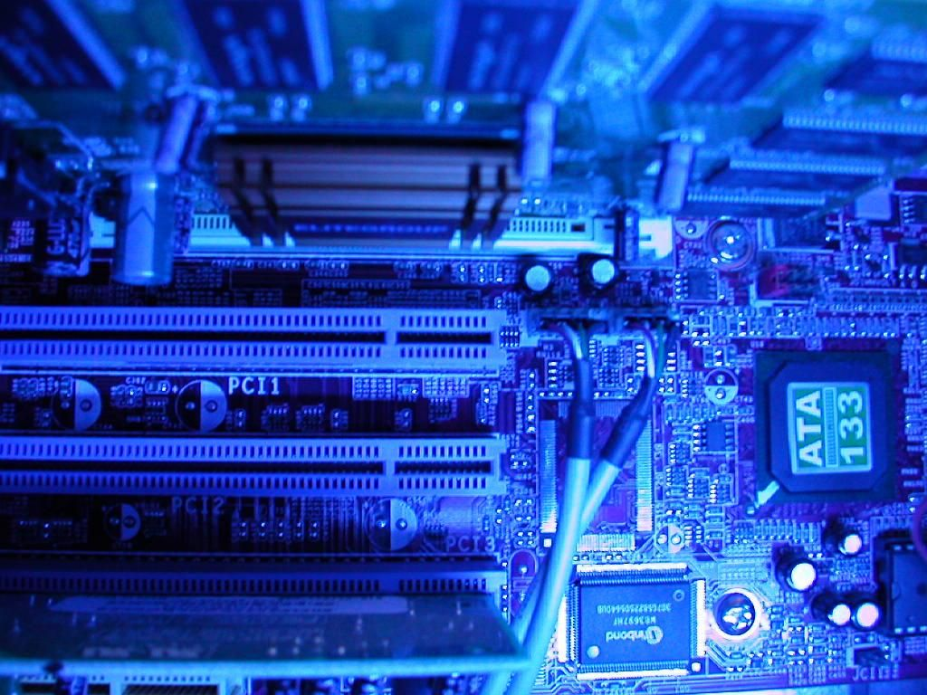
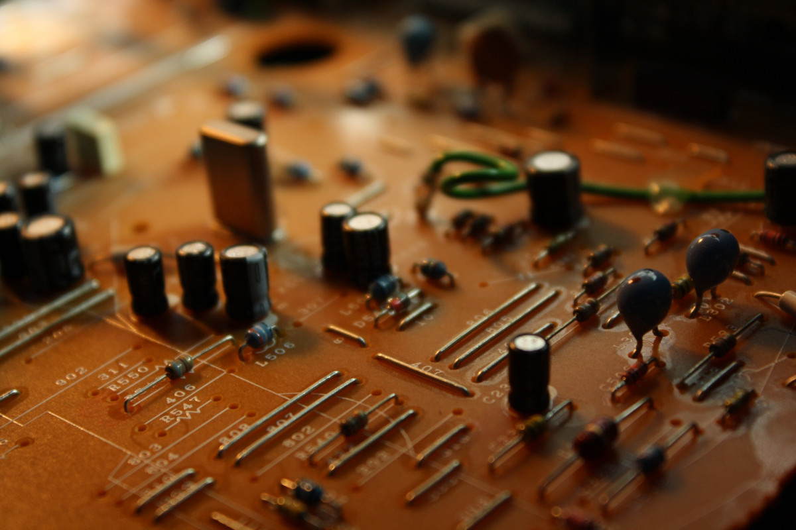
Hardware Components and Integration
Component
Function
Arduino Microcontroller
Processes sensor data, controls motor.
Ultrasonic Sensor
Detects motion and triggers lid opening.
Moisture Sensor
Monitors moisture levels in the garbage.
Motor
Controls the opening and closing of the lid.

Slide 5
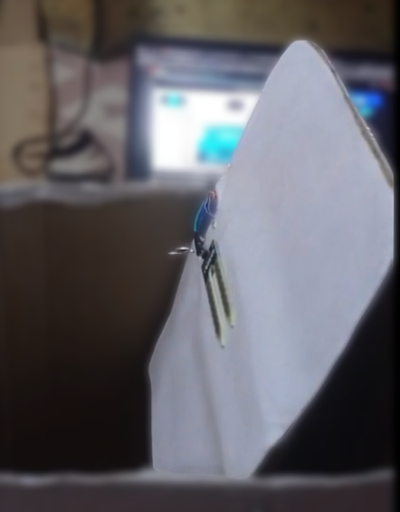



Sensor Functionality and Waste Separation
Motion Detection
The ultrasonic sensor detects movement and automatically opens the lid, enhancing convenience and hygiene.
Moisture Sensing
The moisture sensor monitors moisture levels in the garbage and send signal to Arduino about the value, then the Arduino decides whether it will go in dry compartment or wet compartment
Waste Separation
The two compartments ensure proper separation of dry and wet waste, facilitating recycling and reducing landfill waste.

Slide 6

Prototype Development and Testing
1
Hardware Integration
Connecting and configuring the Arduino microcontroller, sensors, motor, and other components to ensure proper functionality.
2
Software Programming
Developing the code to be used by Arduino to process sensor data and control the motor
3
Prototype Testing
Testing of the prototype in real-world scenarios to evaluate its performance, reliability, and accuracy.

Slide 7
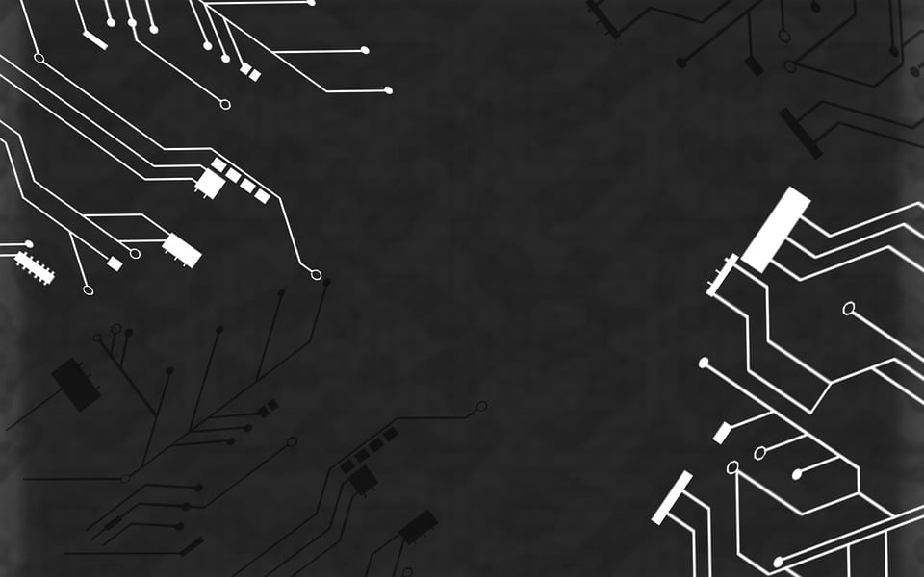
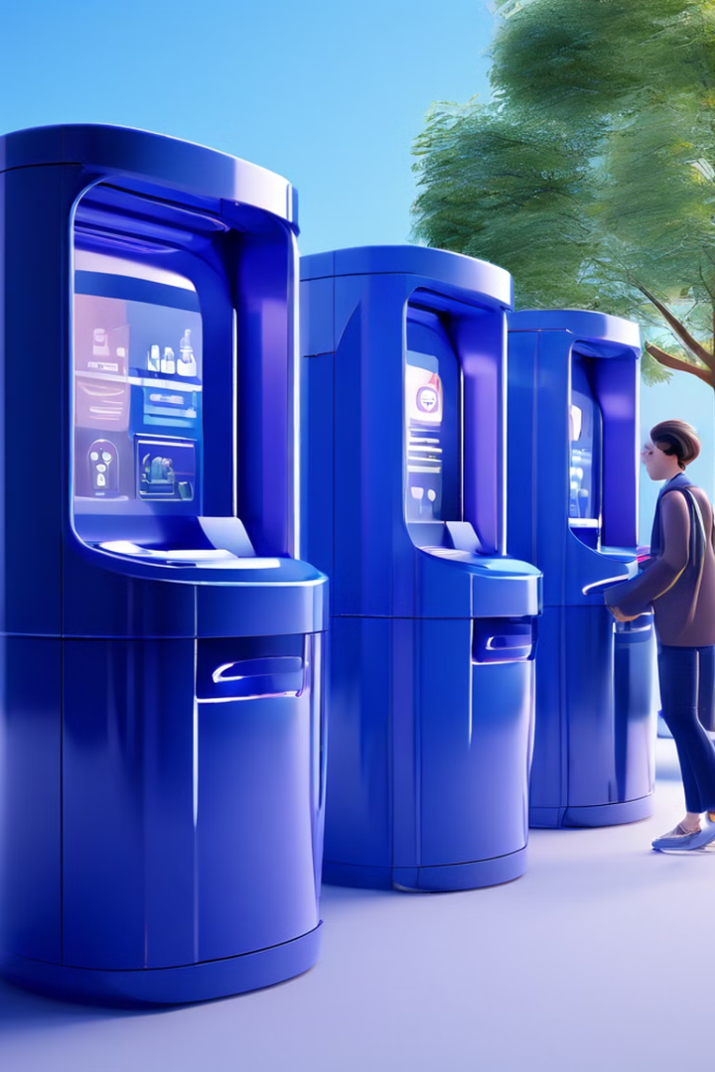
Potential Applications and Benefits
Residential Homes
Enhances waste management, promotes recycling, and minimizes odors and pests.
Commercial Buildings
Optimizes waste collection, reduces operational costs, and improves environmental sustainability.
Public Spaces
Promotes cleanliness, reduces littering, and encourages responsible waste disposal.
Educational Institutions
Fosters environmental awareness, promotes recycling practices, and encourages responsible waste management.

Slide 8
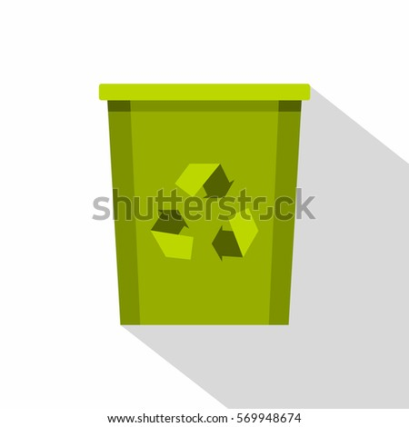
Conclusion and Future Enhancements
Smart City Integration
This prototype can be given as a one stop solution to the municipal corporations to enhance waste management and to support waste segregation movements.
Enhanced Recycling
Developing advanced sorting mechanisms to further automate waste separation and improve recycling rates.

