Slide 1

SMART INDIA HACKATHON 2026
Problem Statement ID – SIH26162
Problem Statement Title -AI-Based Detection and Classification of Industrial Fires and Persistent Thermal Sources Using NASA FIRMS, OSM & Satellite Data
Theme - Disaster Management
PS Category- Software
Team ID - SIH26-A0H-T316
Team Name - HACK PROCESSING UNIT

Slide 2
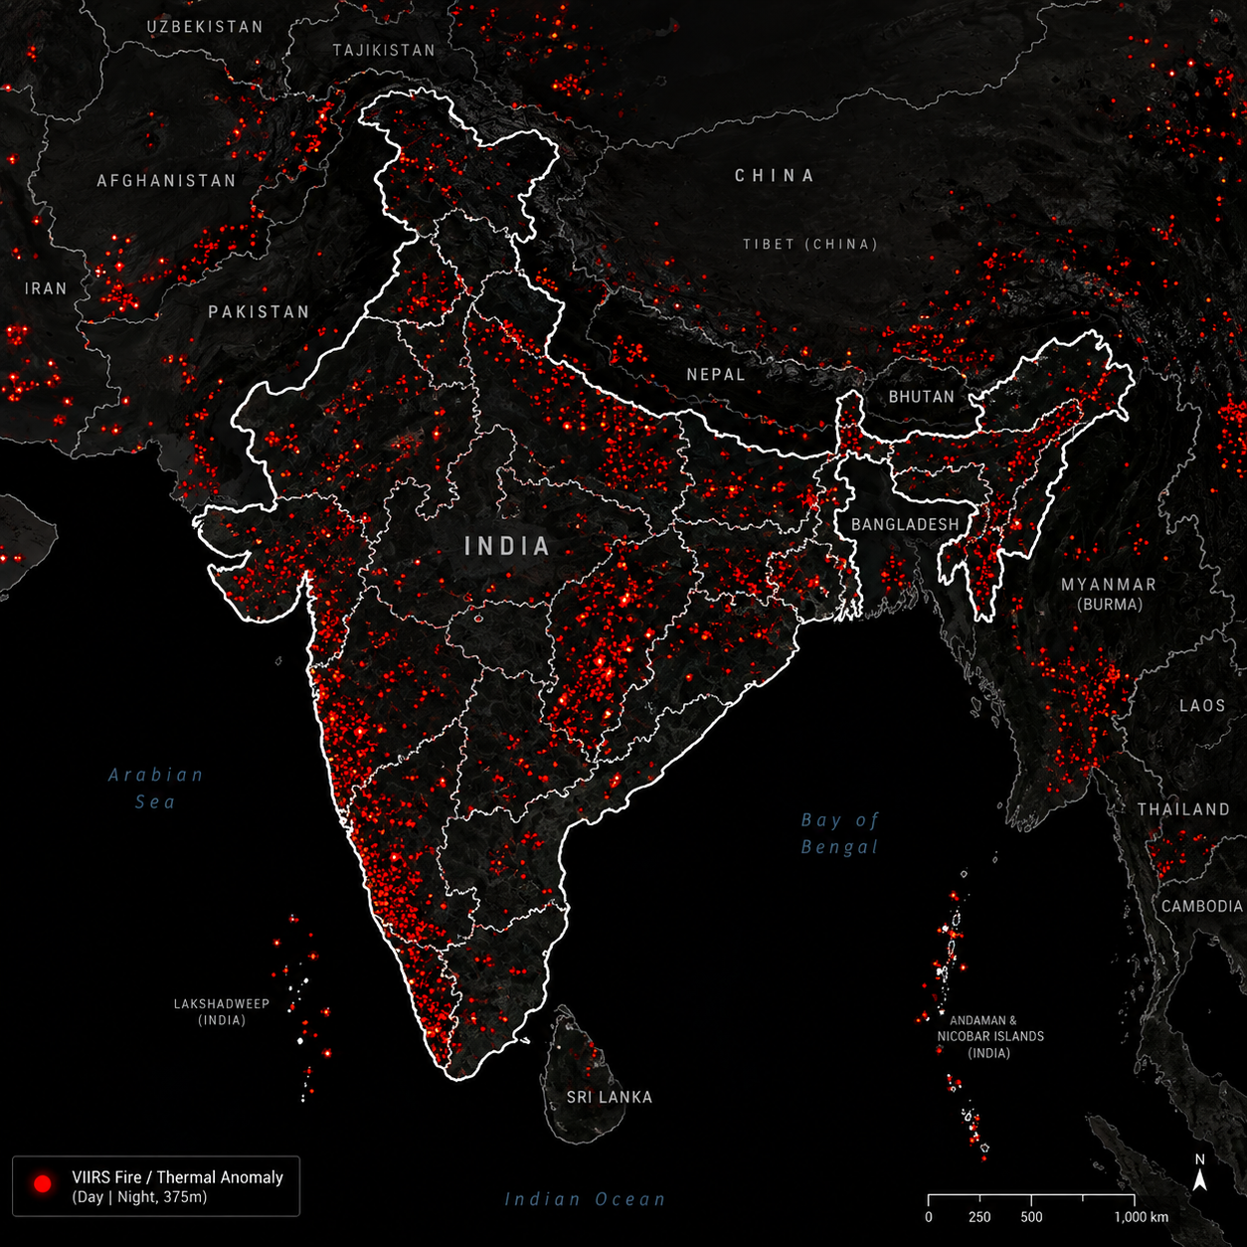
IFDCS – Industrial Fire Detection & Classification System
The Problem - Every day, satellites detect thousands of heat signatures near industrial facilities, but systems like NASA FIRMS cannot distinguish industrial fires from wildfires or agricultural burning. In April 2026, a thermal power-plant boiler explosion in Chhattisgarh killed 13 workers and injured 20, highlighting the need for faster detection of abnormal industrial thermal events.
Addressing the Gap
Innovation & Uniqueness
  Detection Gap: Satellites like NASA FIRMS see heat but not context — they can't identify what's actually burning.
Fire Intensity in MW, Not Just Detection – We estimate Fire Radiative Power directly from INSAT, so alerts say "128 MW, rising" instead of just "fire detected."
Data Gap: No unified map links India's refineries, plants, and mines to satellite coordinates for context.
Daytime Flare Detection – Reuses existing Sentinel-2 SWIR data to catch gas flares during daylight, closing a gap most systems only solve at night.
Proposed Solution
AsseExplass & Enhance
Response Gap: Every heat signal looks equally urgent, burying real emergencies under wildfire and farm-burning noise.
Ingest & Fuse – Pulls INSAT-3D/3DR and NASA FIRMS thermal alerts, joins it with facility, Bhuvan land-cover, and flare-catalog data, and estimates fire intensity in megawatts.
India-Sourced Optical Proof – Uses Resourcesat/Bhoonidhi alongside Sentinel-2, so visual confirmation doesn't depend solely on a foreign satellite.
Classify – The XGBoost model weighs the odds it's an industrial fire, wildfire, gas flare, mining activity, or farm burn.
Validate & Flag – Checks the reading against that facility's own history across two satellite passes; anything unusually hot or unconfirmed gets flagged for review.
Never-Blocking Evidence Layer – Optical images and FRP calculations run fully async after the alert, so slow or failed fetches never delay a real warning.
Explainable AI – SHAP values turn the score into a plain-English reason, like "flagged HIGH — 4x above normal, matches known facility."
Mining as a Distinct Class – Verified Bhuvan land-cover data separates active mining sites from generic wasteland, a gap most global land-cover sources miss.
Optical Confirmation – Sentinel-2 or Resourcesat fetches a real image of the site once an alert is confirmed, without ever delaying the alert itself.
New-Facility Safety Net – Newly registered sites aren't left unmonitored; they get an industry-average baseline with visibly lower confidence instead of silence.
Report & Monitor – Live GIS dashboard shows every event, colour-coded by risk, while the system tracks each site's heat over weeks and flags the ones that just won't cool down.

Slide 3
TECHNICAL APPROACH
FACILITY
INSAT + FIRMS Ingest
Land-Cover (Bhuvan)
Flare Pre-Filter
Store & Baseline
Cold-Start Gate
XGBoost Classification
Validate & Flag
Explainable AI (SHAP)
Optical Confirmation
Flare
Confirmed
GIS Dashboard
Flare Baseline check
INSAT + FIRMS Ingest – INSAT-3D/3DR every 30 min (MIR/TIR) for continuous monitoring plus estimated FRP in MW; FIRMS VIIRS/MODIS every ~3 hr for polar confirmation. Joined to facility registry, tagged with satellite and source_tier.
Flare Pre-Filter – Cross-checks against VIIRS Nightfire catalog; new PFM and SHM masks reduce industrial false positives; daytime detection added via Sentinel-2 SWIR bands (B11/B12), closing the daylight blind spot.
Store & Baseline – All readings (facility and flare, tagged by reading_type) inserted into TimescaleDB's 90-day window; older data archived to Parquet. Daily rolling_mean/std recompute builds each site's thermal fingerprint.
XGBoost Classification – Single model ( per research showing fewer false positives), trained on land_cover_class + facility_type + thermal features, outputs one of six labels with probabilities stored.
Explainable AI (SHAP) – TreeExplainer generates feature attributions as a plain-language narrative per event.
Optical Confirmation – Background worker auto-fetches a Sentinel-2 or Resourcesat image after alerting; failures never block it.
Land-Cover (Bhuvan) – Hotspot coordinates checked against Bhuvan LULC via buffer-based lookup (~300–500m). Confirms forest, cropland, built-up, mining, or water - mining verified as a distinct sub-class. Facilities tagged with facility_type.
Validate & Flag – Two-tier: Tier 1 geostationary issues a preliminary alert (~20–30 min); Tier 2 polar pass corroborates via z-score + persistence, setting status confirmed/under_review/dismissed - also the flare branch's merge point.
Flare Confirmed – Matched flares
skip Cold-Start and Classification but pass a lightweight intensity check against historical FRP — flags abnormal escalation instead of routine pass-through, then rejoins at Validate & Flag.
Cold-Start Gate – New facilities marked insufficient_baseline until enough samples exist; monitored via a temporary industry-average baseline with lower confidence instead of left unmonitored.
GIS Dashboard – Live map shows status, class, land cover, FRP, and evidence.

Slide 4
FEASIBILITY AND VIABILITY
Feasibility Of The Idea
Potential Challenges and Risks
Strategies To Overcome Challenges
Technical Feasibility – A single well-validated XGBoost model, backed by published fire-classification research, cuts training complexity and inference cost compared to running two models.
Data dependencies – The system leans on six external sources (INSAT/MOSDAC, FIRMS, Bhuvan, Bhoonidhi, VIIRS Nightfire, Copernicus), each with its own access rules and uptime — a coordination risk outside the team's control.
Handling API Reliability – Every external call gets retry and caching built in, and we're starting all six data-access requests early so approval delays don't hold up development.
Data Feasibility – Freely available INSAT-3D/3DR via MOSDAC, NASA FIRMS thermal archive, plus Bhuvan land cover and OSM/GEM facility data — verified access, large enough for reliable weak-labelling.
Building Training Data Carefully – We're putting together a labelled dataset from FIRMS history, flare records, mining zones, and facility matches, then double-checking it against a small set of real incidents.
Unlabelled training data – No verified dataset exists linking hotspots to actual fire causes; building one requires significant manual cross-referencing effort.
Operational Feasibility – Pipeline from hotspot ingestion to dashboard alert, designed with async optical and FRP layers so a slow fetch never blocks the core alert.
Satellite revisit gaps – Polar satellites (VIIRS/MODIS) only pass every ~3 hours, creating a real-world confirmation delay before an alert can be fully trusted.
Balancing Speed and Accuracy – INSAT's quick 30-minute updates drive the first alert, while VIIRS confirmation happens in the background instead of slowing things down.
Economic Feasibility – Low infrastructure cost since it reuses free Indian and open satellite data, high disaster-response value, reduces damage and delayed response to industrial fires.
Facility registry accuracy – With CPCB access blocked, reliance on OSM/GEM data risks misclassifying unregistered or mismapped industrial sites.
Cleaning Up Facility Data – We're manually reviewing and fixing OSM/GEM entries against known sites, while still following up on CPCB access as a backup option.
Regulatory & Access Feasibility – We already secured working MOSDAC and Bhuvan logins mid-development, proving real data access instead of just assuming it.
INSAT-specific FRP calibration – The fire-intensity formula uses an uncalibrated coefficient, so reported megawatt values remain estimates until cross-validated against VIIRS.
Being Honest About FRP Numbers – Fire intensity is labeled as an estimate, and we keep comparing it against VIIRS readings over time to make it more accurate.

Slide 5
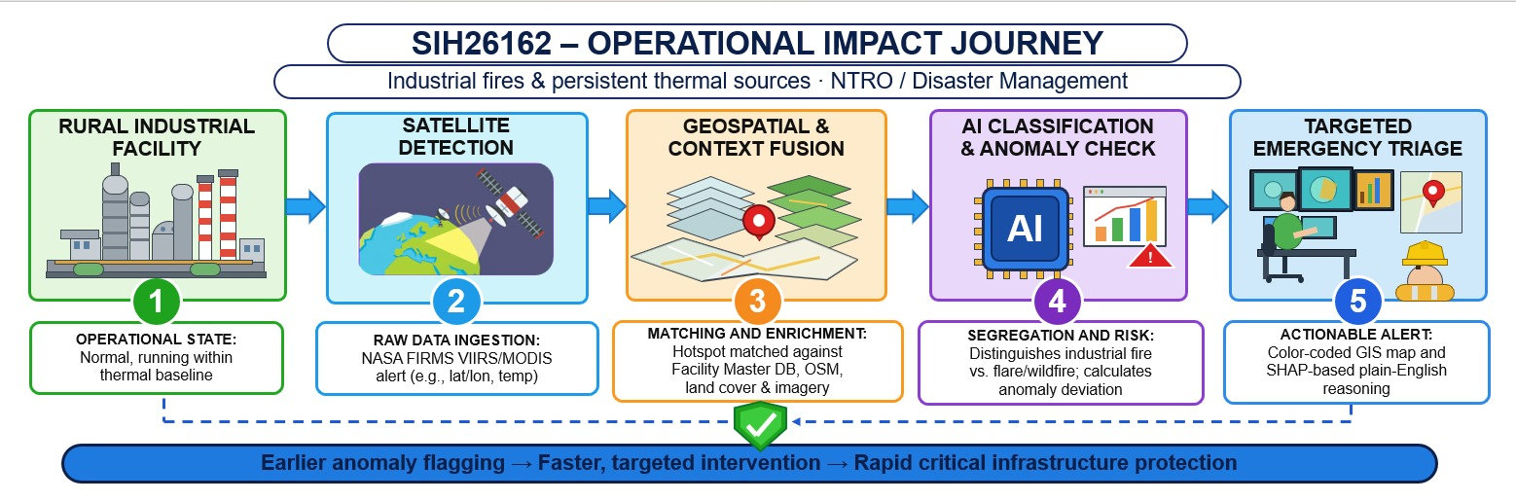
IMPACT AND BENEFITS
Impact on the Target Audience
Benefits of the Solution
Facility operators are alerted first — the system catches a site running hotter than usual or a flare quietly escalating, before it becomes a real emergency.
For facility operators – Real-time thermal monitoring catches their own site running hotter than normal, or a flare quietly escalating, before it becomes a reportable emergency.
Disaster response teams receive the next alert already carrying location, fire intensity, and a plain-language reason, cutting the time spent figuring out what's happening.
For regulators – A six-way classification separates industrial fire from wildfire, mining, gas flare, and farm burning, preventing wasted enforcement action on non-industrial heat sources.
Regulators step in using the same SHAP-explained trail to verify the incident without manually reviewing raw satellite data themselves.
For disaster response teams – Every alert already carries measurable fire intensity in megawatts, letting them prioritize a 500 MW event over a 20 MW one instead of treating all alerts equally.
Nearby communities stay protected throughout — not through their own awareness, but because every step before them moved faster.
For the whole response chain – Optical confirmation, FRP, and flare-data access can fail independently without ever blocking or hiding a genuine alert underneath them.
For analysts and reviewers – Every flagged event carries a SHAP-generated plain-language reason they can actually verify, not an unexplained black-box score.
For the nation's safety infrastructure – Built on INSAT, Bhuvan, and Resourcesat wherever possible, reducing dependency on foreign satellites for a critical, sovereign monitoring system.

Slide 6
RESEARCH AND REFERENCES
1. Government/Official Data Sources – From a research standpoint, grounding a system in authorized government data (MOSDAC/ISRO, Bhuvan/NRSC, CPCB) rather than scraped or assumed data strengthens reproducibility and institutional trust. It signals the research isn't theoretical — it's built on verifiable, sanctioned sources a reviewing body can independently audit, cross-check, or extend without questioning data provenance.
2. Policy/Regulatory Context – Situating research within existing government frameworks (disaster management mandates, environmental monitoring policies) demonstrates the work isn't isolated academic exercise but addresses a recognized institutional need. This alignment matters for adoption feasibility — research disconnected from policy context often fails to transition from prototype to actual deployment, regardless of technical merit.
3. Acknowledgment Line – Proper acknowledgment of data-providing institutions is standard research ethics, not just courtesy. It maintains the chain of accountability between data source and downstream analysis, allows the provider to track usage of their infrastructure, and is frequently a stated condition of access -as MOSDAC explicitly required here.
Liu et al. (2018) — VIIRS Nightfire for Industrial Heat Sources, Journal: Remote Sensing of Environment — directly underpins your Flare Pre-Filter, the core mechanism separating gas flares from industrial fires. link
[XGBoost vs Random Forest FIRMS/MODIS fire-type classification study, 2023] — validates your single-model architecture decision in Step 7, the heart of your six-class classification system. link
Si et al. (2026) — Offshore Platform Flare Detection, Journal: ESSD — Sentinel-2 SWIR+TAI methodology behind your daytime flare detection, the biggest genuine innovation in your workflow. link
[PFM/SHM-Aware Spatiotemporal Contextual Fire Detection] (2026) — Journal: Remote Sensing — supports your industrial false-positive reduction logic, directly tied to your strongest quantitative claim (88.6%→22.7% FP reduction). link
Iban & Aksu (2024) — SHAP-Driven Explainable AI Framework for Wildfire Susceptibility Mapping, Journal: Remote Sensing — validates your Explainable AI step, a key differentiator for judges. link
Links

