Slide 1


SMART SEARCH OVER ENCIPHERED DATA FOR CLOUD COMPUTING
Name of student Group No: A_G12
1 Gauri Kavitkar B151024252
2 Sarvesh Kher B151024332
3 Gaurav Mahendrakar B151024334
4 Mayuresh Patil B151024336
Computer Engineering Department Guided by –Ms.Nikhita Nerkar
RMDSSOE, Warje

Slide 2
Introduction to the Domain
CLOUD computing is a new but gradual maturity model of enterprise
IT infrastructure that provides high quality applications and services [1].
Types of cloud computing
Infrastructure as a Service (IaaS)
Software as a Service (SaaS)
Platform as a Service (PaaS)

Slide 3
Problems identified in the domain
Implementation is costly.
Security.

Slide 4
Motivation
1. Semantic search becomes increasingly important as the keyword based search scheme cannot exploit the hidden meanings of terms and the semantic similarity between terms.
2. By utilizing some semantic tools, the semantic search scheme can improve both precision and recall.
3. The concept hierarchy is mainly constructed to indicate the relationships between concepts.
4. The most important usage of concept hierarchy is to distinguish meanings for classification or exploit semantic similarities.

Slide 5
Project Scope
1.Store documents on cloud
2.Key Exchange With User
3.Key Management
4. Multi-party searchable encryption
5. Content Based Filtering using TF-IDF

Slide 6
Objective
Use semantic based search scheme instead of keyword based search to achieve searching efficiency
Use of ECC instead of RSA for better security

Slide 7
Goals
To provide an efficient search scheme for enciphered data on cloud.
Provide security to personal data stored by the user on cloud using various security based techniques.

Slide 8
Literature Survey
Sr no | Paper name | Year | Description
01 | Zhangjie Fu, Lili Xia, Xingming Sun, Alex X. Liu, Guowu Xie “Semantic-aware Searching over Encrypted Data for Cloud Computing” in IEEE Transactions on Information Forensics and Security[6] | 2018 | It uses semantic search scheme based on the concept hierarchy and the semantic relationship between concepts in the encrypted datasets. It uses two cloud servers used to store the outsourced datasets and return the ranked results to data users.
02 | Tianyue Peng, Yaping Lin, Xin Yao, Wei Zhang “An Efficient Ranked Multi-Keyword Search for Multiple Data Owners Over Encrypted Cloud Data” in Network Technology and Application[7] | 2018 | It proposes a novel secure search protocol that allows different data owners to encrypt the files and indexes with different keys then construct a tree-based index structure for each data owner and encrypt with AOPPF and allows the cloud server to merge encrypted indexes without knowing any information.

Slide 9
03 | N.Deepa, P.Vijayakumar, Bharat S. Rawal, B.Balamurugan “An extensive review and possible attack on the privacy preserving ranked multikeyword search for multiple data owners in cloud computing” in IEEE International Conference on Smart Cloud[8] | 2017 | The system develops an efficient searching algorithm and an efficient matching algorithm in the CSP, in order to prevent, man in the middle attack and impersonation attack. It secure key distribution algorithm from the data owner side to data user side, where the data decryption keys are distributed in a secure way to the data users.
Literature survey

Slide 10
Problems Identified in the Existing work
Many schemes are proposed to make encrypted data searchable based on keywords. However, keyword-based search schemes ignore the semantic representation information of users retrieval and cannot completely meet with users search intention.

Slide 11
Problem Statement
To provide Security and Semantic search in Cloud Computing and keep data aware from third party or unauthorized access.

Slide 12
Hypothesis
There exists a synonym for every word searched.

Slide 13
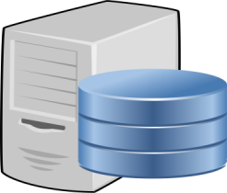





System Architecture
Data Stored on Cloud with Indexing Using SHA
Encryption key of User1
Data and index encrypted using AES algorithm
Encryption key of User2
User1 Request for Doc1
Document Searching is Performed using encrypted index
Encryption key of User3
Content Based Filtering using TF-IDF
User1 Request for Doc2
Key Management (ECC)
Data Secured using Private key
Doc 1(index 3)
Doc 2(index 2)
User1 Request for Doc3
Doc 3(index 3)

Slide 14
Project Modules
Sr no | Modules | Features
1 | User Interface | Clarity, responsive
2 | Database | Synset, user friendly
3 | Cloud | Scalable, easy maintainance
4 | Key Management | Secure, fast
5 | Search Index | Efficienct

Slide 15
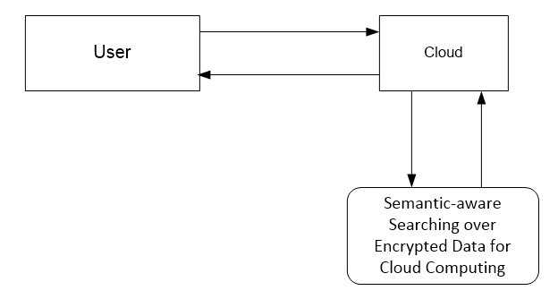
DFD-0

Slide 16
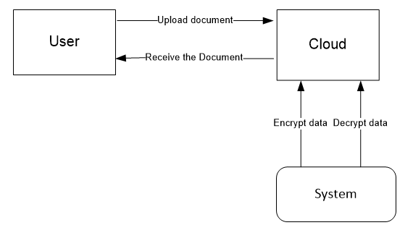
DFD-1

Slide 17
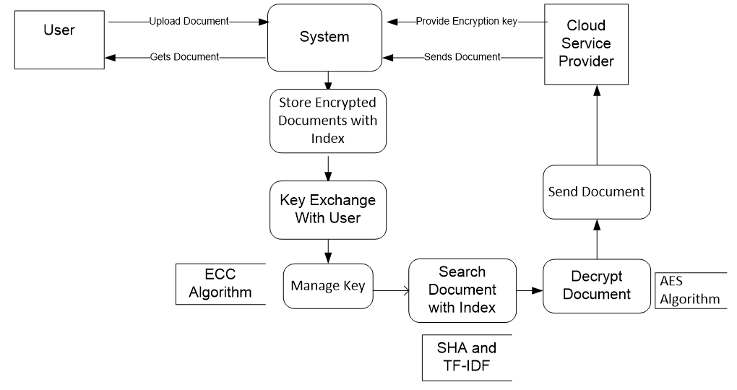
DFD-2

Slide 18
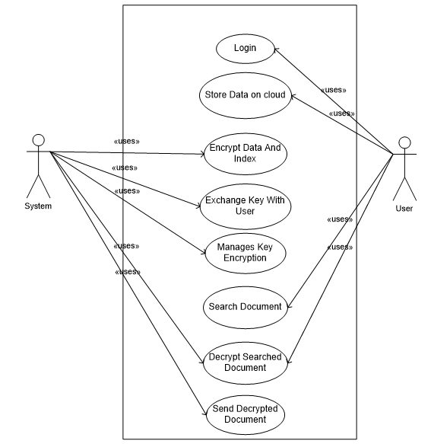
Use Case

Slide 19
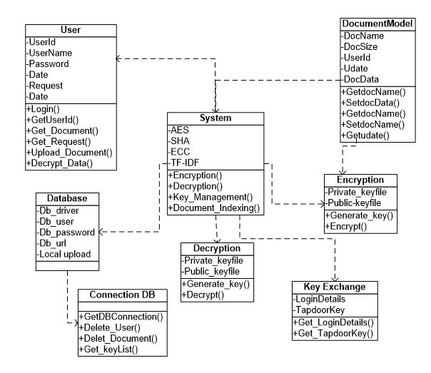
Class Diagram

Slide 20
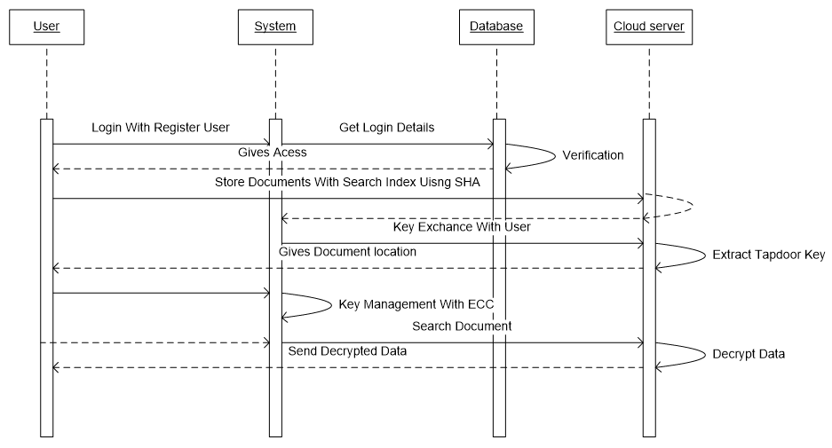
Sequence Diagram

Slide 21
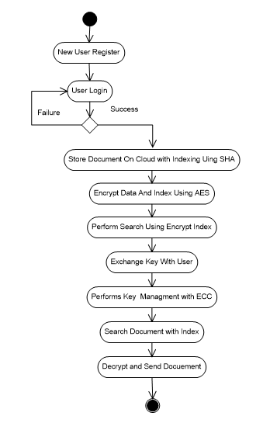
Activity Diagram

Slide 22
Proposed Algorithm
Encryption/Decryption using AES Algorithm
TF-IDF Algorithm
SHA-1 (Secure Hashing Algorithm)
ECC (Elliptical Curve Cryptography)

Slide 23
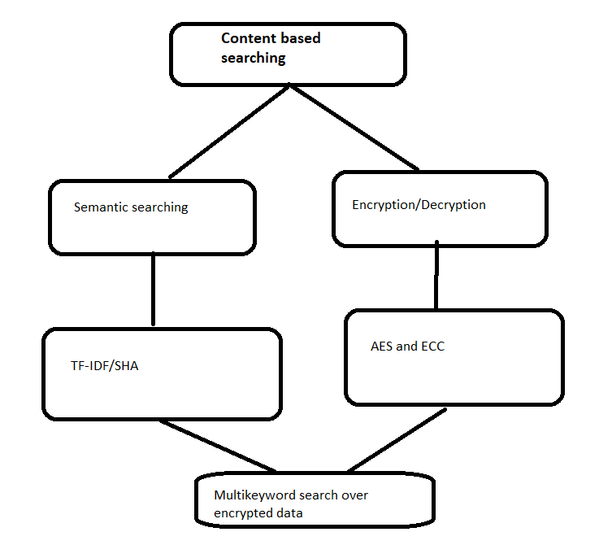
Divide & Conquer
A divide-and-conquer algorithm works by recursively breaking
down a problem into two or more sub-problems of the same or
related type, until these become simple enough to be solved directly.

Slide 24
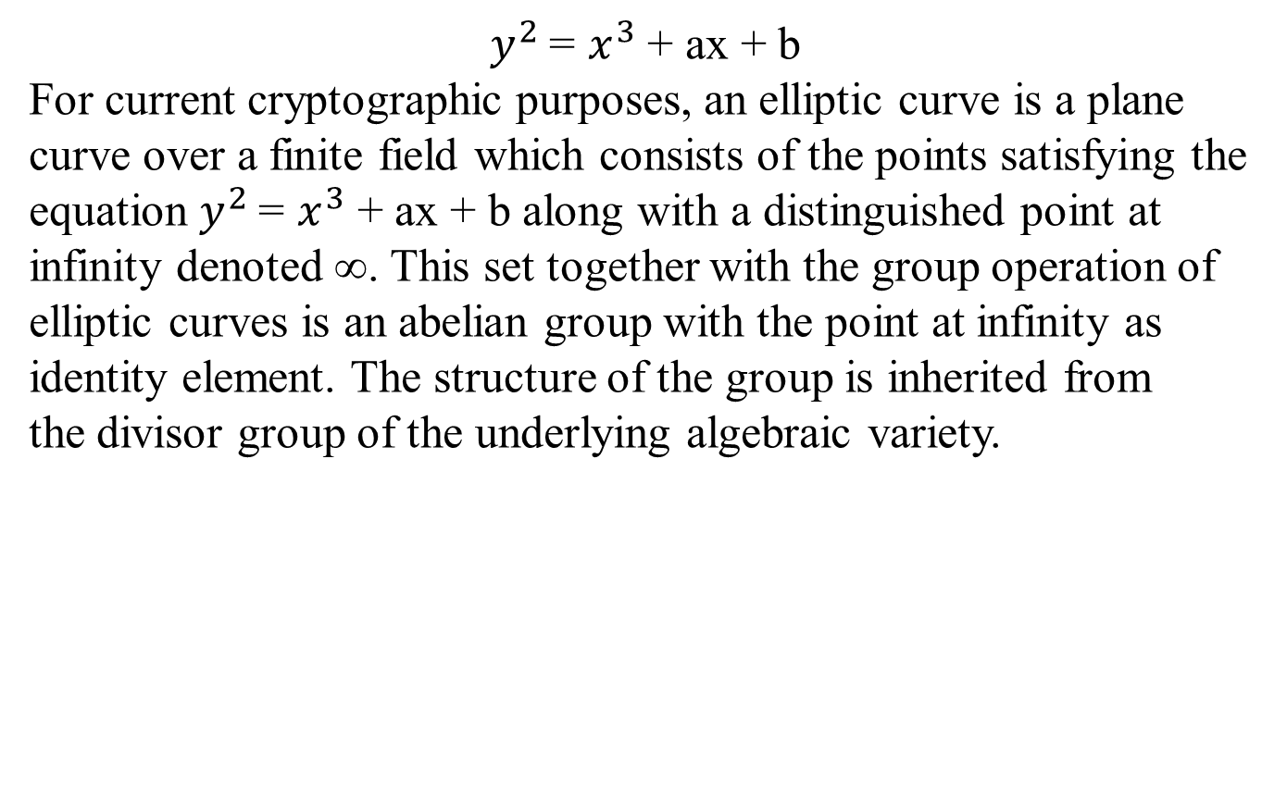
Mathematical Modeling
$y^{2}$=$x^{3}$ + ax + b
For current cryptographic purposes, an elliptic curve is a plane curve over a finite field which consists of the points satisfying the equation $y^{2}$=$x^{3}$ + ax + b along with a distinguished point at infinity denoted ∞. This set together with the group operation of elliptic curves is an abeliangroup with the point at infinity as identity element. The structure of the group is inherited from the divisor group of the underlying algebraic variety.

Slide 25
Feasibility Analysis
In TF-IDF we have to compare the each item’s attributes to rest of the items in the database and a cumulative score is calculated based on their similarities.
AES is based on a design principle known as a substitution-permutation network, and is fast in both software and hardware.
AES use 10 cycles of repetition for 128-bit keys. Each round consists of several processing steps, each containing four similar but different stages, including one that depends on the encryption key itself. All this can be done in polynomial time but requires indefinite time for db interaction so it is NP-COMPLETE

Slide 26
Project Cost Analysis & System Requirements
COCOMO Model
Mode | “A” variable | “B” variable | “C” variable | “D” variable | KLOC | Effort | Duration | Staffing
Organic | 2.4 | 1.05 | 2.5 | 0.38 | 12.500 | 34.08 | 9.552 | 3.564

Slide 27
Cost Analysis
Effort =a*KLOC^{b}, in person/months
with KLOC = lines of code, (in the thousands) = 34.038
Duration =c*effort^{d}, finally = 9.552
Staffing =effort/duration = 3.564
System Requirement
The minimum configuration required on server platform
2.4 GHZ, 80 GB HDD for installation.
512 MB memory.
PC
Network Devices

Slide 28
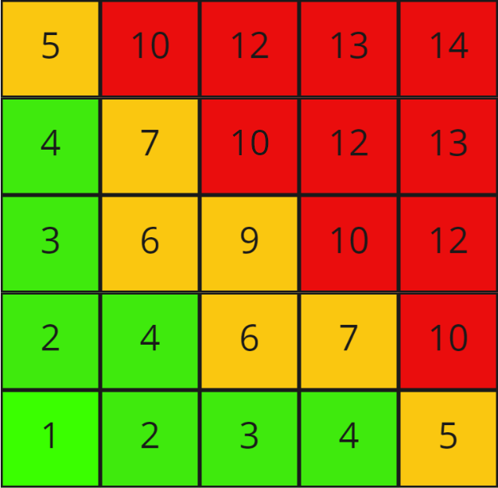
Risk Analysis & Mitigation
Almost impossible (1) | Once in 10+ years
Not likely to occur (2) | Once in 2 – 10 years
Could occur (3) | Once in < 2 years
Known to occur (4) | 1 – 3 times per month
Common occurrences (5) | 4+ times per month

Slide 29
Risk Analysis & Mitigation
Sr. No | Risk (Description of risk ) | Probability | Impact | Risk Mitigation
1 | Interdependency of implementation of modules. | Medium | Medium | The module that are not interdependent should be designed before the analysis.
2 | Software is resource intensive and slow. | Low | High | The software should be designed efficiently and in a language that maximizes efficiency and minimizes system load.
3 | Overly optimistic schedule | Medium | Low | Increase the man hours put in by each team member.

Slide 30
Sr. No | Risk (Description of risk ) | Probability | Impact | Risk Mitigation
4. | Lack of database stability | Low | High | The development team should communicate database administrator to keep it stable
5. | Technology will not meet expectation. | Medium | High | If idea of the project doesn’t meet then management team must take quick action.

Slide 31
Quality Assurance Measures
Accuracy
Meaningfulness
High Speed
Security
Low latency

Slide 32
Data sets considered
Wordnet
WordNet is a large lexical database of English. Nouns, verbs, adjectives and adverbs are grouped into sets of cognitive synonyms (synsets), each expressing a distinct concept.
Synsets are interlinked by means of conceptual-semantic and lexical relations.
WordNet is also freely and publicly available for download.
WordNet's structure makes it a useful tool for computational linguistics and natural language processing.

Slide 33
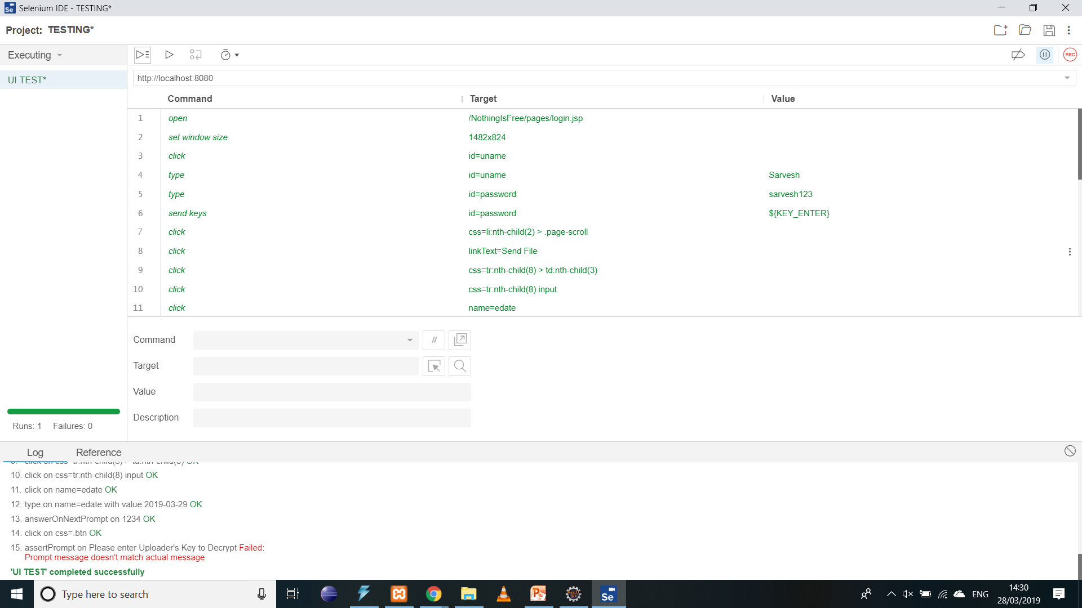
Testing Strategy Used
UI testing by Selenium IDE

Slide 34
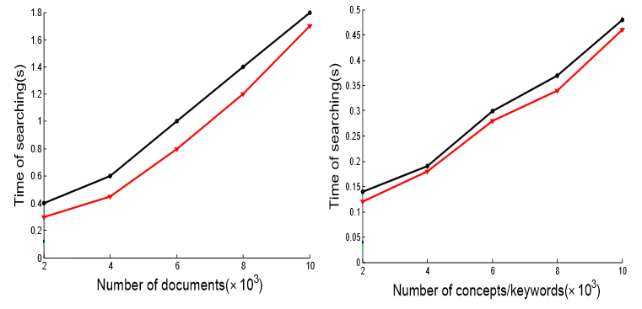
Comparative Result Analysis

Slide 35
Results & Discussion
We have formulated a new primitive, Smart Search over Enciphered Data, for enabling users to selectively authorize each other to search in their encrypted data which gives a better improvement than existing system.
We have improved the security by switching RSA with ECC
For searching the document an TF-IDF technique is used which can provide excellent time efficiency.

Slide 36
Conclusion & Future Work
Our solution to improve accuracy, we extend the concept hierarchy to expand the search conditions. Authorization information along with index file of each document helps to detect malicious users and prevent them from accessing user’s private data. Experiments on real world dataset illustrate that our scheme is efficient. Many systems are proposed to make encrypted data searchable based on keywords. However, keyword-based search schemes ignore the semantic representation information of user’s retrieval, and cannot completely meet with users search intention.

Slide 37
References
[1] “Introduction to algorithms" by Cormen,Leiserson, Rivest and Stein, Ch 28
[2] “ALGORITHM ANALYSIS ANDCOMPLEXITY CLASSES” Rayward-Smith, chapter 6), (Lewis & Papadimitriou, chapter 6)
[3] Public Key Cryptography Applications Algorithms and Mathematical Explanations Anoop MS, Tata Elxsi Ltd, India
[4] http://mathworld.wolfram.com/UnimodularMatrix.html
[5] “Security Using Colors and Armstrong Numbers” by S. Pavithra Deepa, S. Kannimuthu, V. Keerthika 1,3UG Student, Department of IT, SriKrishna College of Engineering and Technology
[6] Zhangjie Fu, Lili Xia, Xingming Sun, Alex X. Liu, Guowu Xie “Semantic-aware Searching over Encrypted Data for Cloud Computing” in IEEE Transactions on Information Forensics and Security
[7] Tianyue Peng, Yaping Lin, Xin Yao, Wei Zhang “An Efficient Ranked Multi-Keyword Search for Multiple Data Owners Over Encrypted Cloud Data” in Network Technology and Application
[8] N.Deepa, P.Vijayakumar, Bharat S. Rawal, B.Balamurugan “An extensive review and possible attack on the privacy preserving ranked multikeyword search for multiple data owners in cloud computing” in IEEE International Conference on Smart Cloud
[9] K Kiran Kumar, G Bharath Kumar, G Ramachandra Rao, Sk John Sydulu “Safe and High Secured Ranked Keyword Search over an Outsourced Cloud Data”in in International Journal of Research Volume 03 Issue 10 June 2017.
[10] Zhicheng Dou, Zhengbao Jiang, Sha Hu, Ji-Rong Wen, and Ruihua Song “Automatically Mining Facets for Queries from Their Search Results” in IEEE Transaction on Knowledge and data engineering, VOL. 28

Slide 38
[11] Hongwei Li, Yi Yang, Tom H. Luan, Xiaohui Liang, Liang Zhou, Xuemin Shen “Enabling Fine-grained Multi-keyword Search Supporting Classified Sub-dictionaries over Encrypted Cloud Data” in IEEE Transactions on dependable and secure computing
[12] Vishwakarma Singh, Bo Zong, and Ambuj K. Singh ” Nearest Keyword Set Search in Multi-Dimensional Datasets” in IEEE Transaction on Knowledge and data engineering, VOL. 28
[13] Zhangjie Fu, Xingming Sun, Sai Ji, Guowu Xie “Towards Efficient Content-aware Search over Encrypted Outsourced Data in Cloud” in IEEE INFOCOM 2016 - The 35th Annual IEEE International Conference on Computer Communications
[14] Sneha A. Mittal, C. Rama Krishna “Privacy Preserving Synonym Based Fuzzy Multi- Keyword Ranked Search over Encrypted Cloud Data” in International Conference on Computing, Communication and Automation
[15] TENG Yiping, CHENG Xiang, SU Sen, WANG Yulong, SHUANG Kai “Privacy-Preserving Top-k Keyword Similarity Search over Outsourced Cloud Data” in Network Technology and Application
[16] Deepali D.Rane, V.R.Ghorpade “Multi-User Multi-Keyword Privacy Preserving Ranked Based Search Over Encrypted Cloud Data” in International Conference on Pervasive Computing (ICPC)
[17] Rongmao Chen, Yi Mu, Guomin Yang, Fuchun Guo and Xiaofen Wang “Dual-Server Public-Key Encryption with Keyword Search for Secure Cloud Storage” in IEEE Transactions on Information Forensics Security
[18] Qiang Tang “Nothing is for Free: Security in Searching
Shared and Encrypted Data” in IEEE Transaction on information forensics and security

Slide 39
Base Paper
https://ieeexplore.ieee.org/document/8323426/
https://www.ijraset.com/status.php

