Slide 1
AWS EC2 Instance Spot Price Prediction
CS 777 – BIG DATA ANALYSIS
SHLOK MANDLOI & SARVESH KRISHNAN RAJENDRAN
BOSTON UNIVERSITY – MET CS 777

Slide 2
Introduction:
Objective: Predict AWS spot instance prices using machine learning, enabling cost optimization and reduced risk from price fluctuations.
Features: Integrates a scalable PySpark preprocessing pipeline for cleaning and transforming large-scale historical price data.
Models: Utilizes regression models (Linear Regression, Random Forest) and distributed deep learning with Elephas and Keras for accurate predictions.
Infrastructure: Deployed on Google Cloud Storage and Dataproc for efficient distributed data processing and scalability.
Impact: Empowers businesses to plan workloads, optimize bidding strategies, and confidently utilize AWS spot instances in dynamic pricing environments.

Slide 3
Data Acquisition:
Source: https://www.kaggle.com/datasets/noqcks/aws-spot-pricing-market
Regional Data Acquisition: The dataset comprises multiple CSV files, with each file containing spot pricing data for a specific AWS region (e.g., us-east-1, us-west-2). This structure facilitates region-wise exploration of AWS's dynamic pricing mode.
Schema: All files share a unified schema: datetime (timestamp), instance_type (e.g., t2.micro), os (e.g., Linux), region (AWS region), and price (spot price in USD).
Preprocessing: Files were cleaned, merged into a unified DataFrame, and a region column was added to retain region-specific identification for comprehensive analysis.

Slide 4
Data Preprocessing:
Overview:
Ingestion & Cleaning:
Reads all regional CSV files from a GCS bucket.
Removes duplicates, drops rows with missing values, and filters invalid or zero prices.
Feature Engineering:
Converts categorical fields (instance_type, os, region) into numerical indices with StringIndexer and applies one-hot encoding.
Retains only processed features and price for modeling.
Output:
Saves the preprocessed DataFrame as .parquet in GCS, since it offers efficient storage, fast query performance, and compatibility with distributed processing frameworks like Spark.

Slide 5
Feature Engineering
Categorical Encoding:
Used StringIndexer to convert categorical columns (instance_type, os, region) into numerical indices.
Applied OneHotEncoder to transform indices into sparse binary vectors, avoiding unintended ordinal relationships.
Column Management:
Dropped unnecessary columns (datetime, original categorical columns, and indices) post-encoding to streamline the dataset.
Optimized Dataset:
Retained only encoded features and the target variable (price) for efficient storage and faster model processing.

Slide 6
Model Training
Implemented Models:
1. Linear Regression: Baseline model.
2. Ensemble Learning (Random Forest Regressor): Combines predictions for improved accuracy.
3. Decision Tree Regressor: Captures non-linear relationships.
4. Feed Forward Neural Network

Slide 7
Regression
Objective: Models the relationship between features and the target variable as a straight line.
Use Case: Serves as a baseline to evaluate other models, especially for datasets where features and target have linear dependencies.
Key Parameters:
regParam (Regularization Parameter): Controls overfitting by adding penalties to the model complexity. Higher values reduce overfitting but may increase bias.
elasticNetParam: Balances L1 (Lasso) and L2 (Ridge) penalties, combining feature selection and regularization. Values range from 0 (pure L2) to 1 (pure L1).
Strengths: Simple, interpretable, and efficient for linear relationships.
Limitations: Poor performance on datasets with non-linear or complex relationships.

Slide 8
Regression
Linear Regression provides a baseline to assess the relationship between encoded features and the target variable (price), offering a simple comparison against more advanced models.
Training and Validation: The model is trained with 80% of the dataset and validated using TrainValidationSplit to select the best hyperparameter configuration based on RMSE.
Evaluation Metrics: RMSE and R² are used to measure prediction accuracy and the model's ability to explain spot price variance.
Hyperparameter Grid: Grid search is performed over values of regParam (e.g., [0.01, 0.1]) and elasticNetParam (e.g., [0.0, 0.5])
Results: RMSE: 4.0712.

Slide 9
Ensemble Learning
Random Forest Regressor: RF handles high-dimensional data well by identifying important features and ranking them based on their contribution to predictive performance. This makes it particularly suited for datasets with complex interactions and a mix of categorical and numerical features.
Parameters tuned:
numTrees: Determines the number of trees in the forest. A higher value improves robustness but increases computational cost.
maxDepth: Limits the depth of individual trees, controlling model complexity to prevent overfitting.
maxBins: Specifies the number of bins for discretizing continuous features during splits.
Trained on 80% of the dataset and validated using TrainValidationSplit with a hyperparameter grid to optimize accuracy and generalization.
Results: RMSE: 3.5832

Slide 10
Decision Tree Regressor
A supervised learning algorithm used for predicting continuous values by recursively splitting the dataset based on feature values.
It is used to model the non-linear relationships between AWS spot prices and input features such as instance type, operating system, and region.
Hyperparameter Tuning:
A hyperparameter grid is defined using ParamGridBuilder, optimizing parameters such as:
maxDepth: Controls the maximum depth of the decision tree to prevent overfitting.
maxBins: Specifies the number of bins for discretizing continuous features.
The TrainValidationSplit method is used for cross-validation, splitting the training data and selecting the best model based on RMSE.
Results: RMSE: 3.5569 (RF performed marginally better than Decision Tree, denoted superior compatibility between tree based models and the data)

Slide 11
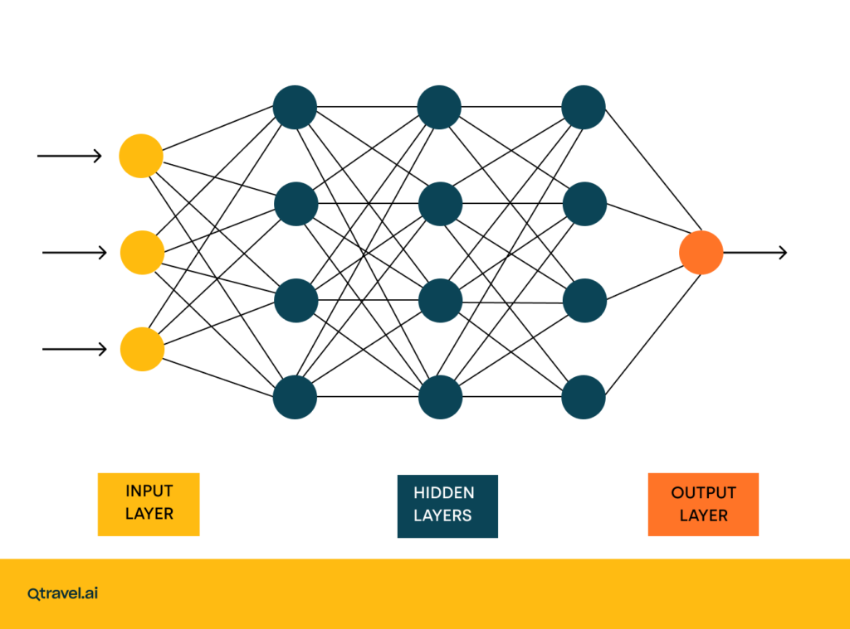


Neural Network
Type of Model: Feed-forward neural network.
Since PySpark does not support custom neural networks, so we use Elephas to integrates Keras with Spark to scale deep learning tasks.
Distributed Learning: Elephas enables distributed training by leveraging Spark clusters, allowing training on large datasets efficiently.
For training the deeper neural network, the dataset was sampled to 50% of its original size, reducing it to approximately 13 million rows. This decision was driven by the computational intensity of neural networks and the limitations of the cluster configuration GCP, which lacked GPU support due to quota constraints, making it impractical to handle the full dataset effectively.

Slide 12
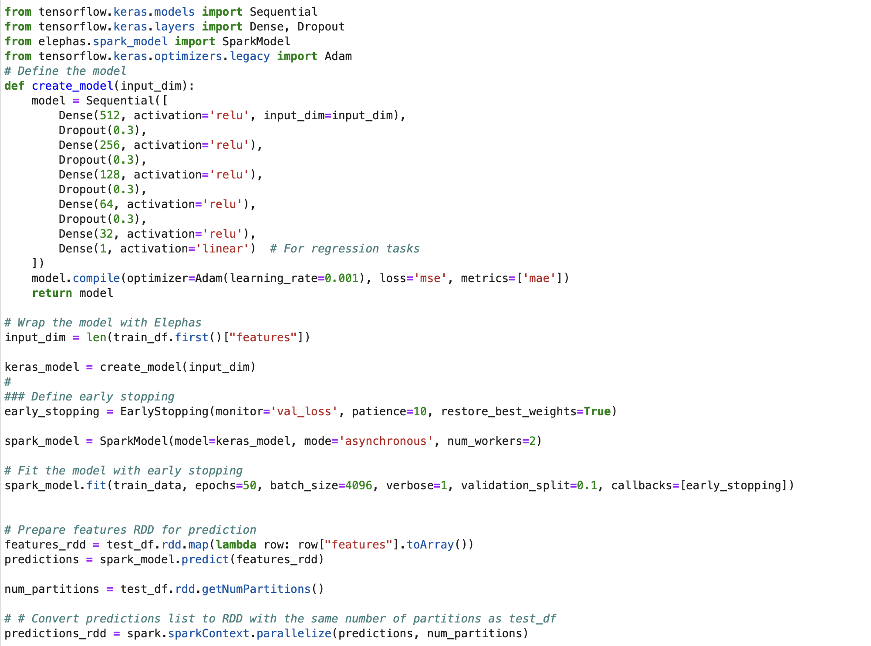
Neural Network
Key Benefits of Distributed Deep Learning:
Faster Training: Parallel processing reduces the overall training time.
Scalability: Efficient handling of large datasets that may not fit into memory on a single machine.
Handling High-Dimensional Data: Deep neural networks are effective for capturing complex patterns in large, high-dimensional datasets.

Slide 13
Results
Metric | Linear Regression | Random Forest | Decision Tree | Neural Network
Mean Squared Error (MSE) | 16.57466 | 12.8393 | 12.6515 | 0.000406
Root Mean Squared Error (RMSE) | 4.0712 | 3.5832 | 3.5569 | 0.02102
The neural network's significantly lower error metrics indicate it is the better model for predicting AWS spot prices in this scenario.
This result highlights the power of distributed deep learning with Elephas and Keras for tackling complex regression tasks with large datasets.

Slide 14
Conclusion
Developed an AWS Spot Price Prediction System using distributed data processing and advanced machine learning to address dynamic pricing challenges.
Achieved good predictive accuracy and scalability through a robust pipeline incorporating PySpark, Elephas, and Google Cloud technologies.
Further we can explore advanced architectures like transformer-based models or recurrent neural networks to improve prediction accuracy for highly volatile pricing trends.

Slide 15
Future Scope:
A real-time AWS EC2 spot pricing optimizer can utilize AWS SDKs (like Boto3 for Python) to fetch live spot price data directly from the DescribeSpotPriceHistory API. This enables the system to monitor regional price trends in real time and make informed decisions about optimal bidding strategies. To ensure scalability and low latency, Apache Kafka can be used for streaming and processing the incoming pricing data. These technologies provide a reliable foundation for developing a cost-effective solution that dynamically adapts to regional price fluctuations, empowering users to maximize their cloud resource efficiency.

