Slide 1

APACHE KAFKA
Sarvesh Krishnan Rajendran
U86908171
CS -777 Big Data

Slide 2

INTRODUCTION TO APACHE KAFKA
Apache Kafka is a distributed event streaming platform designed for high-throughput, real-time data flows.
Initially developed at LinkedIn and then open-sourced in 2011, has become a key tool for large-scale, real-time data processing systems.
Kafka is a better alternative to traditional message brokers.
In modern applications, where huge volumes of data are generated at a rapid pace, having a robust infrastructure to handle and process these data streams in real time is crucial. Kafka’s architecture is built around scalability, fault tolerance, and durability, making it a preferred choice for mission-critical applications across various industries.

Slide 3
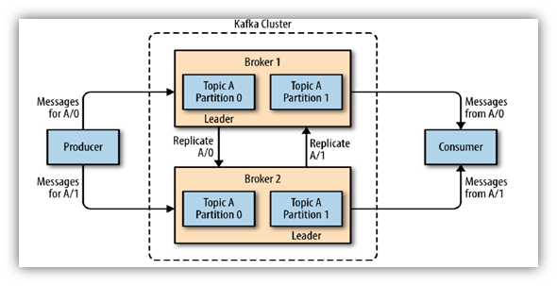
ARCHITECTURE OVERVIEW
Producers: Producers are the components that generate and send messages to Kafka topics. They efficiently handle massive amounts of data and route it to particular topics inside the Kafka cluster.
Topics: In Kafka, a topic serves as a category or feed for publishing records. Similar to a log, topics store events and are partitioned to allow for parallelism, scalability, and fault tolerance. Each record in a topic has a distinct offset, ensuring accurate identification.
Partitions: Kafka topics are separated into smaller parts called partitions, which are composed of ordered records. This segmentation allows Kafka to extend horizontally because each partition is controlled by a distinct broker, which increases throughput. Partitioning improves fault tolerance by duplicating data across many brokers.

Slide 4
ARCHITECTURE OVERVIEW
Consumers: Consumers are components that retrieve data from Kafka topics. They are divided into consumer groups, allowing numerous consumers to efficiently distribute the effort of reading messages from partitions within a subject.
Brokers : Brokers are the servers that make up the core of the Kafka architecture. They collect data from topics and handle incoming and outgoing requests from producers and consumers. In a Kafka cluster, brokers work together to maintain the complete dataset and achieve fault tolerance via partition replication.
Zookeeper: Traditionally, Zookeeper managed Kafka's metadata and kept track of broker status. It tracked the distributed cluster's health as well as that of brokers and partition leaders.

Slide 5
ADVANTAGES
Kafka ensures high throughput and low latency, making it capable of processing large message volumes efficiently.
Kafka’s main strengths is its ability to scale horizontally, allowing for effortless expansion by adding more servers or data centers as data needs grow.
Kafka is designed to accommodate multiple producers and consumers, enabling it to gather and standardize data from a wide range of sources.
Reliability is achieved through partition-level replication, allowing Kafka to maintain data availability even if some brokers fail.
The Kafka Connect framework simplifies integration, providing a standardized way to connect external systems to Kafka using ready-made connectors.

Slide 6
DISADVANTAGES
Kafka’s steep learning curve and technological complexity can be challenging, requiring significant time to understand its setup, configuration, and maintenance.
The lack of built-in monitoring and management tools means that teams must rely on third-party solutions or invest considerable effort in managing operations effectively.
Kafka’s dependency on ZooKeeper adds complexity and can introduce performance bottlenecks, particularly when handling large clusters or partitions.

Slide 7

DEMO Real Time Prediction of Heart Disease
Developed a machine learning pipeline using PySpark
Included preprocessing steps like StringIndexer, OneHotEncoder, and VectorAssembler etc.
Trained and tested a classification model on heart disease data with 1= Heart Disease and 0 = No Heart Disease with an f1 score of 0.8.
Saved the complete pipeline for future use in real-time predictions.
Set up a real-time data streaming pipeline using Apache Kafka and PySpark to read incoming health metrics, apply a pre-trained model for predicting heart disease risk, and stream the results back to Kafka for continuous processing

