Slide 1
CS-688 Web mining and graph analytics project
Sentiment Analysis Using Twitter Dataset
Sarvesh Krishnan Rajendran- U86908171

Slide 2
About the project
The goal of this project is to identify the sentiment of tweets as positive or negative using different machine learning approaches
This analysis is pivotal for understanding public opinion in social media platforms, which is beneficial for businesses, policy making, and public relations.
Built 3 models for sentiment analysis which include, Logistic Regression , Neural Networks and DistilBert Models.

Slide 3

Dataset overview
The dataset for this project is called Sentiment140 taken from Kaggle which has a dataset of about 1.6Million tweets.
The dataset also has a column which states if the corresponding text instance in positive or negative
Since using a dataset that has 1.6million instances for which building machine learning models will be time consuming and exhaustive, I had sampled 1,00,000 instances and used them for building and evaluating our model
Link

Slide 4
DATA PREPROCESSING
Text preprocessing steps included (For Logistic Regression & Neural Network):
Stemming
Lemmatization
Vectorization
BERT handle tokenization and contextual understanding internally, reducing the necessity for preprocessing steps like stemming or lemmatization, streamlining the workflow.

Slide 5
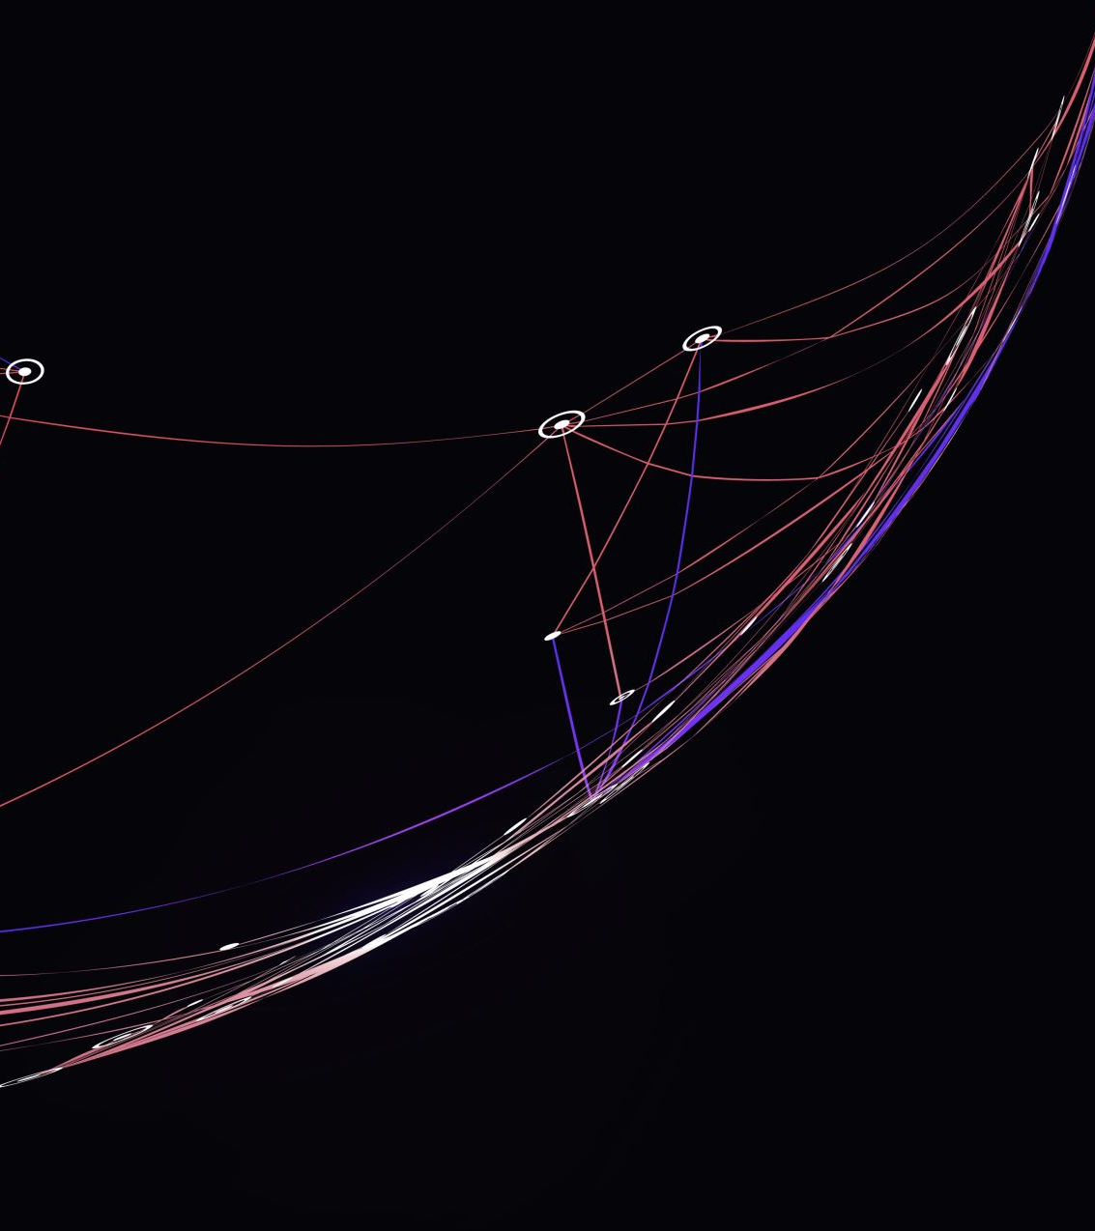
Models used and its overview
Logistic Regression: A straightforward, baseline model for binary classification tasks.
Neural Network: A complex model with multiple layers that can capture deep nonlinear relationships in data.
DistilBERT: A lighter version of the BERT model that retains most of the original's predictive power but is more feasible for training with limited resources.

Slide 6
Results and Model Comparison
Model performance comparison based on accuracy:
Logistic Regression achieved an accuracy of 74.48%.
Neural Network model achieved an accuracy of 71.17%.
DistilBERT model outperformed others with an accuracy of 83%.
The better performance of DistilBERT model highlights the effectiveness of transformer models in handling complex NLP tasks

Slide 7
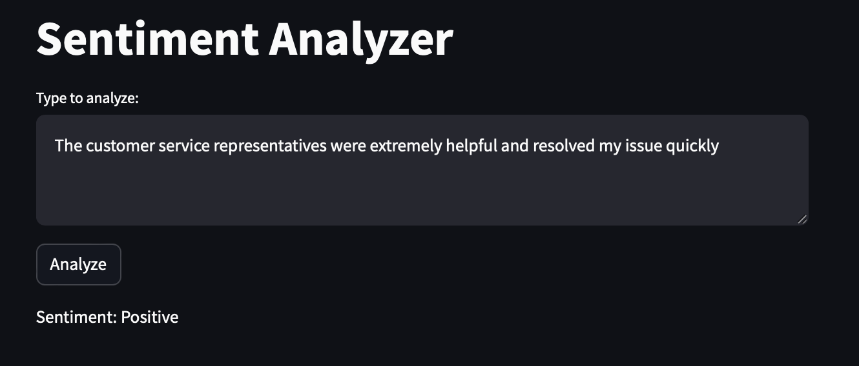
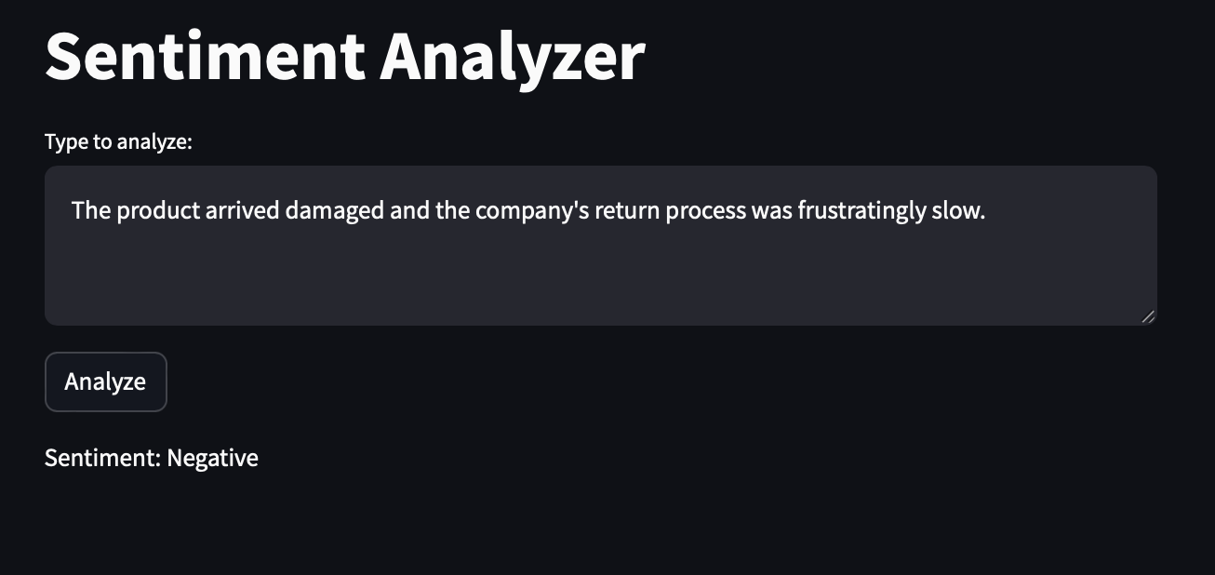
USER INTERFACE
Developed a user interface to interact with the DistilBERT model that I built and trained, allowing real-time sentiment analysis of user-inputted tweets/text.
The interface is designed using Streamlit providing instant feedback on the sentiment of the tweet/ text that is entered.

Slide 8
CONCLUSION
This project successfully demonstrated the application of logistic regression, neural networks, and DistilBERT in sentiment analysis, with DistilBERT providing the most accurate results
These findings reinforce the potential of using advanced machine learning models to enhance sentiment analysis tasks.

