Slide 1

Sensors and Automation (Interdisciplinary Foundation Course–II) Theory Session
COEP Tech., Pune

Slide 2
Course Contents: S&A
Course Name: Sensors and Automation
(Interdisciplinary Foundation Course–II)
Teaching Scheme Examination Scheme
Lectures: 1 Hr / Week Assignment/Quizzes : 40 marks
Practicals: 2 Hrs / Week End Semester Exam : 60 marks
Unit No | Contents
1 | Basics of Sensors: Concepts and terminology of transducer, sensor, sensor classifications and characteristics (Static and dynamic), Working principle, characterization and applications of: strain gauges, LVDT, capacitive, RTD, thermocouple, thermistor, Solid-State, pressure, optical, chemical sensors, integration of sensors for IOT and Industry 4.0 applications.
2 | Industrial Automation Industrial Automation: concept, automation components, necessity and working principle, block schematic of Programmable Logic Controller (PLC). Input & Output modules (AI, DI, AO, DO), Introduction to Ladder Programming, introduction to Distributed Control Systems (DCS). Industrial automation leads to Industrial IOT and Industry 4.0.

Slide 3
Applications of Sensors and Automation

Slide 4
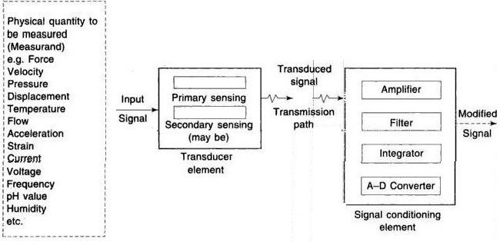
Generalized Measurement System

Slide 5
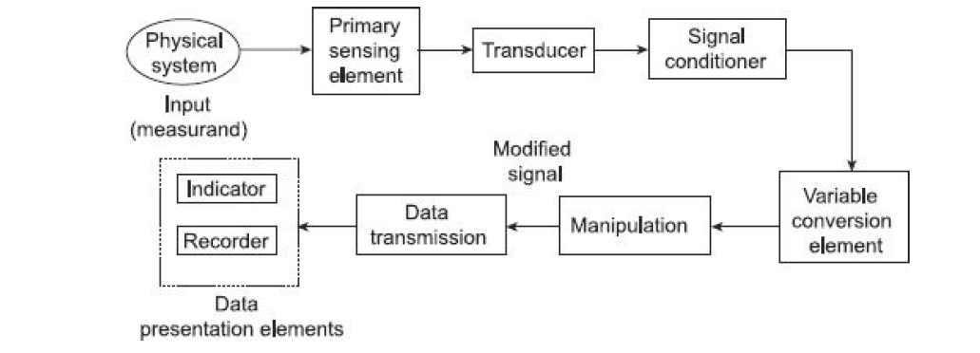

Slide 6
Generalized Measurement System: Applications
Measurement of system parameters information
Control of a certain process operation
Simulation of system conditions
Experimental design studies
To perform various manipulations
Testing of materials, maintenance of standards and specifications
Verifications of physical phenomenal scientific theories
Quality control in industry

Slide 7
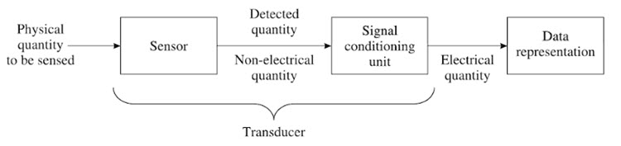
Sensor/Transducers
A Sensor is a device that is used to detect changes in any physical quantity like Temperature, Speed, Flow, Level, Pressure, etc. Any changes in the input quantity will be detected by a Sensor and reflected as changes in output quantity.
Both the input and output quantities of a Sensor are Physical i.e., non-electrical in nature.
Generally speaking, a Transducer is a device that converts one form of energy into another by the principle of Transduction. Usually, a signal in one form of energy is converted to a signal in another form by a Transducer.
From the above example, a Transducer is a device that converts a Physical Quantity into an Electrical Quantity.

Slide 8
Sensor is a device that detects and responds to a physical or chemical stimulus.
Examples of sensors include temperature sensors, pressure sensors, motion sensors, and pH sensors.
Transducer, on the other hand, is a device that converts one form of energy into another.
Examples of transducers include speakers, microphones, accelerometers, and actuators.

Slide 9
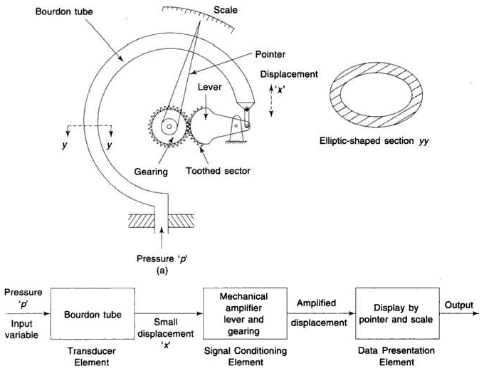
Example of Measurement System: Mechanical Application

Slide 10
Electrodynamic type Application: Displacement Measurement

Slide 11
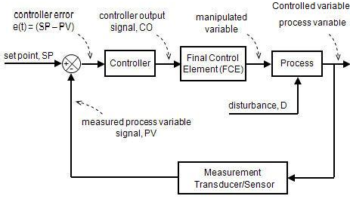
Automation: Automatic Control system:

Slide 12
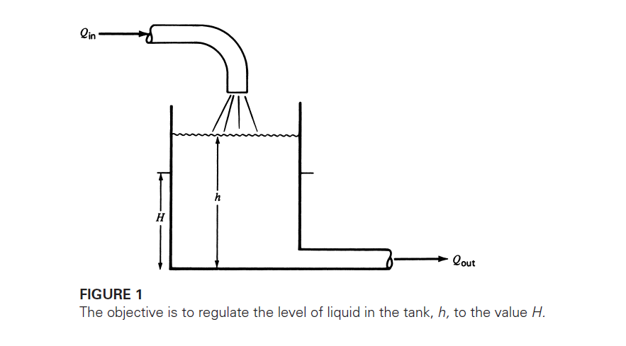
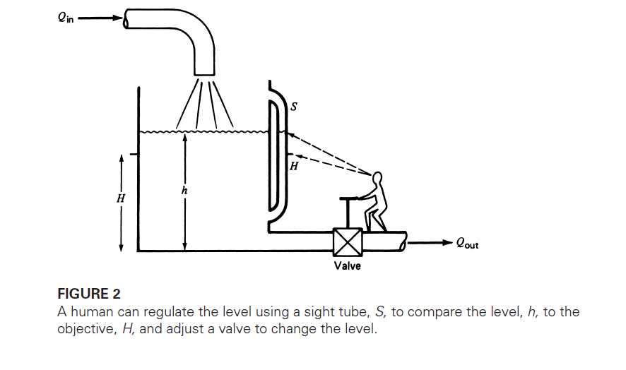
Why Automation ?: Example Level Measurement system
Example: 1 Manual Level control

Slide 13
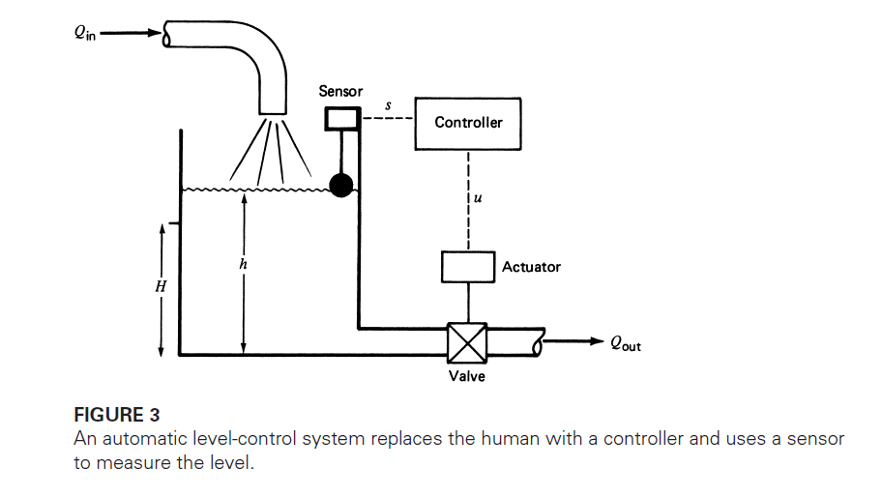
Example: 1 Automatic Level control

Slide 14
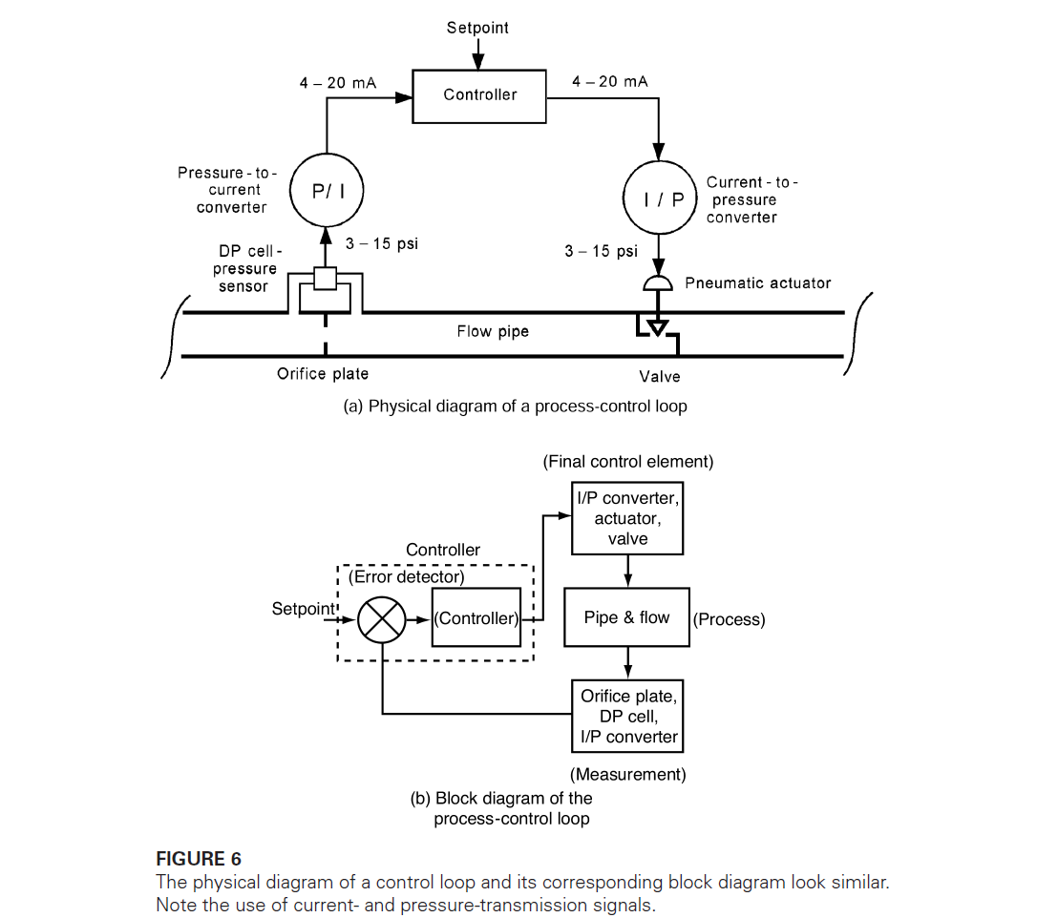
Example: 2 Automatic flow control

Slide 15
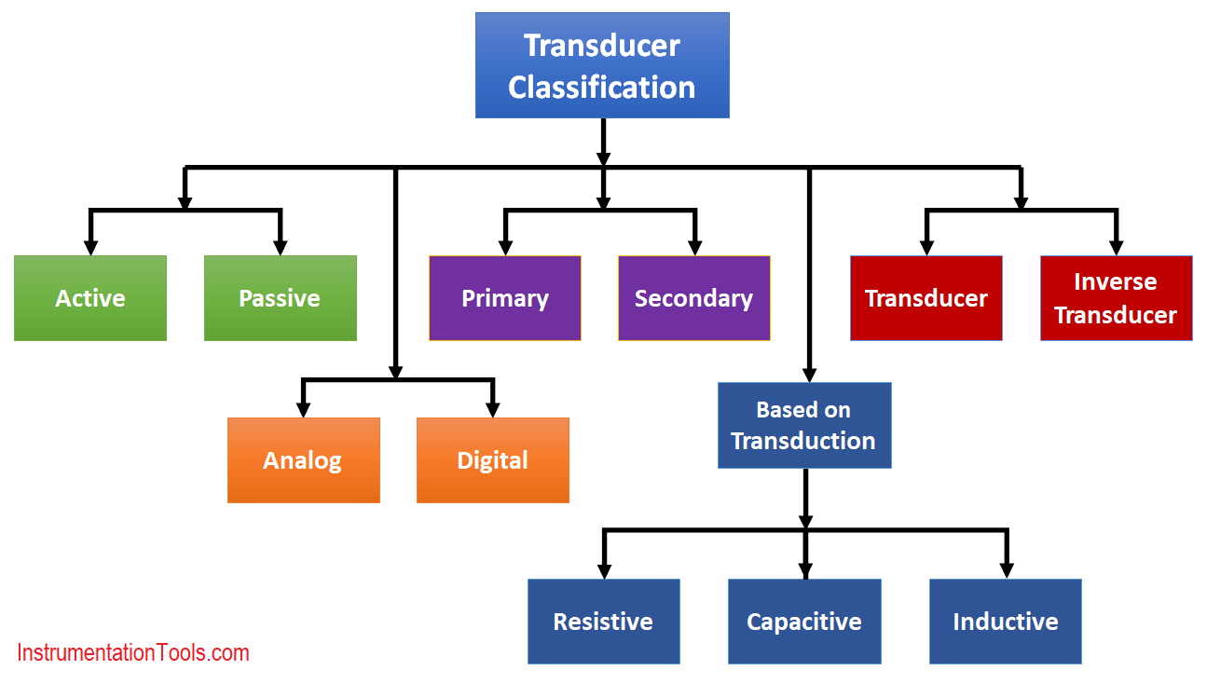
General classification of Transducers/Sensors

Slide 16
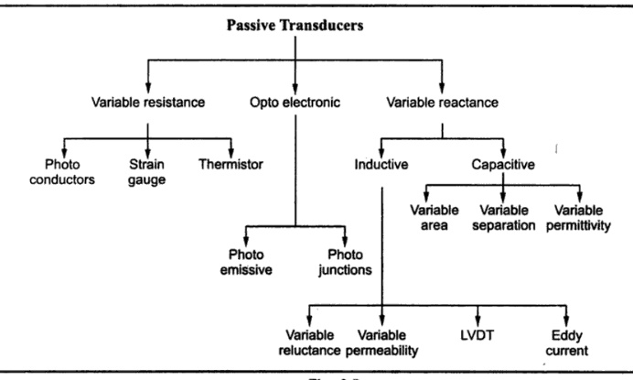

Slide 17
Types of Sensors and Applications
There are many different types of transducers, including:
Pressure transducers - These transducers convert pressure into an electrical signal, typically used in applications such as fluid measurement, automotive systems, and industrial control systems.
Temperature transducers - These transducers convert temperature into an electrical signal, and are used in applications such as HVAC systems, industrial process control, and food processing.

Slide 18
Accelerometer transducers - These transducers measure acceleration or vibration and are used in applications such as structural health monitoring, aerospace, and automotive systems.
Strain gauge transducers - These transducers measure changes in the strain of a material and are used in applications such as load cells, torque sensors, and pressure sensors.

Slide 19
Flow transducers - These transducers measure fluid flow and are used in applications such as chemical processing, water treatment, and food and beverage production.
Magnetic transducers - These transducers use magnetic fields to measure position, velocity, or distance, and are used in applications such as robotics, automotive systems, and industrial control systems.
Optical transducers - These transducers use light to measure position, velocity, or distance, and are used in applications such as laser measurement, spectroscopy, and imaging.

Slide 20
Ultrasonic transducers - These transducers use sound waves to measure distance, level, or flow, and are used in applications such as medical imaging, industrial testing, and underwater navigation.
Capacitive transducers - These transducers measure changes in capacitance and are used in applications such as touch screens, proximity sensors, and level sensors.
Piezoelectric transducers - These transducers convert mechanical energy into electrical energy and are used in applications such as medical imaging, sonar, and vibration sensing.

Slide 21
Light sensors - used to detect light levels in an environment.
Humidity sensors - used to measure the amount of moisture in the air or in a material.
Magnetic sensors - used to detect magnetic fields.
Flow sensors - used to measure the flow rate of fluids or gases.
Gas sensors - used to detect the presence of gases in the air.
pH sensors - used to measure the acidity or alkalinity of a substance.

Slide 22
Sound sensors - used to detect sound levels in an environment.
Image sensors - used to capture images or video.
Position sensors - used to measure the position or movement of an object.
Motion sensors - used to detect motion or movement.
Proximity sensors - used to detect the presence of an object without physical contact.

Slide 23
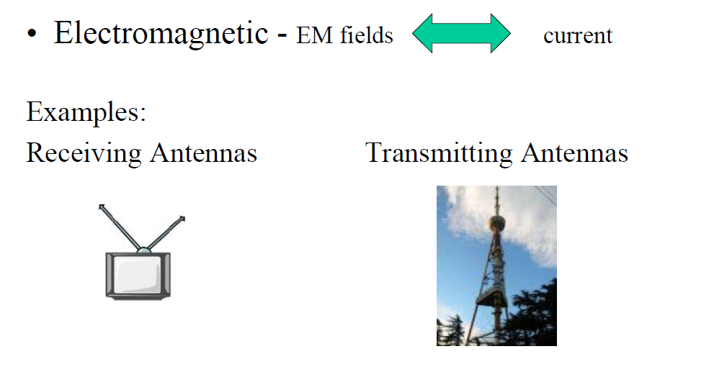
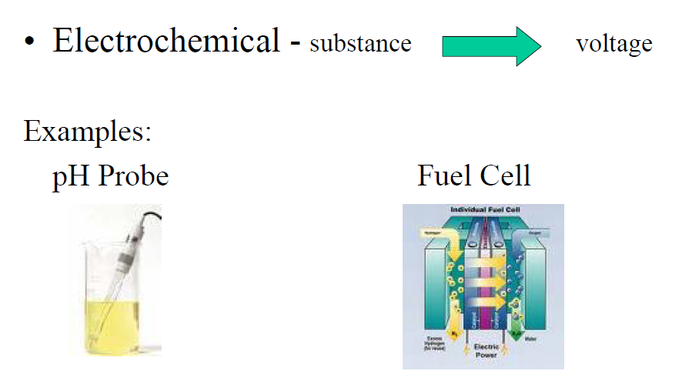
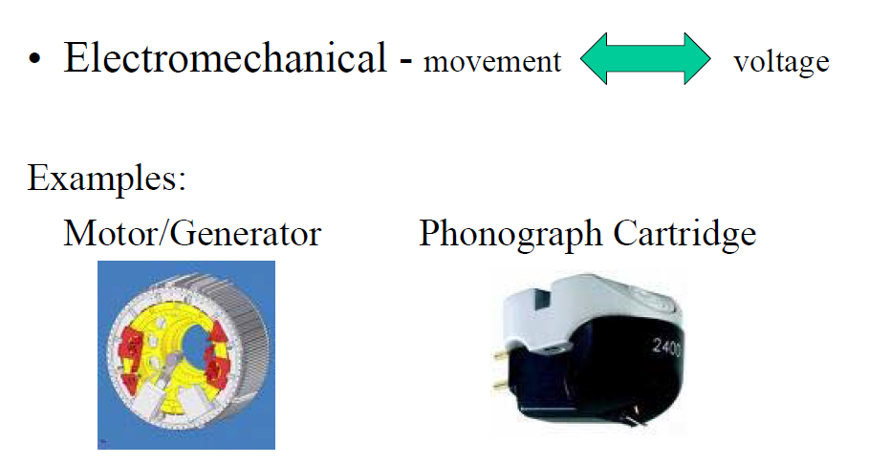
Transducers Classification: According to Application Area

Slide 24
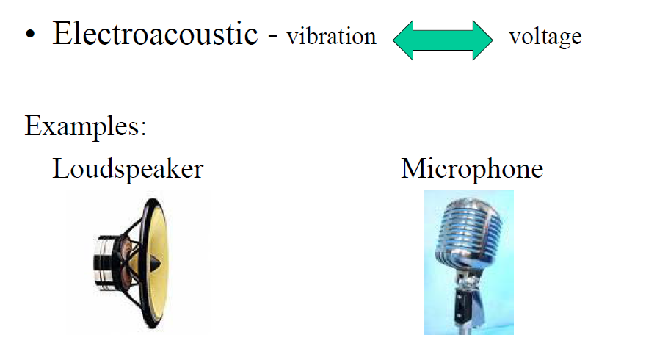
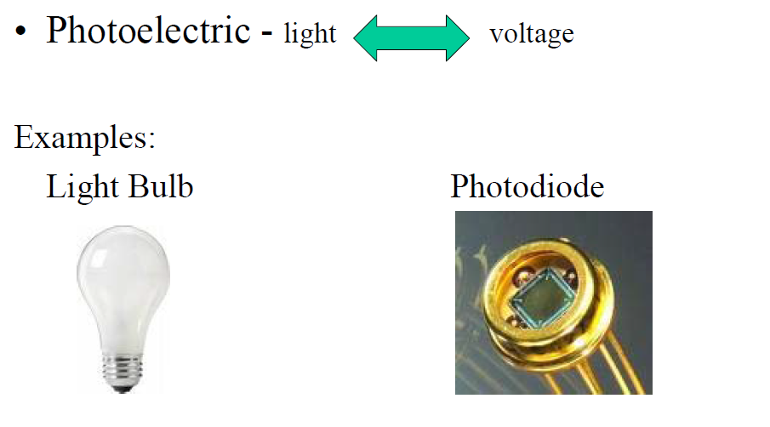
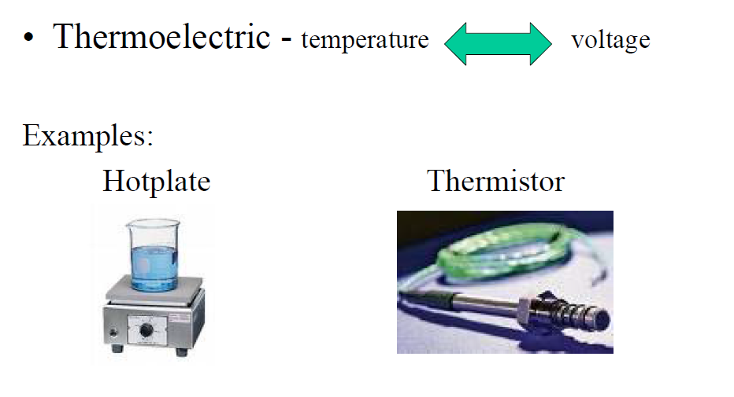

Slide 25
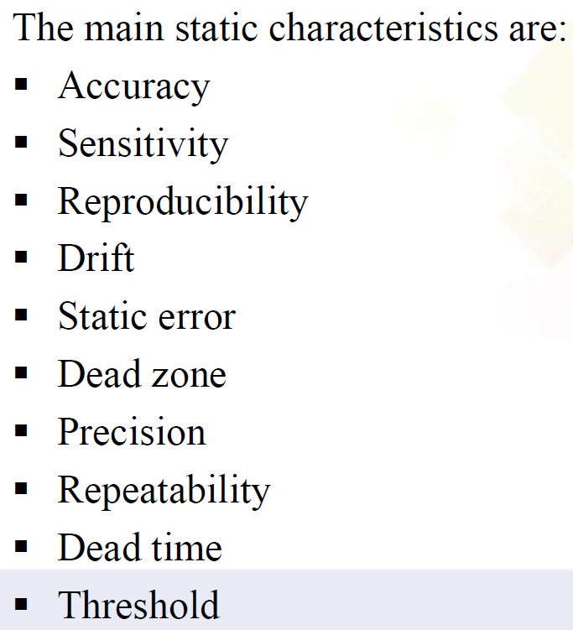
Transducer Characteristics :
1.Static 2.Dynamic
1.Static Characteristics

Slide 26
1.Accuracy
Accuracy is defined as the closeness of the transducer output to the true value of the measured quantity.
However, in usual practice, it is specified as the inaccuracy of measurement from the true value by calculating the absolute and percent error.
The accuracy of an instrument depends on the various systematic errors.

Slide 27
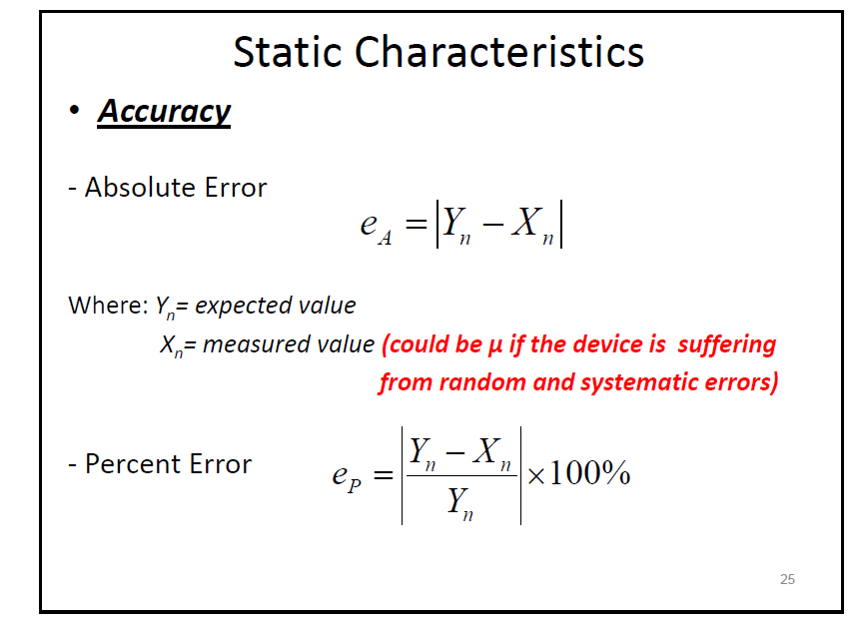

Slide 28
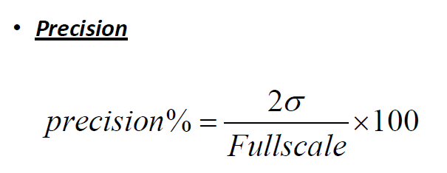
2.Precision is defined as the ability of the instrument to reproduce a certain set of readings within a given accuracy
3.Repeatability: It is defined as the ability of the instrument to reproduce a group of measurements of the same measured quantity, made by the same observer, using the same instrument, and under the same conditions

Slide 29
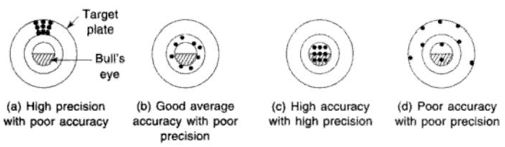
Accuracy vs. Precision
The precision of the instrument depends on the factors that cause random errors.

Slide 30
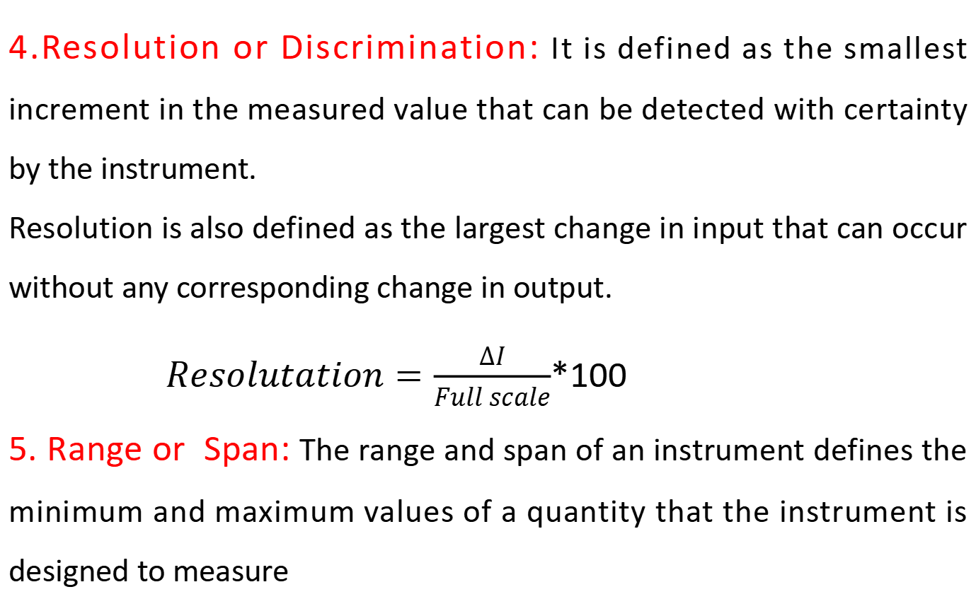
4.Resolution or Discrimination: It is defined as the smallest increment in the measured value that can be detected with certainty by the instrument.
Resolution is also defined as the largest change in input that can occur without any corresponding change in output.
$Resolutation=\frac{∆I}{Full scale}$*100
5. Range or Span: The range and span of an instrument defines the minimum and maximum values of a quantity that the instrument is designed to measure

Slide 31
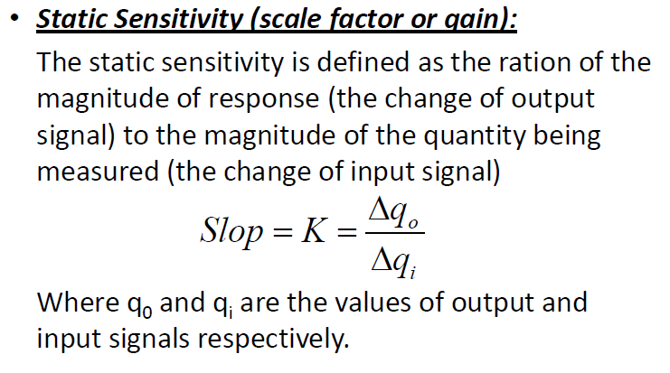

Slide 32
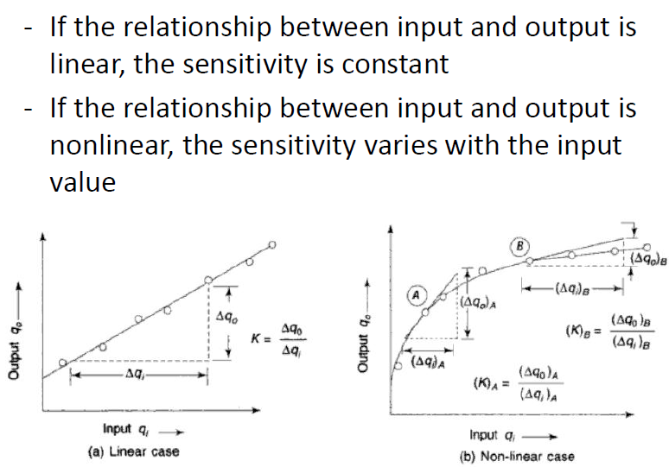

Slide 33
7.Linearity refers to the property of a system or function that exhibits a proportional relationship between its inputs and outputs.

Slide 35
8.Drift: The variation of output for a given input caused due to change in the sensitivity of the instrument due to certain interfering inputs like temperature changes.

Slide 36
9.Hysteresis refers to a phenomenon in which the value of a physical property of a system depends on its history.
Hysteresis loss is caused by the magnetization and demagnetization of the core as current flows in the forward and reverse directions. As the magnetizing force (current) increases, the magnetic flux increases.
Examples include backlash in gears caused by excess play, forces exerted by elastic materials, Schmitt triggers from electronic circuits, and magnetization of ferrous materials

Slide 37
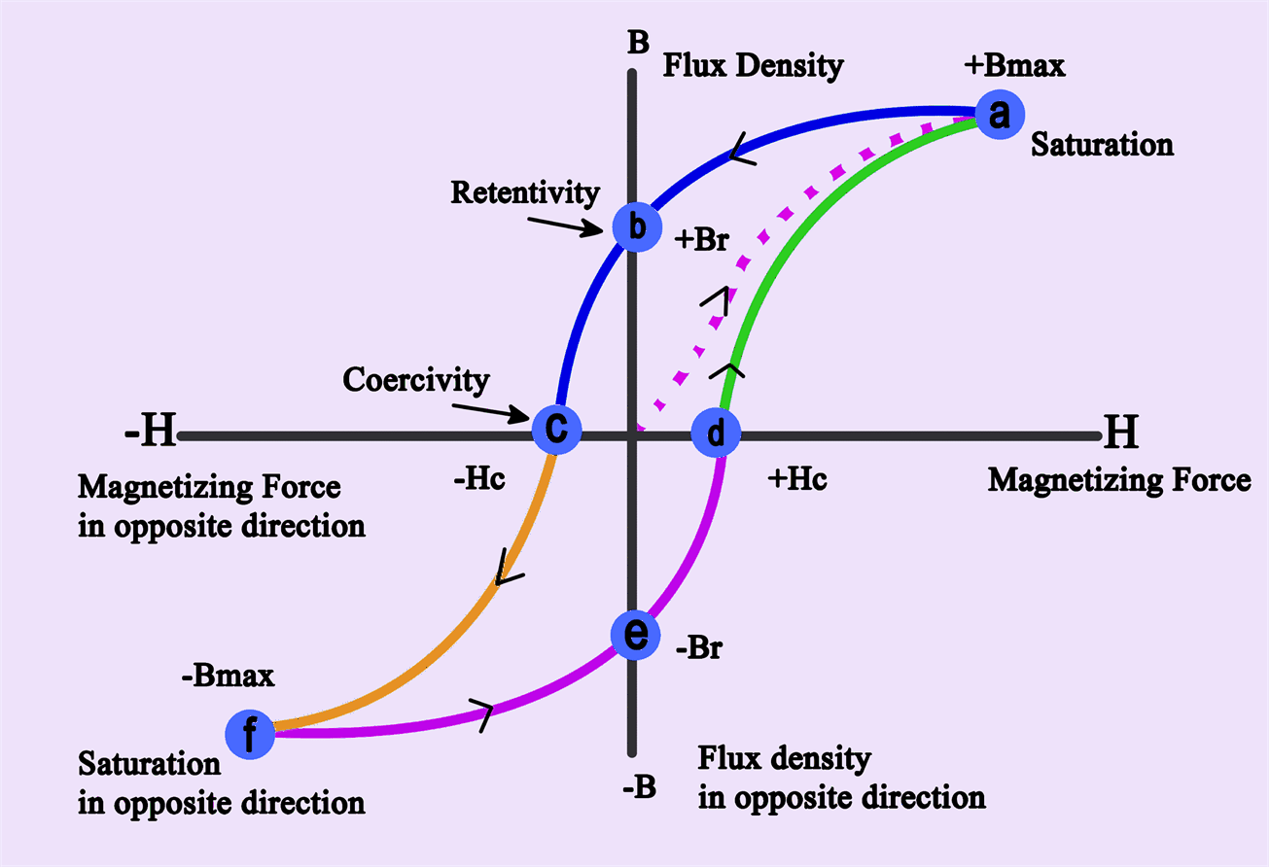

Slide 38
10.Dead Band: It is defined as the largest change of the measured to which the instrument does not respond
11.Backlash: It is defined as the maximum distance or angle through t which any part of the mechanical system may be moved in one direction causing motion of the next part.(It is similar to hysteresis loop)

Slide 39
12.Loading Effect(Impendence Load):
Any measuring instrument with an input signal source would extract some energy, thereby changing the value of measured variable.
This means that the input signal suffers a change by it is being measured this is called as loading
Major problem in analog signal conditioning is loading of one circuit by another. Circuit
The loading effect cannot zero. But it can be minimized’

Slide 40
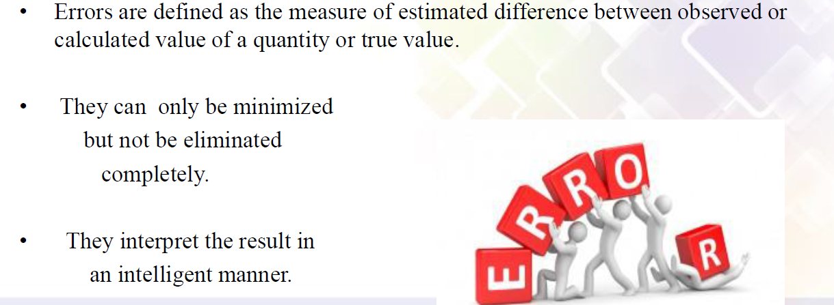
13.Errors

Slide 41
Type of Errors
Systematic errors: Errors that tend to have the same magnitude and sign for the given set of conditions, such as instrument, environmental, and loading errors. This type of error can be eliminated by applying the proper calibration.
Random (or Accidental) errors): These errors are of variable magnitude and sign and do not obey any known law. Theses errors caused due to random variation in the parameter or the system of measurement, such as the accuracy of measuring small quantities. This type of error can be calculated by using statistical analysis.

Slide 42
Gross errors:
These are generally the fault of the person using the instruments, and are due to:
Incorrect reading of instruments .
Incorrect recording of experiment data..
Incorrect use of instruments.
These errors may be of any magnitude and cannot be subjected to mathematical treatment.

Slide 43
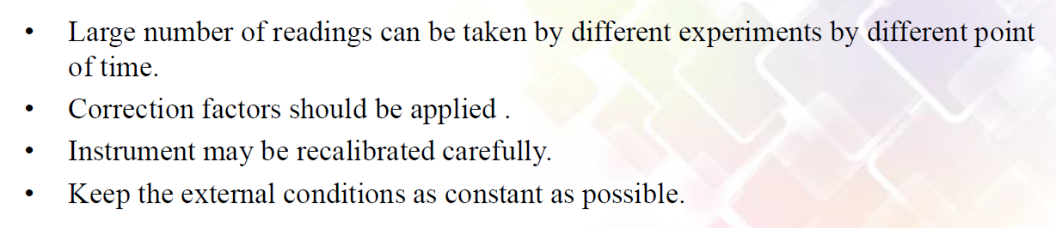
Remedies to Minimize Errors

Slide 44
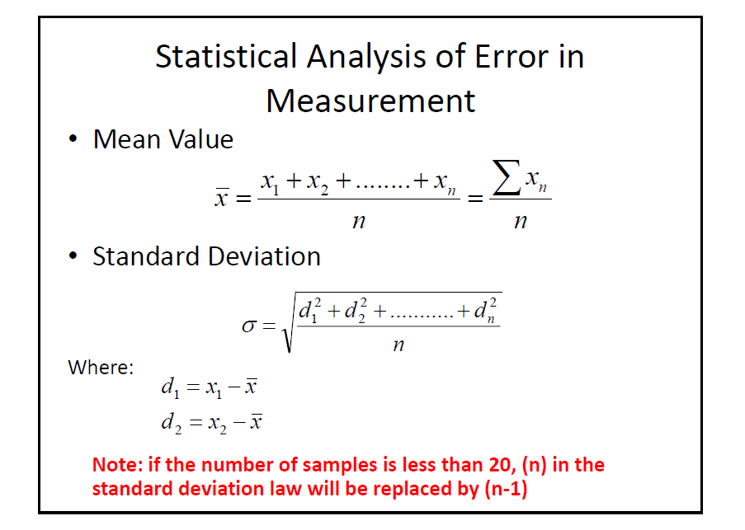

Slide 46
Statistical Analysis of Error in Measurement
Interpretation of Standard deviation
If the error is truly random and we have large sample of readings, the data and the standard deviation is related to the normal probability curve.
The normal probability curve has the following characteristics:
68% of readings lie within ±1σ of the mean
95.5% of readings lie within ±2σ of the mean
99.7% of readings lie within ±3σ of the mean

Slide 47
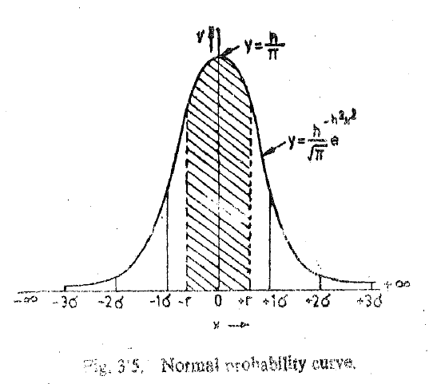

Slide 48
Example 1:
The temperature measured in eight locations in a room and the the values obtained were 21.2℃, 25.0 ℃,18.5 ℃,19.5 ℃,27.1 ℃,19.0 ℃ and 20.0. ℃ 18.5 ℃ Find
1. Arithmetic Mean
2. Standard Deviation

Slide 49
Example 2:
The following 10 observations were recorded when measuring a voltage 41.7, 42.0 ,41.8 ,42.0, 42.1,41.9, 42.5,42.0, 41.9 and 41.8
Find
Arithmetic Mean(A:41.97)
Standard deviation(A:0.221)
Probable error of one reading
Range

Slide 50
Example 3:
In a test temp. is measured 100 times with various instruments and procedure and following observations made
Find
Arithmetic Mean(400.78) 2.Average deviation(1.048)3.Standard Deviation(1.38),4. Variance 5. Probable error(0.43)
Temp. ℃ | 397 | 398 | 399 | 400 | 401 | 402 | 403 | 404 | 405
Frequency | 1 | 3 | 12 | 23 | 37 | 16 | 4 | 2 | 2

Slide 51
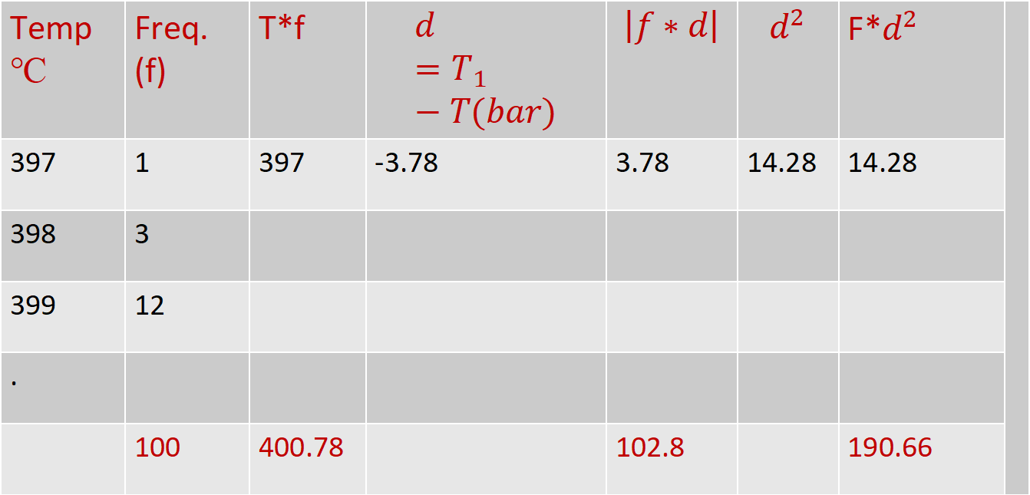
Sample calculations
Temp ℃ | Freq. (f) | T*f | $$d=T_{1}−T(bar)$$ | $$\left|f∗d\right|$$ | $$d^{2}$$ | F*$d^{2}$
397 | 1 | 397 | -3.78 | 3.78 | 14.28 | 14.28
398 | 3
399 | 12
.
 | 100 | 400.78 |  | 102.8 |  | 190.66

Slide 52
Example 4:
In a test temp. is measured100 times with various instruments and procedure and following observations made
Find:,
Arithmetic Mean(99.98℃) 2.Average deviation(0.5196℃)3.Standard Deviation(0.67℃)
4. Variance(0.46℃) 5. Probable error(0.4626℃)
Temp.℃ | 98.5 | 99 | 99.5 | 100 | 100.5 | 101.0 | 101.5
Frequency | 4 | 13 | 19 | 35 | 17 | 10 | 02

Slide 53
Dynamic characteristics
The dynamic characteristics of a transducer refer to how the transducer responds to changes in the input signal over time.
Frequency response: This refers to the range of frequencies that the transducer can accurately measure. A transducer with a wider frequency response will be able to measure a broader range of signals.
Rise time: This is the time it takes for the transducer's output to reach a specified percentage of its final value in response to a step change in the input signal. A faster rise time indicates a more responsive transducer.

Slide 54
3.Overshoot and settling time: Overshoot refers to the amount by which the transducer's output exceeds its final value before settling down.
4. Settling time is the time it takes for the output to settle within a specified range of the final value.
A transducer with low overshoot and settling time will produce more accurate and stable measurements.
5.Hysteresis: This refers to the tendency of the transducer's output to lag behind changes in the input signal. Hysteresis can cause measurement errors and can be minimized through careful calibration and design of the transducer.
5.Non-linearity: This refers to the deviation of the transducer's output from a linear relationship with the input signal.

Slide 55
Input Signals in Dynamic Systems

Slide 56
Input Signals in Dynamic Systems

Slide 57
Dynamic Characteristics of Zero order system:
Potentiometer

Slide 58
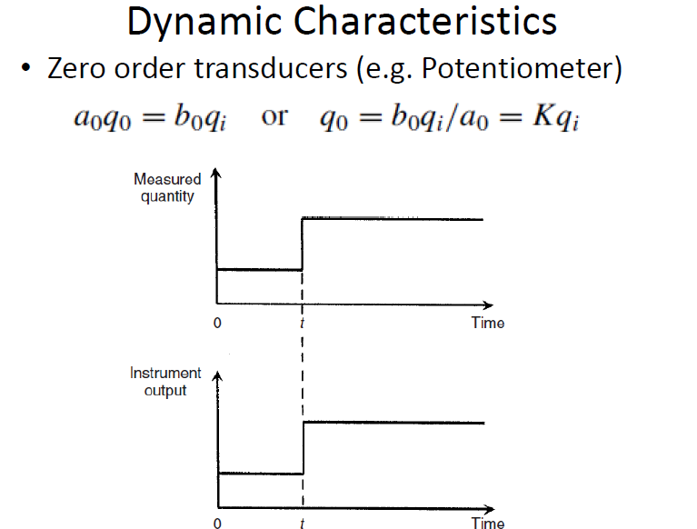

Slide 59
Dynamic Characteristics of First order system
( Thermocouple )

Slide 60
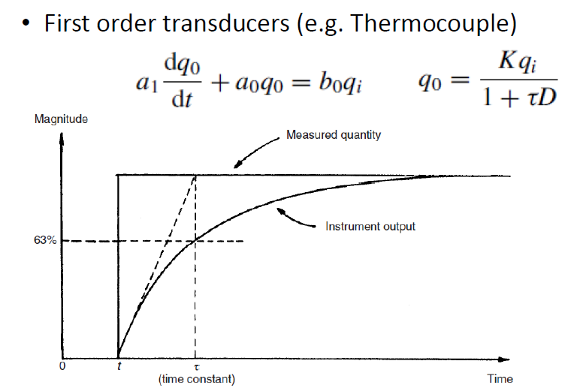

Slide 61
Dynamic Characteristics of Second order system

Slide 62
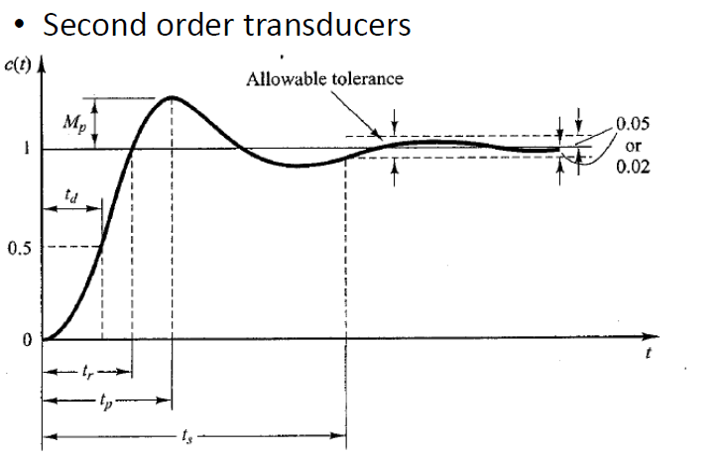
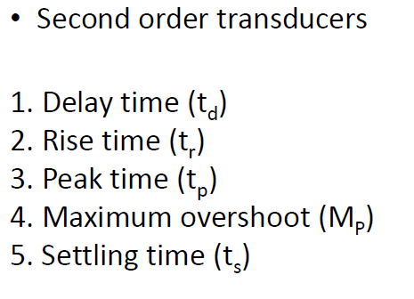

Slide 63
Selecting of a transducer:
Type of energy: Determine the type of energy that needs to be measured or converted, such as electrical, mechanical, thermal, or optical.
Sensitivity: The sensitivity of a transducer is the minimum amount of energy that it can detect or convert. The sensitivity required depends on the precision needed for the application.
Range: The range of a transducer is the minimum and maximum values that it can measure or convert..

Slide 64
4.Accuracy: The accuracy of a transducer is the degree of closeness between the measured or converted value and the true value.
5.Response time: The response time of a transducer is the time it takes to detect or convert energy. The response time required depends on the speed at which the energy is changing.
6.Environment: Consider the environment in which the transducer will be used, including temperature, humidity, pressure, and vibration.
q7.The cost of a transducer can vary significantly depending on its features and specifications

Slide 65
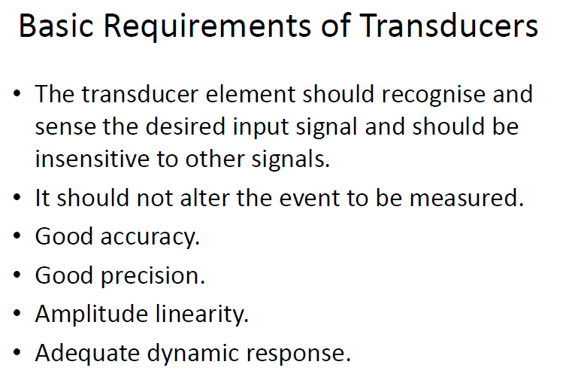
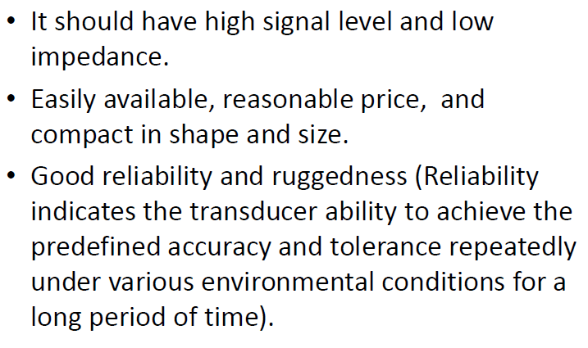

Slide 66
THANK YOU

