Slide 1
Programmable Logic Controllers
PLC Timer Functions
Outline
Introduction
PLC Timer Functions
Examples of Timer Function Applications

Slide 2
Objectives
Describe PLC retentive and delay timer functions.
List and describe major timing functions that are commonly used in circuits and processes.
Apply PLC functions and PLC circuitry to process control for timing functions.
Apply PLC timers in multiple timing problems that combine two or more of the basic timing functions.
Apply PLC timers for the control of processes.

Slide 3
Introduction
The most commonly used process control device after coils and contacts is the timer.
The most common timing function is TIME DELAY-ON, which is the basic function.
There are also many other timing configurations, all of which can be derived from one or more of the basic TIME DELAY- ON functions.
PLCs have the one basic function timer capability in multiples.

Slide 4
Timer Uses
The timing block functions are used with various contact arrangements and in multiples to accomplish various timing tasks.
Typical industrial timing tasks include timing of the intervals for welding, painting, and heat treating.
Timers can also predetermine the interval between two operations.
With a PLC you can utilize as many timer blocks as you need, within the PLC memory limitations.

Slide 5
Basic Timing and Derived Functions
Here we illustrate the basic PLC TIME DELAY- ON function and some other derived timing functions.
Typical of the derived functions are
TIME DELAY-OFF,
interval pulse timing,
and multiple pulse timing of more than one process operation.

Slide 6
Timer Variables
One major advantage of the PLC timer is that its time may be a programmable variable time as well as a fixed time.
The variable time interval may be in accordance with a changing register value.
Another advantage of the PLC timer is that its timer accuracy, repeatability, and reliability are extremely high because it is based on solid-state technology.

Slide 7
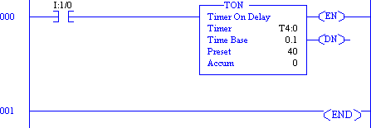
Non-retentive Timers
A single-input timer called a non-retentive timer is used in some PLCs.
Energizing I:1/0 causes the timer to run for 4 seconds
.
At the end of 4 seconds the output (DN) goes on.
When the input is de-energized, the output goes off and the timer resets to 0.
If the input I:1/0 is turned off during the timing interval (for example, after 2.7 seconds), the timer resets to 0.
TON is the basic non-retentive timer in Allen-Bradley PLCs

Slide 8
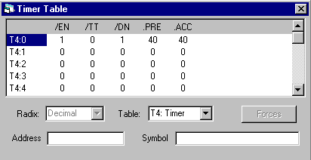
Timer Information
The timer table contains all information for that timer
/EN: Timer is enabled (i.e. the input rung is energized)
/TT: Timer is timing
/DN: Timer is done
.PRE: Timer preset value (point at which the timer stops timing)
.ACC: Timer accumulator (accumulated time value)

Slide 9
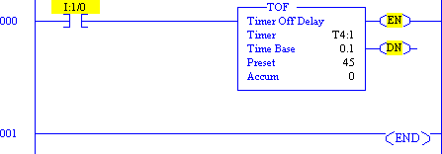
Timer Delay Off (TOF)
The TOF timer functions the opposite of the TON timer.
De-Energizing I:1/0 causes the timer to run for 4.5 seconds. The DN bit is initially set.
At the end of 4.5 seconds the output (DN) goes off. When the input is energized the timer resets to 0.
If the input I:1/0 is turned on during the timing interval (for example, after 2.7 seconds), the timer resets to 0.

Slide 10
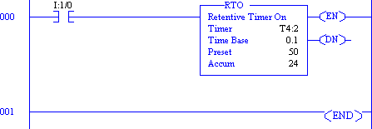
Retentive Timers (RTO)
Functions exactly like TON except the accumulated time value is retained even if the input rung is de- energized.

Slide 11
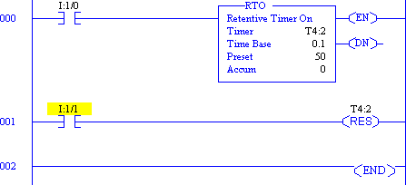
Timer Reset Coils (RES)
A reset coil (RES) can be associated with a timer to provide a means of resetting the accumulated time value (and status bits) at any given time

Slide 12
Examples Of Timer Function Applications
On delay
Output B comes on at a specific set time after output A is turned on. When
A is turned off, B also goes off.
Limited on time
A and B go on at the same time. B goes off after specific set time period,
but A remains on.
One-shot operation
Output B goes on for a specified time after output A is turned on. Output
B will run for its specified time interval even if A is turned off during the B
timing interval.
Interval time within a cycle
We may require that an output come on 7.5 seconds after system startup
, remain on for 4.5 seconds, and then go off and stay off. The interval would
repeat only after the system is shut off and then turned back on.

Slide 13
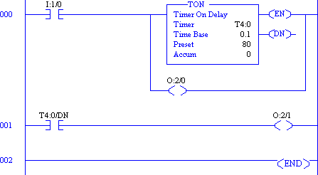
On Delay Timer Function
The first example is the simplest form of time delay.
When the circuit is turned on, one action takes place.
A specified time later, another action occurs.
O:2/1 energizes exactly 8 seconds after O:2/0 energizes, provided I:1/0 remains energized

Slide 14
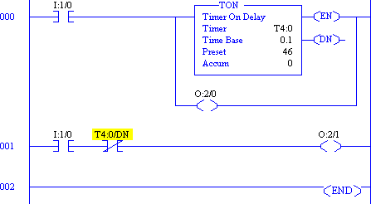
Limited On-Time Timer Function
This example illustrates a situation in which two outputs go on at the same time.
Then, one of them is to go off after a preset period of time.
One output, O:2/0, stays on; the other output, O:2/1, turns off at the end of the timing interval.
Resetting is accomplished by turning I:1/0 off.

Slide 15
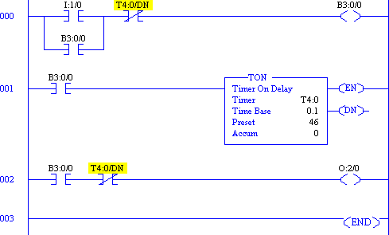
One-shot Operation Timer Function
The next example is a one-shot system.
– The done bit comes on after its specified time period even if the input is turned off during the timing period.

Slide 16
Interval Time Within a Cycle
This example is for a timed interval of a number of seconds after the start of a process operation.
This time interval is sometimes called an
embedded time interval.
A fan is to come on 8.7 seconds after a system is turned on.
It is then to run until 16 seconds after the system is turned on, which is a net time of 7.3 seconds.

Slide 17
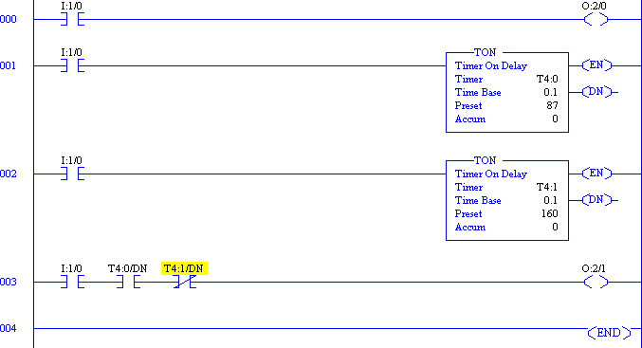

Slide 18
THANK YOU

