Slide 1
Programmable Logic Controllers
PLC Counter Functions
Outline
Introduction
PLC Counter Functions
Examples of Counter Function Applications

Slide 2
Objectives
Describe the PLC counter functions.
List some of the major counting functions used in circuits and processes.
Apply the PLC counter function and associated circuitry to process control.
Apply combinations of counters and timers to process control.
Introduction
PLC counters have programming formats which are similar to timer formats
Transitions on counter input rung causes the counter to count up (or down)
Counter reset is accomplished via the (RES) instruction

Slide 3
Up Counter (CTU)
The CTU is an instruction that counts false-to-true rung transitions.
Rung transitions can be caused by events occurring in the program (from internal
logic or by external devices) such as parts traveling past a detector or actuating a
limit switch.
When rung conditions for a CTU instruction have made a false-to-true
transition, the accumulated value is incremented by one count, provided that
the rung containing the CTU instruction is evaluated between these transitions.
The ability of the counter to detect false–to–true transitions depends on the
speed (frequency) of the incoming signal.
The accumulated value is retained when the rung conditions again become false.
The accumulated count is retained until cleared by a reset (RES) instruction.

Slide 4
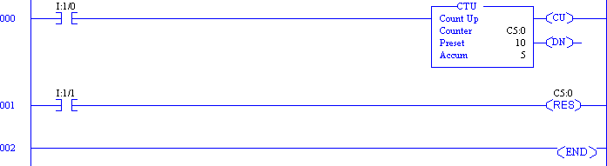
Up Counter Example
Accumulated count is reset only by the (RES) instruction
The counter will increment the accumulator value even after the preset is reached

Slide 5
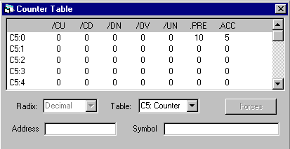
Counter Status Bits
/CU: count up
/CD: count down
/DN: counter done
/OV: counter overflow
/UN: counter underflow

Slide 6
Using Status Bits (CTU)
This bit | Is Set When | And remains set until
Count Up Overflow Bit (OV) | Accumulated value wraps around to -32768 (from +32767) | A (RES) instruction with the same address as the CTU instruction is enabled OR the count is decremented less than or equal to +32767 with a count down (CTD) instruction
Done Bit (DN) | Accumulated value is equal to or greater than the preset value | Accumulated value becomes less than the preset value
Count Up Enable Bit (CU) | Rung conditions are true | Rung conditions go false or a (RES) instruction with the same address as the CTU instruction is enabled

Slide 7
Down Counter (CTD)
The CTD is an instruction that counts false-to-true rung transitions.
– Rung transitions can be caused by events occurring in the program such as parts traveling past a detector or actuating a limit switch.
When rung conditions for a CTD instruction have made a false-to-true transition, the accumulated value is decremented by one count, provided that the rung containing the CTD instruction is evaluated between these transitions.
The accumulated counts are retained when the rung conditions again become false.
The accumulated count is retained until cleared by a reset (RES) instruction.

Slide 8
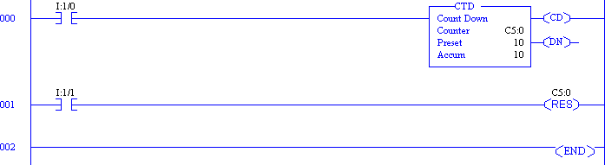
Down Counter Example
Accumulated count is reset only by the (RES) instruction
The counter will decrement the accumulator value even after a 0 count is reached

Slide 9
Using Status Bits (CTD)
This bit | Is Set When | And remains set until
Count Down Underflow Bit (UN) | Accumulated value wraps around to +32,767 (from -32,768) and continues counting down from there | A (RES) instruction with the same address as the CTD instruction is enabled OR the count is incremented to greater than or equal to -32768 with a count up (CTU) instruction
Done Bit (DN) | Accumulated value is equal to or greater than the preset value | Accumulated value becomes less than the preset value
Count Down Enable Bit (CD) | Rung conditions are true | Rung conditions go false or a (RES) instruction with the same address as the CTD instruction is enabled

Slide 10
Counter Applications
Straight counting in a process
– The counter output goes on after the set count is received by repetitive pulses to the counter input.
A process where a timed interval is started when a count reaches a preset value
A process where a count of events is to start after a fixed time interval

Slide 11
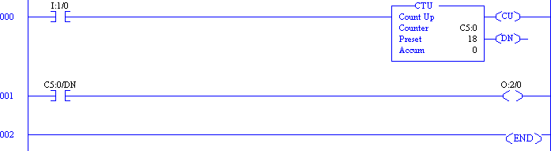
Straight Counting in a Process
After a certain number of counts occur, the output goes on.
The output can be used to energize an indicator.
The output status could also be utilized in the ladder diagram logic in the form of a contact.
Either counter will function (count) if its input rung transitions from false-to-true.
After the count input receives 18 pulses, the O:2/0 output will energize.

Slide 12
Delayed Start of the Counting Process
In this process we do not wish to start counting until one hour after the process starts.
A timer output contact in the timer run line closes after the time period.
The closure then enables the counter to start counting input pulses.
After a count of 150, the output comes on.

Slide 13
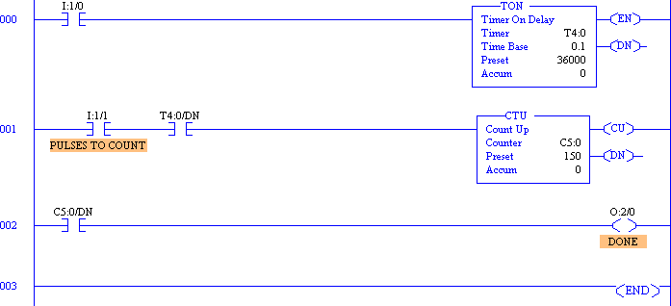
Ladder Logic Example

Slide 14
THANK YOU

