Slide 1
Graph Theory
Chapter 8

Slide 2
Varying Applications (examples)
Computer networks
Distinguish between two chemical compounds with the same molecular formula but different structures
Solve shortest path problems between cities
Scheduling exams and assign channels to television stations

Slide 3
Topics Covered
Definitions
Types
Terminology
Representation
Sub-graphs
Connectivity
Hamilton and Euler definitions
Shortest Path
Planar Graphs
Graph Coloring

Slide 4
Definitions - Graph
A generalization of the simple concept of a set of dots, links, edges or arcs.
Representation: Graph G =(V, E) consists set of vertices denoted by V, or by V(G) and set of edges E, or E(G)

Slide 5
Definitions – Edge Type
Directed: Ordered pair of vertices. Represented as (u, v) directed from vertex u to v.
Undirected: Unordered pair of vertices. Represented as {u, v}. Disregards any sense of direction and treats both end vertices interchangeably.
u
v
u
v

Slide 6
Definitions – Edge Type
Loop: A loop is an edge whose endpoints are equal i.e., an edge joining a vertex to it self is called a loop. Represented as {u, u} = {u}
Multiple Edges: Two or more edges joining the same pair of vertices.
u

Slide 7
Definitions – Graph Type
Simple (Undirected) Graph: consists of V, a nonempty set of vertices, and E, a set of unordered pairs of distinct elements of V called edges (undirected)
Representation Example: G(V, E), V = {u, v, w}, E = {{u, v}, {v, w}, {u, w}}
u
v
w

Slide 8
Definitions – Graph Type
Multigraph: G(V,E), consists of set of vertices V, set of Edges E and a function f from E to {{u, v}| u, v V, u ≠ v}. The edges e1 and e2 are called multiple or parallel edges if f (e1) = f (e2).
Representation Example: V = {u, v, w}, E = {e₁, e₂, e₃}
u
e₁
e₂
w
v
e₃

Slide 9
Definitions – Graph Type
Pseudograph: G(V,E), consists of set of vertices V, set of Edges E and a function F from E to {{u, v}| u, v Î V}. Loops allowed in such a graph.
Representation Example: V = {u, v, w}, E = {e₁, e₂, e₃, e₄}
u
e₁
w
e₄
e₂
v
e₃

Slide 10
Definitions – Graph Type
Directed Graph: G(V, E), set of vertices V, and set of Edges E, that are ordered pair of elements of V (directed edges)
Representation Example: G(V, E), V = {u, v, w}, E = {(u, v), (v, w), (w, u)}
u
v
w

Slide 11
Definitions – Graph Type
Directed Multigraph: G(V,E), consists of set of vertices V, set of Edges E and a function f from E to {{u, v}| u, v V}. The edges e1 and e2 are multiple edges if f(e1) = f(e2)
Representation Example: V = {u, v, w}, E = {e₁, e₂, e₃, e₄}
u
w
e₄
e₁
e₂
v
e₃

Slide 12
Definitions – Graph Type
Type | Edges | Multiple Edges Allowed ? | Loops Allowed ?
Simple Graph | undirected | No | No
Multigraph | undirected | Yes | No
Pseudograph | undirected | Yes | Yes
Directed Graph | directed | No | Yes
Directed Multigraph | directed | Yes | Yes

Slide 13
Terminology – Undirected graphs
u and v are adjacent if {u, v} is an edge, e is called incident with u and v. u and v are called endpoints of {u, v}
Degree of Vertex (deg (v)): the number of edges incident on a vertex. A loop contributes twice to the degree (why?).
Pendant Vertex: deg (v) =1
Isolated Vertex: deg (k) = 0
Representation Example: For V = {u, v, w} , E = { {u, w}, {u, v} }, deg (u) = 2, deg (v) = 1, deg (w) = 1, deg (k) = 0, w and v are pendant , k is isolated
u
v
k
w

Slide 14
Terminology – Directed graphs
For the edge (u, v), u is adjacent to v OR v is adjacent from u, u – Initial vertex, v – Terminal vertex
In-degree (deg⁻ (u)): number of edges for which u is terminal vertex
Out-degree (deg⁺ (u)): number of edges for which u is initial vertex
Note: A loop contributes 1 to both in-degree and out-degree (why?)
Representation Example: For V = {u, v, w} , E = { (u, w), ( v, w), (u, v) }, deg⁻ (u) = 0, deg⁺ (u) = 2, deg⁻ (v) = 1,
deg⁺ (v) = 1, and deg⁻ (w) = 2, deg⁺ (u) = 0
u
v
w

Slide 15
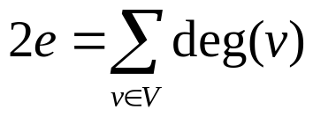
Theorems: Undirected Graphs
Theorem 1
The Handshaking theorem:
(why?) Every edge connects 2 vertices

Slide 16
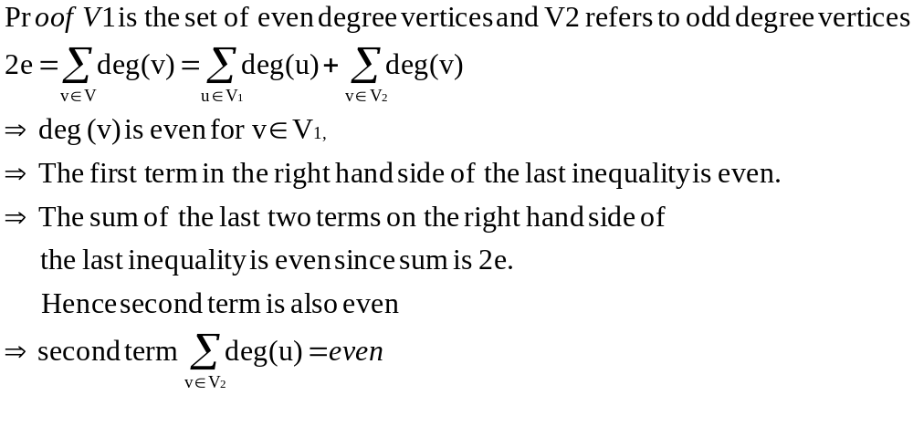
Theorems: Undirected Graphs
Theorem 2:
An undirected graph has even number of vertices with odd degree

Slide 17

Theorems: directed Graphs
Theorem 3: deg ⁺ (u) = deg ⁻ (u) = |E|

Slide 18
Simple graphs – special cases
Complete graph: K_{n}, is the simple graph that contains exactly one edge between each pair of distinct vertices.
Representation Example: K₁, K₂, K₃, K₄
K₁
K₂
K₃
K₄

Slide 19
Simple graphs – special cases
Cycle: C_{n}, n ≥ 3 consists of n vertices v₁, v₂, v₃ … v_{n} and edges {v₁, v₂}, {v₂, v₃}, {v₃, v₄} … {v_{n-1}, v_{n}}, {v_{n}, v₁}
Representation Example: C₃, C₄
C₃
C₄

Slide 20
Simple graphs – special cases
Wheels: W_{n}, obtained by adding additional vertex to Cn and connecting all vertices to this new vertex by new edges.
Representation Example: W₃, W₄
W₃
W₄

Slide 21
Simple graphs – special cases
N-cubes: Q_{n}, vertices represented by 2n bit strings of length n. Two vertices are adjacent if and only if the bit strings that they represent differ by exactly one bit positions
Representation Example: Q₁, Q₂
10
11
0
1
00
01
Q₁
Q₂

Slide 22
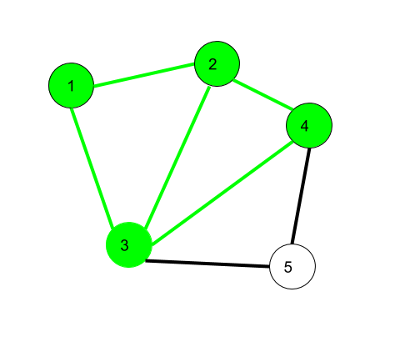
1. Walk –
A walk is a sequence of vertices and edges of a graph i.e. if we traverse a graph then we get a walk.
Here, 1->2->3->4->2->1->3 is a walk.

Slide 23
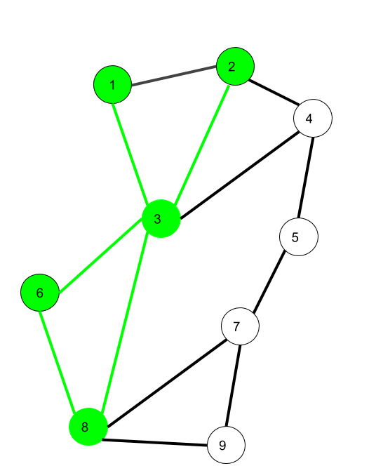
2. Trail –
Trail is an open walk in which no edge is repeated.
Here 1->3->8->6->3->2 is trail
Also 1->3->8->6->3->2->1 will be a closed trail

Slide 24
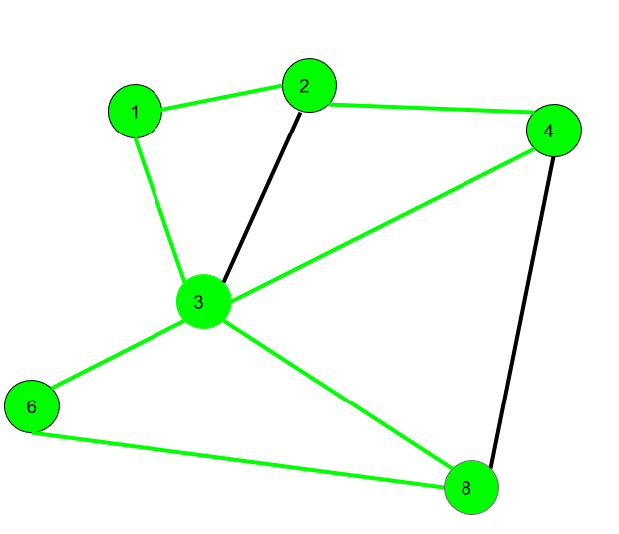
Circuit –
Traversing a graph such that not an edge is repeated but vertex can be repeated and it is closed also i.e. it is a closed trail.
Here 1->2->4->3->6->8->3->1 is a circuit.

Slide 25
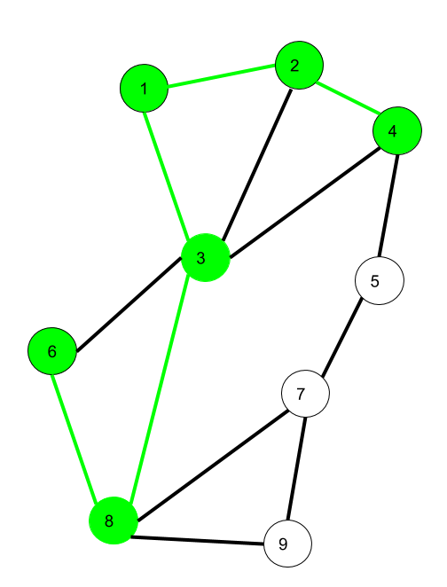
Path –
It is a trail in which neither vertices nor edges are repeated i.e. if we traverse a graph such that we do not repeat a vertex and nor we repeat an edge. As path is also a trail, thus it is also an open walk.
Here 6->8->3->1->2->4 is a Path

Slide 26
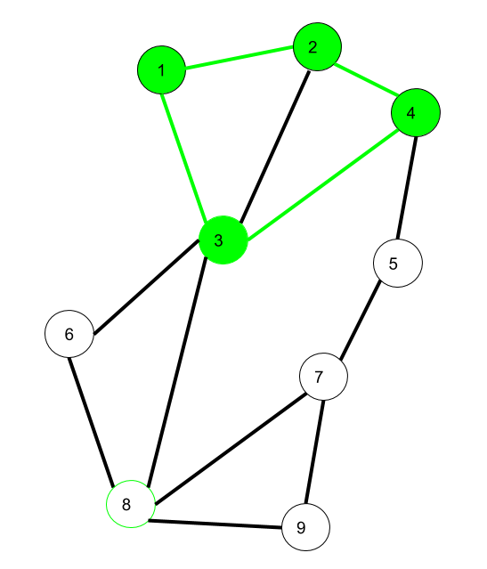
Cycle –
Traversing a graph such that we do not repeat a vertex nor we repeat a edge but the starting and ending vertex must be same
Here 1->2->4->3->1 is a cycle.

Slide 27
Bipartite graphs
In a simple graph G, if V can be partitioned into two disjoint sets V₁ and V₂ such that every edge in the graph connects a vertex in V₁ and a vertex V₂ (so that no edge in G connects either two vertices in V₁ or two vertices in V₂)
Application example: Representing Relations
Representation example: V₁ = {v₁, v₂, v₃} and V₂ = {v₄, v₅, v₆},
v₁
v₄
v₂
v₅
v₃
v₆
V₁
V₂

Slide 28
Complete Bipartite graphs
K_{m,n} is the graph that has its vertex set portioned into two subsets of m and n vertices, respectively There is an edge between two vertices if and only if one vertex is in the first subset and the other vertex is in the second subset.
Representation example: K_{2,3,} K_{3,3}
K_{2,3}
K_{3,3}

Slide 29
Subgraphs
A subgraph of a graph G = (V, E) is a graph H =(V’, E’) where V’ is a subset of V and E’ is a subset of E
Application example: solving sub-problems within a graph
Representation example: V = {u, v, w}, E = ({u, v}, {v, w}, {w, u}}, H₁ , H₂
u
u
u
v
w
v
w
v
G
H₁
H₂

Slide 30
Subgraphs
G = G1 U G2 wherein E = E1 U E2 and V = V1 U V2, G, G1 and G2 are simple graphs of G
Representation example: V1 = {u, w}, E1 = {{u, w}}, V2 = {w, v},
E1 = {{w, v}}, V = {u, v ,w}, E = {{{u, w}, {{w, v}}
u
u
w
v
w
w
v
G1
G2
G

Slide 31
Representation
Incidence (Matrix): Most useful when information about edges is more desirable than information about vertices.
Adjacency (Matrix/List): Most useful when information about the vertices is more desirable than information about the edges. These two representations are also most popular since information about the vertices is often more desirable than edges in most applications

Slide 32
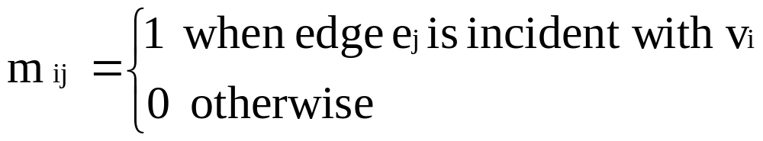
Representation- Incidence Matrix
G = (V, E) be an unditected graph. Suppose that v₁, v₂, v₃, …, v_{n} are the vertices and e₁, e₂, …, e_{m} are the edges of G. Then the incidence matrix with respect to this ordering of V and E is the nx m matrix M = [m _{ij}], where
Can also be used to represent :
Multiple edges: by using columns with identical entries, since these edges are incident with the same pair of vertices
Loops: by using a column with exactly one entry equal to 1, corresponding to the vertex that is incident with the loop

Slide 33
Representation- Incidence Matrix
Representation Example: G = (V, E)
 | e₁ | e₂ | e₃
v | 1 | 0 | 1
u | 1 | 1 | 0
w | 0 | 1 | 1
u
e1
e2
v
w
e3

Slide 34
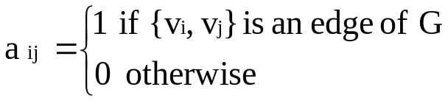

Representation- Adjacency Matrix
There is an N x N matrix, where |V| = N , the Adjacenct Matrix (NxN) A = [a_{ij}]
For undirected graph
For directed graph
This makes it easier to find subgraphs, and to reverse graphs if needed.

Slide 35
Representation- Adjacency Matrix
Adjacency is chosen on the ordering of vertices. Hence, there as are as many as n! such matrices.
The adjacency matrix of simple graphs are symmetric (a_{ij} = a_{ji}) (why?)
When there are relatively few edges in the graph the adjacency matrix is a sparse matrix
Directed Multigraphs can be represented by using aij = number of edges from v_{i} to v_{j}

Slide 36
Representation- Adjacency Matrix
Example: Undirected Graph G (V, E)
 | v | u | w
v | 0 | 1 | 1
u | 1 | 0 | 1
w | 1 | 1 | 0
u
v
w

Slide 37
Representation- Adjacency Matrix
Example: directed Graph G (V, E)
 | v | u | w
v | 0 | 1 | 0
u | 0 | 0 | 1
w | 1 | 0 | 0
u
v
w

Slide 38
Representation- Adjacency List
Each node (vertex) has a list of which nodes (vertex) it is adjacent
Example: undirectd graph G (V, E)
u
node | Adjacency List
u | v , w
v | w, u
w | u , v
v
w

Slide 39
Graph - Isomorphism
G1 = (V1, E2) and G2 = (V2, E2) are isomorphic if:
There is a one-to-one and onto function f from V1 to V2 with the property that
  a and b are adjacent in G1 if and only if f (a) and f (b) are adjacent in G2, for all a and b in V1.
Function f is called isomorphism
Application Example:
In chemistry, to find if two compounds have the same structure

Slide 40
Graph - Isomorphism
Representation example: G1 = (V1, E1) , G2 = (V2, E2)
f(u₁) = v₁, f(u₂) = v₄, f(u₃) = v₃, f(u₄) = v₂,
u₁
u₂
v₁
v₂
u₃
u₄
v₄
v₃

Slide 41
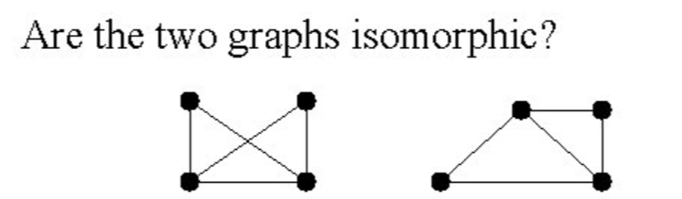

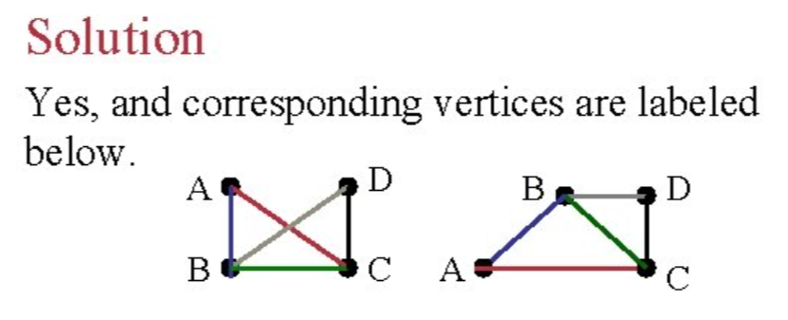

Slide 42
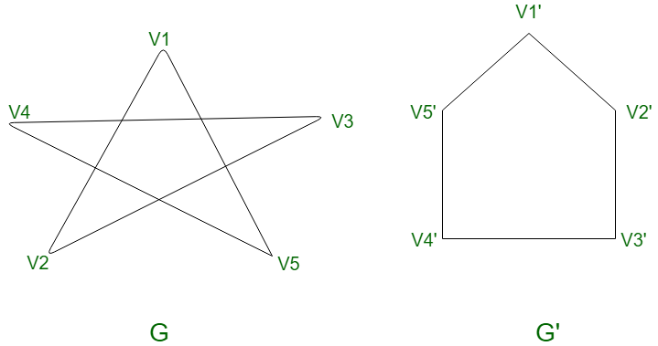
are isomorphic?

Slide 43
Connectivity
Basic Idea: In a Graph Reachability among vertices by traversing the edges
Application Example:
- In a city to city road-network, if one city can be reached from another city.
- Problems if determining whether a message can be sent between two computer using intermediate links
- Efficiently planning routes for data delivery in the Internet

Slide 44
Connectivity – Path
A Path is a sequence of edges that begins at a vertex of a graph and travels along edges of the graph, always connecting pairs of adjacent vertices.
Representation example: G = (V, E), Path P represented, from u to v is {{u, 1}, {1, 4}, {4, 5}, {5, v}}
2
1
v
3
u
4
5

Slide 45
Connectivity – Path
Definition for Directed Graphs
A Path of length n (> 0) from u to v in G is a sequence of n edges e₁, e₂ , e₃, …, e_{n} of G such that f (e₁) = (x_{o}, x₁), f (e₂) = (x₁, x₂₎, …, f (e_{n}) = (x_{n-1}, x_{n)}, where x₀ = u and x_{n} = v. A path is said to pass through x₀, x₁, …, x_{n} or traverse e₁, e₂ , e₃, …, e_{n}
For Simple Graphs, sequence is x₀, x₁, …, x_{n}
In directed multigraphs when it is not necessary to distinguish between their edges, we can use sequence of vertices to represent the path
Circuit/Cycle: u = v, length of path > 0
Simple Path: does not contain an edge more than once

Slide 46
Connectivity – Connectedness
Undirected Graph
An undirected graph is connected if there exists is a simple path between every pair of vertices
Representation Example: G (V, E) is connected since for V = {v₁, v₂, v₃, v₄, v₅}, there exists a path between {v_{i}, v_{j}}, 1 ≤ i, j≤ 5
v₄
v₁
v₃
v₂
v₅

Slide 47
Connectivity – Connectedness
Undirected Graph
Articulation Point (Cut vertex): removal of a vertex produces a subgraph with more connected components than in the original graph. The removal of a cut vertex from a connected graph produces a graph that is not connected
Cut Edge: An edge whose removal produces a subgraph with more connected components than in the original graph.
Representation example: G (V, E), v₃ is the articulation point or edge {v₂, v₃}, the number of connected components is 2 (> 1)
v₃
v₅
v₁
v₂
v₄

Slide 48
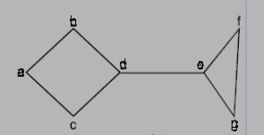
Find cut vertex and cut edge

Slide 49
Connectivity – Connectedness
Directed Graph
A directed graph is strongly connected if there is a path from a to b and from b to a whenever a and b are vertices in the graph
A directed graph is weakly connected if there is a (undirected) path between every two vertices in the underlying undirected path
A strongly connected Graph can be weakly connected but the vice-versa is not true (why?)

Slide 50
Connectivity – Connectedness
Directed Graph
Representation example: G1 (Strong component), G2 (Weak Component), G3 is undirected graph representation of G2 or G1
G1
G2
G3

Slide 51
Connectivity – Connectedness
Directed Graph
Strongly connected Components: subgraphs of a Graph G that are strongly connected
Representation example: G1 is the strongly connected component in G
G
G1

Slide 52
Isomorphism - revisited
A isomorphic invariant for simple graphs is the existence of a simple circuit of length k , k is an integer > 2 (why ?)
Representation example: G1 and G2 are isomorphic since we have the invariants, similarity in degree of nodes, number of edges, length of circuits
G1
G2

Slide 53
Counting Paths
Theorem: Let G be a graph with adjacency matrix A with respect to the ordering v₁, v2, …, V_{n} (with directed on undirected edges, with multiple edges and loops allowed). The number of different paths of length r from Vi to Vj, where r is a positive integer, equals the (i, j)^{th} entry of (adjacency matrix) A^{r.}
Proof: By Mathematical Induction.
Base Case: For the case N = 1, a_{ij} =1 implies that there is a path of length 1. This is true since this corresponds to an edge between two vertices.
We assume that theorem is true for N = r and prove the same for N = r +1. Assume that the (i, j)^{th} entry of A^{r} is the number of different paths of length r from v_{i} to v_{j}. By induction hypothesis, b_{ik} is the number of paths of length r from v_{i} to v_{k}.

Slide 54
Counting Paths
Case r +1: In A^{r+1} = A^{r}. A,
The (i, j)^{th} entry in A^{r+1} , b_{i1}a_{1j} + b_{i2} a_{2j} + …+ b_{in} a_{nj}
where b_{ik} is the (i, j)^{th} entry of A^{r}.
By induction hypothesis, b_{ik} is the number of paths of length r from v_{i} to v_{k}.
The (i, j)^{th} entry in A^{r+1} corresponds to the length between i and j and the length is r+1. This path is made up of length r from v_{i} to v_{k} and of length from v_{k} to vj. By product rule for counting, the number of such paths is b_{ik*} a_{kj} The result is b_{i1}a_{1j} + b_{i2} a_{2j} + …+ b_{in} a_{nj ,}the desired result.

Slide 55
Counting Paths
a ------- b
| |
| |
c -------d
A = 0 1 1 0 A⁴ = 8 0 0 8
1 0 0 1 0 8 8 0
1 0 0 1 0 8 8 0
0 1 1 0 8 0 0 8
Number of paths of length 4 from a to d is (1,4) th entry of A⁴ = 8.

Slide 56
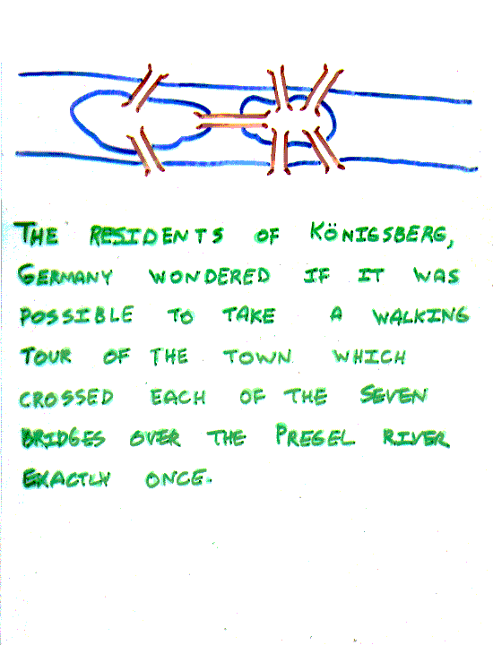
The Seven Bridges of Königsberg, Germany
The residents of Königsberg, Germany, wondered if it was possible to take a walking tour of the town that crossed each of the seven bridges over the Presel river exactly once. Is it possible to start at some node and take a walk that uses each edge exactly once, and ends at the starting node?

Slide 57
The Seven Bridges of Königsberg, Germany
You can redraw the original picture as long as for every edge between nodes i and j in the original you put an edge between nodes i and j in the redrawn version (and you put no other edges in the redrawn version).
Original:
2
3
4
Redrawn:
2
4
1
3

Slide 58
The Seven Bridges of Königsberg, Germany
Euler:
Has no tour that uses each edge exactly once.
(Even if we allow the walk to start and finish in different places.)
Can you see why?

Slide 59
Euler - definitions
An Eulerian path (Eulerian trail, Euler walk) in a graph is a path that uses each edge precisely once. If such a path exists, the graph is called traversable.
An Eulerian cycle (Eulerian circuit, Euler tour) in a graph is a cycle that uses each edge precisely once. If such a cycle exists, the graph is called Eulerian (also unicursal).
Representation example: G1 has Euler path a, c, d, e, b, d, a, b
a
b
c
d
e

Slide 60
The problem in our language:
Show that is not Eulerian.
In fact, it contains no Euler trail.

Slide 61
Euler - theorems
1. A connected graph G is Eulerian if and only if G is connected and has no vertices of odd degree
2. A connected graph G is has an Euler trail from node a to some other node b if and only if G is connected and a ≠ b are the only two nodes of odd degree

Slide 62
Euler – theorems (=>)
Assume G has an Euler trail T from node a to node b (a and b not necessarily distinct).
For every node besides a and b, T uses an edge to exit for each edge it uses to enter. Thus, the degree of the node is even.
1. If a = b, then a also has even degree. → Euler circuit
2. If a ≠ b, then a and b both have odd degree. → Euler path

Slide 63
Euler - theorems
1. A connected graph G is Eulerian if and only if G is connected and has no vertices of odd degree
a
b
f
c
d
Building a simple path:
{a,b}, {b,c}, {c,f}, {f,a}
Euler circuit constructed if all edges
are used. True here?
e

Slide 64
Euler - theorems
1. A connected graph G is Eulerian if and only if G is connected and has no vertices of odd degree
c
d
e
Delete the simple path:
{a,b}, {b,c}, {c,f}, {f,a}
C is the common vertex for this
sub-graph with its “parent”.

Slide 65
Euler - theorems
1. A connected graph G is Eulerian if and only if G is connected and has no vertices of odd degree
c
d
Constructed subgraph may not be connected.
C is the common vertex for this sub-graph
with its “parent”.
C has even degree.
Start at c and take a walk:
{c,d}, {d,e}, {e,c}
e

Slide 66
Euler - theorems
1. A connected graph G is Eulerian if and only if G is connected and has no vertices of odd degree
a
b
f
c
d
“Splice” the circuits in the 2 graphs:
{a,b}, {b,c}, {c,f}, {f,a}
“+”
{c,d}, {d,e}, {e,c}
“=“
{a,b}, {b,c}, {c,d}, {d,e}, {e,c}, {c,f}
{f,a}
e

Slide 67
Euler Circuit
Circuit C := a circuit in G beginning at an arbitrary vertex v.
  Add edges successively to form a path that returns to this vertex.
H := G – above circuit C
While H has edges
  Sub-circuit sc := a circuit that begins at a vertex in H that is also in C (e.g., vertex “c”)
  H := H – sc (- all isolated vertices)
  Circuit := circuit C “spliced” with sub-circuit sc
Circuit C has the Euler circuit.

Slide 68
Representation- Incidence Matrix
 | e₁ | e₂ | e₃
a | 1 | 0 | 0
b | 1 | 1 | 0
c | 0 | 1 | 1
d | 0 | 0 | 1
e | 0 | 0 | 0
f | 0 | 0 | 0
e4 | e₅ | e₆ | e₇
0 | 0 | 0 | 1
0 | 0 | 0 | 0
0 | 1 | 1 | 0
1 | 0 | 0 | 0
1 | 1 | 0 | 0
0 | 0 | 1 | 1
e1
a
b
e7
e2
e3
f
c
d
e6
e5
e
e4

Slide 69
Hamiltonian Graph
Hamiltonian path (also called traceable path) is a path that visits each vertex exactly once.
A Hamiltonian cycle (also called Hamiltonian circuit, vertex tour or graph cycle) is a cycle that visits each vertex exactly once (except for the starting vertex, which is visited once at the start and once again at the end).
A graph that contains a Hamiltonian path is called a traceable graph. A graph that contains a Hamiltonian cycle is called a Hamiltonian graph. Any Hamiltonian cycle can be converted to a Hamiltonian path by removing one of its edges, but a Hamiltonian path can be extended to Hamiltonian cycle only if its endpoints are adjacent.

Slide 70
A graph of the vertices of a dodecahedron.
Is it Hamiltonian?
Yes.

Slide 71
This one has a Hamiltonian path, but not a Hamiltonian tour.
Hamiltonian Graph

Slide 72
Hamiltonian Graph
This one has an Euler tour, but no Hamiltonian path.

Slide 73
Hamiltonian Graph
Similar notions may be defined for directed graphs, where edges (arcs) of a path or a cycle are required to point in the same direction, i.e., connected tail-to-head.
The Hamiltonian cycle problem or Hamiltonian circuit problem in graph theory is to find a Hamiltonian cycle in a given graph. The Hamiltonian path problem is to find a Hamiltonian path in a given graph.
There is a simple relation between the two problems. The Hamiltonian path problem for graph G is equivalent to the Hamiltonian cycle problem in a graph H obtained from G by adding a new vertex and connecting it to all vertices of G.
Both problems are NP-complete. However, certain classes of graphs always contain Hamiltonian paths. For example, it is known that every tournament has an odd number of Hamiltonian paths.

Slide 74
Hamiltonian Graph
DIRAC’S Theorem: if G is a simple graph with n vertices with n ≥ 3 such that the degree of every vertex in G is at least n/2 then G has a Hamilton circuit.
ORE’S Theorem: if G is a simple graph with n vertices with n ≥ 3 such that deg (u) + deg (v) ≥ n for every pair of nonadjacent vertices u and v in G, then G has a Hamilton circuit.

Slide 75

Shortest Path
Generalize distance to weighted setting
Digraph G = (V,E) with weight function W: E → R (assigning real values to edges)
Weight of path p = v₁ → v₂ → … → v_{k} is
Shortest path = a path of the minimum weight
Applications
  static/dynamic network routing
  robot motion planning
  map/route generation in traffic

Slide 76
Shortest-Path Problems
Shortest-Path problems
  Single-source (single-destination). Find a shortest path from a given source (vertex s) to each of the vertices. The topic of this lecture.
  Single-pair. Given two vertices, find a shortest path between them. Solution to single-source problem solves this problem efficiently, too.
  All-pairs. Find shortest-paths for every pair of vertices. Dynamic programming algorithm.
  Unweighted shortest-paths – BFS.

Slide 77

Optimal Substructure
Theorem: subpaths of shortest paths are shortest paths
Proof (”cut and paste”)
  if some subpath were not the shortest path, one could substitute the shorter subpath and create a shorter total path

Slide 78
Negative Weights and Cycles?
Negative edges are OK, as long as there are no negative weight cycles (otherwise paths with arbitrary small “lengths” would be possible)
Shortest-paths can have no cycles (otherwise we could improve them by removing cycles)
  Any shortest-path in graph G can be no longer than n – 1 edges, where n is the number of vertices

Slide 79
Shortest Path Tree
The result of the algorithms – a shortest path tree. For each vertex v, it
  records a shortest path from the start vertex s to v. v.parent() gives a predecessor of v in this shortest path
  gives a shortest path length from s to v, which is recorded in v.d().
The same pseudo-code assumptions are used.
Vertex ADT with operations:
  adjacent():VertexSet
  d():int and setd(k:int)
  parent():Vertex and setparent(p:Vertex)

Slide 80
Relaxation
For each vertex v in the graph, we maintain v.d(), the estimate of the shortest path from s, initialized to ∞ at the start
Relaxing an edge (u,v) means testing whether we can improve the shortest path to v found so far by going through u
u
v
u
v
2
2
Relax (u,v,G)
if v.d() > u.d()+G.w(u,v) then
v.setd(u.d()+G.w(u,v))
v.setparent(u)
5
9
5
6
Relax(u,v)
Relax(u,v)
5
7
5
6
2
2
u
v
u
v

Slide 81
Dijkstra's Algorithm
Non-negative edge weights
Greedy, similar to Prim's algorithm for MST
Like breadth-first search (if all weights = 1, one can simply use BFS)
Use Q, a priority queue ADT keyed by v.d() (BFS used FIFO queue, here we use a PQ, which is re-organized whenever some d decreases)
Basic idea
  maintain a set S of solved vertices
  at each step select "closest" vertex u, add it to S, and relax all edges from u

Slide 82
Dijkstra’s ALgorithm
Solution to Single-source (single-destination).
Input: Graph G, start vertex s
Dijkstra(G,s)
01 for each vertex u ∈ G.V()
02 u.setd(∞)
03 u.setparent(NIL)
04 s.setd(0)
05 S ← ∅ // Set S is used to explain the algorithm
06 Q.init(G.V()) // Q is a priority queue ADT
07 while not Q.isEmpty()
08 u ← Q.extractMin()
09 S ← S ∪ {u}
10 for each v ∈ u.adjacent() do
11 Relax(u, v, G)
12 Q.modifyKey(v)
relaxing edges

Slide 83
Dijkstra’s Example
u
v
1
10
∞
∞
Dijkstra(G,s)
01 for each vertex u ∈ G.V()
02 u.setd(∞)
03 u.setparent(NIL)
04 s.setd(0)
05 S ← ∅
06 Q.init(G.V())
07 while not Q.isEmpty()
08 u ← Q.extractMin()
09 S ← S ∪ {u}
10 for each v ∈ u.adjacent() do
11 Relax(u, v, G)
12 Q.modifyKey(v)
9
s
0
2
3
4
6
7
5
∞
∞
2
x
y
u
v
1
10
10
∞
9
s
0
2
3
4
6
7
5
5
∞
2
x
y

Slide 84
Dijkstra’s Example
u
v
1
10
8
14
Dijkstra(G,s)
01 for each vertex u ∈ G.V()
02 u.setd(∞)
03 u.setparent(NIL)
04 s.setd(0)
05 S ← ∅
06 Q.init(G.V())
07 while not Q.isEmpty()
08 u ← Q.extractMin()
09 S ← S ∪ {u}
10 for each v ∈ u.adjacent() do
11 Relax(u, v, G)
12 Q.modifyKey(v)
9
s
0
2
3
4
6
7
5
5
7
2
x
y
u
v
1
10
8
13
9
s
0
2
3
4
6
7
5
5
7
2
x
y

Slide 85
Dijkstra’s Example
u
v
1
10
8
9
Dijkstra(G,s)
01 for each vertex u ∈ G.V()
02 u.setd(∞)
03 u.setparent(NIL)
04 s.setd(0)
05 S ← ∅
06 Q.init(G.V())
07 while not Q.isEmpty()
08 u ← Q.extractMin()
09 S ← S ∪ {u}
10 for each v ∈ u.adjacent() do
11 Relax(u, v, G)
12 Q.modifyKey(v)
9
0
2
3
4
6
7
5
5
7
2
x
y
u
v
1
10
8
9
9
0
2
3
4
6
7
5
5
7
2
x
y

Slide 86
Dijkstra’s Algorithm
O(n²) operations
  (n-1) iterations: 1 for each vertex added to the distinguished set S.
  (n-1) iterations: for each adjacent vertex of the one added to the distinguished set.
Note: it is single source – single destination algorithm

Slide 87
Traveling Salesman Problem
Given a number of cities and the costs of traveling from one to the other, what is the cheapest roundtrip route that visits each city once and then returns to the starting city?
An equivalent formulation in terms of graph theory is: Find the Hamiltonian cycle with the least weight in a weighted graph.
It can be shown that the requirement of returning to the starting city does not change the computational complexity of the problem.
A related problem is the (bottleneck TSP): Find the Hamiltonian cycle in a weighted graph with the minimal length of the longest edge.

Slide 88
Planar Graphs
A graph (or multigraph) G is called planar if G can be drawn in the plane with its edges intersecting only at vertices of G, such a drawing of G is called an embedding of G in the plane.
Application Example: VLSI design (overlapping edges requires extra layers), Circuit design (cannot overlap wires on board)
Representation examples: K1,K2,K3,K4 are planar, Kn for n>4 are non-planar
K₄

Slide 89
Planar Graphs
Representation examples: Q₃

Slide 90
Planar Graphs
Representation examples: K_{3,3} is Nonplanar
v₁
v₂
v₃
v₁
v₅
v₁
v₅
R₂₁
R₂
R₁
R₁
R₂₂
v₃
v₄
v₅
v₆
v₄
v₂
v₄
v₂

Slide 91
Planar Graphs
Theorem : Euler's planar graph theorem
For a connected planar graph or multigraph:
v – e + r = 2
number
of regions
number
of vertices
number
of edges

Slide 92
Planar Graphs
Example of Euler’s theorem
A planar graph divides the plane
into several regions (faces), one
of them is the infinite region.
R1
K₄
R4
R2
v=4,e=6,r=4, v-e+r=2
R3

Slide 93
Planar Graphs
Proof of Euler’s formula: By Induction
Base Case: for G1 , e₁ = 1, v₁ = 2 and r₁= 1
n+1 Case: Assume, r_{n} = e_{n} – v_{n} + 2 is true. Let {an+1, bn+1} be the edge that is added to Gn to obtain Gn+1 and we prove that r_{n} = e_{n} – v_{n} + 2 is true. Can be proved using two cases.
v
u
R1

Slide 94
Planar Graphs
Case 1:
r_{n+1} = r_{n} + 1, e_{n+1} = e_{n} + 1, v_{n+1} = v_{n} => r_{n+1} = e_{n+1} – v_{n+1} + 2
a_{n+1}
R
b_{n+1}

Slide 95
Planar Graphs
Case 2:
r_{n+1} = r_{n}, e_{n+1} = e_{n} + 1, v_{n+1} = v_{n} + 1 => r_{n+1} = e_{n+1} – v_{n+1} + 2
a_{n+1}
R
b_{n+1}

Slide 96
Planar Graphs
Corollary 1: Let G = (V, E) be a connected simple planar graph with |V| = v, |E| = e > 2, and r regions. Then 3r ≤ 2e and e ≤ 3v – 6
Proof: Since G is loop-free and is not a multigraph, the boundary of each region (including the infinite region) contains at least three edges. Hence, each region has degree ≥ 3.
Degree of region: No. of edges on its boundary; 1 edge may occur twice on boundary -> contributes 2 to the region degree.
Each edge occurs exactly twice: either in the same region or in 2 different regions
a_{n+1}
R
b_{n+1}

Slide 97
Region Degree
R
Degree of R = 3
Degree of R = ?
R

Slide 98
Planar Graphs
Each edge occurs exactly twice: either in the same region or in 2 different regions
2e = sum of degree of r regions determined by 2e
2e ≥ 3r. (since each region has a degree of at least 3)
r ≤ (2/3) e
From Euler’s theorem, 2 = v – e + r
2 ≤ v – e + 2e/3
2 ≤ v – e/3
So 6 ≤ 3v – e
or e ≤ 3v – 6

Slide 99
Planar Graphs
Corollary 2: Let G = (V, E) be a connected simple planar graph then G has a vertex degree that does not exceed 5
Proof: If G has one or two vertices the result is true
If G has 3 or more vertices then by Corollary 1, e ≤ 3v – 6
2e ≤ 6v – 12
If the degree of every vertex were at least 6:
by Handshaking theorem: 2e = Sum (deg(v))
2e ≥ 6v. But this contradicts the inequality 2e ≤ 6v – 12
There must be at least one vertex with degree no greater than 5

Slide 100
Planar Graphs
Corollary 3: Let G = (V, E) be a connected simple planar graph with v vertices ( v ≥ 3) , e edges, and no circuits of length 3 then e ≤ 2v -4
Proof: Similar to Corollary 1 except the fact that no circuits of length 3 imply that degree of region must be at least 4.

Slide 101
Planar Graphs
Elementary sub-division: Operation in which a graph are obtained by removing an edge {u, v} and adding the vertex w and edges {u, w}, {w, v}
Homeomorphic Graphs: Graphs G1 and G2 are termed as homeomorphic if they are obtained by sequence of elementary sub-divisions.
u
v
u
w
v

Slide 102
Planar Graphs
Kuwratoski’s Theorem: A graph is non-planar if and only if it contains a subgraph homeomorephic to K_{3,3} or K₅
Representation Example: G is Nonplanar
a
a
b
a
b
b
c
j
c
d
h
e
c
i
k
e
d
g
f
d
e
H
K₅
g
f
G

Slide 103
Graph Coloring Problem
Graph coloring is an assignment of "colors", almost always taken to be consecutive integers starting from 1 without loss of generality, to certain objects in a graph. Such objects can be vertices, edges, faces, or a mixture of the above.
Application examples: scheduling, register allocation in a microprocessor, frequency assignment in mobile radios, and pattern matching

Slide 104
Vertex Coloring Problem
Assignment of colors to the vertices of the graph such that proper coloring takes place (no two adjacent vertices are assigned the same color)
Chromatic number: least number of colors needed to color the graph
A graph that can be assigned a (proper) k-coloring is k-colorable, and it is k-chromatic if its chromatic number is exactly k.

Slide 105
Vertex Coloring Problem
The problem of finding a minimum coloring of a graph is NP-Hard
The corresponding decision problem (Is there a coloring which uses at most k colors?) is NP-complete
The chromatic number for C_{n} = 3 (n is odd) or 2 (n is even), K_{n} = n, K_{m,n} = 2
Cn: cycle with n vertices; Kn: fully connected graph with n vertices; Km,n: complete bipartite graph
C₄
C₅
K₄
K_{2, 3}

Slide 106
Vertex Covering Problem
The Four color theorem: the chromatic number of a planar graph is no greater than 4
Example: G1 chromatic number = 3, G2 chromatic number = 4
(Most proofs rely on case by case analysis).
G1
G2

