Slide 1

Title
Customer Insight Hub
Transforming Team-Customer Connections.

Slide 2

Problem
• Small teams struggle to gather and analyze customer insights.
• Limited resources lead to ineffective customer engagement strategies.
• Inconsistent customer feedback loops hinder product development.

Slide 3
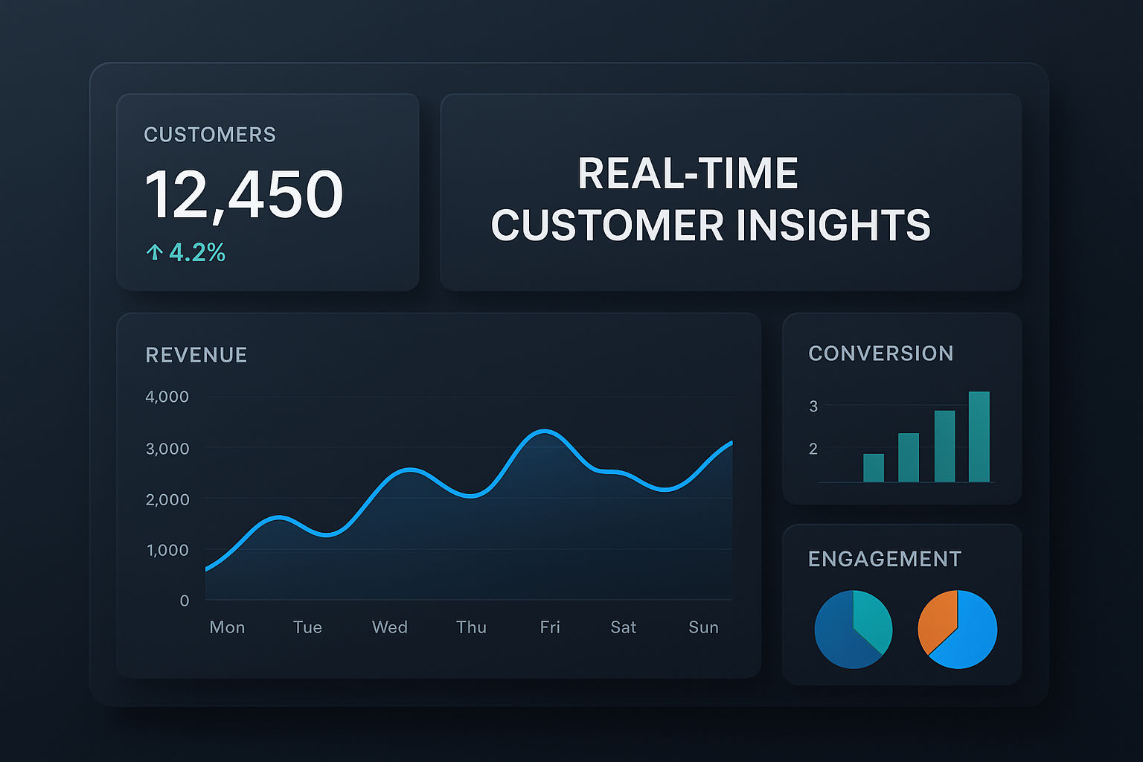
Solution
• A user-friendly platform for gathering and analyzing customer insights.
• Real-time feedback tools to enhance customer engagement.
• Integrated analytics dashboard for actionable insights.

Slide 4

Market
• Targeting small to medium-sized businesses across various industries.
• Estimated market size of $15 billion for customer experience tools.
• Growing need for effective customer feedback management solutions.

Slide 5

Product
• Intuitive survey and feedback collection tools.
• Customizable user dashboard with analytics insights.
• Collaboration features for team-based strategies.
• Integration with existing CRMs for seamless data flow.

Slide 6
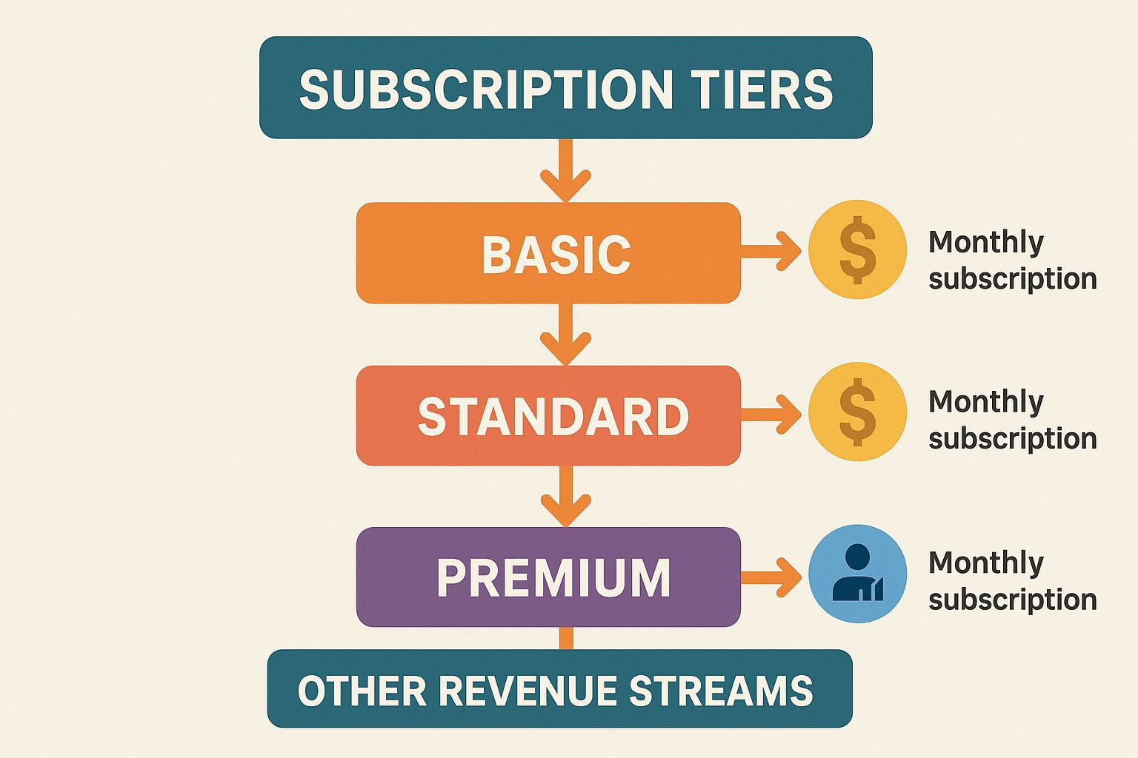
Business Model
• Subscription-based model offering different tiers for scalability.
• Additional revenue through premium analytics features.
• Potential for partnership programs with CRM providers.

Slide 7
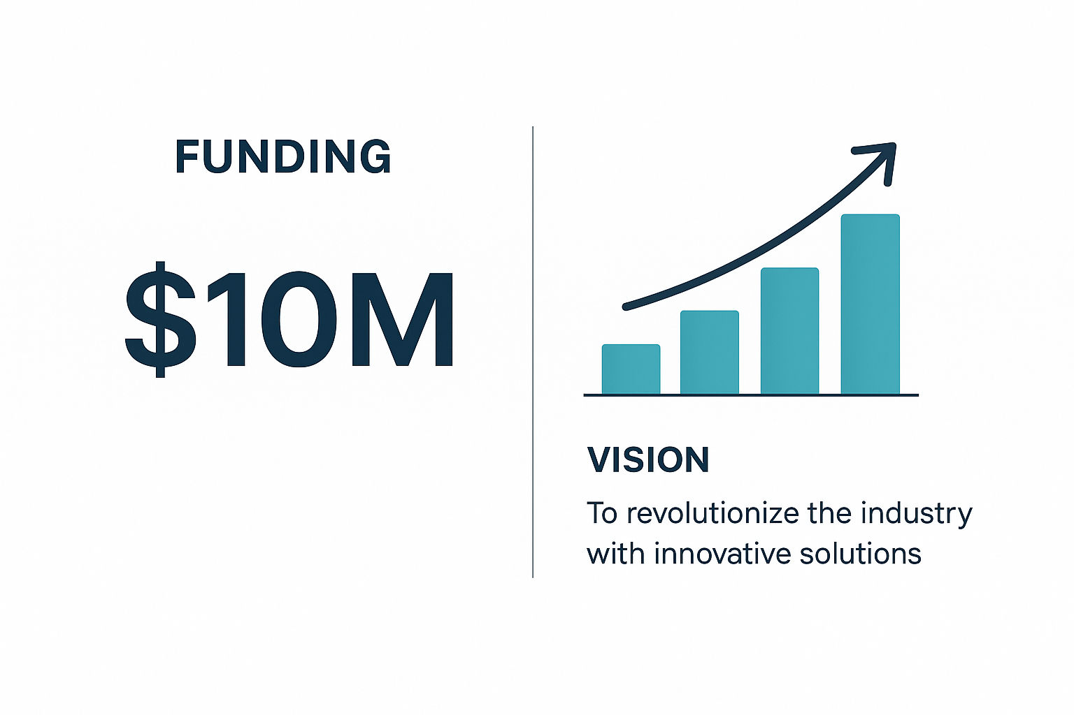
The Ask
• Seeking $500,000 in funding to finalize product development and marketing.
• Looking for strategic partnerships for market entry.
• Purpose: Enhance our product features and grow the customer base.

