Slide 1

PRE-IDEATHON TEMPLATE
GENESIS
IDEATHON
TEAM & DOMAIN
Team Name : Gryffindor
Team Members :
Sarvesh S - CB.EN.U4CCE26148
Dilip Kumar A - CB.EN.U4CCE26118
Abhijith S - CB.EN.U4CCE26101
Muhammad Rayyan K A - CB.EN.U4CCE26030
Selected Domain : #2 - Energy, Mobility and Smart Infrastructure
Problem Statement :To create Efficient Utilization and Accessibility of EV Charging Infrastructure in India

Slide 2


DOMAIN PROBLEM IN OUR WORDS
TEAM
Gryffindor
Explain the problem in your domain simply, in your own words
In India, even though the use of EV vehicles have rapidly increased, the charging stations have not kept their pace with the growing demand effectively.
Charging operators face a high difficulty in supplying the demand, in planning the capacity of their stations and in keeping the prices economical.
The consumers are not properly aware of the cost of charging, availability of the services and about the waiting hours.
The objective is to address these challenges and improve the efficiency, availability and user accessibility of the growing charging network.
India is rapidly evolving in EV technologies and has become a major global market for the investors around the globe and by the Government on EV technologies.
So, when these infrastructures are deployed, it is not only important to increase the count of the charging stations but to make it easily accessible to its users.
Addressing this problem now can very well control future congestion and help in reduction of unused charging stations, while increasing the user experience of India's growing EV charging network.

Slide 3

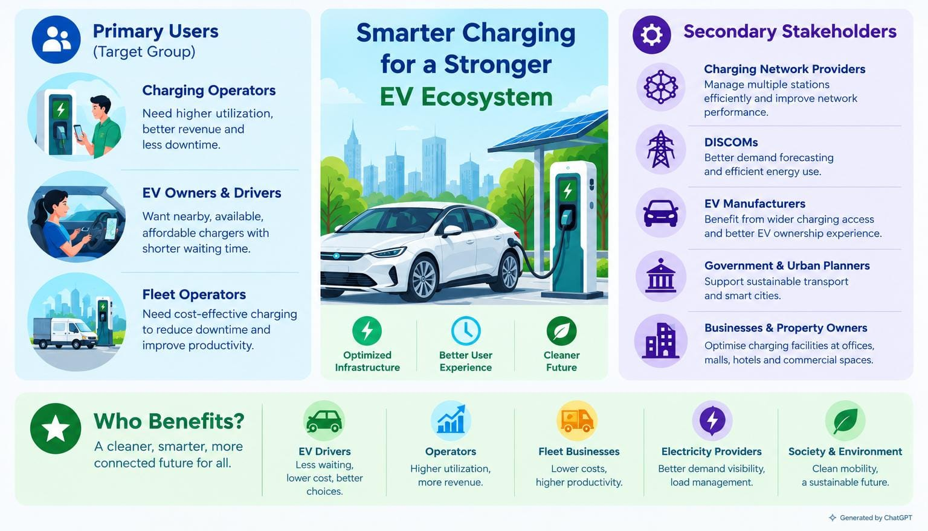
WHO IS AFFECTED?
TEAM
Gryffindor
Target users, stakeholders, beneficiaries

Slide 4
CURRENT SITUATION & CONTEXT
TEAM
Gryffindor
Existing scenario and background:
Rapid growth of electric mobility systems is observed in India.
Charging station's utility varies based on time and location.
In this case some charging stations are not used while some charging stations are facing congestion.
Drivers struggle to find the nearby, affordable EV charging stations.
❖ Relevant data or facts:
Charging station's demand fluctuates throughout the day.
This wastes the user's leisure time.
EV charging station owners face a negative financial outcome due to uneven usage.
Integrating this with AI's will be very useful for both the ends.
AI's can predict the demand and optimize the usage.
❖ Current workflow:
Drivers or vehicle owners search for a nearby charging power station.
Drivers may find difficult to compare the prices and availability of the charging power stations.
Drivers may find difficult to compare the prices and availability of the charging power stations
They may face unexpected time delays.

Slide 5

KEY CHALLENGES
TEAM
Gryffindor
Main difficulties & Bottlenecks :
An uneven charger usage – very busy during peak hours and idle during off-time hours.
Unpredictable demand and long waiting times.
Inefficient pricing and reduced operator profitability.
Inaccurate data regarding real-time availability of charging units.
Root causes :
Lack of real-time monitoring of the EV stations.
Inefficient pricing and reduced proper maintenance.
Lack of integration of charging networks.
Inadequate predictive measures for the demand and poor strategies.
Consequences :
Revenue losses for charging operators.
Longer queues and inconvenience for EV users.
Reduced user confidence and slower EV adoption.
Unnecessary infrastructure expansion and resource wastage.

Slide 6
EXISTING SOLUTIONS / APPROACHES
TEAM
Gryffindor
Existing approach
✓Charger discovery apps
✓Individual network apps
✓Operator management software
✓Manual monitoring and fixed pricing
✓Interoperability standards
Main limitation
✧ Finding a charger doesn't guarantee the best charging experience.
✧ Information can be fragmented across networks.
✧ Capabilities vary; operators may still need to interpret data and act.
✧ Slow decisions and limited predictive capability.
✧ Data exchange does not automatically create optimization
Opportunity for our solution
◇ Rank chargers by effective cost, wait, distance and reliability.
◇ Cross-network comparison where integrations permit.
◇ Action-oriented forecasting and recommendations.
◇ Demand forecasting and scenario-based pricing recommendations.
◇ Combine available data into useful decisions.

Slide 7
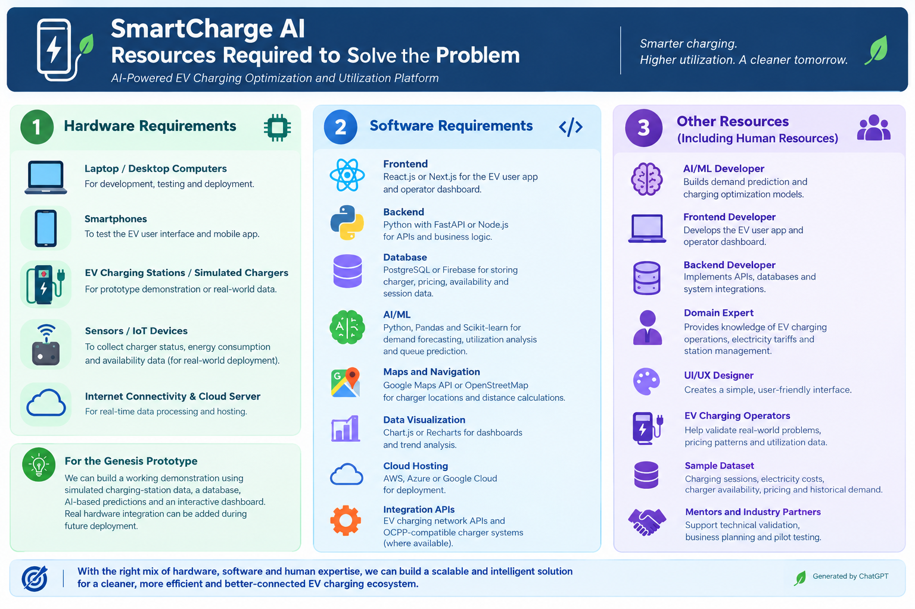
PROBLEM INSIGHTS & OPPORTUNITY AREAS
TEAM
Gryffindor
Resources required to solve the problem

Slide 8

INITIAL DIRECTION & EXPECTED OUTCOME
TEAM
Gryffindor
1. What Our Team Intends to Do
Develop an AI-powered EV charging platform combining station utilization optimization with smart charger recommendations.
Use charging station data to predict demand and identify available or underutilized chargers.
Recommend suitable charging stations to EV drivers based on availability, distance, price, and estimated waiting time.
2. What We Want to Improve
Reduce waiting times and congestion at busy charging stations.
Improve utilization of underused charging stations.
Help operators make better pricing and operational decisions.
Make EV charging more convenient, reliable, and cost-effective.
3. What Successful Improvement Should Achieve
Better distribution of EV charging demand across stations.
Reduced waiting time and fewer unnecessary trips to unavailable chargers.
Improved charger utilization and revenue potential for operators.
A smoother, more reliable charging experience for EV drivers.

