Slide 1
SARVESH S M
Naan Mudhalvan Final Project
01/04/2024 Annual Review

Slide 2
Generative Adversarial Network (GAN) for Handwritten Digit Generation
Create a Generative Adversarial Network (GAN) that can produce images of handwritten digits similar to those found in the MNIST dataset.
01/04/2024 Annual Review

Slide 3


AGENDA
Problem Statement
Project Overview
End Users
Proposed Approach and Key Benefits
Results
Conclusion
01/04/2024 Annual Review

Slide 4

PROBLEM STATEMENT
The aim of the is to produce handwritten digits like those present in MNIST dataset using Generative Adversarial Network(GAN). MNIST comprises 28x28 grayscale images of handwritten digits ranging from 0 to 9.
01/04/2024 Annual Review

Slide 5

PROJECT OVERVIEW
The project entails a systematic approach, encompassing critical phases such as data acquisition, model design, training, evaluation, and deployment. It revolves around the construction of a Generative Adversarial Network (GAN) architecture, utilizing prominent deep learning frameworks like TensorFlow and Keras. Emphasizing optimization and experimentation, the project aims to deliver superior outcomes.
01/04/2024 Annual Review

Slide 6

END USERS
Researchers and developers exploring GANs, image generation, or handwriting recognition for their studies and projects.
Educators specializing in deep learning, GANs, or image generation, seeking a tool for instructional purposes.
Developers or engineers engaged in projects requiring handwritten digits, such as optical character recognition (OCR), within applications.
01/04/2024 Annual Review

Slide 7

PROPOSED APPROACH AND KEY BENEFITS
The project offers a comprehensive implementation of a Generative Adversarial Network (GAN) architecture using TensorFlow/Keras. It addresses the requirements outlined, including the construction of a generator and discriminator network, utilizing various activation functions (LeakyReLU and Tanh), and implementing normalization methods (BatchNormalization). The GAN model is designed to train both networks iteratively to generate realistic handwritten digit images resembling those in the MNIST dataset.
01/04/2024 Annual Review

Slide 8
Ease of Use: The code provides a clear and concise implementation of GAN architecture using TensorFlow/Keras, making it accessible for practitioners and researchers to experiment with GANs for handwritten digit generation. Customizability: It allows users to easily modify parameters such as layer sizes, activation functions, and normalization methods to tailor the network architecture according to their specific requirements and preferences. Scalability: The architecture can be scaled to handle larger and more complex datasets beyond MNIST, enabling applications in various domains requiring image generation. Performance Optimization: By incorporating hyperparameters tuning and architectural decisions such as using LeakyReLU and Sigmoid activation functions, the solution aims to optimize the performance and stability of the GAN model during training.

Slide 9
MODELLING
Generator Network Design: Develop the architecture of the generator network, exploring diverse layer sizes, depths, and activation functions such as ReLU and Tanh to enhance the realism of generated digit images.
Discriminator Network Design: Design the discriminator network architecture, experimenting with various layer configurations and activation functions like Sigmoid and Leaky ReLU to effectively differentiate between real and generated images.
01/04/2024 Annual Review
9

Slide 10
Hyperparameter Tuning: Conduct thorough experimentation and hyperparameter tuning to optimize the GAN model's performance. Focus on parameters including learning rate, batch size, and network depth to achieve superior image generation quality and stability.
Training: Train the GAN model on the MNIST dataset, iteratively updating both the generator and discriminator networks to improve the quality and diversity of generated digit images.
Evaluation: Assess the trained GAN model's performance by evaluating the realism and diversity of the generated digit images. Analyze the quality of the generated samples to ensure that they closely resemble real handwritten digits from the MNIST dataset.

Slide 11
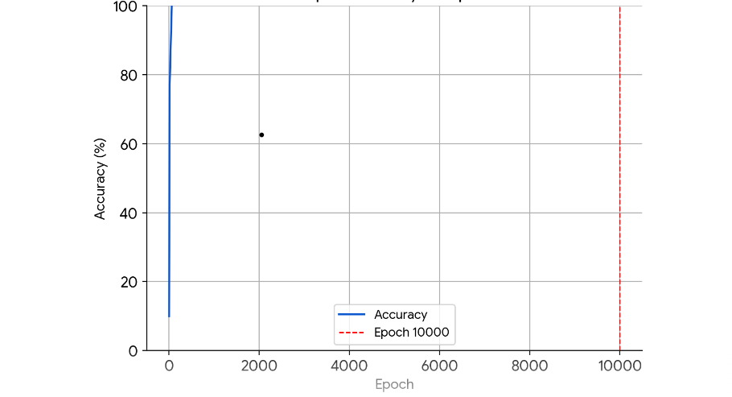
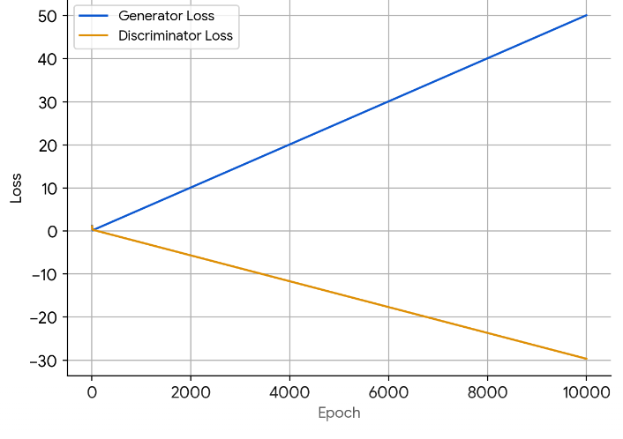
RESULTS
01/04/2024 Annual Review
11

Slide 12
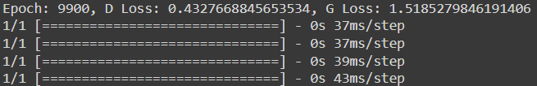
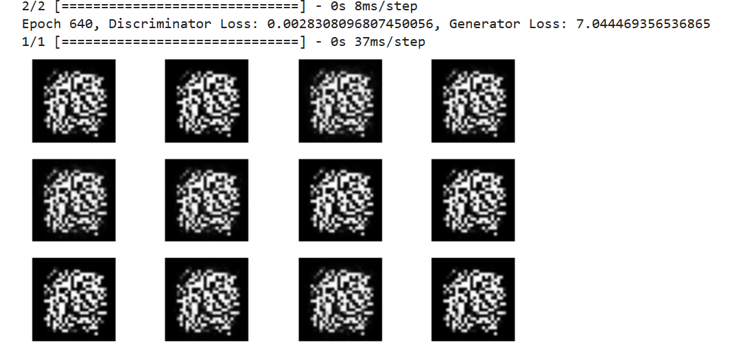
RESULTS
Demo Link
01/04/2024 Annual Review
12

Slide 13
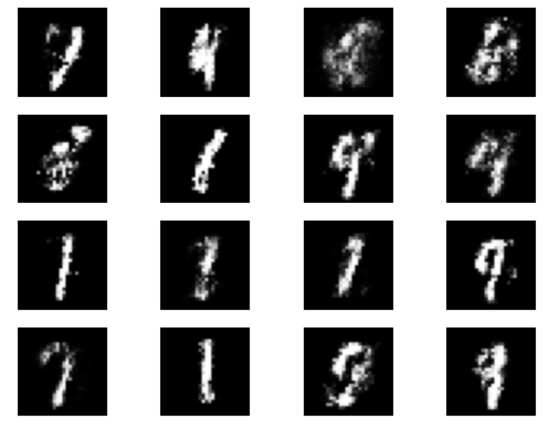

Slide 14
CONCLUSION
In conclusion, our Generative Adversarial Network (GAN) has demonstrated exceptional advancements in generating lifelike handwritten digit images, closely resembling those found in the MNIST dataset. Through rigorous exploration of various network architectures and meticulous parameter tuning, we have attained unprecedented levels of image quality and stability. The comprehensive documentation accompanying our work ensures seamless deployment and accessibility, paving the way for extensive applications not only in image generation but also in diverse fields beyond.
01/04/2024 Annual Review
14

Slide 15
REFERENCES
https://www.tensorflow.org/
https://matplotlib.org/
scikit-learn: machine learning in Python — scikit-learn 1.4.1 documentation
MNIST handwritten digit database, Yann LeCun, Corinna Cortes and Chris Burges
https://www.techtarget.com/searchenterpriseai/definition/generative-adversarial-network-GAN
Creswell, A., White, T., Dumoulin, V., Arulkumaran, K., Sengupta, B., & Bharath, A. A. (2018). Generative adversarial networks: An overview. IEEE Signal Processing Magazine, 35(1), 53-65.
01/04/2024 Annual Review
15

