Slide 1
#Hack-AI Hack-a-Thon
Problem Statement-1:
Al-Powered Early Disease Detection Develop an AI model that can analyze medical images (X-rays, MRIs, etc.) and detect early- stage diseases like cancer or tuberculosis with high accuracy. Ensure it works for underprivileged communities with low-cost hardware.
Team :
Thakur Vishwanath Singh
Sarvesh Sawant
T. Vedanta Madhuraj Singh
Adamya Bhandari

Slide 2
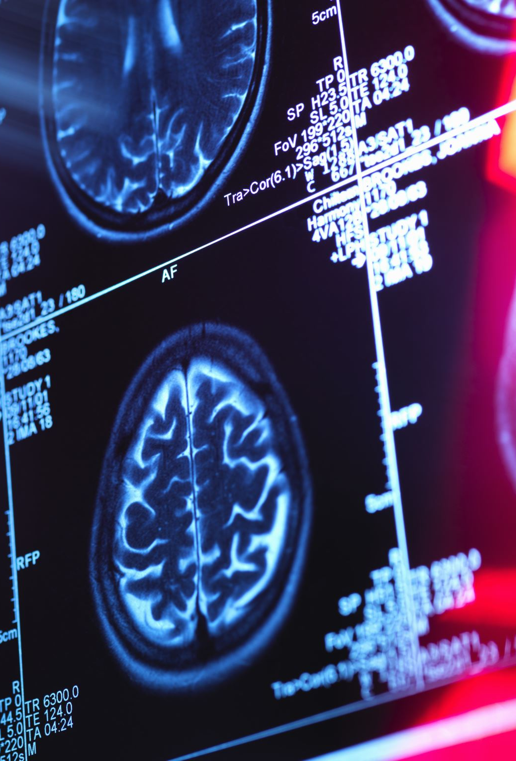
Objective
Develop an AI-powered system that can analyze medical images (X-rays, MRIs, CT scans, etc.) to detect early-stage diseases such as cancer, tuberculosis, and other critical illnesses with high accuracy. The model should be:
✅ Affordable – Optimized for low-cost hardware, making it accessible in rural and underprivileged areas. ✅ Accurate – Capable of detecting diseases in early stages, improving treatment outcomes. ✅ Scalable – Deployable on cloud, mobile devices, and portable diagnostic tools. ✅ Fast & Automated – Reducing dependency on radiologists for initial screening.

Slide 3
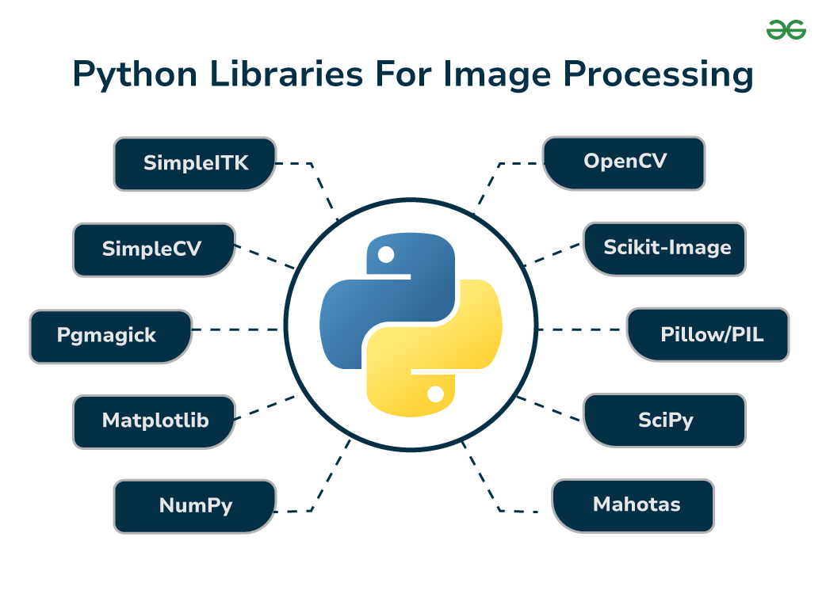
Packages Used throughout the Execution
OS - Standard library module for interacting with the file system.
cv2 (OpenCV) - Used for reading and preprocessing images.
numpy - Used for numerical computations and handling arrays.
tensorflow - Used for building and training the deep learning model.
sklearn (scikit-learn) - Used for encoding labels and splitting data.

Slide 4
Importance and Impacts
Why Early Detection Matters?
Higher Survival Rates – Enables timely treatment, improving outcomes.
Lower Healthcare Costs – Reduces expenses by preventing late-stage treatments.
Enhanced Accuracy – Minimizes diagnostic errors with AI-driven analysis.
Greater Accessibility – Provides affordable solutions for remote areas.
Impact on Healthcare
Bridges Expertise Gaps – Supports healthcare workers in underserved regions.
Cost-Effective Diagnosis – Optimized for low-cost medical devices.
Faster Screening – Accelerates diagnosis and treatment decisions.
Strengthens Public Health – Aids early detection of diseases like cancer and tuberculosis.

Slide 5
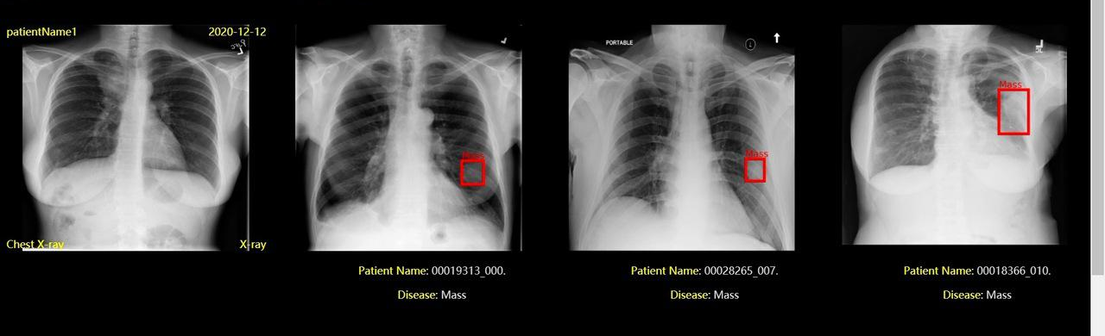
Proposed Model Architecture
Input: X-ray, MRI, CT scan images.
Preprocessing:
contrast enhancement, resizing.
Model Training:
Using CNN-based architectures like ResNet, MobileNetV2.
Augmentation techniques to improve accuracy.
Output: Classification of disease presence (Normal, Abnormal, Stage-wise detection).

Slide 6
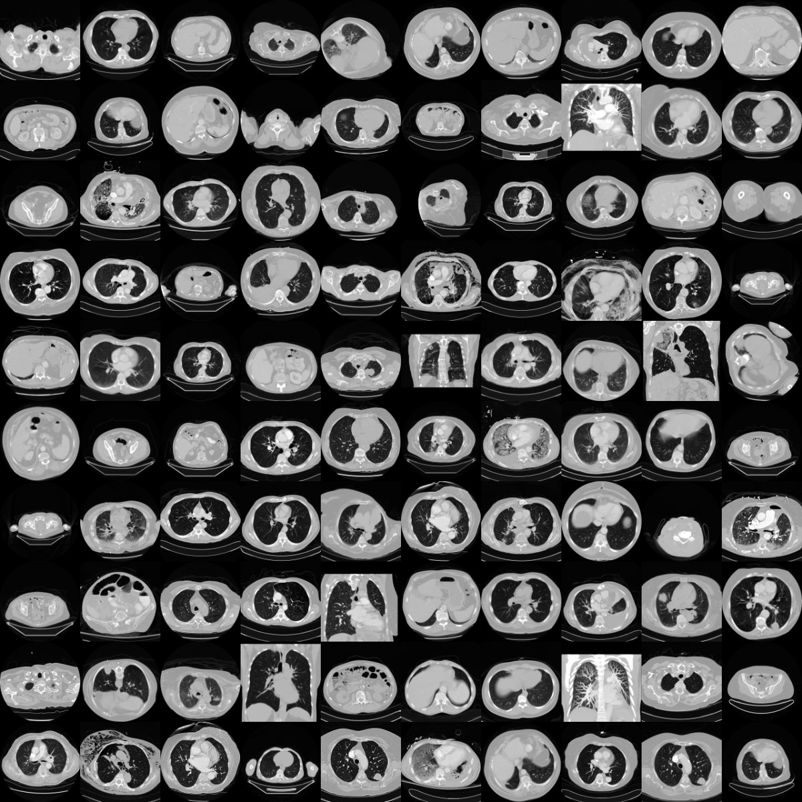
Data Collection & Preprocessing
Datasets Used:
Publicly available datasets (Chest, pneumonia and Retina at Kaggle).
Data Challenges & Solutions:
Imbalanced dataset → Synthetic Data Augmentation.
Low-quality images → Preprocessing techniques.

Slide 7
Model Performance & Evaluation
Metrics for Performance Evaluation:
Accuracy, Sensitivity, Specificity, F1-score.
ROC-AUC Curve for model validation.
Comparison with Traditional Methods:
AI vs. Human Radiologists in early detection.

Slide 8
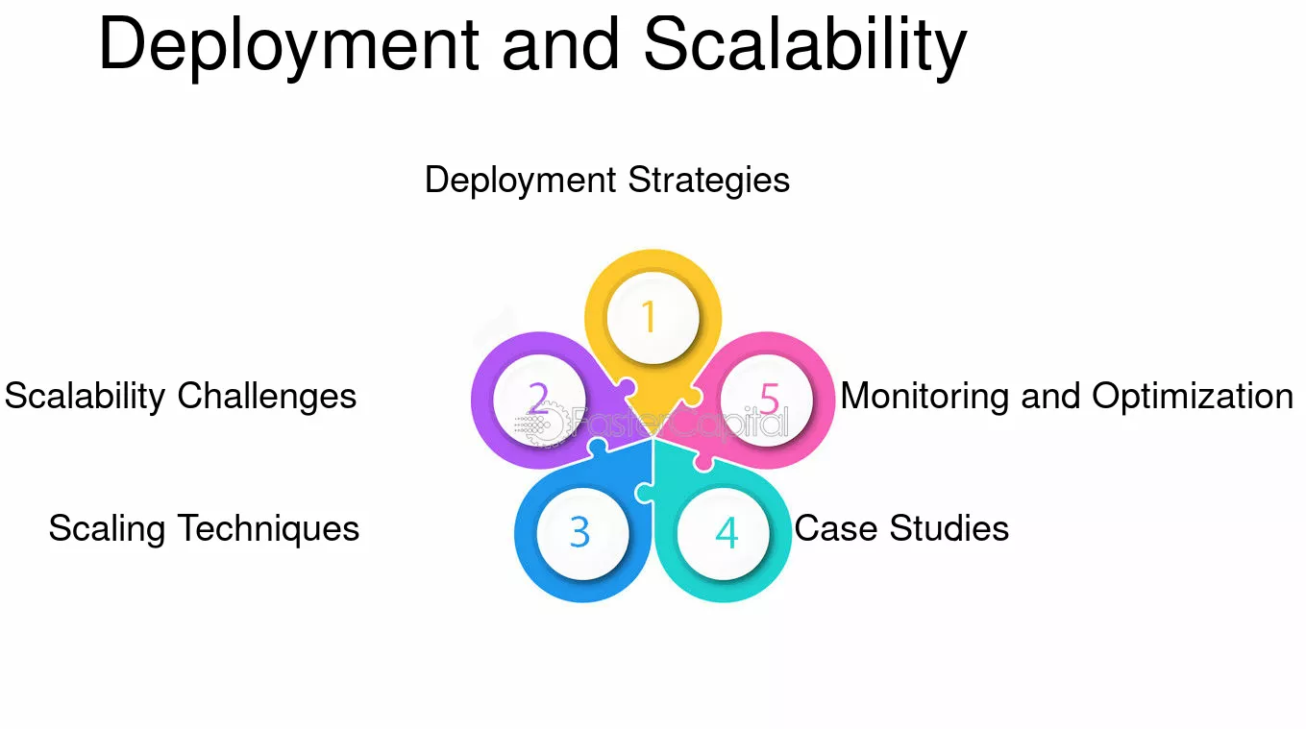
Deployment & Scalability Deployment Strategy
Streamlit Web App – User-friendly interface for real-time disease detection.
Edge AI Integration – Deployable on mobile and low-power devices for remote diagnostics.
Affordability & Accessibility
Lightweight AI Models – Optimized for low-cost hardware in rural areas.
Training Programs – Educating community health workers to utilize AI efficiently.

Slide 9
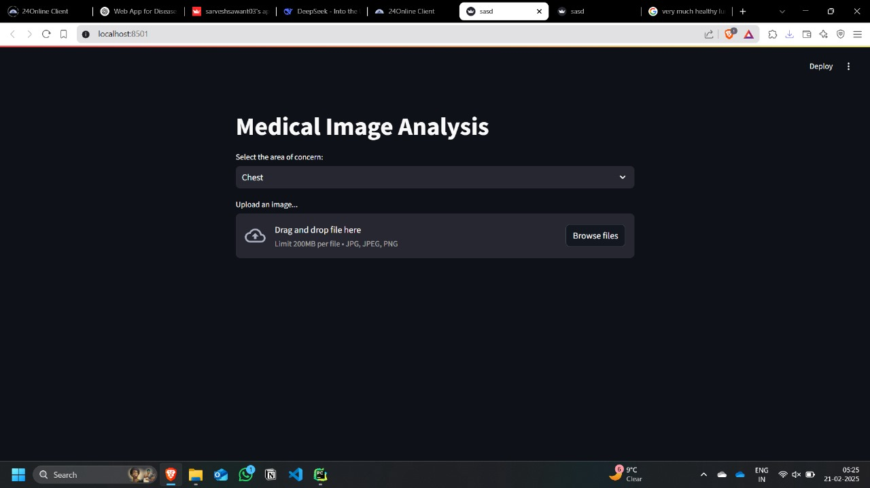
AI-Powered Medical Image Analysis
User-Friendly Interface: Allows selection of medical concern (e.g., chest) and image upload.
AI-Driven Diagnosis: Uses deep learning for early disease detection from medical images.
Efficient & Accessible: Supports high-resolution images (up to 200MB) with a simple drag-and-drop feature.
Deployment Ready: Designed for local use (localhost) with potential for cloud/edge deployment.

Slide 10
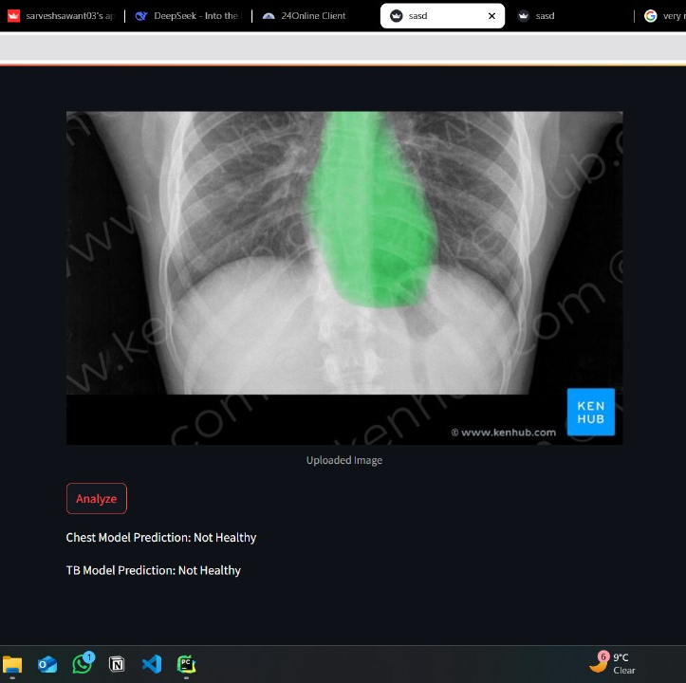
AI-Powered Medical Image Analysis Summary
Automated Diagnosis: AI processes chest X-ray images to detect abnormalities.
Highlighted Region: The green overlay marks an area of concern detected by the model.
Health Assessment: The system predicts "Not Healthy" for both general chest health and tuberculosis (TB) detection.
User Interface: Uses Streamlit for easy image upload and analysis with a one-click "Analyze" button.
Potential Applications: Early disease detection, assisting radiologists, and improving accessibility in remote areas.

Slide 11
Conclusion
AI-powered medical image analysis is revolutionizing early disease detection by enhancing accuracy, accessibility, and efficiency. By leveraging deep learning, such systems assist healthcare professionals in diagnosing conditions like tuberculosis and other chest-related diseases swiftly and cost-effectively. This innovation holds immense potential for improving patient outcomes, especially in underserved regions, making healthcare more inclusive and proactive.

