Slide 1
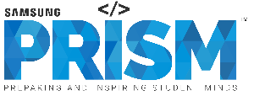
Work-let Name: Marathi NLU & ASR model for Rasa using Spacy, Fast Text, Jarvis
Worklet Details
Worklet ID: FP05
College Name: Vellore Institute of Technology Chennai
Understanding in-depth NLP concepts
Understanding of RASA configuration options
Understanding Jarvis and its usage
Created a basic chatbot using SpaCy and Rasa
Applied various type of pattern matching using SpaCy
Converted the aforementioned to Hindi
Created spacy pluggable pipeline of hindi fasttext vector
Lack of corpus with proper and extensive intents
Lack of Marathi language convertors to generate corpus
KPIs achieved till now
Any Challenges/ Issues faced
Mood Bot using RASA in Hindi
Next Steps
Marathi corpus collection
Integrating the fast text model into the pipeline
Fine tune the RASA learning pipeline
Key Achievements/ Outcome till now
Date: 11/02/2022

