Slide 1





Final Project-MICR150
Sarvesh Surve

Slide 2
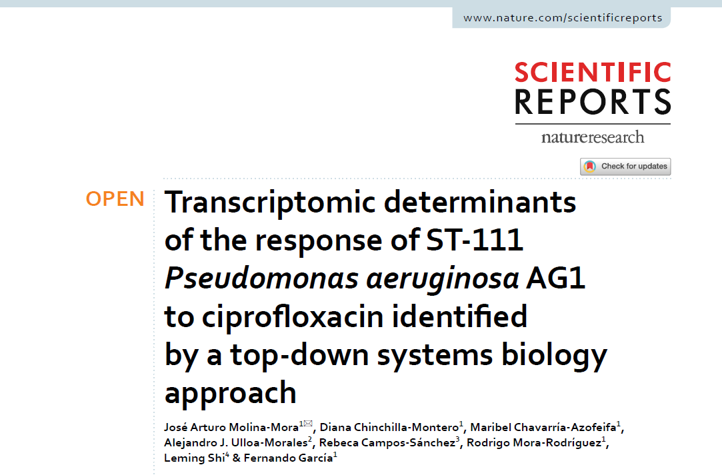
Study Selection
Shortlisted four studies for analysis
Ran the whole analysis pipeline for 3 of them
Two of them had single gene deletion mutant comparison hence very few significantly DE genes.
Selected study is simple antibiotic exposure for two timepoints and comparison with 0 hour
Notes:
Remembered what Tom emphasized. Simple Study.

Slide 3
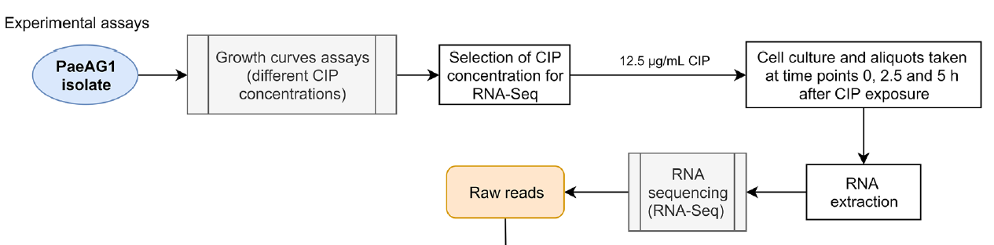






Experimental Design

Slide 4
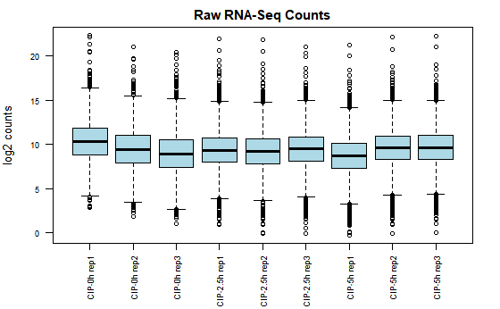
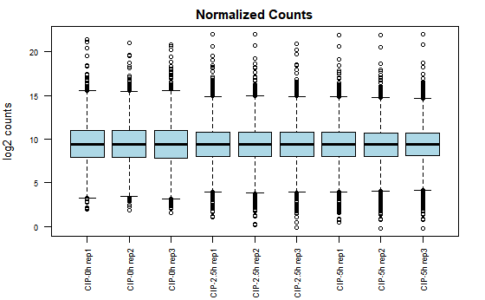
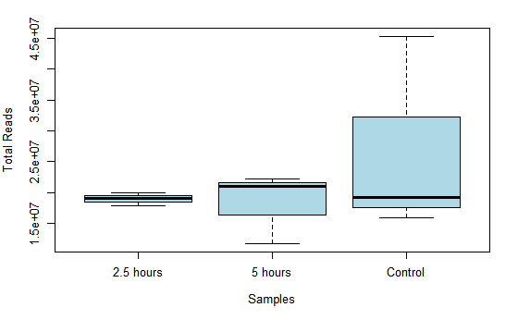
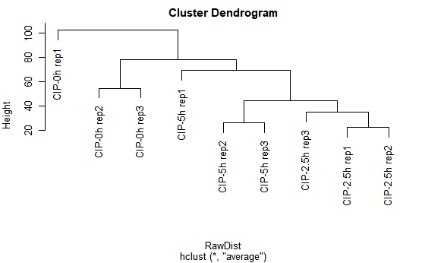
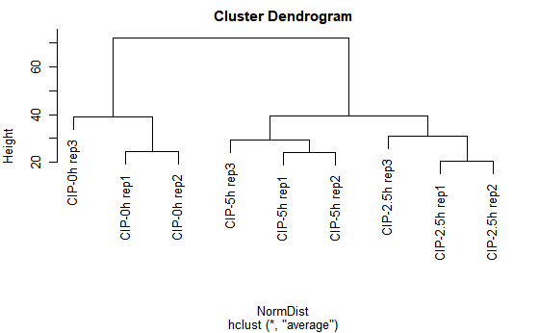
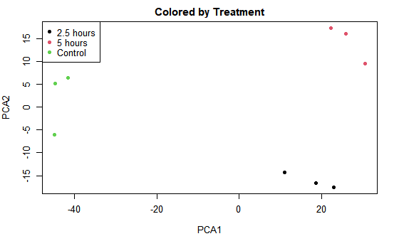
Data visualization
Raw Reads
Normalized
Notes:
Look out for these colors to differentiate the timepoints

Slide 5
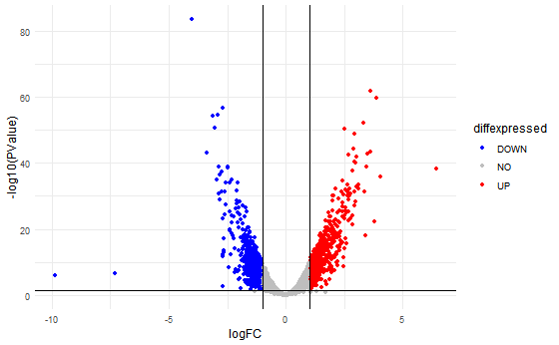
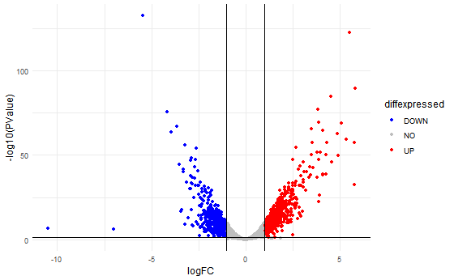
2.5 Hours
5 Hours
Upregulated | Downregulated | Reference
563 | 515 | This analysis
204 | 151 | Publication
Upregulated | Downregulated | Reference
672 | 552 | This analysis
248 | 190 | Publication
DESeq2 was used by authors

Slide 6
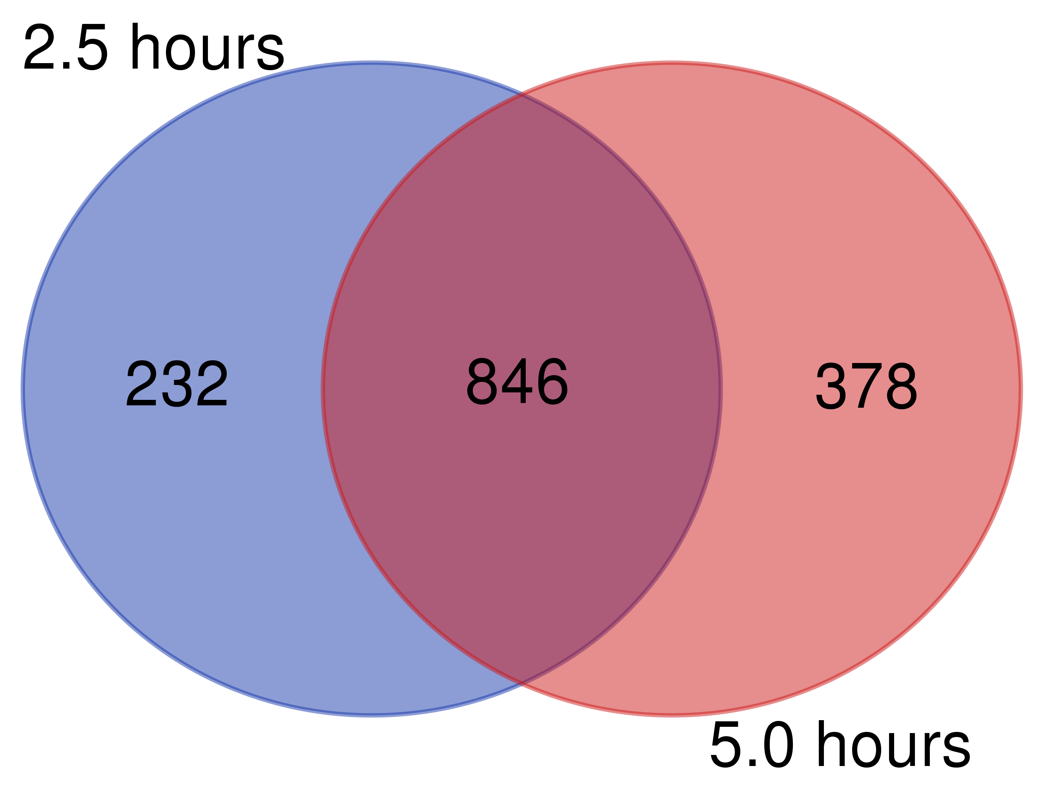
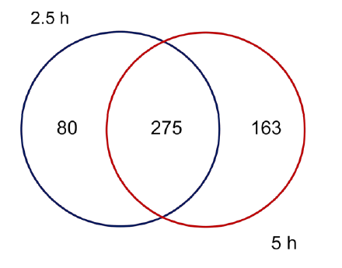

78% of DE genes are shared between the timepoints
My analysis
Published
https://bioinformatics.psb.ugent.be/

Slide 7
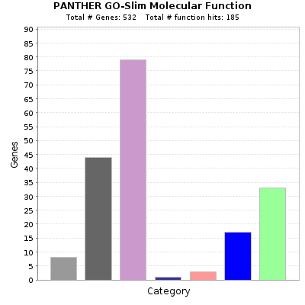
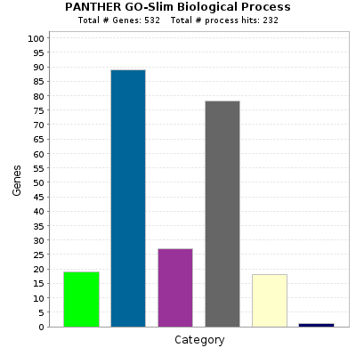
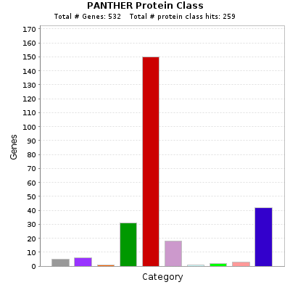
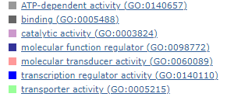
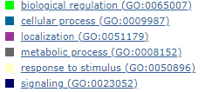
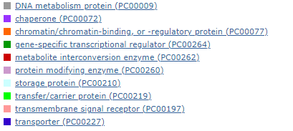

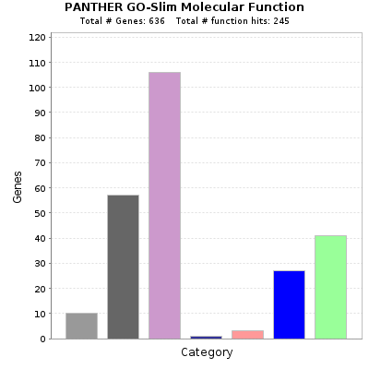
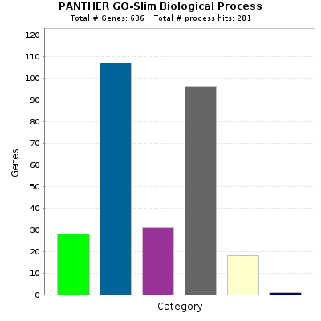
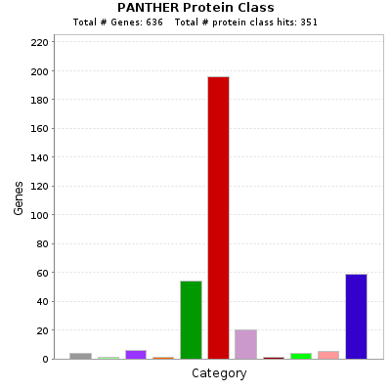
2.5 Hours
5 Hours
Notes:
One thing about bacteria is sugar utilization and cell wall is altered in any scenario

Slide 8
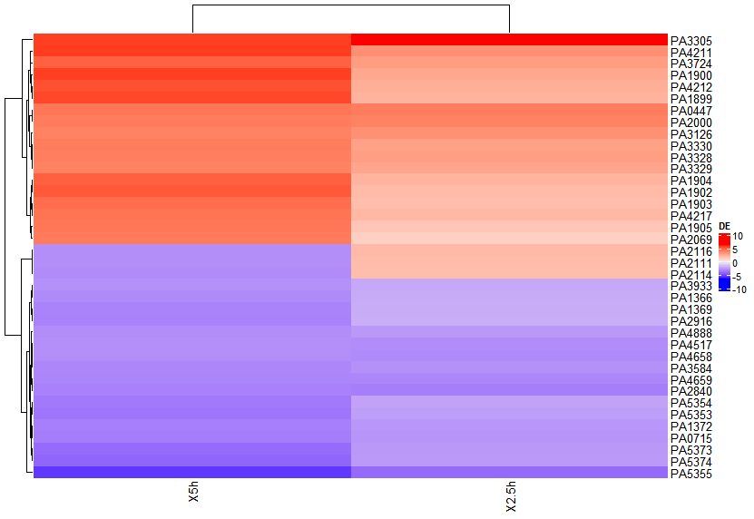

Malonate decarboxylase operon is upregulated
FlgB-J operon downregulated
Well-annotated genome
All scripts are available
RNAseq github linked in paper is missing
5.0 hours exposure
2.5 hours exposure
Notes:
There study focused on phage gene activation upon exposure and potential drug targets
I am excited by the basic pathway changes such as metabolic changes such as malonate decarboxylase upregulation or flagella downregulation
Some people in my lab might find this interesting -flagella

Slide 9
Thank You!
Bruce Stanton
Thomas Hampton
Sam Neff
Lily Charpentier
All the other faculty members
Molina-Mora, J. A. et al. Transcriptomic determinants of the response of ST-111 Pseudomonas aeruginosa AG1 to ciprofloxacin identified by a top-down systems biology approach. Sci. Rep. 10, 1–23 (2020).

