Slide 1


Data Structure
ENCS205
Dr.Swati, Ms.Suman & Ms Neetu
Assistant Professor
School of Engineering & Technology (SOET)
K.R. MANGALAM University
UNIT-2
Linked List
Notes:
New Courses replaced with New Programmes

Slide 2

Sessions 18 Outlook
Linked List: Definition
Components of linked list
Representation
Advantages and Disadvantages
Notes:
New Courses replaced with New Programmes

Slide 3
Objective
Students should be able to lean about Dynamic data Structure.
Implementing algorithms for creating, inserting, deleting, searching, and displaying elements in various types of linked lists.
Analyzing the complexities of algorithms for linked list operations
Notes:
New Courses replaced with New Programmes

Slide 4
Pretest
1. Which of these best describes an array?
a: A data structure that shows a hierarchical behaviour
b: Container of objects of similar types
c: Container of objects of mixed types
d: All of the mentioned
2. What is the time complexity of insertion at any point in an array?
a: O(N)
b: O(N^2)
c: O(NLogN)
d: None of these
Option:b
Option:a
Notes:
New Courses replaced with New Programmes

Slide 5
Pretest
3. Pick incorrect options from the following
a: If structure contains 3 types of data then one pointer is sufficient for that structure
b: One variable can be bound to many structures
c: Contents of a structure are stored in contiguous memory
d: None of these
4. The memory occupied by a pointer _______
a: Is dependent on which data type the pointer points to.
b: Is independent of data type.
c: Depends on the program we are writing,
d: None of these
Option:b
Option:b
Notes:
New Courses replaced with New Programmes

Slide 6

Link List
Notes:
New Courses replaced with New Programmes

Slide 7
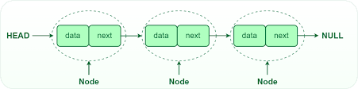
Link List
Linked list is a series of connected nodes.
A node in the linked list contains two parts
first is the data part
second is the address part.
The last node of the list contains a pointer to the null
https://www.geeksforgeeks.org/what-is-linked-list/
Notes:
New Courses replaced with New Programmes

Slide 8
Why Linked List?
Arrays can be used to store linear data of similar types, but arrays have the following limitations.
1) The size of the arrays is fixed: So we must know the upper limit on the number of elements in advance. Also, generally, the allocated memory is equal to the upper limit irrespective of the usage.
2) Inserting a new element in an array of elements is expensive because the room has to be created for the new elements and to create room existing elements have to be shifted.
Notes:
New Courses replaced with New Programmes

Slide 9
For example
In a system, if we maintain a sorted list of IDs in an array id[].
id[] = [1000, 1010, 1050, 2000, 2040].
And if we want to insert a new ID 1005, then to maintain the sorted order,
we have to move all the elements after 1000 (excluding 1000).Deletion is also expensive with arrays until unless some special techniques are used. For example, to delete 1010 in id[], everything after 1010 has to be moved.
Notes:
New Courses replaced with New Programmes

Slide 10
Representation
A linked list is represented by a pointer to the first node of the linked list.
The first node is called the head. If the linked list is empty, then the value of the head is NULL.
Each node in a list consists of at least two parts:
1) data
2) Pointer (Or Reference) to the next node
Notes:
New Courses replaced with New Programmes

Slide 11
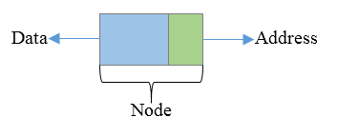
Creation of Node and Declaration of Linked Lists
struct node
{
int data;
struct node * next;
};
struct node * n;
n=(struct node*)malloc(sizeof(struct node*));
Notes:
New Courses replaced with New Programmes

Slide 12

Applications
Notes:
New Courses replaced with New Programmes

Slide 13

Applications
Image viewer
Previous and next page in a web browser
Music Player
GPS navigation systems
Task Scheduling
Notes:
New Courses replaced with New Programmes

Slide 14
Advantages And Disadvantages
Advantages
Dynamic data structure
Implementation
Insertion and deletion
Versatility
Persistence
Disadvantages
Memory usage
Accessing an element
More complex implementation
Lack of cache locality
Notes:
New Courses replaced with New Programmes

Slide 15
Importance of Linked List
Dynamic Data structure
Ease of Insertion/Deletion.
Efficient Memory Utilization
Implementation
Notes:
New Courses replaced with New Programmes

Slide 16
Linked List vs Array
Array | Linked List
Arrays are stored in contiguous location. | Linked Lists are not stored in contiguous location.
Fixed size. | Dynamic Size
Memory is allocated at compile time. | Memory is allocated at run time.
Uses less memory than Linked Lists. | Uses more memory than Arrays as it stores both data and address of next node.
Elements can be accessed easily in O(1) time. | Elements can be access by traversing through all the nodes till we reach the required node.
Insertion and deletion operation is slower than Linked List. | Insertion and deletion operation is faster than Linked List.
Notes:
New Courses replaced with New Programmes

Slide 17
Time Complexity Analysis of Linked List and Array
Operation | Linked list | Array
Random Access | O(N) | O(1)
Insertion and deletion at beginning | O(1) | O(N)
Insertion and deletion at end | O(N) | O(1)
Insertion and deletion at a random position | O(N) | O(N)
Notes:
New Courses replaced with New Programmes

Slide 18
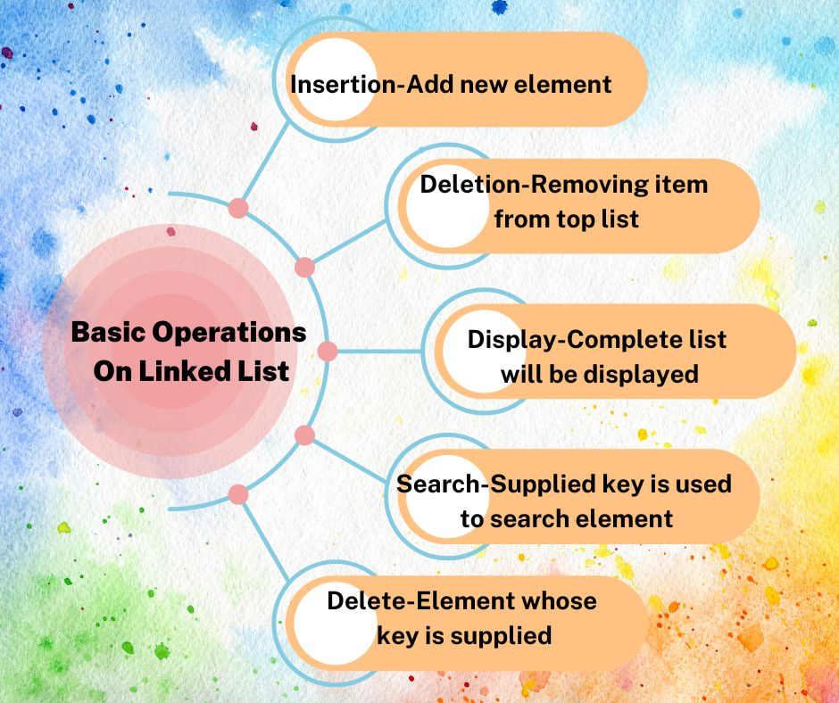
Operations
Notes:
New Courses replaced with New Programmes

Slide 19
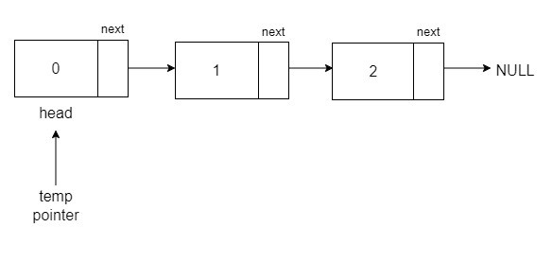
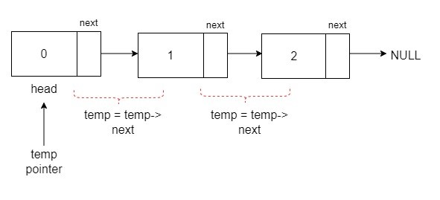
Traversal Operations
Notes:
New Courses replaced with New Programmes

Slide 20
Algorithm
STEP 1: SET PTR = HEAD
STEP 2: IF PTR = NULL
WRITE "EMPTY LIST" GOTO STEP 7 END OF IF
STEP 4: REPEAT STEP 5 AND 6 UNTIL PTR != NULL
STEP 5: PRINT PTR→ DATA
STEP 6: PTR = PTR → NEXT
[END OF LOOP]
STEP 7: EXIT
Code for traversing :
struct node *temp = head; printf("\n\nList elements are - \n");
while(temp != NULL) {
printf("%d --->",temp->data);
temp = temp->next; }
Complete code here.
Notes:
New Courses replaced with New Programmes

Slide 21
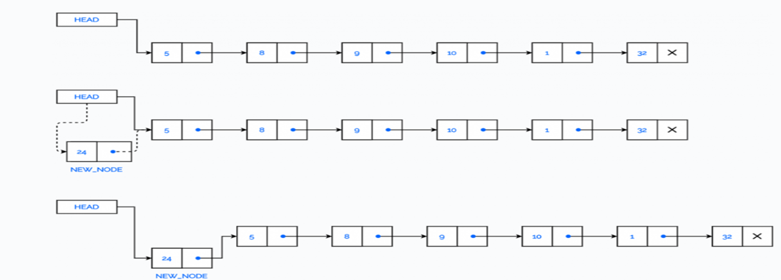
Insertion Operations At the beginning.
At the beginning.
At the end.
At Location node
Notes:
New Courses replaced with New Programmes

Slide 22
Algorithm: Insert At Beginning
Step 1: IF AVAIL = NULL
Write OVERFLOW
Go to Step 7 [END OF IF]
Step 2: SET NEW_NODE = AVAIL
Step 3: SET AVAIL = AVAIL -> NEXT
Step 4: SET NEW_NODE -> DATA = VAL
Step 5: SET NEW_NODE -> NEXT = HEAD
Step 6: SET HEAD = NEW_NODE
Step 7: EXIT
Notes:
New Courses replaced with New Programmes

Slide 23
Code for node insertion
void LinkedList::insertFront(int data){
Node* new_node = new Node();
// assign data value
new_node->data = data;
// change the next node of this new_node
// to current head of Linked List
new_node->next = head;
Complete code here.
Notes:
New Courses replaced with New Programmes

Slide 24
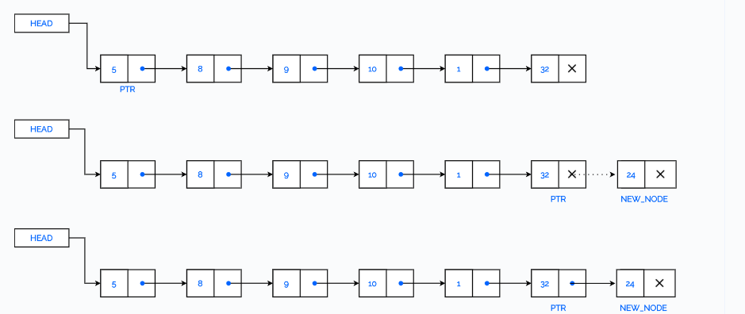
Inserting at the End
Notes:
New Courses replaced with New Programmes

Slide 25
Algorithm: Insert At End
Step 1: IF AVAIL = NULL
Write OVERFLOW
Go to Step 10 [END OF IF]
Step 2: SET NEW_NODE = AVAIL
Step 3: SET AVAIL = AVAIL -> NEXT
Step 4: SET NEW_NODE -> DATA = VAL
Step 5: SET NEW_NODE -> NEXT = NULL
Step 6: SET PTR = HEAD
Step 7: Repeat Step 8 while PTR -> NEXT != NULL Step
Step 8: SET PTR = PTR -> NEXT [END OF LOOP]
Step 9: SET PTR -> NEXT = NEW_NODE
Step 10: EXIT
Notes:
New Courses replaced with New Programmes

Slide 26
Code
void LinkedList::insertLast(int data)
{
Node* freshNode = new Node();
freshNode->data = data;
// since this will be the last node so it will point to NULL
freshNode->next = NULL;
//need this if there is no node present in linked list at all
if(head==NULL)
{
head = freshNode;
cout << freshNode->data << " inserted" << endl;
return;
}
struct Node* temp = head;
// traverse to the last node of Linked List
while(temp->next!=NULL)
temp = temp->next;
// assign last node's next to this freshNode
temp->next = freshNode;
cout << freshNode->data << " inserted" << endl;
}
Complete Code here
Notes:
New Courses replaced with New Programmes

Slide 27
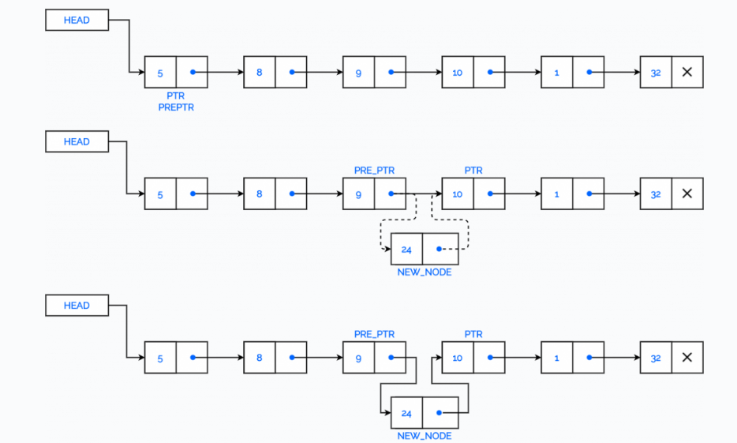
Insert a Node after a given Node in a Linked list
Notes:
New Courses replaced with New Programmes

Slide 28
Algorithm: Insert After An Element
Step 1: IF AVAIL = NULL Write OVERFLOW Go to Step 12 [END OF IF]
Step 2: SET NEW_NODE = AVAIL
Step 3: SET AVAIL = AVAIL -> NEXT
Step 4: SET NEW_NODE -> DATA = VAL
Step 5: SET PTR = HEAD
Step 6: SET PREPTR = PTR
Step 7: Repeat Steps 8 and 9 while PREPTR -> DATA != NUM
Step 8: SET PREPTR = PTR
Step 9: SET PTR = PTR -> NEXT [END OF LOOP]
Step 10 : PREPTR -> NEXT = NEW_NODE
Step 11: SET NEW_NODE -> NEXT = PTR
Step 12: EXIT
Notes:
New Courses replaced with New Programmes

Slide 29
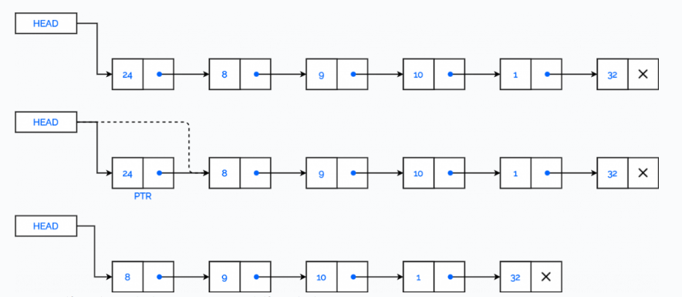
Deleting First Elements from a Linked List
The first node is deleted.
The last node is deleted.
The node after a given node is deleted
Notes:
New Courses replaced with New Programmes

Slide 30
Algorithm: Delete From Beginning
Step 1: IF HEAD = NULL
Write UNDERFLOW
Go to Step 5 [END OF IF]
Step 2: SET PTR = HEAD
Step 3: SET HEAD = HEAD -> NEXT
Step 4: FREE PTR
Step 5: EXIT
Notes:
New Courses replaced with New Programmes

Slide 31
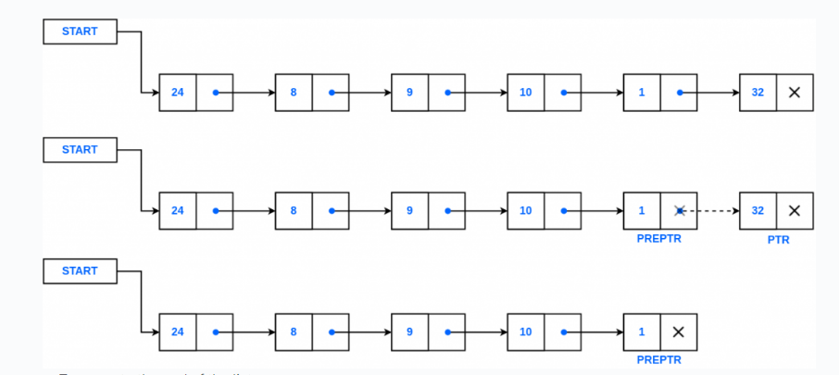
Delete last Node from a Linked list
Notes:
New Courses replaced with New Programmes

Slide 32
Algorithm: Delete From End
Step 1: IF HEAD = NULL Write UNDERFLOW Go to Step 8 [END OF IF]
Step 2: SET PTR = HEAD
Step 3: Repeat Steps 4 and 5 while PTR -> NEXT != NULL
Step 4: SET PREPTR = PTR
Step 5: SET PTR = PTR -> NEXT [END OF LOOP]
Step 6: SET PREPTR -> NEXT = NULL
Step 7: FREE PTR
Step 8: EXIT
Notes:
New Courses replaced with New Programmes

Slide 33
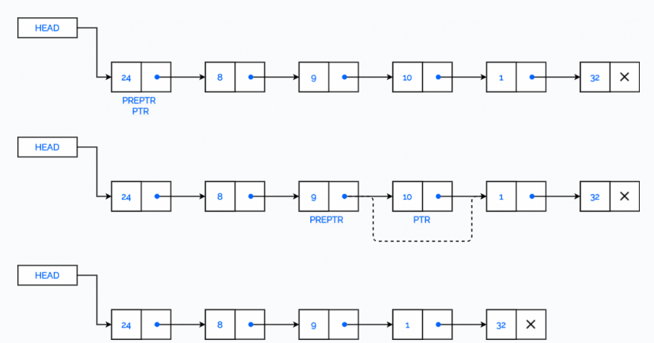
Delete the Node after a given Node
Notes:
New Courses replaced with New Programmes

Slide 34
Algorithm: Delete After A Node
Step 1: IF HEAD = NULL Write UNDERFLOW Go to Step 10 [END OF IF]
Step 2: SET PTR = HEAD
Step 3: SET PREPTR = PTR
Step 4: Repeat Steps 5 and 6 while PREPTR -> DATA != NUM
Step 5: SET PREPTR = PTR
Step 6: SET PTR = PTR -> NEXT [END OF LOOP]
Step 7: SET TEMP = PTR
Step 8: SET PREPTR -> NEXT = PTR -> NEXT
Step 9: FREE TEMP
Step 10 : EXIT
Notes:
New Courses replaced with New Programmes

Slide 35
Code
void del(node *before_del)
{
if (before_del == NULL || before_del->next == NULL)
return;
node* temp = before_del->next;
before_del->next = temp->next;
delete temp;
}
Complete code here
Notes:
New Courses replaced with New Programmes

Slide 36
Search
Algorithm:
Step 1: [INITIALIZE] SET PTR = HEAD
Step 2: Repeat Steps 3 and 4 while PTR != NULL
Step 3: If ITEM = PTR -> DATA SET POS = PTR Go To Step 5 ELSE SET PTR = PTR -> NEXT [END OF IF] [END OF LOOP]
Step 4: SET POS = NULL
Step 5: EXIT
Notes:
New Courses replaced with New Programmes

Slide 37
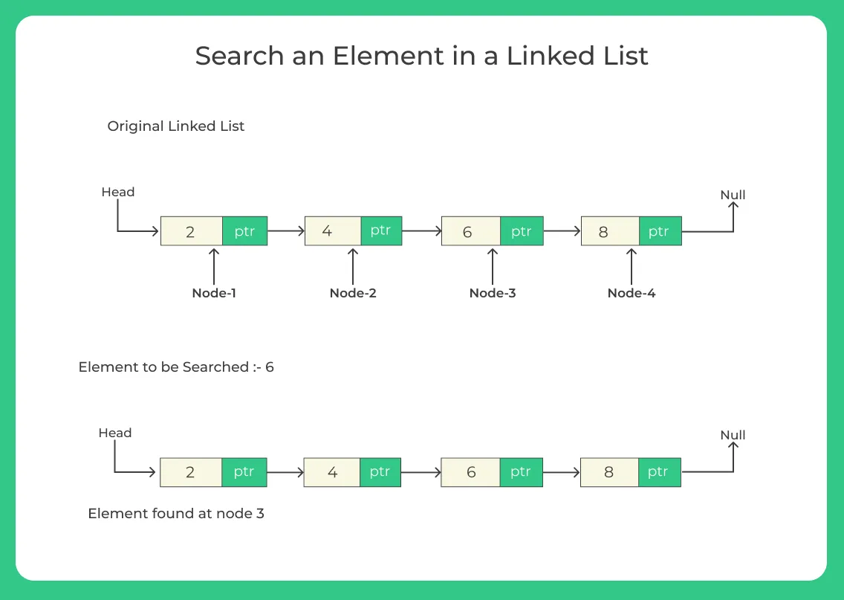
Search
Notes:
New Courses replaced with New Programmes

Slide 38
Review
Linked List: Definition
Linear data structure composed of nodes.
Each node contains data and a pointer/reference to the next node.
Components of linked list
Nodes: Elements containing data and pointers.
Head pointer: Points to the first node.
Tail pointer (optional): Points to the last node.
Notes:
New Courses replaced with New Programmes

Slide 39
Review
Representation
Nodes linked via pointers.
Dynamic memory allocation for nodes.
Head pointer for access.
Advantages and Disadvantages
Dynamic memory allocation.
Efficient insertion/deletion.
Disadvantages:
Higher memory overhead.
No direct access to elements.
Potentially slower access than arrays.
Notes:
New Courses replaced with New Programmes

Slide 40


Notes:
New Courses replaced with New Programmes

